Slide 1
THING DIFFERENT - 02
Spatiotemporal Non-Uniformity-Aware Online Task Scheduling in Collaborative Edge Computing for IIoT
PRESENTERS:
VARUN
AMRITH B
SARVESHA
AJETH
KANISHTHIKA
HARINIE C B

Slide 2
RECAP
Problem Addressed
Factories in Industrial IoT generate data that varies by location and time (spatiotemporal non-uniformity).
Edge servers have limited resources, and tasks must be processed quickly, securely, and cost-effectively.
Existing solutions struggle with dynamic workloads and long-term cost constraints.
Proposed Solution
An online task scheduling framework that adapts in real time without prior knowledge.
Uses:
Lyapunov optimization
Graph models
Heuristic algorithms & imitation learning

Slide 3
UPDATE
Implementation Status
We have implemented the Lyapunov optimization algorithm and heuristic search algorithms along with physical and network parameters for a numerical python simulation. Parallelly 40% of the implementation is done in EdgeSimPy
Lyapunov Optimization
Converts long-term cost constraints into real-time scheduling decisions.
Maintains virtual queues to track cost over time and ensure stability.
Balances task response delay and operational cost through a drift-plus-penalty approach.
Does not require prior knowledge of future workloads or network states.
Heuristic Search Algorithms
Particle Swarm Optimization (PSO)
Used for factory classification into source, sink, or isolated nodes.
Efficiently searches large solution spaces while reducing computation time.
Harmony Search (HS)
Optimizes task allocation once node categories are fixed.

Slide 4
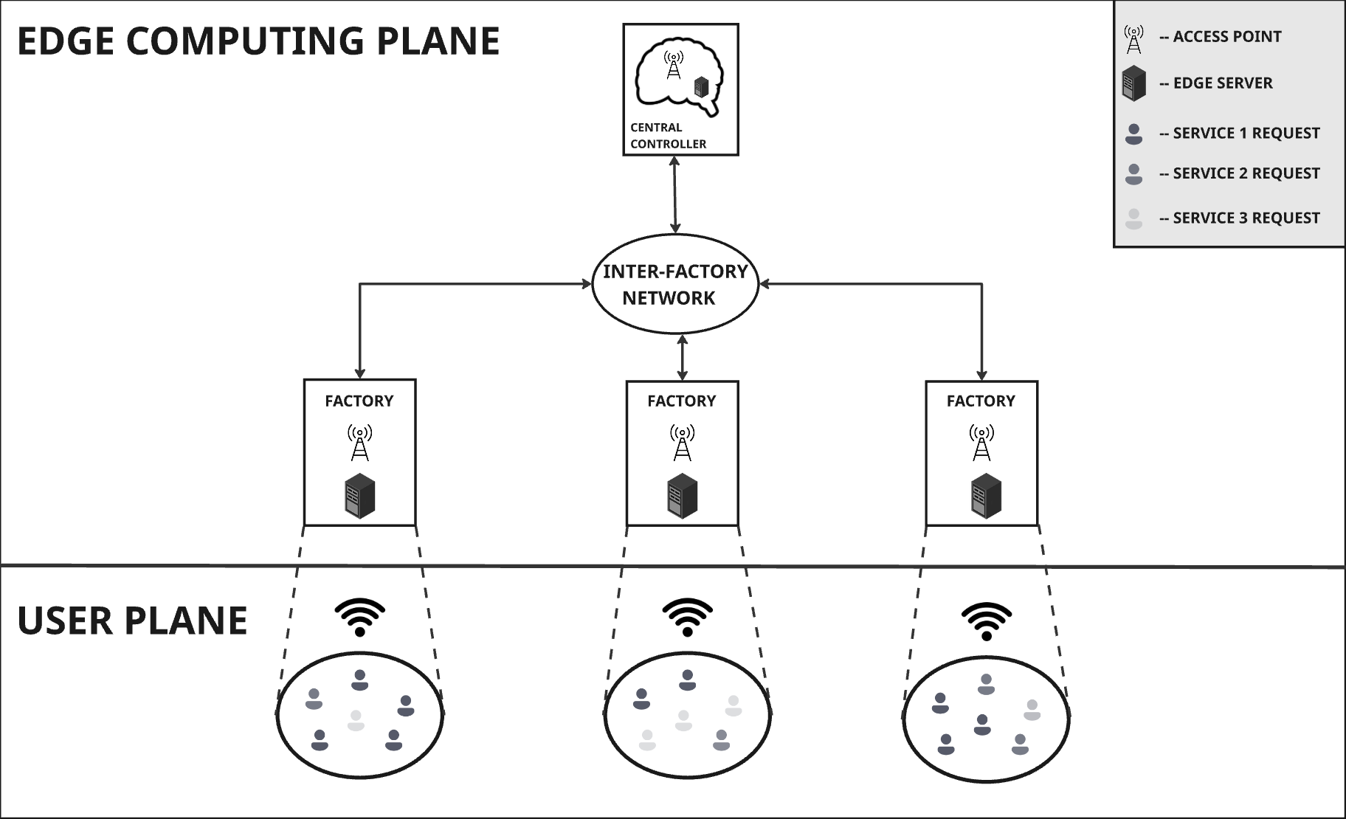
ARCHITECTURE DIAGRAM

Slide 5
Heuristic Search Algorithms
High-Level Strategy (PSO):
The first stage is about forming a high-level plan for the entire network. The goal is to answer the question: "What is the best configuration of roles (Source, Sink, Isolated) for our network of factories right now?"
Problem Type: This is a discrete combinatorial optimization problem. The number of possible combinations of roles is vast, and a brute-force search would be impossible in real-time.
Why PSO is a great fit: PSO excels at quickly exploring a large and complex solution space to find a good starting point. Its social, "swarming" behavior is perfect for this task because:
Broad Search
Fast Convergence
The output of this stage is a single, optimized assignment, such as [Source, Isolated, Sink, Source, Sink] (eg), which serves as the blueprint for the next stage.

Slide 6
Heuristic Search Algorithms
Low-Level Execution (Harmony Search):
The second stage takes the strategic blueprint from the PSO and translates it into a detailed, executable plan. The goal here is to answer the question: "Now that we know who the Sources and Sinks are, exactly how many tasks should each Source send to each Sink?"
Problem Type: This is a continuous numerical optimization problem. The task is to find the precise numerical values for task offloading that will minimize delay and cost.
Why HS is a great fit: HS is well-suited for fine-tuning a solution within a defined space. Its "improvisation" and "pitch adjustment" mechanics make it ideal for this task:
Fine-Tuning
Refining a Solution
This output is the specific schedule for task offloading that the central controller would execute.

Slide 7
Simulation Demo

Slide 8
Edge Side Contribution
Input Parameters
CPU capacity (F)
Bandwidth (R)
Cycles per task (C)
Data size (L)
Communication cost
Lyapunov parameters.
Lyapunov Drift Penalty Function
Full integration of computation time, communication delay, and energy cost.
Virtual queue (Q[t]) tracks energy constraint violation.
PSO
Optimized using parameters F, R, C, CommCost.
Assignment evaluated with drift-plus-penalty objective.
Harmony Search
Uses CPU-based sink capacity (F[j]/C).
Adds computed metrics: comp time, comm time, energy cost.
Outputs
Per-slot logs of assignments and decisions.
Final averages: T_avg, E_avg, and virtual queue stability.

Slide 9
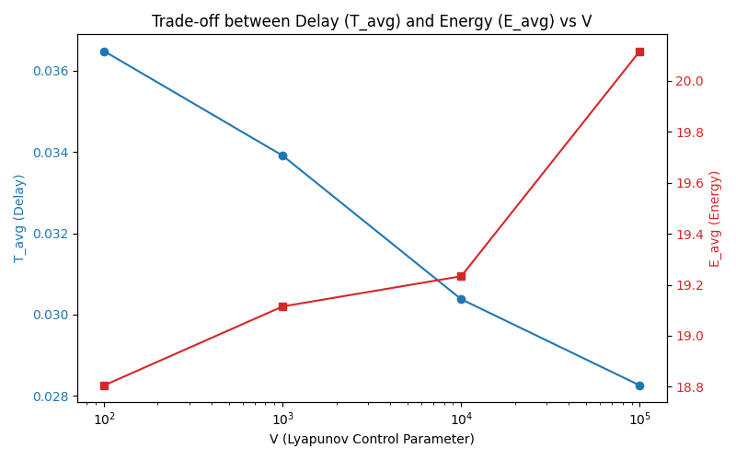
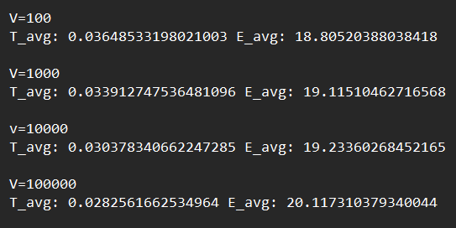
RESULT - V

Slide 10
PLAN FOR REVIEW 3
Complete EdgeSimPy implementation
Node Configuration: Defining the computational capacity of each edge node within the EdgeSimPy environment, aligning with the parameters in our numerical simulation.
Network Topology: Building the inter-factory network and defining communication links with realistic bandwidths and costs.
Task Generation: Configuring EdgeSimPy to generate tasks in real-time, simulating the spatiotemporal non-uniformity of our scenario.
Performance Evaluation and Validation
Metric Collection: We will collect key metrics such as average delay, total cost, and virtual queue backlog to demonstrate the effectiveness and stability of our proposed solution.
Code-to-Simulation Mapping: We will prepare a detailed walkthrough to explain how our custom-implemented algorithms (PSO and Harmony Search) integrate with and control the EdgeSimPy simulation environment.

