Slide 1

EDGE-BASED PREDICTIVE MAINTENANCE IN SMART FACTORIES
Review - 2
Title of the Paper : An edge-cloud IIoT framework for predictive maintenance in manufacturing systems
Authors : Nivethitha Somu , Nirupam Sannagowdara Dasappa
Journal : Advanced Engineering Informatics
Team Members:
Team No : 6
Pradeep S - CB.SC.U4CSE23232
Rishiikesh S K - CB.SC.U4CSE23236
Sri Jayaram J S - CB.SC.U4CSE23255
Sathya Roopan M - CB.SC.U4CSE23256
Mylavaram Pranav - CB.SC.U4CSE23433
K.Venkatesh- CB.SC.U4CSE23519

Slide 2
EDGE-BASED PREDICTIVE MAINTENANCE IN SMART FACTORIES
Review - 2
Problem Statement:
Industrial machines often face costly downtime either due to routine maintenance or unexpected failures, leading to financial losses and inefficiencies.
Proposed solution:
IntelliPdM deploys multiple sensors across machines to monitor various parameters and detect anomalies, enabling predictive maintenance that minimizes downtime and reduces costs.

Slide 3


UPDATES FROM REVIEW - 1
Initially, CNN was considered at the Edge for better vibration pattern recognition, but ANN was retained since it offers lower latency and is lightweight for real-time inference on resource-constrained devices.
At the Cloud, 1D-CNN was replaced with Random Forest, which is faster, resource-efficient, and effective for feature-based fault prediction.
The IntelliPdM predictive maintenance framework was implemented in the iFogSim environment, enabling simulation of realistic IoT–Edge–Cloud interactions.
Sensor simulation functions were added to generate real-time vibration, temperature, and current data streams from machines for realistic input to the models.
ANN models at the Edge perform low-latency anomaly detection, while the Cloud layer aggregates data and applies Random Forest classification for accurate predictions.
Scheduling and actuation functions ensure time-critical data is prioritized, with alerts or machine shutdowns triggered upon fault detection, while monitoring functions track latency, accuracy, data volumes, and downtime reduction.

Slide 4
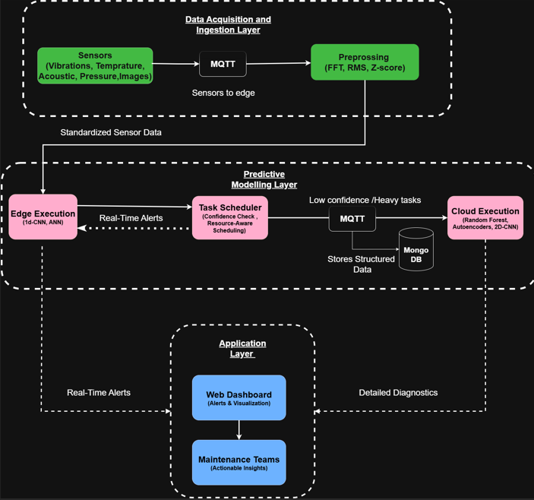

ARCHITECTUE
AT THE EDGE LAYER, AN ARTIFICIAL NEURAL NETWORK (ANN) ANALYZES DATA STREAMS IN REAL TIME TO DETECT FAULTS INSTANTLY WITH LOW LATENCY, WHILE THE CLOUD USES A RANDOM FOREST MODEL FOR DEEPER ANALYSIS WHEN CONFIDENCE IS LOW, REDUCING FALSE ALARMS AND IMPROVING RELIABILITY.
RESULTS ARE VISUALIZED ON A DASHBOARD OR LOGS FOR QUICK DECISION-MAKING. UNLIKE THE OLD FTP-BASED BATCH SETUP, THE NEW ARCHITECTURE USES MQTT AND EDGE PREPROCESSING TO ENABLE REAL-TIME PIPELINES, COMBINING ANN AT THE EDGE FOR FAST ALERTS AND RANDOM FOREST IN THE CLOUD FOR DETAILED INSIGHTS, MAKING THE SYSTEM CLOSER TO REAL-WORLD DEPLOYMENT WITH REALISTIC EVALUATION OF LATENCY, ENERGY, AND NETWORK USAGE.

Slide 5
LET’S MOVE ON TO THE IMPLEMENTATION PART TO SEE THE SIMULATION OUTPUTS.

Slide 6
IntelliPdM: Core Modules & Workflow
1. Sensing: The CustomSensor simulates real-time data (e.g., temperature, voltage, vibration) from industrial machines.
2. Preprocessing: A PreprocessModule on the edge device instantly receives and cleans the raw sensor data, handling errors like missing values.
3. Edge-First Analysis: The cleaned data is first sent to the EdgeMLModule, which uses a lightweight AI model for fast, immediate fault detection.
4. Hierarchical Forwarding: After this initial check, the EdgeMLModule forwards the data and its initial findings to the CloudMLModule for a more detailed secondary analysis.
5. Deep Cloud Diagnostics: The CloudMLModule uses a more powerful AI model to perform a high-accuracy analysis, confirming faults and identifying subtle patterns for long-term diagnostics.
6. Rapid Actuation: The CustomActuator is triggered by the fast edge-level prediction to immediately stop the machine, ensuring a rapid response to critical faults.

Slide 7
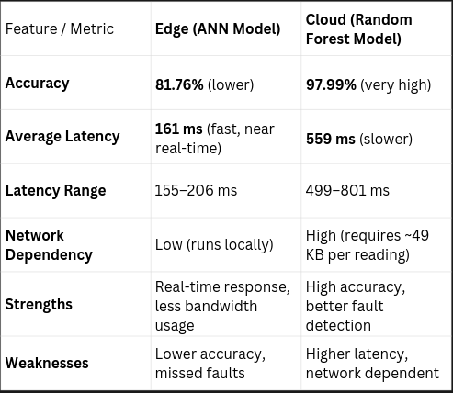
EDGE METRICS EVALUATION
SIMULATION OVERWIEW:
BASIC DETAILS:
TOTAL SIMULATION TIME : 5 MINUTES
TOTAL SENSOR READINGS PROCESSED: 150
TOTAL DATA PROCESSED : 117.19 KB
FAULTS:
REGISTERED 7 FAULTS
NETWORK USAGE:
TOTAL: 7279.30 KB
AVERAGE PER READING: 49,693.33 BYTES

Slide 8
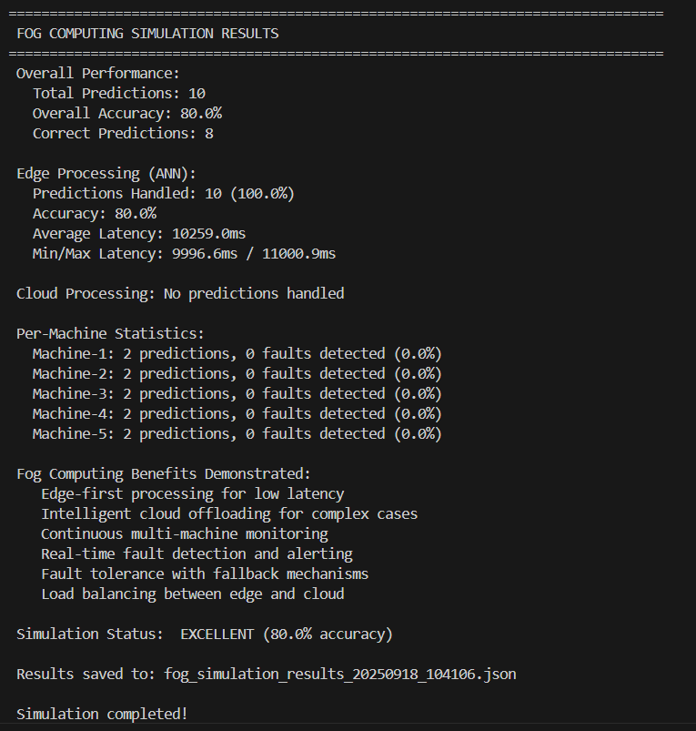
Dual-Model Architecture for Fog Computing:
Artificial Neural Network (Edge Model)
Architecture:
-Input Layer: 7 features
-Hidden Layers: 2 layers (16, 8 neurons)
-Output Layer: 2 classes (Normal/Fault)
-Activation: ReLU (hidden), Sigmoid (output)
Random Forest (Cloud Model)
Architecture:
-Trees: 100 decision trees
-Max Depth: 10
-Features: 6 engineering parameters
-Ensemble Method: Majority voting

Slide 9
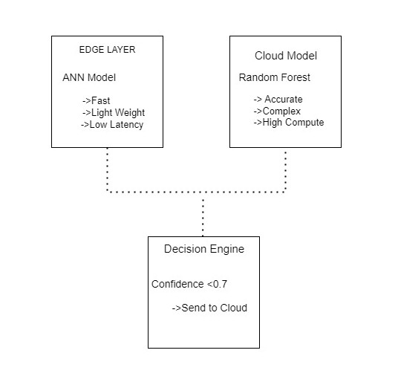
Integration Architecture
Model Integration in Fog Computing
Decision Flow:
1. Sensor Data Collection → Raw industrial parameters
2. Feature Engineering → Extract relevant features
3. Edge Processing (ANN) → Fast initial prediction
4. Confidence Evaluation → Check prediction confidence
5. Routing Decision:
- High Confidence (≥0.7) → Use Edge Result
- Low Confidence (<0.7) → Send to Cloud
6. Cloud Processing (RF) → High-accuracy prediction
7. Result Aggregation → Final decision

Slide 10
Why ANN, not CNN
Brain-like model that learns patterns from sensor data.
Takes inputs such as vibration, temperature, and current readings.
Passes data through layers of neurons to detect faults.
Gives a Normal or Fault result in real time.
Lightweight and fast, so it runs easily on small edge devices.
Used in the project for instant fault detection before sending data to the cloud.

Slide 11
IMPROVEMENTS FOR REVIEW 3:
Data Storage:
1) Structured data → MongoDB
2)Unstructured data (images) → files
Data Flow & Transfer:
1)Use MQTT protocol for reliable streaming
2)Monitor traffic in Wireshark
Simulation:
1)If time permits → GUI in iFogSim
2)Add Optimized Task Scheduling
3)Fix Metrics inconsistencies & tracking bugs
4)Insights Delivered Through Smart Dashboards.

Slide 12

THANK YOU

