Slide 1

Team 07: Cyberdyne Systems
Simulation of Load Balancing in vanilla Federated Learning Systems
Communication-Efficient Learning of Deep Networks from Decentralized Data
H. Brendan McMahan, Eider Moore, Daniel Ramage, Seth Hampson, Blaise Agüera y Arcas

Slide 2
Advancements from previous review
Implemented FedAvg baseline
Integrated client selection strategy (resource-aware)
Improved communication efficiency by increasing local training epoch
Prepared groundwork for CI integration (PSO+GA)
Implementation of SimpleNN and ParticleSwarmOptimization algorithm.
Implementation of Genetic Algorithm

Slide 3
Task-Split
Adithyaa Seyyone: Integrating the server and client module and orchestrating the workflow
Kapil Kanna: Server module functions, FedAvg integration with workflow
Yuvan Dhurkesh: Client module functions, Integration of Client module with CI module
Akshaay: Definition of client and server class

Slide 4
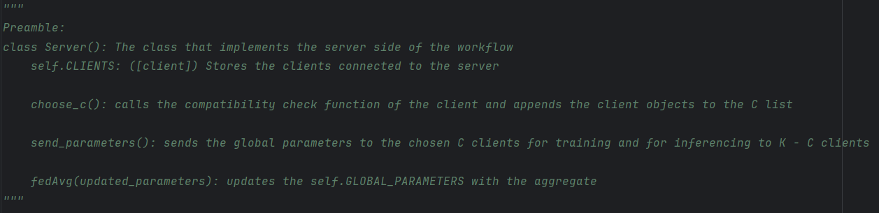
Cloud layer

Slide 5
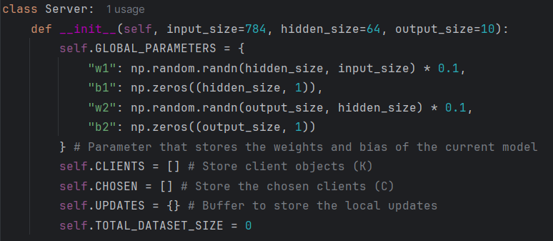
Cloud layer

Slide 6
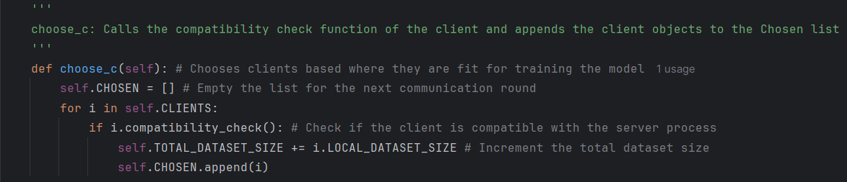
Cloud layer

Slide 7
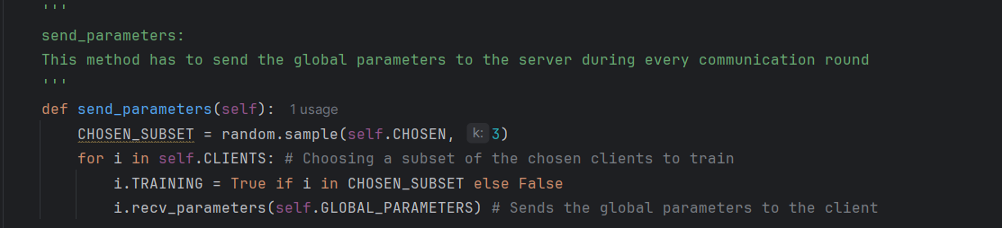
Cloud layer

Slide 8
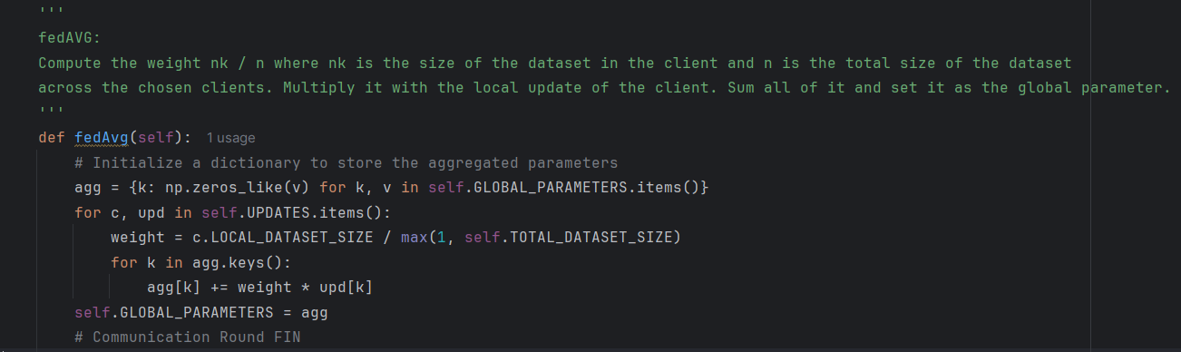
Cloud layer

Slide 9
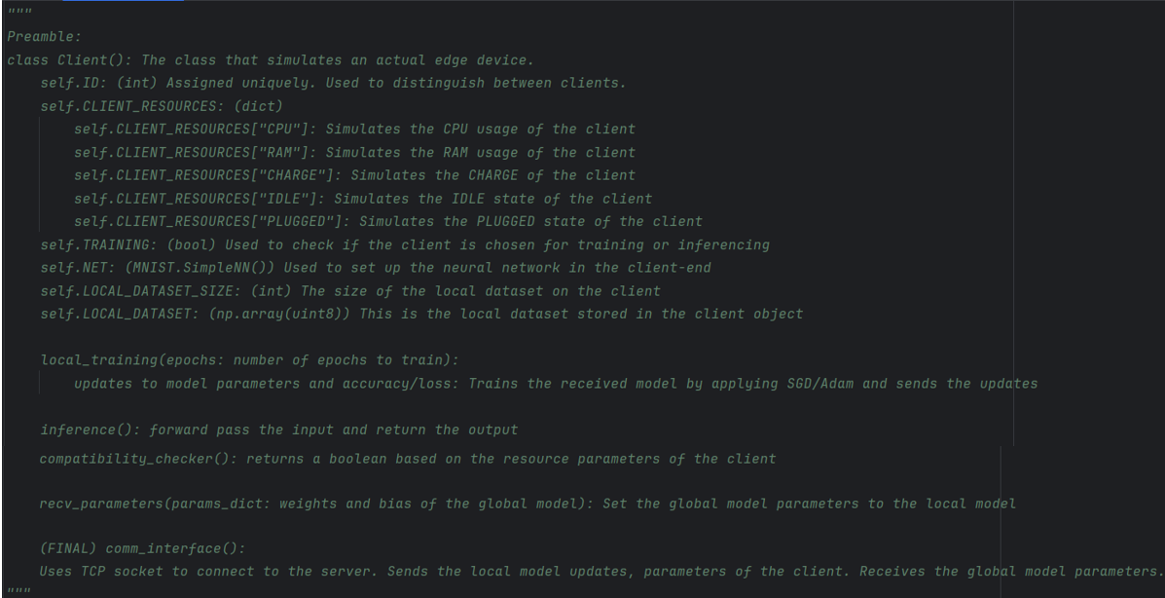
Edge layer

Slide 10
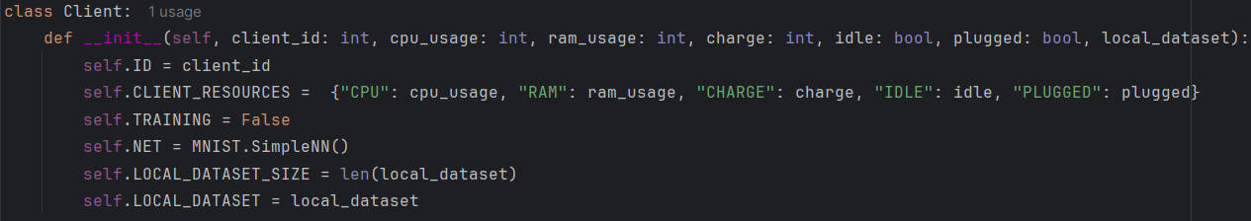
Edge layer

Slide 11
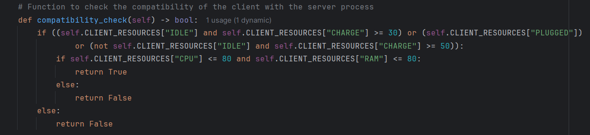
Edge layer

Slide 12
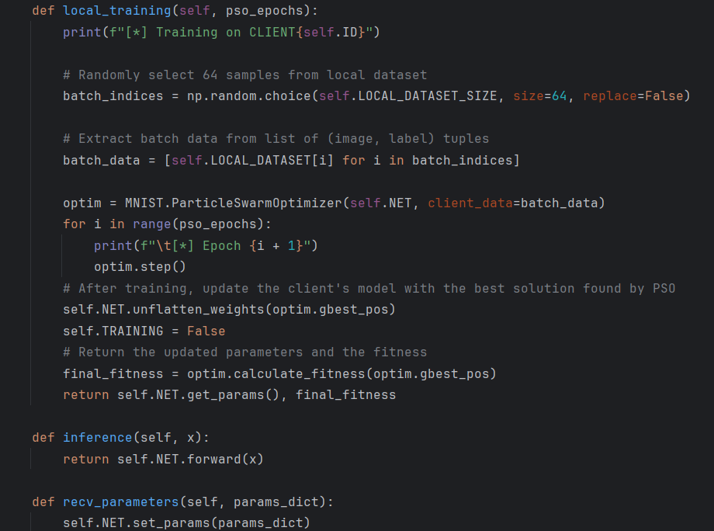
Edge layer

Slide 13
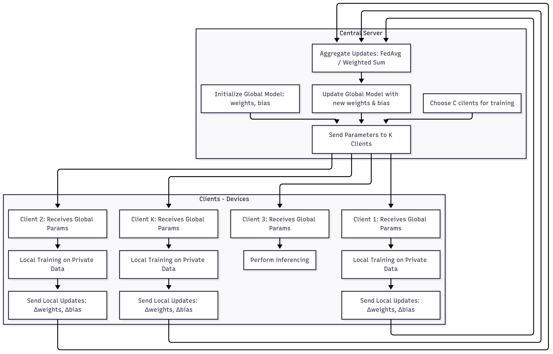
Architecture Design
Cloud Layer
Edge Layer

Slide 14
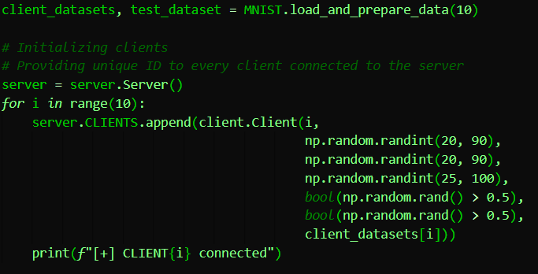
Simulation

Slide 15
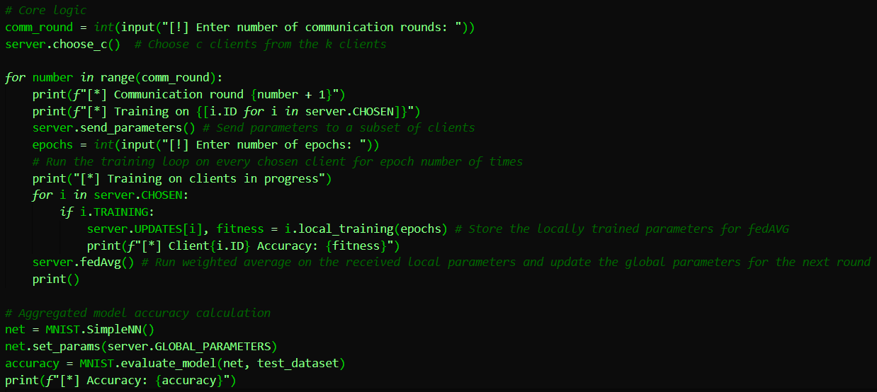
Simulation

Slide 16
Metrics of evaluation
Communication Rounds = 5
Clients (in every comm round) = 5
Epochs = 20
Performed simulation based on above conditions on SGD, PSO, GA and evaluated based on time and accuracy.

Slide 17
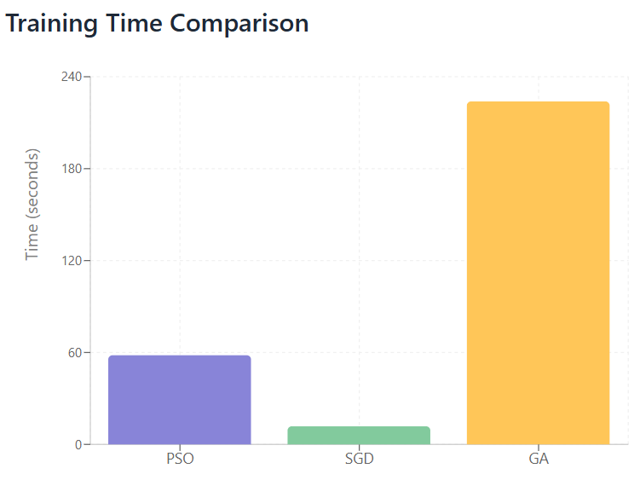
Metrics of evaluation
Time taken:
PSO: 58.19 s
SGD: 11.82 s
GA: 223.88 s

Slide 18
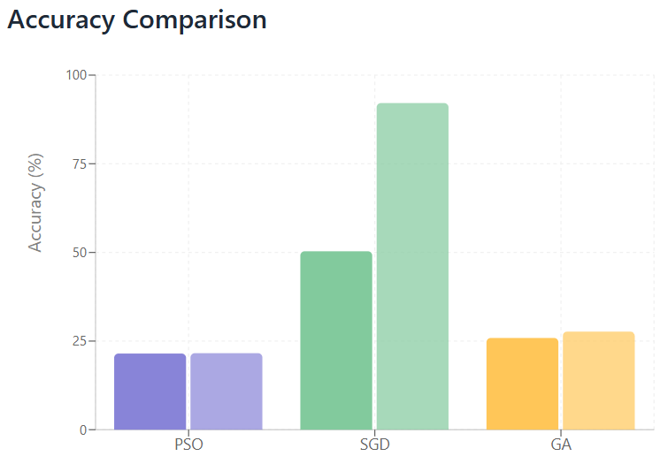
Metrics of evaluation
PSO:
  Accuracy: 21.48%
  Max Accuracy: 21.48%
SGD:
  Accuracy: 50.32%
  Max Accuracy: 92.12%
GA:
  Accuracy: 25.87%
  Max Accuracy: 27.67%

Slide 19
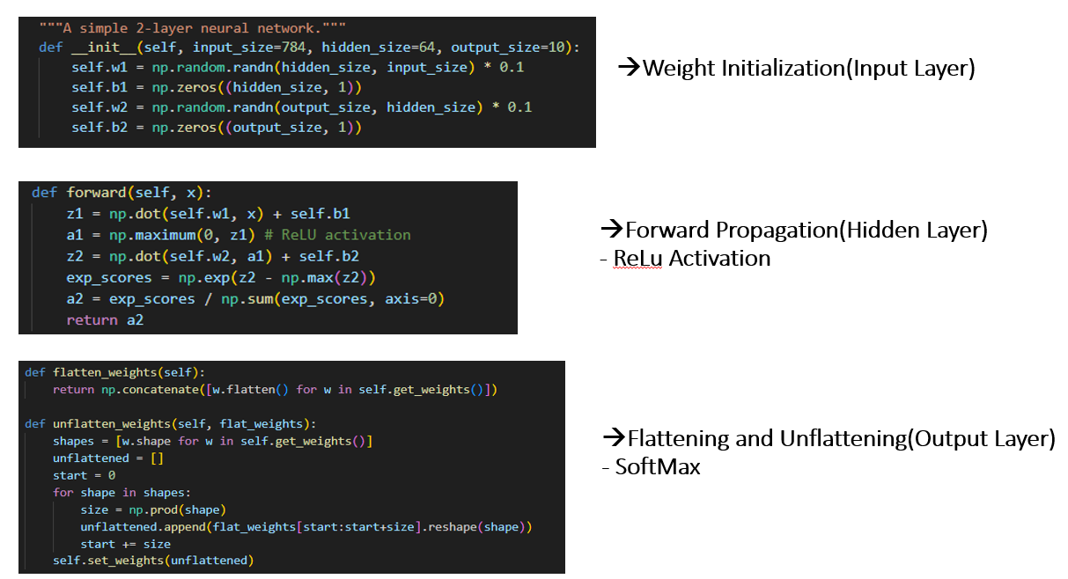
Simple NN:
It holds the model's weights and biases (w1, b1, w2, b2) and contains the logic for making
predictions (forward method).
Architecture:- Input Layer(784 features) → Hidden Layer(64 neurons) → Output Layer(10 neurons).
Hidden Layer: Uses ReLu Activation.
Output Layer: Uses SoftMax Algorithm.

Slide 20
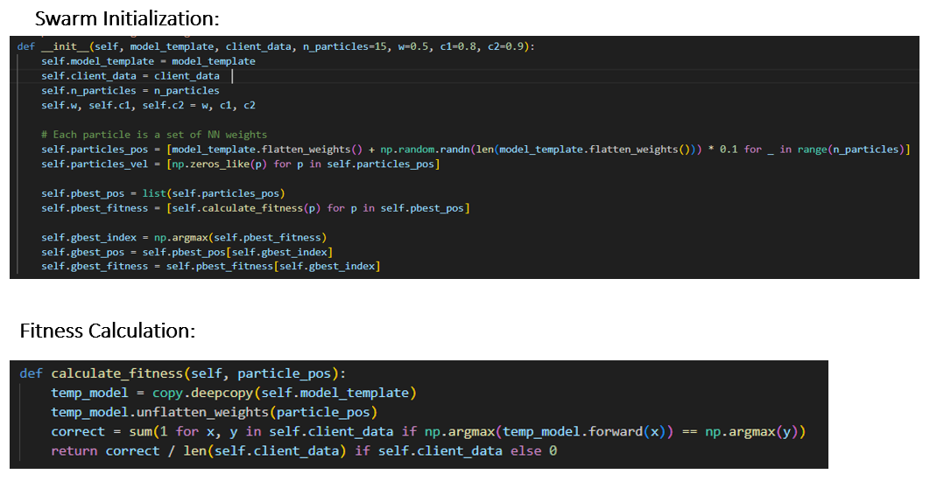
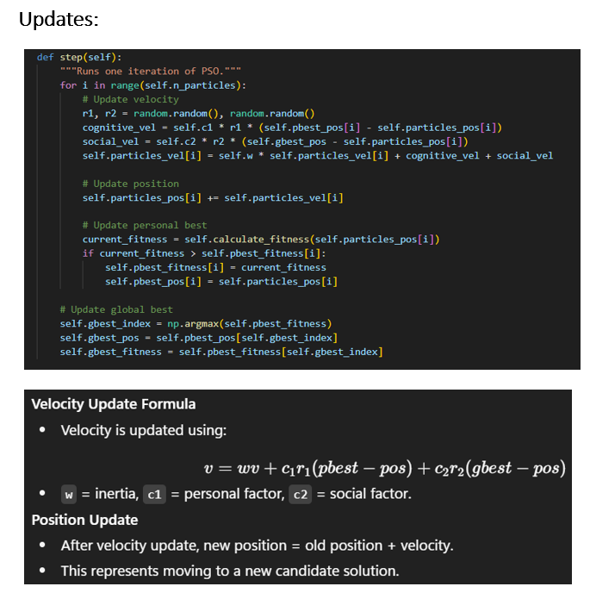

Particle Swarm Optimizer (PSO):
The goal of this stage is to perform a broad search for good solutions in the vast space of all possible weight combinations.
Architecture:- Initialize Swarn → Evaluate Fitness → Update Velocity and Position

Slide 21
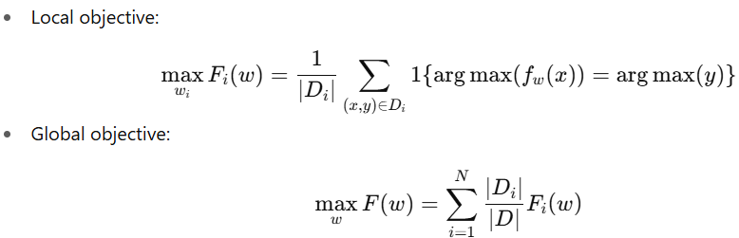
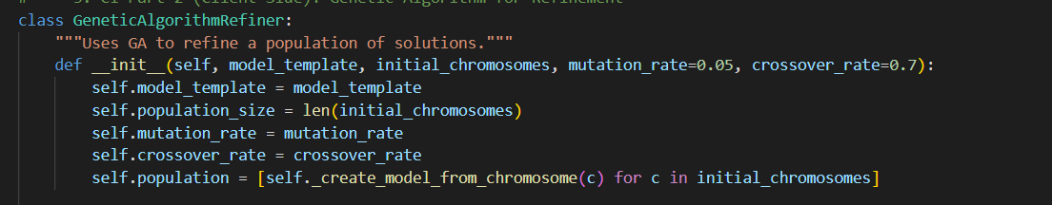
Genetic Algorithm
1)GA is a population-based global search algorithm → does not rely on gradient information, avoids local minima.
2) Uses selection, crossover, mutation instead of gradients.
3) Initialization → Fitness calculation → Selection → Cross over→ Mutation
Initialization
Formulas Used
1)Takes a template model and a list of initial chromosomes
2)Sets mutation rate and crossover rate.
3)Converts each chromosome into a working neural network model using unflatten weights.

Slide 22
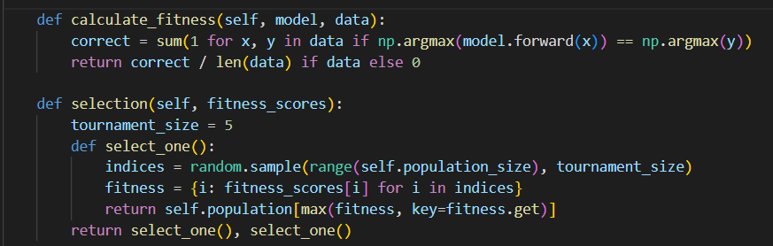
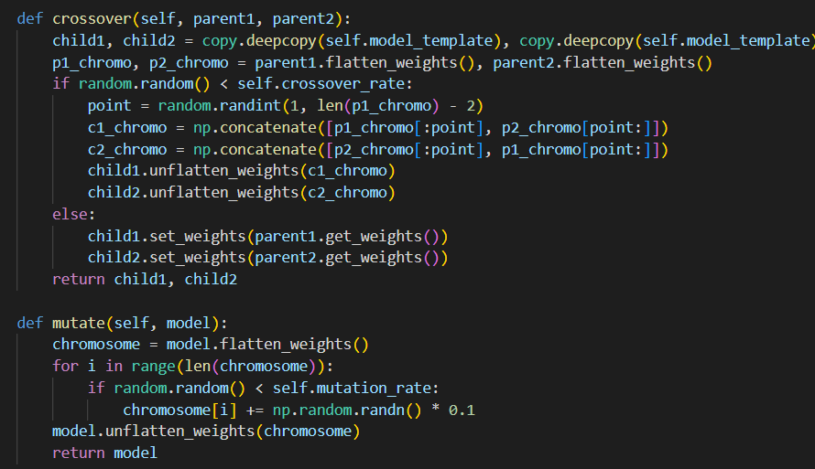
Fitness Calculation & Selection
1)In Fitness calculation the fitness score is evaluated.
2)selection, the algorithm uses tournament selection, where a few models are randomly picked, and the fittest among them is chosen as a parent. This process is repeated to select two parents . A higher fitness means a stronger candidate solution
Cross Over and mutation

Slide 23
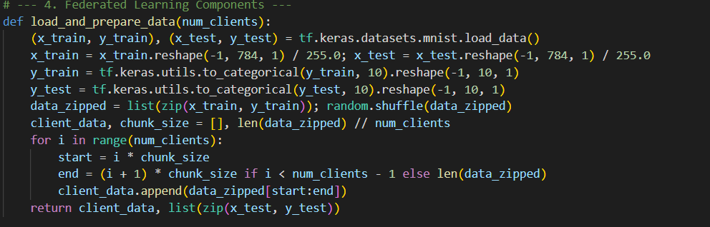
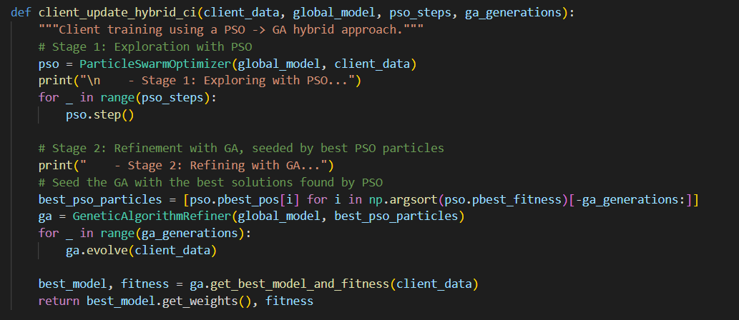
Federated Learning
In this step, we load the MNIST dataset and reshape it so that each image is a flat 784-dimensional vector, normalized between 0 and 1
First, Particle Swarm Optimization explores different weight configurations. Then, the best solutions are refined further using Genetic Algorithms with crossover and mutation.

Slide 24
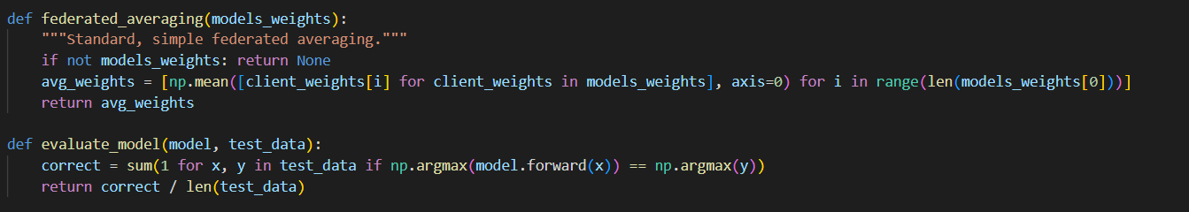
Federated Learning and Evaluation
Here, the server collects model weights from all clients and performs federated averaging.
This function measures how well the global model performs. It runs the model on the test dataset, counts how many predictions are correct, and calculates the accuracy

Slide 25
Future updates
Use socket programming to send and receive model parameters
Make the simulation run on GPU (include CUDA)
Implement encryption techniques
Use multi-threading to inference and train simultaneously
Optimization accuracy will be improved in CI techniques.

Slide 26
Resources used
https://github.com/AshwinRJ/Federated-Learning-PyTorch
https://arxiv.org/abs/1602.05629
AI tools: Gemini
IDE: PyCharm

