Slide 1

Team 07: Cyberdyne Systems
Simulation of Load Balancing in vanilla Federated Learning Systems
Communication-Efficient Learning of Deep Networks from Decentralized Data
H. Brendan McMahan, Eider Moore, Daniel Ramage, Seth Hampson, Blaise Agüera y Arcas

Slide 2
Advancements from previous review
Implemented FedAvg baseline
Integrated client selection strategy (resource-aware)
Improved communication efficiency by increasing local training epoch
Added metrics collection & visualization module
Prepared groundwork for CI integration (PSO+GA)

Slide 3
Task-Split:-
Adithyaa Seyyone: Integrating the server and client module and orchestrating the workflow
Kapil Kanna: Server module functions, FedAvg integration with workflow
Yuvan Dhurkesh: Client module functions, Integration of Client module with CI module
Akshaay: Definition of client and server class
Charan Karthick: Implementation of MNIST and ParticleSwarmOptimization algorithm.
Arjun: Implementation of Genetic Algorithm and integration

Slide 4
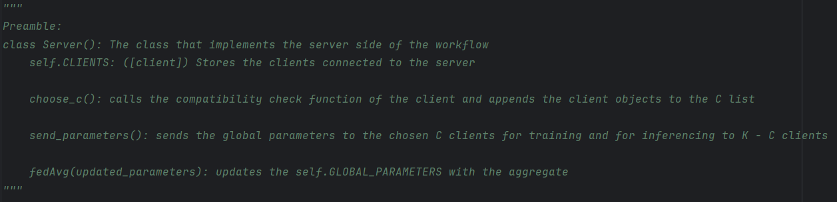
Server

Slide 5
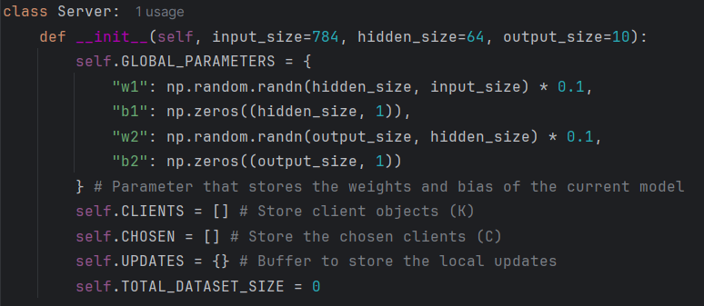
Server

Slide 6
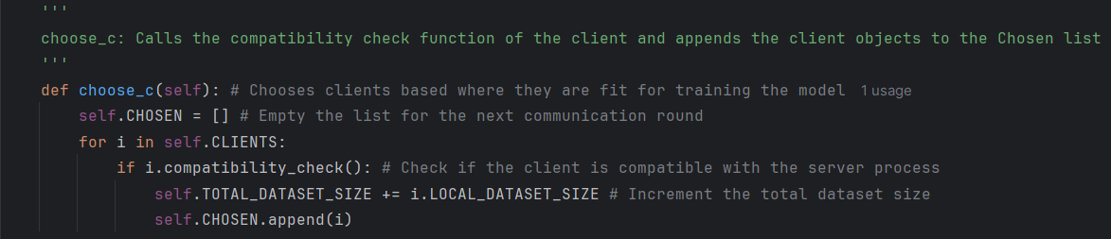
Server

Slide 7
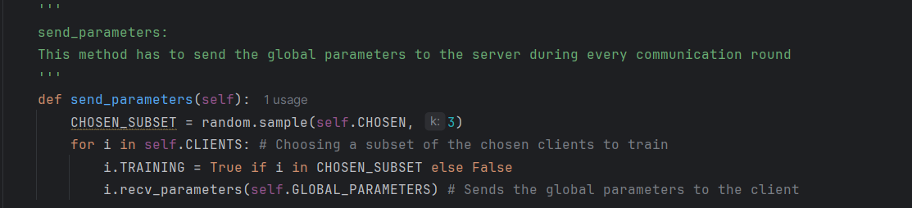
Server

Slide 8
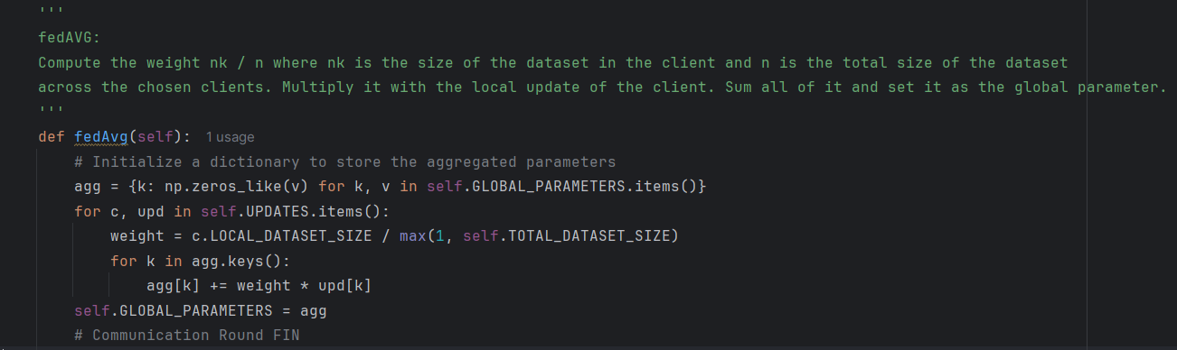
Server

Slide 9
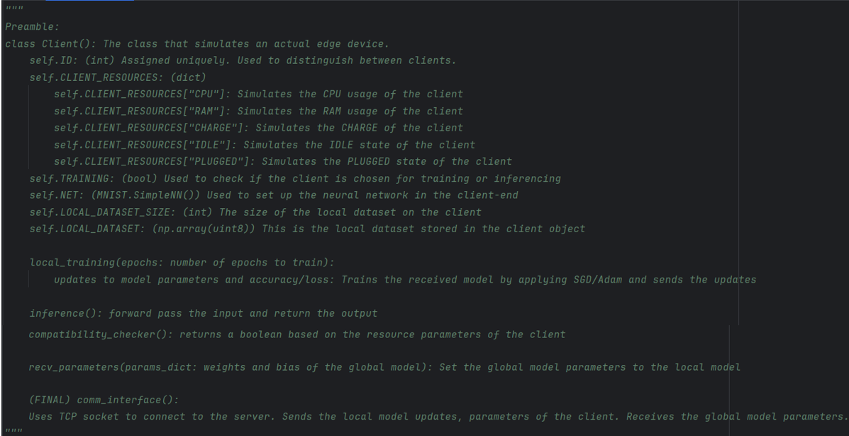
Client

Slide 10
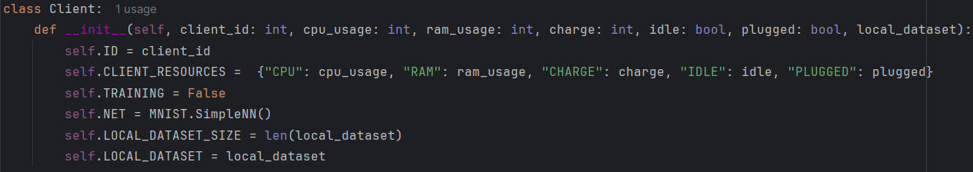
Client

Slide 11
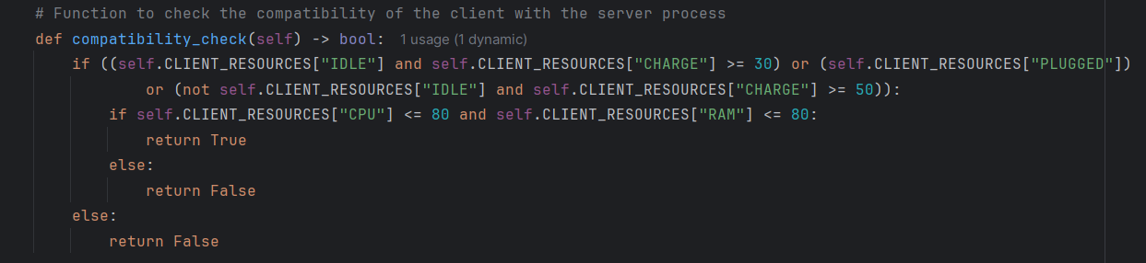
Client

Slide 12
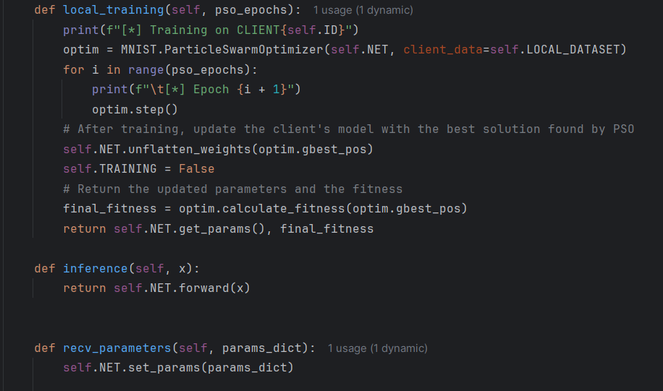
Client

Slide 13
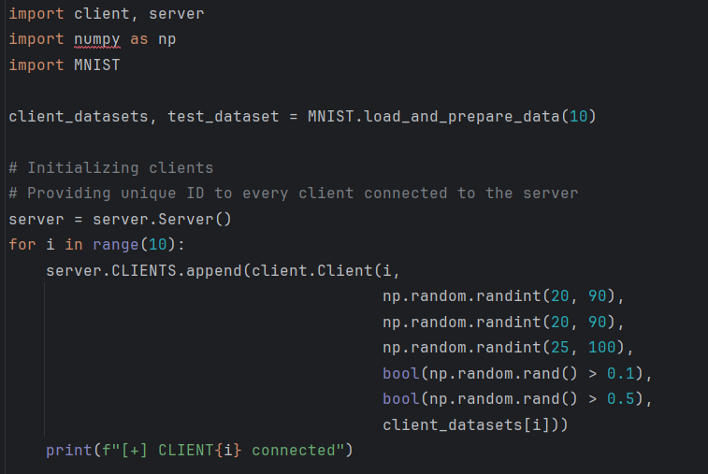
Simulation

Slide 14
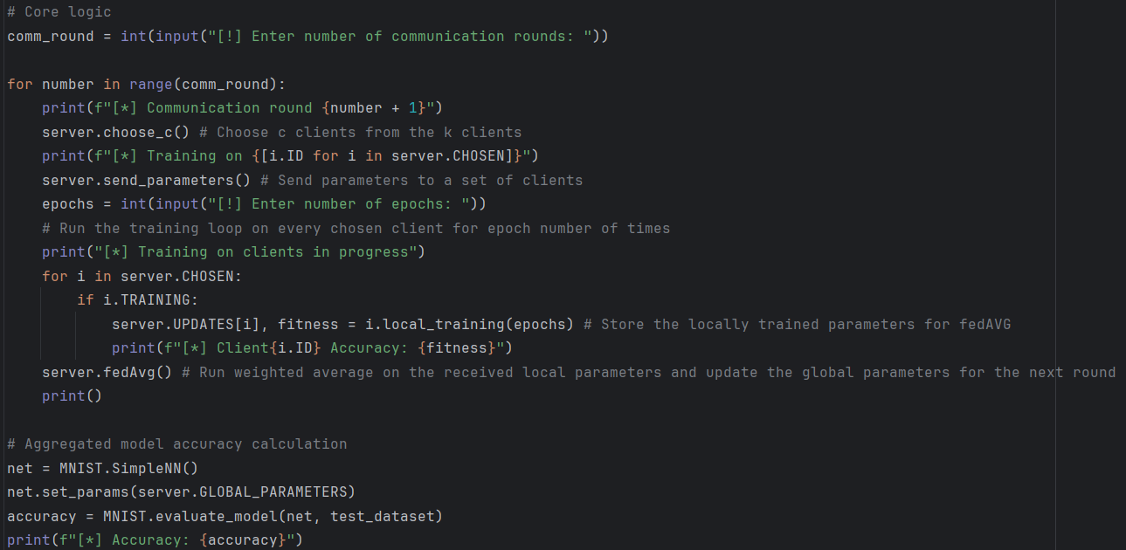
Simulation

Slide 15
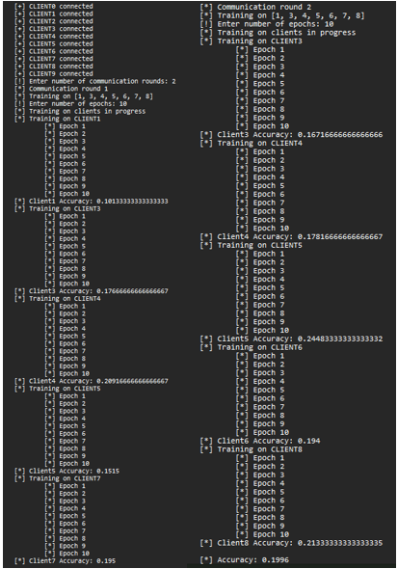
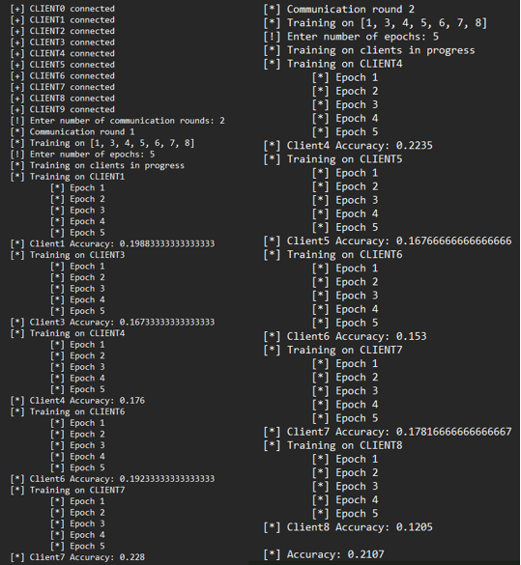
Output

Slide 16
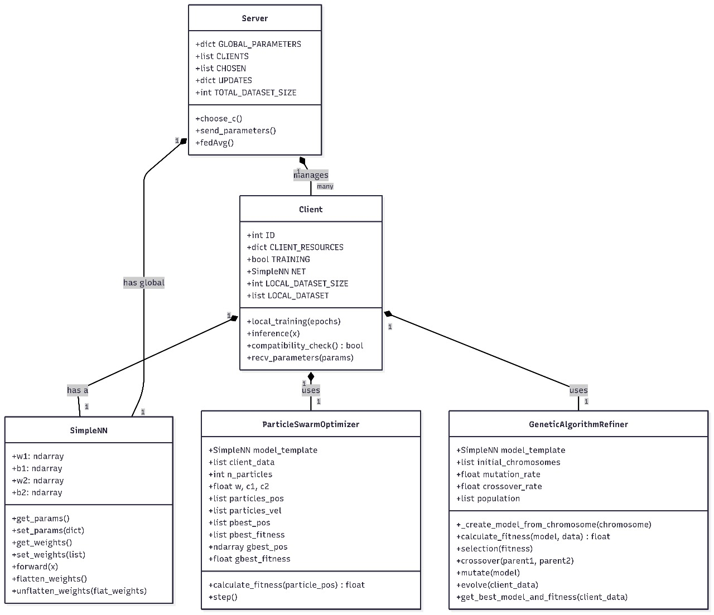
Architecture Design

Slide 17
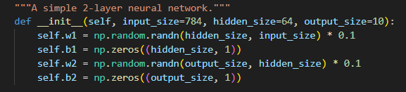
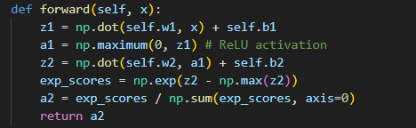
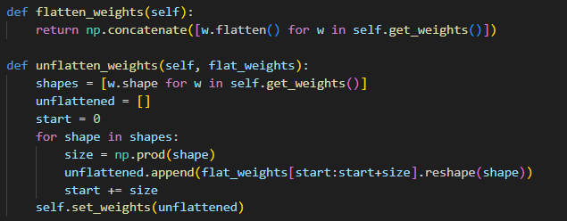
SimpleNN(MNIST):
→Weight Initialization(Input Layer)
→Forward Propagation(Hidden Layer)
- ReLu Activation
→Flattening and Unflattening(Output Layer)
- SoftMax

Slide 18
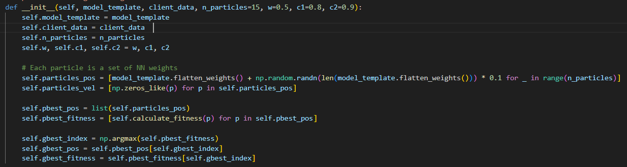
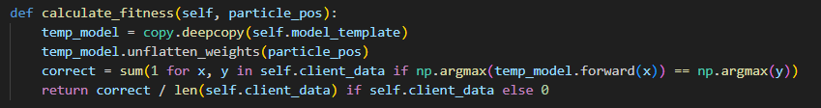
Particle Swarm Optimization:
Swarm Initialization:
Fitness Calculation:

Slide 19
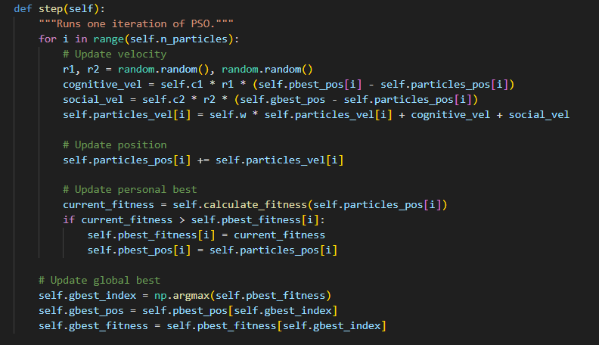
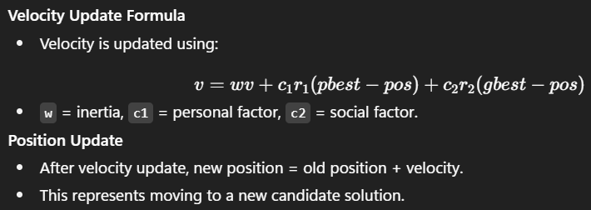
Updates:

Slide 20
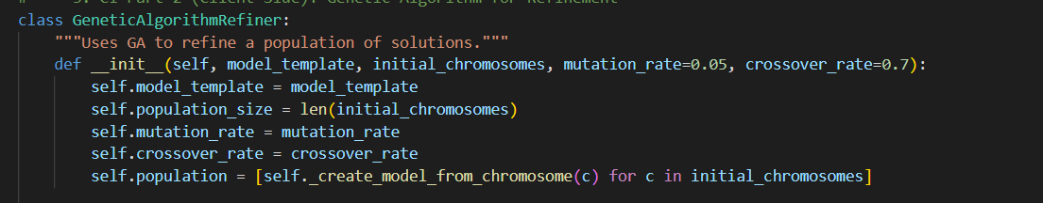
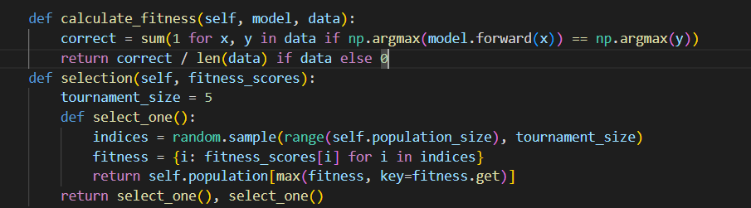
Genetic Algorithm
Initialization
Fitness Evaluation and Selection

Slide 21
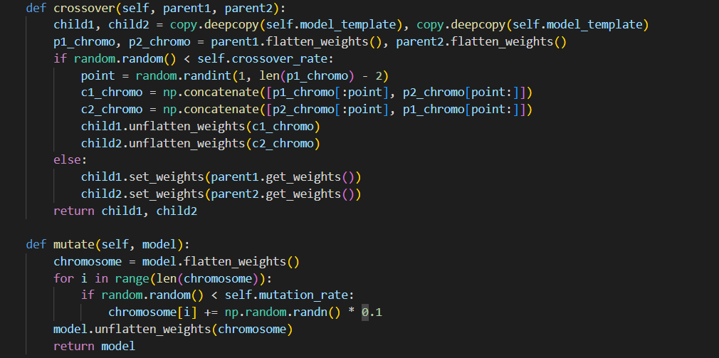
Cross over and Mutation

Slide 22
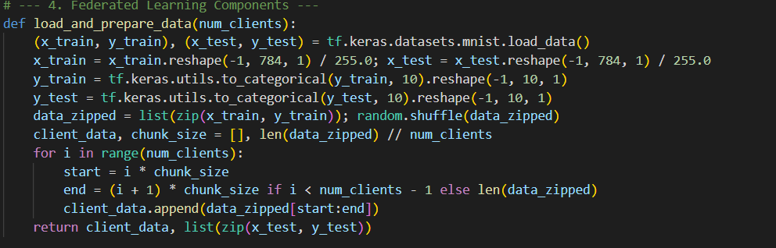
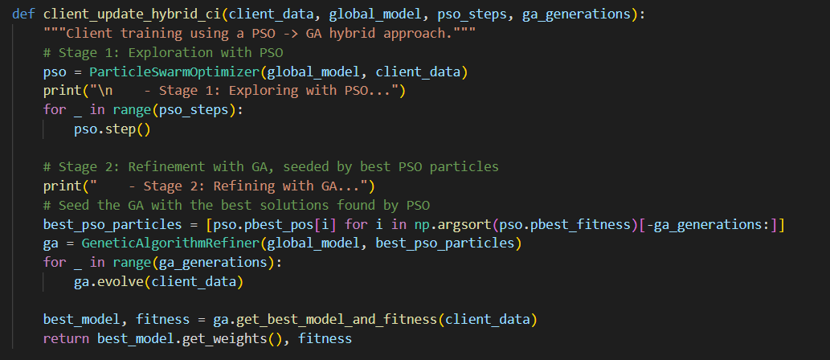
Federated Learning
In this step, we load the MNIST dataset and reshape it so that each image is a flat 784-dimensional vector, normalized between 0 and 1
First, Particle Swarm Optimization explores different weight configurations. Then, the best solutions are refined further using Genetic Algorithms with crossover and mutation.

Slide 23
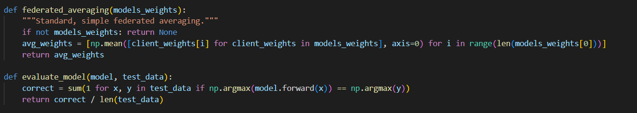
Federated Learning and Evaluation
Here, the server collects model weights from all clients and performs federated averaging.
This function measures how well the global model performs. It runs the model on the test dataset, counts how many predictions are correct, and calculates the accuracy

Slide 24
Future updates
Use socket programming to send and receive model parameters.
Make the simulation run on GPU (include CUDA)
Implement encryption techniques
Include network bandwidth and latency (based on distance between client and server)
Optimization accuracy will improved in CI techniques.

Slide 25
Resources used
https://github.com/AshwinRJ/Federated-Learning-PyTorch
https://arxiv.org/abs/1602.05629
AI tools: Gemini
IDE: PyCharm

