Slide 1

EDGE COMPUTING - REVIEW 1
JOINT SERVICE PLACEMENT AND REQUEST ROUTING IN MULTI-CELL MOBILE EDGE COMPUTING NETWORKS
-JAIME LLORCA, KONSTANTINOS POULARAKIS
PRESENTED BY GROUP NO.: 009-THE SLOTHFORCE

Slide 2
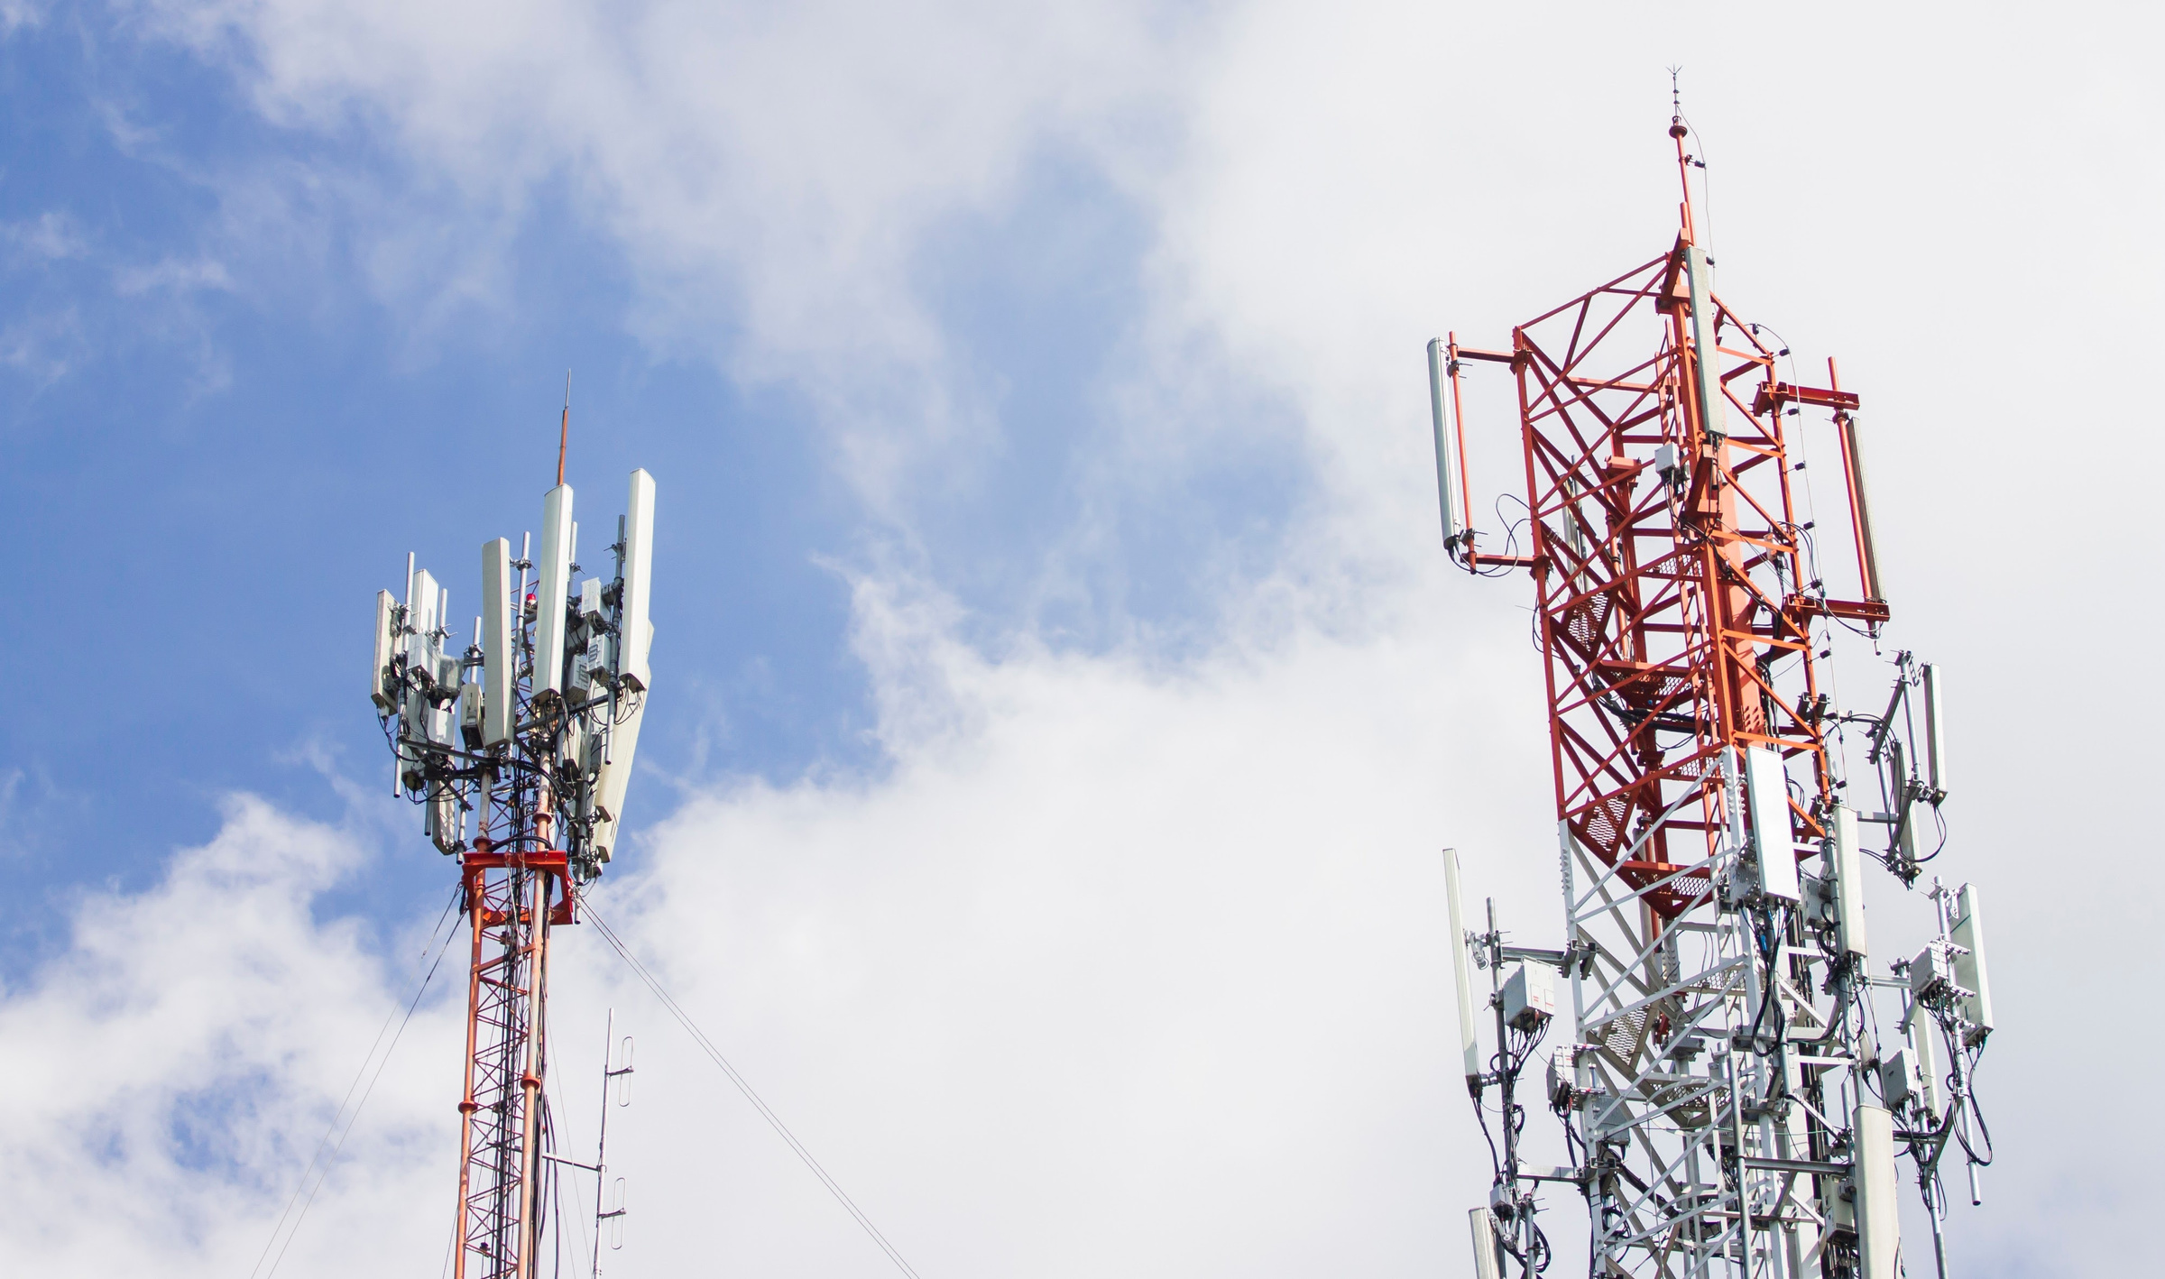
PROBLEM STATEMENT
Maximize the number of user requests served by MEC edge servers (or equivalently, minimize the load on the centralized cloud) while satisfying all resource constraints for every BS
Objective of Service Provider:
Service Placement – Which services to pre-store at which BSs so that they fit within the BS storage limits.
Request Routing – For each user request, which BS (or the cloud) should process it, without exceeding the BS’s CPU and bandwidth capacities.

Slide 3
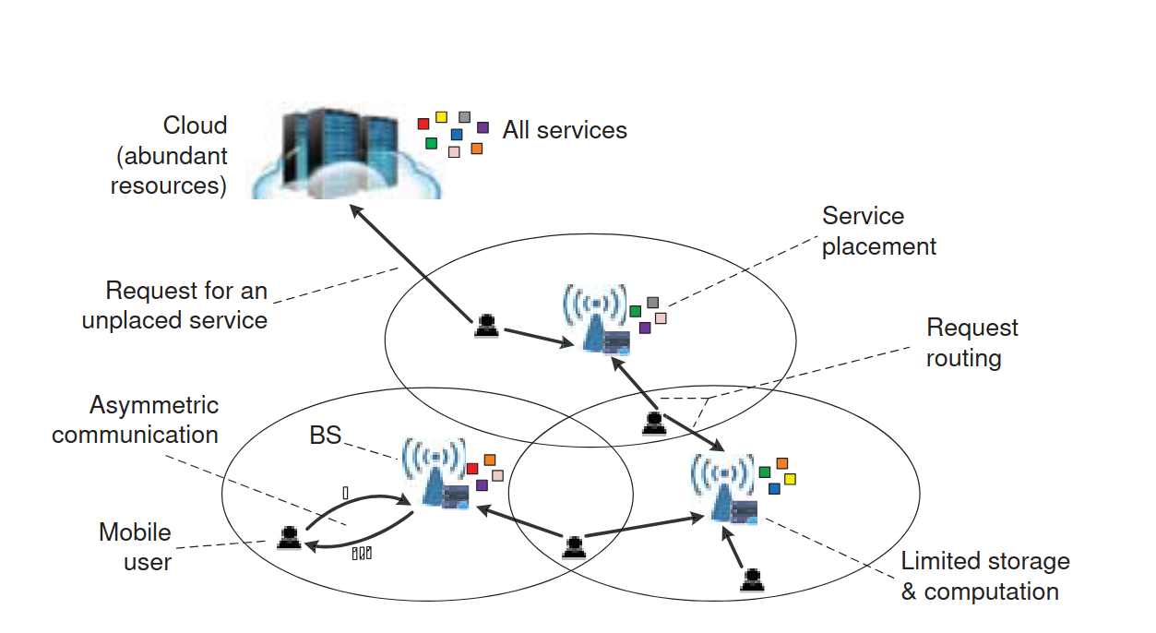
Why This is an Edge Computing Problem??
1️⃣ Computation at the Edge
Services are executed on edge servers at base stations instead of only in the centralized cloud.
Decisions involve where to place services to run them close to users.
2️⃣ Low Latency & QoS Focus
MEC reduces round-trip time compared to cloud processing.
Critical for AR, VR, gaming, autonomous driving.
3️⃣ Resource-Constrained Environment
Each BS has limited:
Storage (RnR_nRn​)
CPU (CnC_nCn​)
Uplink/Downlink Bandwidth
Must optimize usage to maximize served requests locally.
4️⃣ Network-Aware Optimization
Users may be in overlapping coverage → multiple routing options.
Placement & routing jointly optimized to minimize cloud (backhaul) load

Slide 4
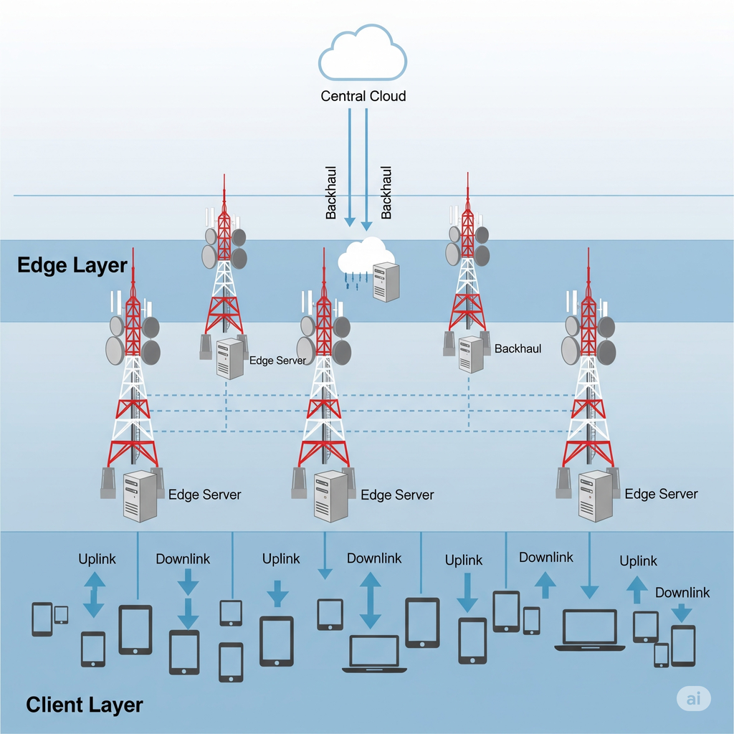
Layered Architecture
Cloud Layer – Central data center with unlimited resources; processes requests the edge cannot handle; higher latency
Backhaul – Network link between edge and cloud; moves service data, forwards unserved requests; limited by latency and bandwidth.
Edge Layer – Local storage, compute, and bandwidth handle requests near users; decides whether to serve locally or forward to cloud
Client Layer – End-user devices (phones, IoT, AR/VR) send service requests via 4G/5G/Wi-Fi and receive results

Slide 5
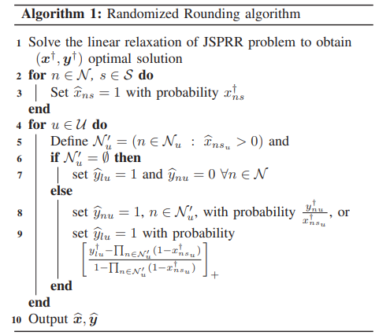
Randomised Rounding Algorithm
Firstly we solve the linear relaxation of the JSPRR problem where we get two matrices where x’[n][s] has the probability value of placing service s on base station n and y’[n][u] has the probability of user u’s demand routed to BS n.
Then we set will have another matrix where we will set x[n][s]=1 with probability using the matrix x’[n][s] for every base station.

Slide 6
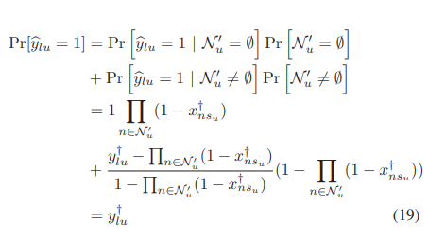
Randomised Rounding Algorithm
For each user we define a set n which is the set of base stations that are reachable from the user .For each user u, look at the BSs that actually got the service after rounding.
If there are no base stations with that service sent to cloud, else pick one base station or the cloud with weighted probability.
.

Slide 7
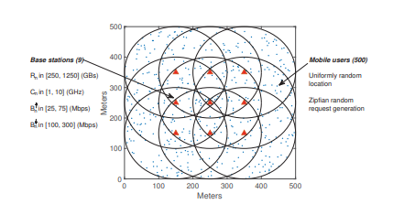
How is this useful in the real world?
Practically this is impossible to implement , becuase we cannot split the service resource into fraction. So how is this algorithm useful?
Well this algorithm provides a better solution than existing solution like the greedy approach where if we take the best base station for the services even which requires less compuation power.
Instead, using the randomised rounding algorithm we can bias on where we can place the service for the most optimal solution.

Slide 8
What This Paper Does Differently
ASPECT | CONTRIBUTION
Multi-cell MEC | Considers overlapping BS coverage, realistic for urban deployments.
Joint Optimization | Simultaneously solves placement and routing problems under resource constraints.
Resource Constraints | Accounts for storage, compute, uplink, and downlink bandwidth together.
Algorithm | Proposes a novel Randomized Rounding-based approximation with performance guarantees.
Cloud Offloading | Minimizes requests offloaded to cloud, unlike earlier works that ignored it.
Scalability | Provides practical solutions scalable to large networks.

Slide 9
Comparative Summary of
Literature
WORK | FOCUS | LIMITS | NOTES
Efficient Multi-User Computation Offloading for Mobile-Edge Cloud Computing Chen et al. (2016) | Service placement | Ignores routing and compute | Simplified edge model
Dynamic Service Placement for Mobile Micro-Clouds with Predicted Future Costs Wang et al. (2017) | Routing only | Static services, no storage limits | Focused on minimizing latency
Joint Optimization of Task Scheduling and Image Placement in Edge Computing Deng et al. (2018) | Joint placement & routing | No bandwidth/ compute constraints | Uses ILP, not scalable
This paper (2020) | Joint placement + routing | All resource constraints, multi-cell, dynamic | New LP + randomized rounding approach

Slide 10


supports java language
Implementation strategy
edgecloudsim
supports user design mobility
user end device moves from one zone to another latency changes,requested can be routed to nearest base station
Advantages Of Using EdgeCloudSim
supports 2 tier architecture
edge /cloud
with limited energy model

Slide 11



other simulator
supports java language
ifogsim2
Advanced model
multiple power states (static,dynamic),component level tracking (mem usage, cpu processing etc)
does not support mobile end users
supports 3 tier architecture
edge/fog/cloud

Slide 12
strategy
Formulate LP Problem using PuLP / CVXPY
pulp - python linear programming ,CVXPY = Convex optimization in Python
Randomized Rounding to convert fractional results to binary
Export as json for externally add to our simulation
read routing json file
simulated iiot devices create virtual devices in xml file
set up EdgeCloudSim
mobility confiig - cvs (timezone , device
_id)
Assign services
Configure network latency, CPU, and bandwidth per zone
simulate and evaluate

Slide 13

TASK SPLITTING
ESWARA RAJ
CHARANJITH
architecture design
simulator setup
like defining setup,configure cloud,build factory zones
Create the simulated IIoT devices with mobility patterns
AMARTHYA SUJAI
AKSHAY
Implement LP + Randomized Rounding to decide where services should be placed.
Integrate placement algorithm with EdgeCloudSim, evaluate results and documentation

Slide 14
Thank you!!

