Slide 1
Dynamic Load Balancing for Real-Time Healthcare IoT Using Fog Computing
Authors : Mohammed Alaa Ala’anzy and Raiymbek Zhanuzak

Slide 2
Team Members :
Team 10BitMistake
CB.SC.U4CSE23526 | Leena Sri K
CB.SC.U4CSE23527 | Lavishka Dhamija
CB.SC.U4CSE23528 | M. Sanjana
CB.SC.U4CSE23559 | Anurup R Krishnan

Slide 3
Why cloud alone isn’t enough and what fog computing offers
⚠️ Problem
🛠️ Proposed Solution
IoT in healthcare creates huge data volumes. Cloud alone introduces latency and congestion, unsuitable for critical care.
OLB balances data load across fog nodes, reducing delay and ensuring real-time health response.

Slide 4
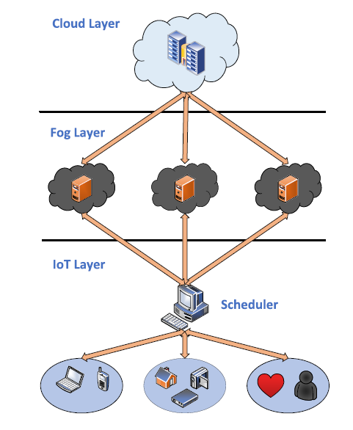
Architecture of Fog Computing
The system employs a three-tier architecture:
IoT Layer : This layer consists of smart sensors and wearable devices that continuously monitor real-time health data.
Fog layer️ : Fog nodes receive the sensor data, perform real-time processing and analysis, and send critical alerts or health status updates back to users.
Cloud Layer : Processed health information is sent to the cloud for secure long-term storage and for access by healthcare providers as needed.

Slide 5
State of Art - Literature Review
Category | Paper | Limitation
Cloud Only Architecture | Fault-tolerant and data-intensive resource scheduling and management for scientific applications in cloud computing, Sensors, Oct. 2021 | High latency and network congestion.
Introducing Fog Layer | From cloud and fog computing to federated-fog computing , Future Gener. Comput. Syst., May 2024 | No dynamic real time resource distribution.
Static Approaches | GVMP: A novel Internet of Things application module placement strategy for heterogeneous infrastructure using iFogSim, Proc. ICCCNT, Jun. 2024 | Struggles with changing load. Lacks adaptability.
Early Load Balancing Frameworks | RBAC-LBRM: An RBAC-based load balancing assisted efficient resource management framework for IoT-edge-fog network,, IEEE Sensors Lett, 2022. | Focused on one or two performance metrics.

Slide 6
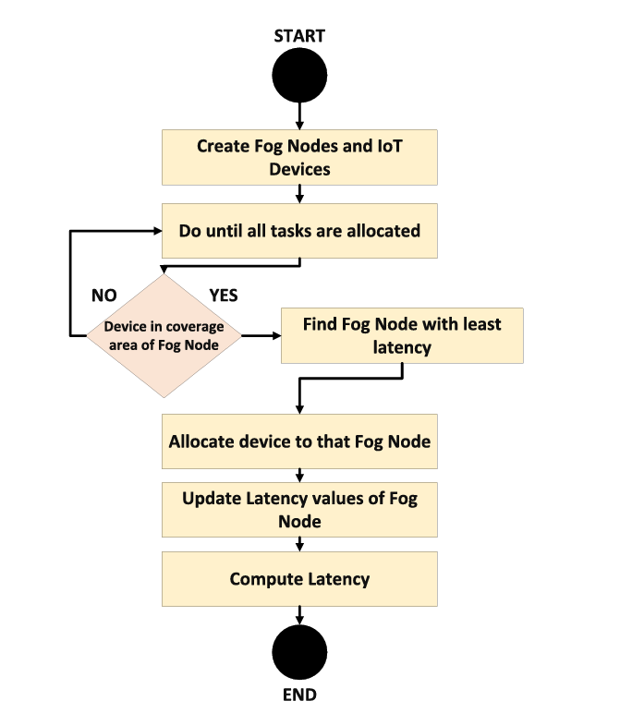

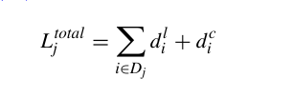
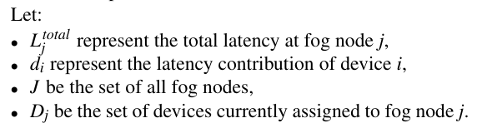
Optimized Load Balancing Algorithm

Slide 7
Implementation Strategy
Simulation: iFogSim2 (Java-based) IoT Device models
Sensors: ECG, SpO2, Heart Rate to monitor patient vitals
Fog Layer: iFogSim2's FogDevice instances
Cloud Storage: Modelled in iFogSim2 as a centralized cloud server node
Comparative Analysis of OLB Algorithm vs Static Load Balancing Algorithm
Visualization of latency, network usage metrics via simulated results

Slide 8
Task Split
Leena Sri K
Lavishka Dhamija
Set up the iFogSim2 environment using Eclipse.
Create the core simulation hierarchy:
Cloud → Fog Nodes → End Devices
Attach wearable sensors (ECG, heart rate, temperature).
Integrate actuators (like alert systems or display monitors).
Maintain consistency across static & dynamic load balancing.
Implement static load balancing algorithms (FNPA, LBS, LAB).
Predefine how tasks are assigned to fog nodes.
Set up basic logic for generating health data (like periodic sensor readings).
Record latency and which devices handled which tasks under static conditions.
Anurup R Krishnan
Sanjana M
Implement OLB for real-time task assignment.
Assign tasks based on current fog node availability.
Monitor traffic and processing load dynamically.
Recalculate only for the active task to reduce overhead.
Simulate data surges (e.g., sudden heart rate spikes).
Record latency, task distribution, and node utilization.
Run multiple simulation tests comparing static vs dynamic methods.
Track and collect key metrics: latency, task completion time, & how well each node is used.
Generate visual graphs showing latency and performance differences.
Comparative Analysis Report.

