Slide 1
Dynamic Load Balancing for Enhanced Healthcare IoT Performance
A Fog Computing Approach to Real-Time Patient Monitoring
Authors: MOHAMMEDALAAALA’ANZY RAMIS AKHMEDOV1, NADER MOHAMED 1,(Member, IEEE), RAIYMBEK ZHANUZAK 2,(Member, IEEE), AND JAMEELA AL-JAROODI 3,(Member, IEEE)

Slide 2
Problem Statement
This paper presents an Optimised Load Balancing (OLB) algorithm designed to enhance network performance in IoT-enabled smart healthcare systems using fog computing. As increasing numbers of wearable healthcare sensors generate massive real-time data, traditional cloud processing introduces significant latency and network congestion. The proposed OLB algorithm dynamically distributes workloads across strategically placed fog nodes, processing sensitive health data nearer to the source. Extensive simulations in the iFogSim toolkit show that OLB outperforms contemporary approaches by reducing latency, network usage, execution time, energy consumption, and operational cost, making it highly responsive and efficient for time-critical healthcare scenarios.

Slide 3
Slide 4: Why Fog/Edge Computing?
The core challenge addressed is real-time health data processing for applications such as patient monitoring or emergency alerts. Cloud-only architectures face unavoidable delays due to geographical distance, leading to latency that can endanger patient outcomes. Edge and fog computing, by bringing computation closer to the data-generating IoT devices, address the critical need for ultra-low latency and guaranteed responsiveness. This is fundamentally an edge problem: it requires rapid, localized computing to meet the stringent requirements of healthcare, where delays or network congestion can have life-threatening consequences.

Slide 4
Slide 4: Why Fog Layer
The Architectural Imperative
The fog layer is chosen over the edge layer because it offers a balanced trade-off between proximity to data sources and resource availability, which is particularly crucial in healthcare IoT environments. While edge computing processes data even closer to devices—sometimes directly on sensors or gateways—these nodes typically have limited computational power, storage capacity, and may not support complex analytics or dynamic workload management. In contrast, the fog layer consists of more capable intermediary nodes positioned near the network edge (such as at base stations or local servers). This enables the fog layer to aggregate, preprocess, and analyze large volumes of healthcare data in real time, efficiently offload traffic from the cloud, and coordinate multiple edge devices. Importantly, fog nodes are better suited for implementing advanced algorithms for load balancing, security, and redundancy, which are often beyond the capabilities of lightweight edge devices. Therefore, for applications demanding low latency, real-time responsiveness, and advanced resource management—such as smart healthcare monitoring—the fog layer provides a scalable and robust platform, whereas an edge-only approach may encounter limitations in scalability, adaptability, and computational efficiency

Slide 5
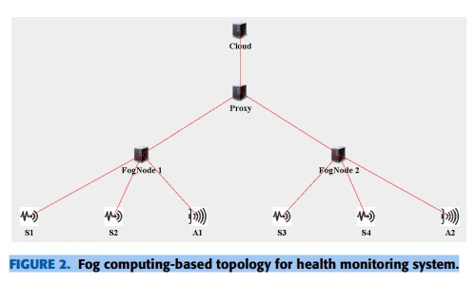

Slide 6
State of the Art Literature
Recent research in healthcare IoT emphasizes overcoming the latency and scalability issues of traditional cloud-centric systems by adopting fog-based and hybrid architectures. Cloud solutions offer high scalability but struggle with latency and bandwidth congestion. Fog-based frameworks such as FNPA and LAB improve latency by associating IoT devices with fog nodes or base stations but lack dynamic real-time workload management. HealthFog and FAAL systems leverage fog computing for localized data analysis and patient monitoring but have limited evaluations on adaptive resource scaling or comprehensive metrics. Mobile Edge Computing (MEC) focuses on energy and cost-efficient task offloading but often relies on static decisions, limiting scalability for rapidly changing healthcare demands. Most existing studies compare fog systems only to cloud-only setups and overlook multi-metric comparisons. The proposed OLB algorithm fills this gap by dynamically balancing traffic and computing loads across fog nodes, achieving superior performance in latency, network usage, execution time, energy consumption, and cost compared to state-of-the-art methods. Additional innovations like RBAC-LBRM and DynaFog contribute to load balancing and task offloading but lack broad adaptability in healthcare contexts. Overall, OLB represents a next-generation fog-based solution addressing real-time healthcare IoT challenges effectively.

Slide 7
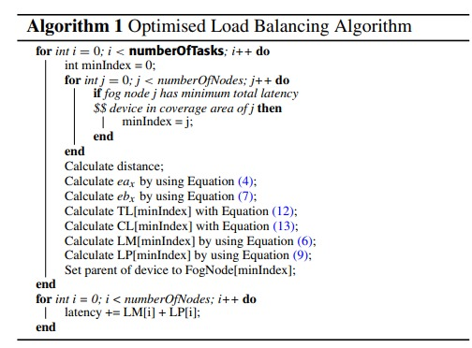
Algorithm

Slide 8
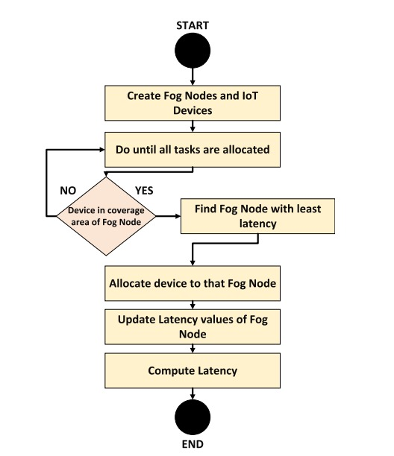
Flowchart

Slide 9
Q&A
Team Details:
CB.SC.U4CSE23526 Leena Sri K
CB.SC.U4CSE23527 Lavishka Dhamija
CB.SC.U4CSE23528 M.Sanjana
CB.SC.U4CSE23559 Anurup R Krishnan

