Slide 1


A CLOUD-FOG BASED ARCHITECTURE FOR IOT APPLICATIONS DEDICATED TO HEALTHCARE
AUTHORS: RANDA M.ABDELMONEEM, ABDERRAHIM BENSLIMANE† , EMAN SHAABAN , SHERIN ABDELHAMID AND SALMA GHONEIM(ICCC)
JOURNEL: INTERNATIONAL CARPATHIAN CONTROL CONFERENCE (ICCC)

Slide 2
INTRODUCTION TO EDGE/FOG:
Problem statement: Current cloud-based healthcare systems face high latency and energy inefficiency due to continuous data transmission.
Fog and Edge Computing are decentralized computing paradigms designed to bring computation, storage, and networking closer to IoT devices and end users, reducing the dependency on centralized cloud data centers. Unlike traditional cloud computing, where data is sent to remote servers for processing, the Fog/Edge model processes data locally or in nearby fog nodes. This enables low-latency responses, efficient bandwidth usage, and better handling of real-time applications such as smart cities, industrial automation, and healthcare monitoring. By distributing computational tasks across multiple layers — edge devices, fog nodes, and cloud servers — this model improves system scalability, reliability, and energy efficiency, making it ideal for modern IoT ecosystems.

Slide 3


INTRODUCTION TO CI MODEL :
Wearable ECG devices demand accurate and fast analysis for timely cardiac diagnosis. Our CNN model shows strong performance in ECG signal classification but faces challenges with noise and uncertainty in real-world data. By exploring ONNX conversion and quantization, we move toward hybrid intelligence systems that enable efficient deployment on edge devices for reliable health monitoring
This project explores the two models, a conventional CNN architectures and a hybrid framework combining ResNet18's deep residual learning, Fuzzy Logic's uncertainty handling, and Particle Swarm Optimization's intelligent parameter tuning. The demonstration aims to enhance diagnostic accuracy, robustness, and adaptability for real-world health monitoring in edge computing environments.

Slide 4


EDGE LAYERS :
•IoT Devices: Sensors collecting patient data in real-time.
•Sink Layer: Gateways aggregating and filtering data.
•Fog Layer: Real-time processing, emergency detection, WSM + MBAR algorithms.
•Cloud Layer: Long-term storage, analytics, historical insights.
Write your topic here

Slide 5
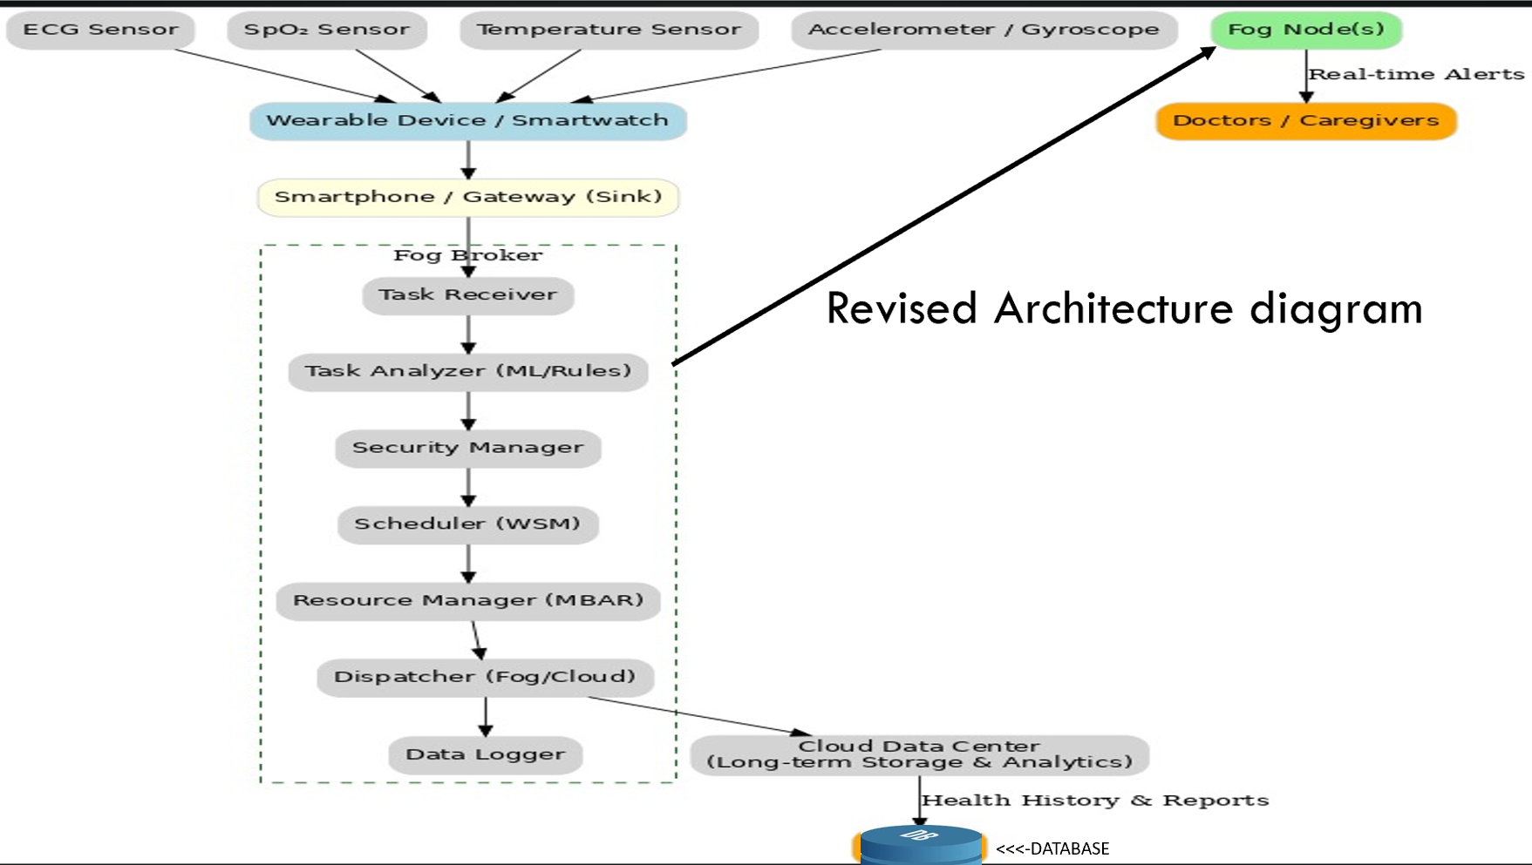

Slide 6
FOG BROKER MODEL :
A FOG BROKER IS THE CENTRAL CONTROLLER AT THE FOG LAYER RESPONSIBLE FOR MANAGING TASKS COMING FROM IOT DEVICES.
IT ENSURES THAT DATA IS PROCESSED INTELLIGENTLY, QUICKLY, AND EFFICIENTLY – ESPECIALLY CRITICAL IN HEALTHCARE SCENARIOS.
EXPLANATION OF FLOW:
TASK RECEIVER – GETS INCOMING HEALTHCARE DATA FROM SINK LAYER (E.G., HEART RATE, SPO₂).
TASK ANALYZER – FLAGS URGENCY (E.G., SPO₂ < 90%) USING RULES OR ML.
SECURITY MANAGER – HANDLES ACCESS, AUTHENTICATION, ENCRYPTION.
SCHEDULER – APPLIES WSM FOR PRIORITY + MBAR FOR NODE ALLOCATION.
RESOURCE MANAGER – TRACKS AVAILABLE FOG RESOURCES TO PREVENT OVERLOAD.
DISPATCHER – SENDS TASKS TO FOG/CLOUD NODES ACCORDINGLY.
DATA LOGGER – STORES TASK OUTCOMES FOR ANALYSIS, DEBUGGING, OR AI TRAINING.
Write your topic here

Slide 7
TASK SCHEDULING ALGO’S & ALLOCATION
WORKING OF WEIGHTED SUM METHOD (WSM) ALGORITHM :
THE WEIGHTED SUM METHOD (WSM) IS A MULTI-CRITERIA DECISION-MAKING (MCDM) TECHNIQUE.
IT IS USED TO PRIORITIZE TASKS WHEN MULTIPLE FACTORS (CRITERIA) INFLUENCE THE DECISION (E.G., URGENCY, CPU DEMAND, DEADLINE).
WORKING OF MBAR (MULTI-CRITERIA BROKER ALLOCATION RULE) ALGORITHM :
THE MBAR ALGORITHM IS USED FOR RESOURCE ALLOCATION IN FOG/CLOUD SYSTEMS AFTER THE TASKS HAVE BEEN PRIORITIZED (USING WSM).
IT ENSURES THAT EACH TASK IS ASSIGNED TO THE MOST SUITABLE RESOURCE NODE (FOG OR CLOUD) WITHOUT OVERLOADING THE SYSTEM.
SINCE NOT ALL TASKS ARE EQUALLY CRITICAL, AN INTELLIGENT SYSTEM MUST:
EVALUATE TASKS BASED ON URGENCY AND REQUIREMENTS
PRIORITIZE TIME-SENSITIVE OR LIFE-THREATENING TASKS (E.G., ABNORMAL ECG)
ASSIGN THEM TO THE BEST-SUITED NODE (FOG OR CLOUD)

Slide 8
simulation plan :
Simulation Plan
Environment Setup
Compile and run the Java program using JDK.
Test Scenarios
Prepare inputs covering normal, high-load, and edge cases.
Execution
Run the program and record outputs, execution time, and resource usage.
Result Analysis
Verify correctness of output.
Analyze performance metrics (execution time, memory usage).
Report Findings
Summarize key observations and suggest improvements.

Slide 9
METRICS TO EVALUATE:
We’ll measure the following to assess our system's efficiency .
• Latency : TO ENSURE REAL-TIME RESPONSE FOR CRITICAL TASKS.
• MISS RATIO : TO TRACK THE PERCENTAGE OF TASKS THAT FAIL TO MEET THEIR DEADLINES.
• RESOURCE UTILIZATION : TO EVALUATE THE EFFICIENCY OF OUR RESOURCE MANAGEMENT.
• COST PER EXECUTION : TO ANALYZE THE OVERALL COST-EFFECTIVENESS OF OUR APPROACH
Step 1
Step 2
Step 3
A presentation is a formal talk, often delivered in front of an audience, aimed at conveying information, persuading others, or sharing insights on a particular topic. Presentations can take various forms, such as verbal speeches, slideshows, demonstrations, or multimedia displays. They are commonly used in academic, professional, and social settings to communicate ideas, proposals, reports, or findings.

Slide 10
ENHANCEMENTS & KEY CONTRIBUTIONS
•IMPROVED ARCHITECTURE CLARITY – REFINED DIAGRAM, CLEARER IOT → SINK → FOG → CLOUD DATA FLOW.
•ALGORITHM IMPLEMENTATION – PSEUDO-CODE FOR WSM & MBAR INTEGRATED AT FOG LAYER.
•EXPANDED SIMULATION PLAN – ADDED LATENCY, MISS RATIO, RESOURCE UTILIZATION METRICS.
•PROOF OF CONTRIBUTION – GITHUB COMMITS/SCREENSHOTS FROM ALL MEMBERS.

Slide 11
Hybrid CI Model Architecture
Model Architecture: ResNet18 backbone with PSO-optimized hyperparameters Fuzzy rule-based inference system with Mamdani/Sugeno methods Hybrid approach combining deep learning and fuzzy logic Input: 250-sample ECG sequences (2.5s at 100Hz) Output: 4-class (Normal, Arrhythmia, Tachycardia, Bradycardia)
Implementation: TensorFlow for model training PSO for hyperparameter optimization Fuzzy logic rules for final classification ONNX runtime for deployment

Slide 12
Extended CNN anomaly detection (ECG) into healthcare IoT scheduling.
• CNN classifies patient ECG data into urgency levels (low / medium / high) and its anomaly .
CNNs excel at pattern recognition in time-series like ECG and cough signals.
Architecture Contribution
Edge/Fog Layer: CNN inference at edge nodes for real-time urgency detection.
Fog Scheduler: Uses CNN urgency output to guide task scheduling (iFogSim).
Code and Implementation
Trained a 1-D CNN model on ECG data and the model outputs urgency label
Generated an output file (ONNX format) and applied quantization for efficient deployment in Fog/Edge devices.
Key Benefits
Improved response time in critical healthcare scenarios.
CNNs excel at pattern recognition in time-series like ECG and cough signals.

Slide 13

THANK YOU

Slide 14
A
Q
Q
A
AND

