Slide 1
Reward-Oriented Task Offloading Under Limited Edge Server Power for Multiaccess Edge Computing Minseok Song , Member, Ieee, Yeongju Lee, And Kyungmin Kim
Adarssh KG :CB.SC.U4CSE23658
Ravindran G :CB.SC.U4CSE23647
Pratyush Yadav :CB.SC.U4CSE23641
Paarthu Reddy: CB.SC.U4CSE23639

Slide 2
Problem Justification
Understanding the idea

Slide 3
How to maximize the total reward for the Edge infrastructure providers while operating within strict power consumption limits of edge servers .
Specific problems :
1. Task Allocation decision : determining which computational task from IOT devices should be offloaded to which edge servers
2. Power budget constraints: Operating within a predefined maximum power limit across all edge servers (inequality: ∑Pⱼ(Uⱼᵗᵒᵗᵃˡ) ≤ Pₗᵢₘᵢₜ)
3. Reward optimization : Maximizing the total profit/revenue earned by EIPs from processing offloaded tasks
4. Resource capacity limits: Ensuring edge server processing capacities are not exceeded
The authors formulate this as the ESA-MAUD (Edge Server Allocation and Maximum Allowable Utilization Determination) problem.

Slide 4
Why is it an edge problem?
Resource scarcity at the network edge : They are like micro data centers with limited computational capacity , thus making efficient resource allocation critical.
Power consumption challenges : Unlike the cloud they must operate within local power constraints
Proximity based service delivery: reducing the latency by processing tasks closer to the user , creates the coverage constraint problem
Multi-Tenant resource sharing : Addresses scenarios where edge servers are shared between multiple customers/applications, which is a common deployment model in edge computing to improve resource utilization and economic efficiency

Slide 5
Proposed Solution :
Phase 1 : Maximum allowable utilization determination (MUD)
To determine the maximum CPU workload each edge server can safely handle so that the total power consumed by all servers stays within the system’s power limit.
This sets a power aware workload cap for every server, ensuring no overload and laying the foundation for efficient task assignment in the next phase.
Phase 2 : Edge server allocation (EAP)
Aim is to allocate individual tasks to specific edge servers to maximize the total reward within the utilization constraints established by phase 1.
Task allocation
Reward maximization

Slide 6
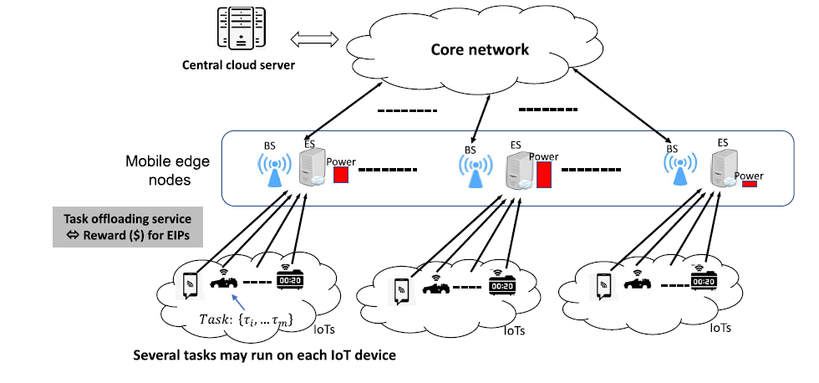
SYSTEM ARCHITECTURE

Slide 7
Maximum allowable utilization determination (MUD)
Phase 1

Slide 8
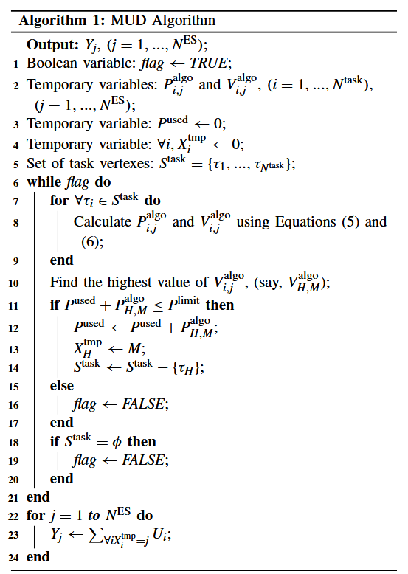
Set current utilization of each server to 0
Set total used power to 0.
List all tasks as unassigned
While total power < power cap and unassigned tasks exist:
For each unassigned task
Calculate extra reward and power.
Calculate efficiency = reward / power.
Select assignment with highest efficiency
If total power after assignment < cap
Assign task , update utilization and power
Remove task from unassigned list
Else :
Stop assignment
Output utilization caps (sum of assigned CPU tasks) for each server.

Slide 9
Edge server allocation problem (EAP)
Phase 2

Slide 10
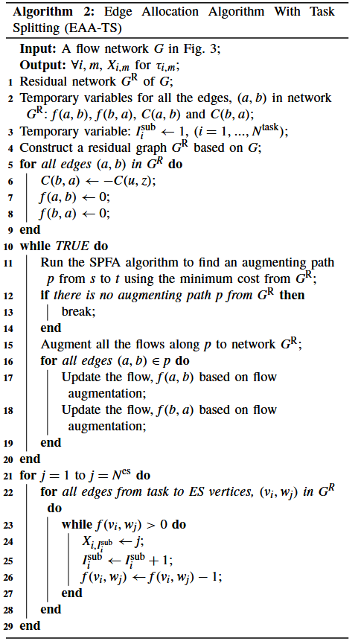
EAP with task splitting

Slide 11
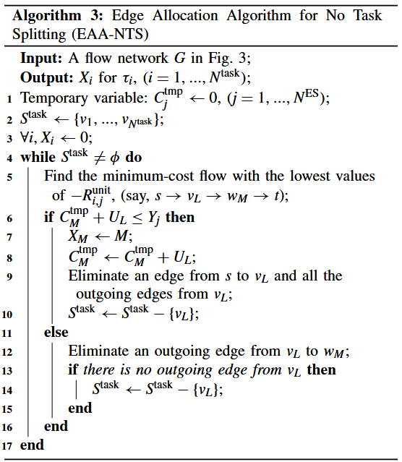
Eap with no task splitting

Slide 12
Language: Python Libraries: Numpy, Pandas, NetworkX, Google OR-Tools. Data input: Small to medium scale simulated data sets (servers, tasks, coverage). Output: Console print, CSV files, plots for validation. simulation environment on PC/laptop.
Implementation strategy

Slide 13
State of the art literature

Slide 14
State-of-the-Art Literature
Unlike traditional approaches that optimize for latency, QoS, or profit alone, this paper uniquely integrates reward optimization with strict power constraints.
Previous solutions like MKAR, MCKP, or auction-based offloading focus either on maximizing profit or minimizing latency but ignore CPU-power non-linearity and task-server affinity (coverage).
It introduces a nonlinear power model derived from real server datasets (SPECpower), and uniquely integrates it into the task allocation problem via MCMF.
A paper with this implementation: Profit-aware Resource Management for Edge Computing Systems. Link -> https://doi.org/10.1145/3213344.3213349

Slide 15
The paper introduces task splitting as a key innovation.
In EAA-TS, tasks can be divided into subtasks, enabling:
Better CPU utilization across ESs.
Finer-grained offloading decisions.
More tasks to be admitted under strict power constraints.
Effective especially when task sizes (CPU demands) are large .
Simulations show that task splitting outperforms non-splitting by up to 22% when power is highly constrained (ratio ≤ 40%).

Slide 16
Task allocation

Slide 17
Adarssh – cb.sc.u4cse23658 | System modelling: Defining edge servers specifications and tasks
Paarthu – cb.sc.u4cse23639 Ravindran – cb.sc.u4cse23647 | MUD algorithm implementation : (Phase 1)
Pratyush – cb.sc.u4cse23641 Adarssh – cb.sc.u4cse23658 | EAP algorithm implementation : (Phase 2)

Slide 18
Thank you

