Slide 1

LOPECS
A Low‑Power Edge Computing System for Real‑Time Autonomous Driving Services
Autonomous vehicles must run services like object detection, SLAM, and voice recognition in real time, but low-power platforms (e.g., Jetson TX1) struggle with limited compute and energy. While cloud offloading can help, it adds latency and network risks in safety-critical tasks. Hence, there is a need for a lightweight adaptive edge computing system that dynamically balances onboard and edge execution to ensure both real-time performance and energy efficiency.

Slide 2

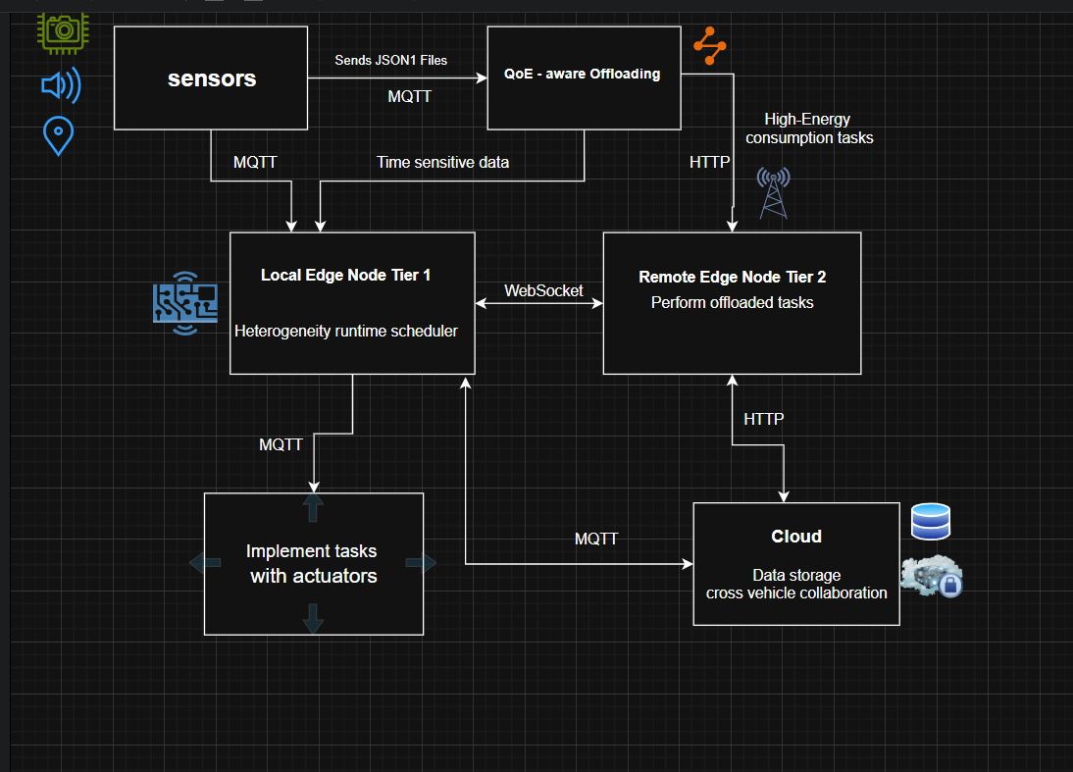
ARCHITECTURE DIAGRAM

Slide 3

CHANGES AND UPDATES
1) Added a Seperate QoE stage within the pipeline,with additional functionalities including sensor fusion and local and offload execution times/energy.
2) Created real-time simulation with dynamic arrivals using SimPy-based event simulation
3) Fused SLAM with Camera detections into a single sensory info and EDF logics are implemented in the tier 1 stage.
4) Supported the tier 2 (remote nodes) stage with new Fallback Mechanisms and Budget Constraints in a batch wise fashion.
5) The data flow is made advanced by adding new parameters and functions such as tag enrichment and functions adapted to the sensory infoemation

Slide 4

QOE CODE
function enrich_task(event, type):
deadline ← DEADLINE_TABLE[type]
QoE_class ← "Insensitive"
score ← 0
if type == "SLAM":
score += weight1 if obstacle detected
score += weight2 if near objects
score -= penalty if VO failure
score += f(confidence_level)
score += bonus if fast arrival
score += bonus if voice confirms obstacle
deadline ← max(5, base_deadline - score)
QoE_class ← classify(score)
if type == "Voice":
score += weight if "obstacle"
score += weight if control command
else score += small_weight
map score → (deadline, QoE_class)
compute (local_time, local_energy)
compute (offload_time, offload_energy)
return enriched_task(deadline, QoE_class, times, energy)
QoE Metadata Enrichment – Adds critical fields like QoE class, deadlines, and energy estimates to each task.
Safety & Time Priority – Automatically routes safety-critical or time-sensitive tasks to Tier-1 for immediate local execution.
Energy–Latency Optimization – Chooses offloading only when it’s faster and more energy-efficient than local processing.
Bandwidth-Aware Tier Selection – Splits offloaded tasks between Tier-2 (remote edge) and Tier-3 (cloud) based on data size/bandwidth limits.
Fallback to Local – Defaults to Tier-1 when neither time nor energy conditions are favorable for offloading.

Slide 5

TIER1
Add a littier 1
# Hardware: CPU, GPU, DSP
# Scheduler: HEFT / Dif-Min
# Local task queue
Global task_queue
Function add_to_tier1(task, use_heft=True):
# Add task to local queue
task_queue.append(task)
# Optionally run HEFT or Dif-Min scheduler
if use_heft:
allocations = run_heft_scheduler(task_queue)
else:
allocations = run_difmin_scheduler(task_queue)
return allocations
tle bit of body text
Local Execution Hub – Tier-1 handles immediate or safety-critical tasks closest to the device, reducing latency.
Flexible Hardware Utilization – Supports CPU, GPU, and DSP so tasks can be matched to the most suitable local resource.
Dynamic Scheduling Algorithms – Offers a choice between HEFT (Heterogeneous Earliest Finish Time) or Dif-Min scheduling for better performance depending on workload.
Central Task Queue – Maintains a global task_queue to store and manage incoming tasks before scheduling.
Fast Resource Allocation – Immediately computes allocations for each task, enabling low-delay execution or quick decision-making for offloading to higher tiers
Add a little bit of body text

Slide 6
TIER 2
# Preprocessing / Compression done at Tier-1 before sending
Global tier2_queue
Function add_to_tier2(task):
# Preprocessing already done at Tier-1
tier2_queue.append(task)
Function schedule_tier2(tasks_all, max_time):
executed = []
fallback = []
used_time = 0
For each task in tasks_all:
total_time = task["offload_time"] + decompression_overhead
if used_time + total_time <= max_time:
# Decompress task
task = tier2_decompress(task)
executed.append(task)
used_time += total_time
else:
# Fallback to Tier-1
fallback.append(task)
tier1.add_to_tier1(task)
return executed, fallback
Function tier2_decompress(task):
# Restore features / data
return task
Handles Preprocessed Data – Tier-2 assumes all tasks arriving from Tier-1 are already compressed or preprocessed, reducing transmission size and latency
Dedicated Tier-2 Queue – Maintains a separate tier2_queue to store incoming tasks before scheduling and decompression.
Time-Budget Scheduling – schedule_tier2 checks each task’s offload time + decompression overhead against a max_time budget to decide whether it can be processed at Tier-2.
Decompression/Feature Restoration – Uses tier2_decompress to restore data or features before execution on Tier-2 resources.
Fallback Mechanism to Tier-1 – If Tier-2 cannot execute a task within the allotted time, the task is automatically returned to Tier-1 for local execution, ensuring no task is dropped.

Slide 7
TIER 3
CLASS Tier3Cloud:
INIT:
data_lake ← []
fleet_status ← {}
hazard_events ← []
collect_data(vehicle_id, log):
Add {vehicle_id, log} to data_lake
update_fleet_status(vehicle_id, status):
fleet_status[vehicle_id] ← status
generate_fleet_report():
RETURN total vehicles, low battery list, avg speed
report_hazard(vehicle_id, hazard_type, location):
Add {vehicle_id, hazard_type, location} to hazard_events
distribute_hazards(region):
RETURN hazards matching region or all
Data Aggregation:
Collects logs and cleaned data from vehicles via Tier-2.
Fleet Monitoring:
Keeps track of vehicle status (battery, speed, location).
Fleet Health Report:
Generates summaries, e.g., low battery vehicles and average speed.
Hazard Management:
Receives hazard reports (e.g., accidents, slippery roads) from Tier-2.
Hazard Distribution:
Shares hazard info back to Tier-2 to alert vehicles.

Slide 8
SimPy
Task Generation:
Tasks are created from SLAM and Voice Recognition data, enhanced with quality and deadline info.
Tier Assignment:
Each task is classified to run either locally (Tier-1) or remotely (Tier-2) based on deadline and energy efficiency.
Priority Queue:
Tasks are ordered by earliest deadline to ensure timely execution.
Task Scheduling:
Tier-1 tasks are grouped into batches and executed on local hardware (CPU, GPU, DSP).
Tier-2 tasks are executed remotely if time budget allows; otherwise, they fallback to Tier-1.
Simulation Execution:
SimPy environment runs the simulation until the predefined time limit.
Results & Metrics:
Final outputs show task completion times, deadline success rate, and energy consumed per tier.
task_source(env, slam_file, voice_file, task_queue):
For each event in slam_file + voice_file:
task ← Enrich event with QoE info
Decide task tier (Tier-1 or Tier-2)
Add task to task_queue (EDF order)
Wait for inter-arrival gap
scheduler(env, task_queue, results, resources, metrics):
tier2_used_time ← 0
tier1_batch ← []
Loop:
IF task_queue not empty:
Pop earliest-deadline task
IF task assigned to Tier-1:
Add to batch
IF batch full or timeout:
Schedule batch on CPU/GPU/DSP
ELSE IF task assigned to Tier-2:
IF within budget:
Simulate remote execution
ELSE:
Fallback to Tier-1 batch

Slide 9
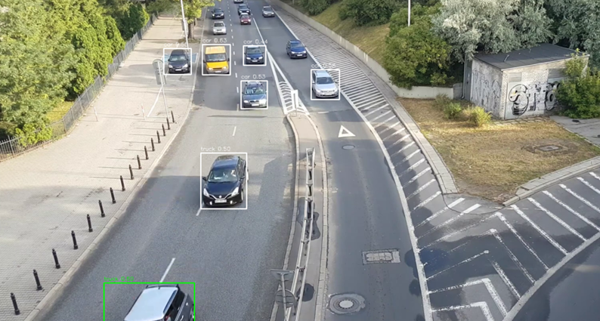
YOLO (OBJECT DETECTION)
Input:
Video frames captured from camera/video file
Goal:
Identify obstacles in real time and log them for safe navigation
Process:
Detects objects in each frame using YOLOv5n
Applies confidence threshold (>= 0.35) to filter reliable detections
Divides frame into left, center, right zones using bounding box center
Compares bounding box area with frame area
(>= 0.015 then near object)
Output:
Object class, bounding box, confidence, position (L/C/R), near/far status

Slide 10
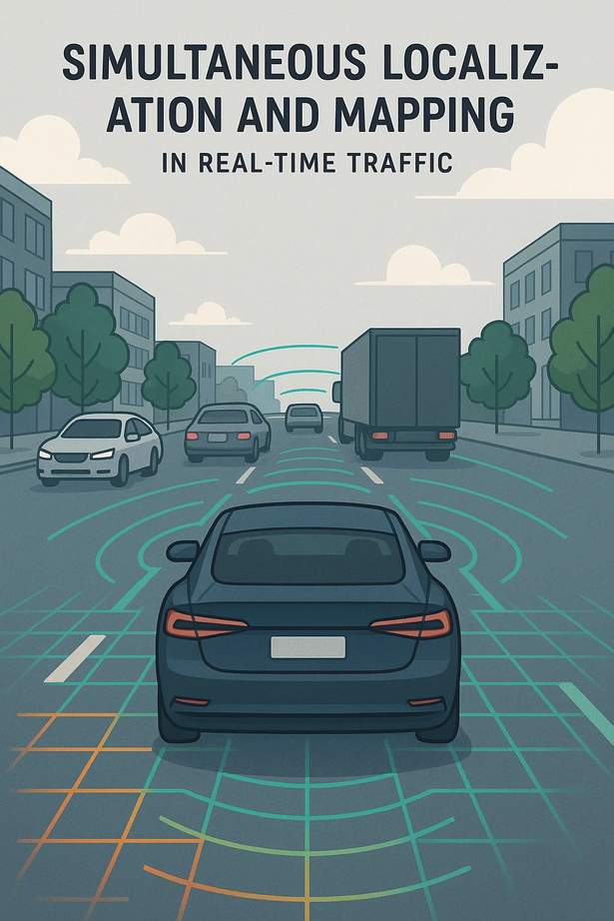
SLAM (VISUAL ODOMETRY)
•INPUT
Video frames from camera
•OUTPUT
Estimated camera pose position (x, y, z) and orientation (yaw)
•GOAL
Track camera motion frame by frame using key point matching
Maintain a reliable trajectory for integration with detection results
•INTEGRATION
Pose data stored in JSON along with YOLO detections
Enables Edge system to combine “what objects are present” with “where the camera is” for better decision-making

Slide 11
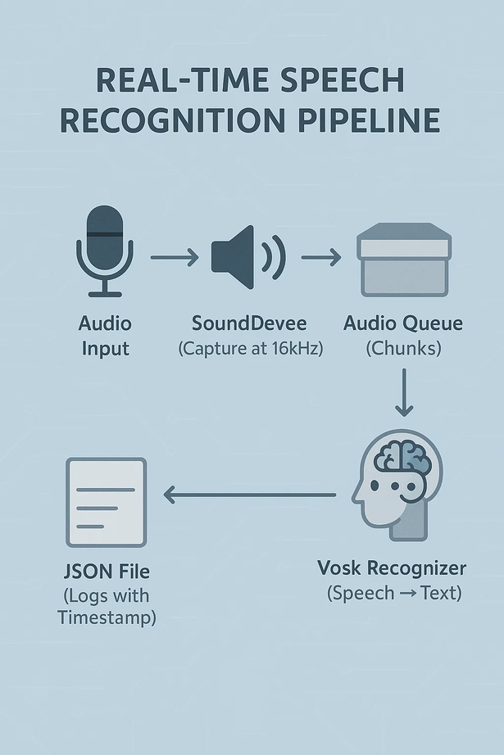
VOICE RECOGNITION
Loads the Vosk speech recognition model for audio-to-text conversion.
Captures live microphone input using the SoundDevice library.
Stores audio data in a queue for smooth real-time processing.
Converts audio chunks to text at 16 kHz sampling rate.
Attaches timestamps to each recognized text segment.
Saves the output as structured JSON logs for later use.

Slide 12
LANE DETECTION
INPUT
VIDEO FRAMES FROM CAMERA
OUTPUT
DETECTED LANE BOUNDARIES OVERLAID ON ROAD
GOAL
IDENTIFY AND HIGHLIGHT LANE LINES IN REAL TIME
ASSIST DRIVER/VEHICLE TO STAY WITHIN LANES
ENABLE SAFE AUTONOMOUS NAVIGATION
PROCESS
CONVERT FRAMES TO GRAYSCALE
APPLY GAUSSIAN BLUR TO REMOVE NOISE
PERFORM CANNY EDGE DETECTION
MASK REGION OF INTEREST (ROAD ONLY)
USE HOUGH TRANSFORM TO DETECT LANE LINES
OVERLAY DETECTED LANES ON ORIGINAL FRAME

