Slide 1


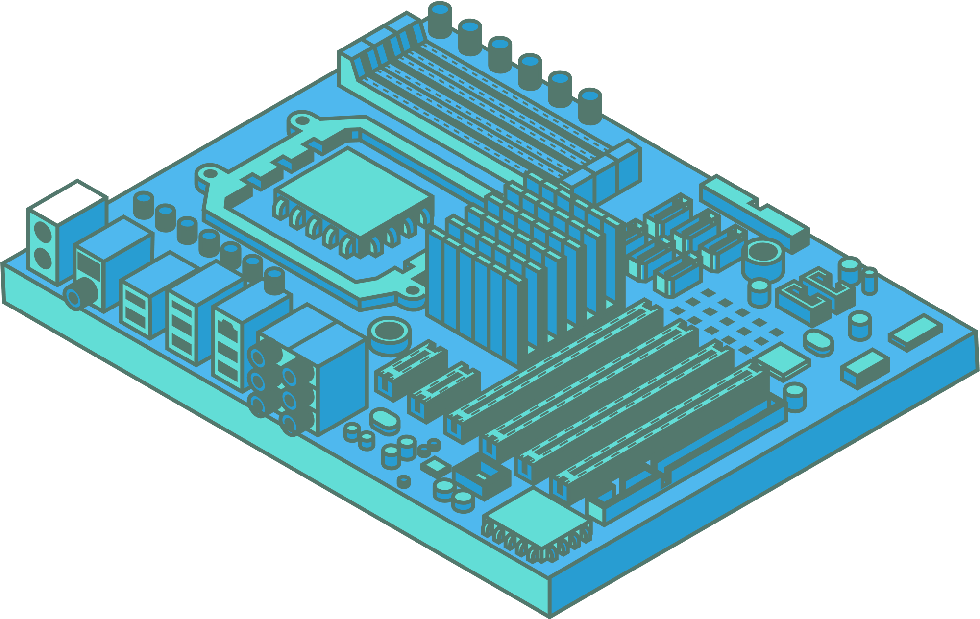
Edge-Based Hybrid System Implementation for Long-Range Safety and Healthcare IoT Applications
HEALTHCARE IOT

Slide 2


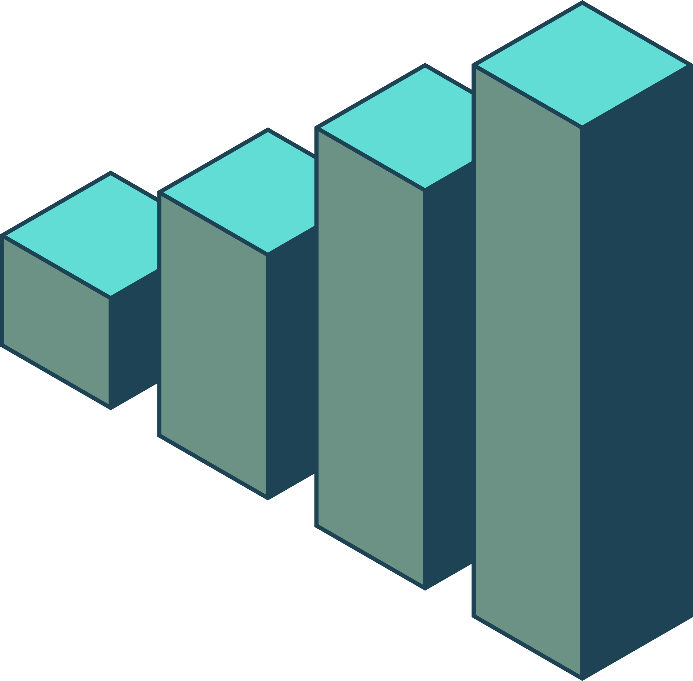
01
Problems in Healthcare IoT
THE CORE PROBLEM: SHORT-RANGE PROTOCOLS IN HEALTHCARE ENVIRONMENTS
To achieve broader coverage for these devices, conventional solutions require deploying multiple gateways, leading to significant inconvenience, increased costs, and added complexity in network infrastructure.
HIGH LATENCY & DELAYS
NETWORK BANDWIDTH BOTTLENECKS
INTERMITTENT CONNECTIVITY RISKS
PRIVACY AND SECURITY CONCERNS
CLOUD CENTRIC

Slide 3
02
How the Proposed Edge System Transforms Healthcare IoT
This paper introduces a novel hybrid edge architecture, integrating self-powered hybrid routers and a versatile IoT gateway, specifically designed to overcome the limitations of cloud-centric IoT in healthcare.
It strategically distributes computational and storage capabilities closer to the data sources, ensuring robust and responsive healthcare monitoring.
SIGNIFICANTLY REDUCED LATENCY FOR REAL-TIME CARE
EXTENDED NETWORK COVERAGE IN LARGE FACILITIES
ENHANCED RELIABILITY & OFFLINE OPERATION
STRENGTHENED SECURITY & PRIVACY
VERSATILE APPLICATION SUPPORT

Slide 4
03
Justification of the Hybrid Edge Strategy & Architecture
The paper's core strategy is to implement an edge-based hybrid network system that strategically distributes computational and storage capabilities closer to the data sources.
It specifically tackles the problem of limited short-range coverage by integrating long-range capabilities at the edge, reducing the need for numerous, costly gateways.
Hybrid Router
IOT Gateway
Low power + robust
Powerful hub within edge
LoRa based LPWAN
Centralized point
Preliminary Processing
advanced edge tasks

Slide 5
Edge Implementations
04
HYBRID ROUTER
IOT GATEWAY
RANGE EXTENSION
ADVANCED PROCESSING AND NETWORK MANAGEMENT
PRELIMINARY DATA PROCESSING
LOCAL GUI
SeCURITY
PROMPT RESPONSES/EMERGENCY DETECTION
CLOUD CONNeCTION

Slide 6
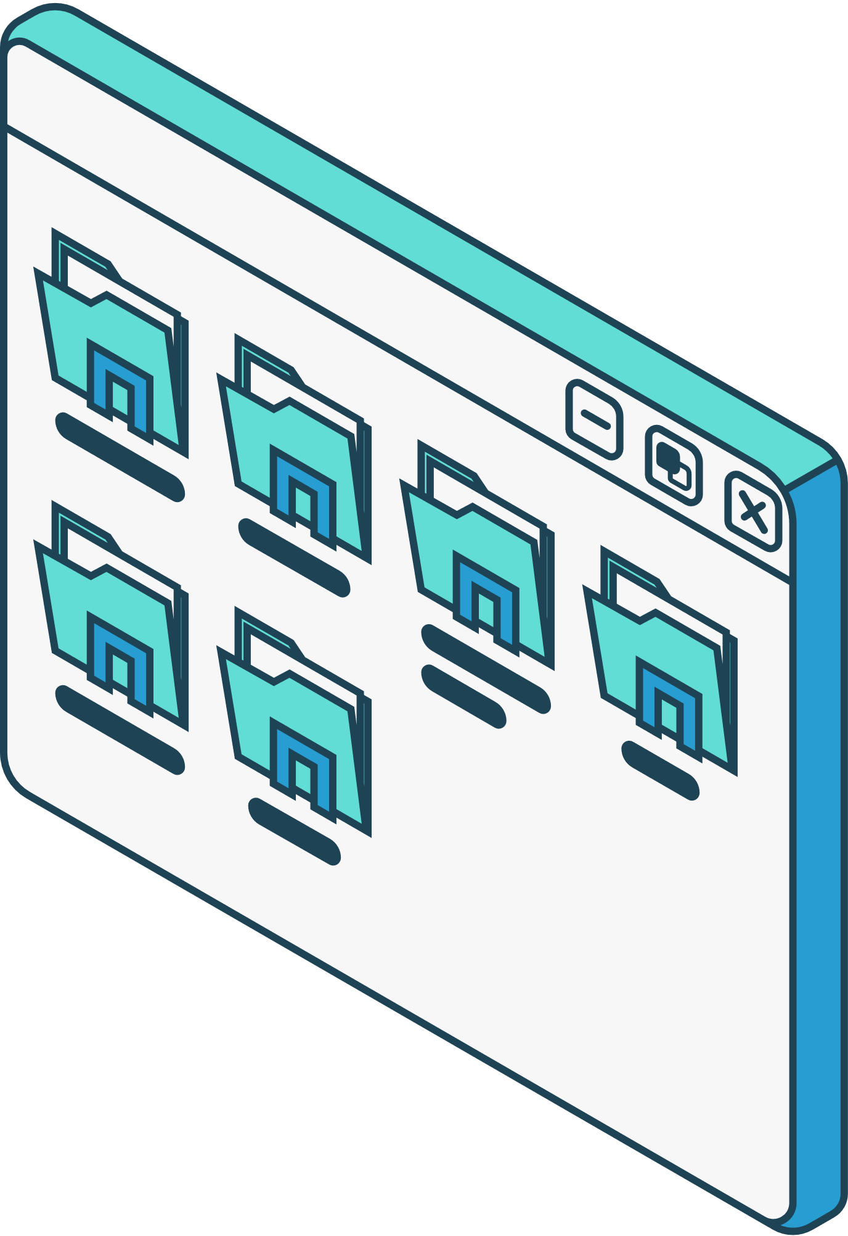
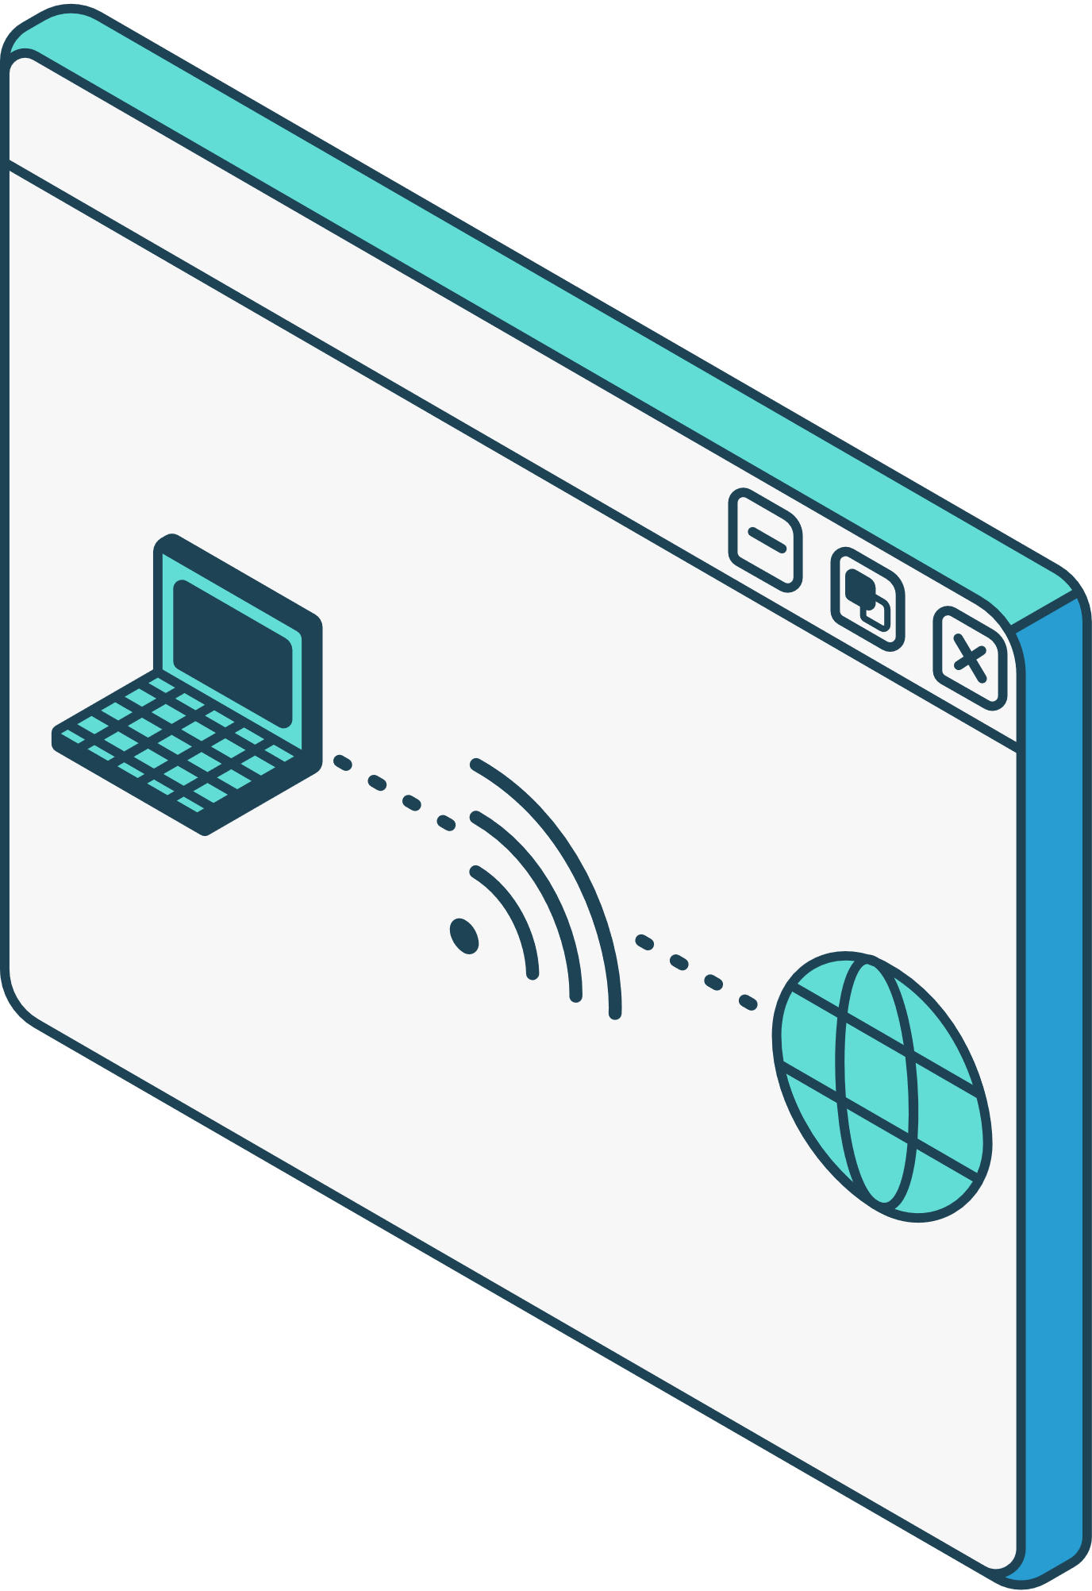
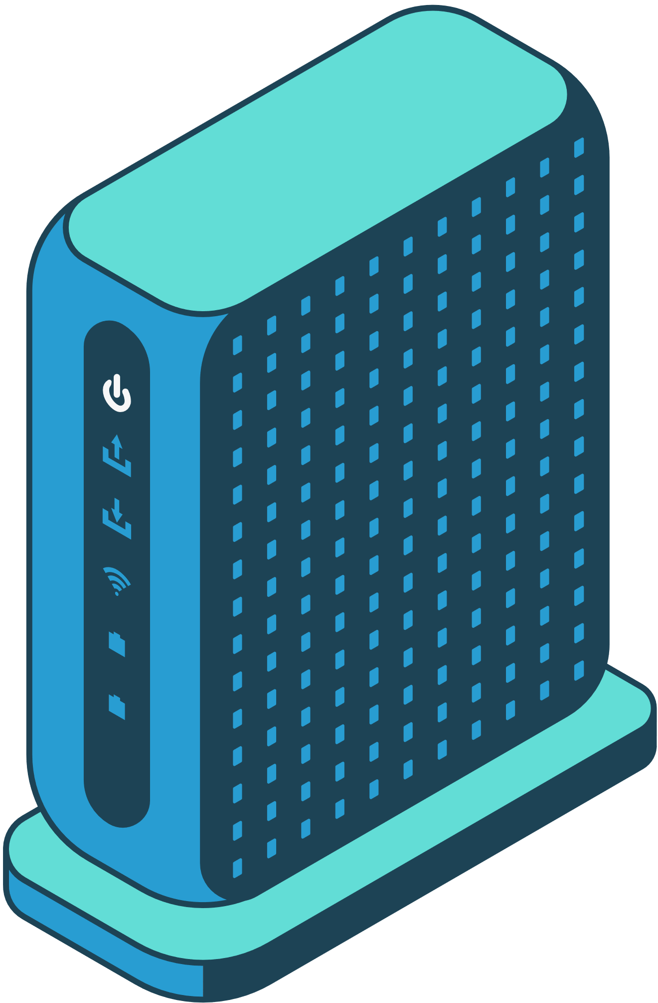
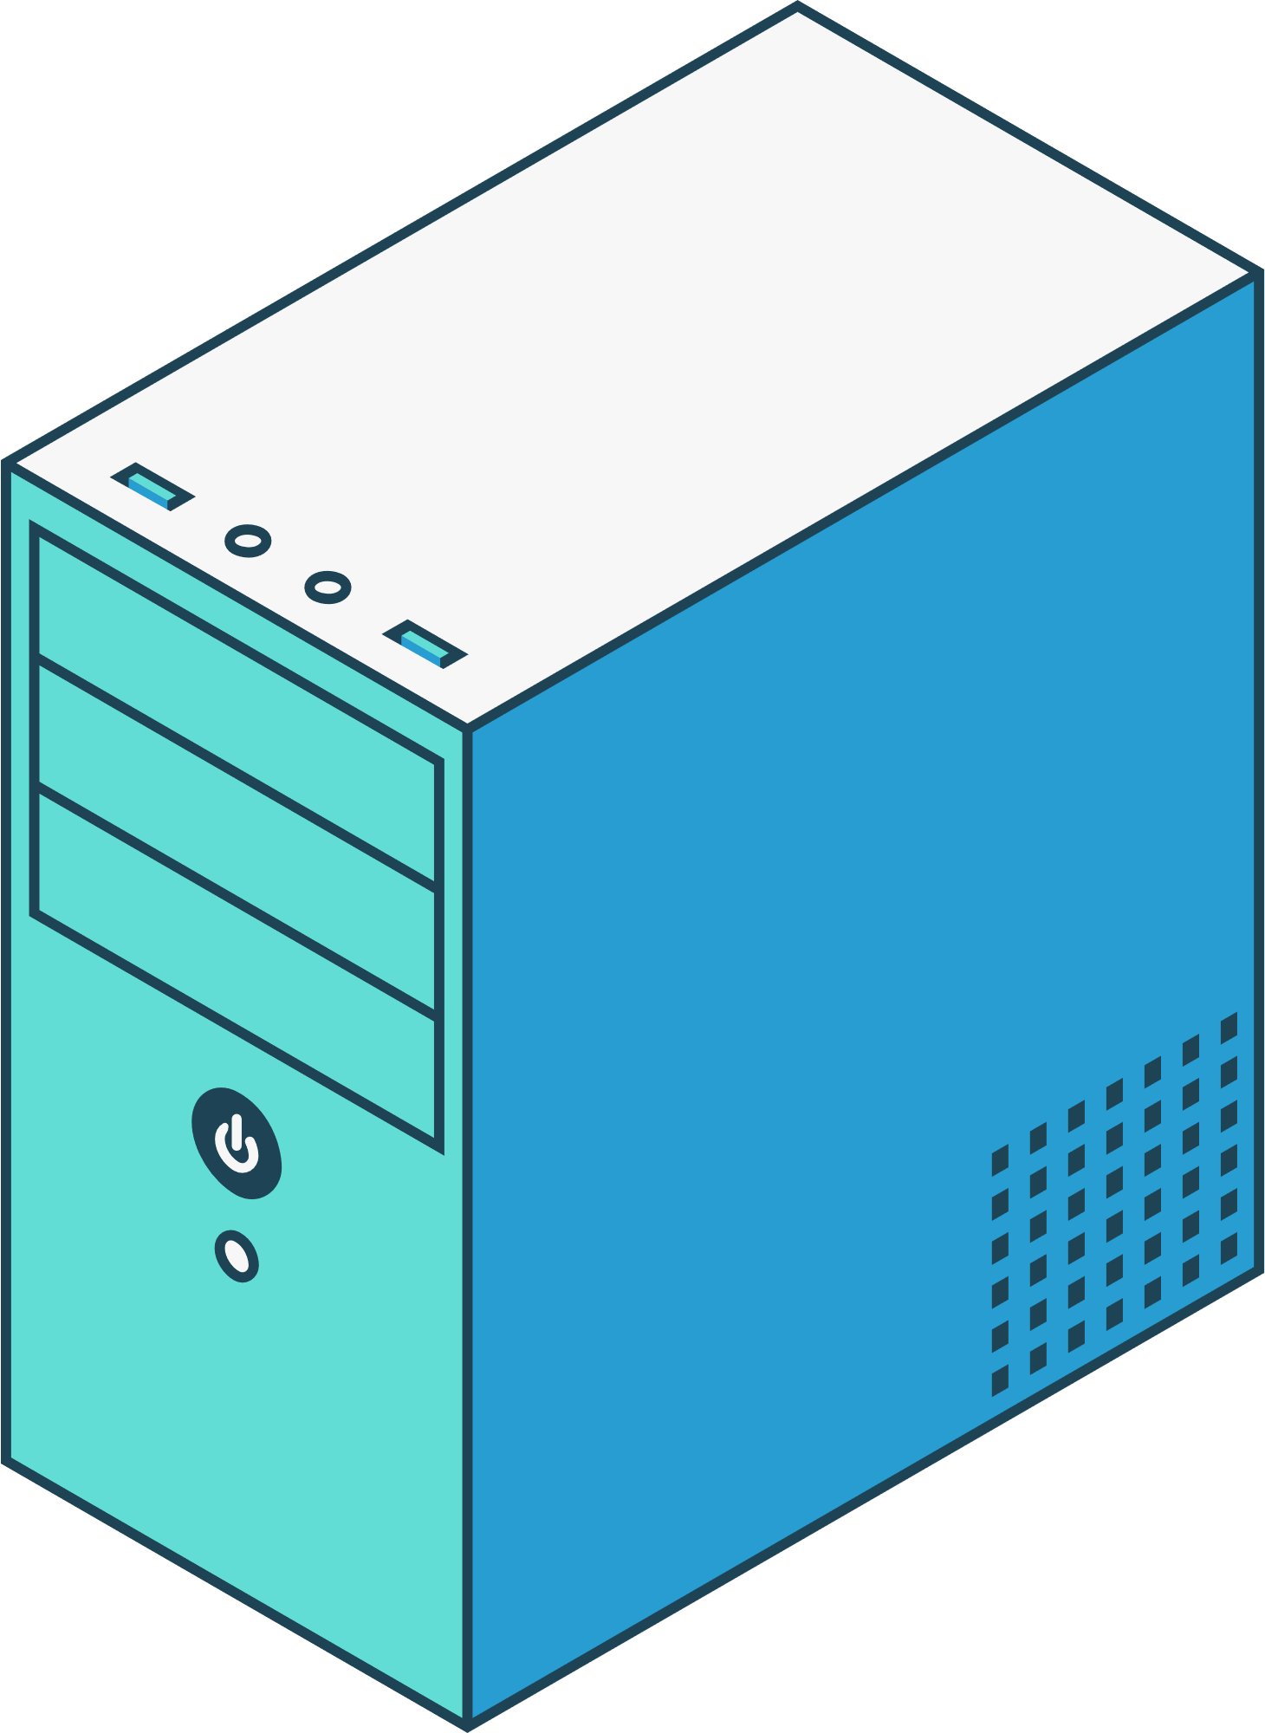
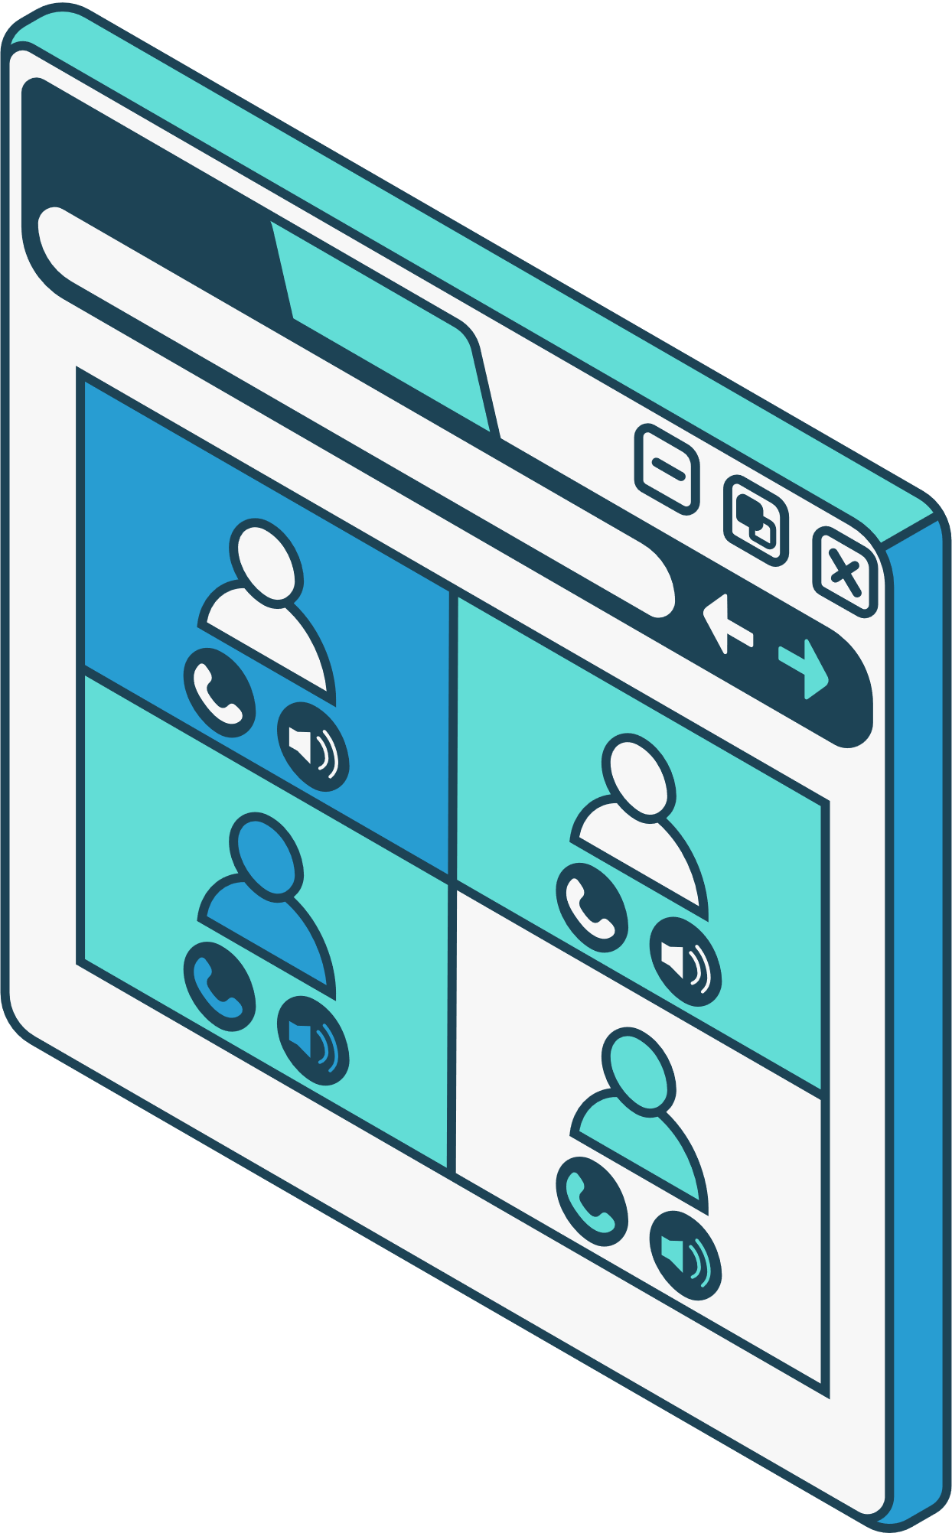
05
Components for the Implementation
WEARABLE HEALTHCARE SENSOR NODE
Employs the AD8232 ECG front end to measure ECG signals or Synthetic ECG signals to mimic real ECG signals
HYBRID ROUTER
UTILIZes a Nordic nRF52840 MCU with BLE 5 and a LoRa module.
IOT GATEWAY
Based on Raspberry Pi with LoRa, BLE, and WiFi modules.

Slide 7
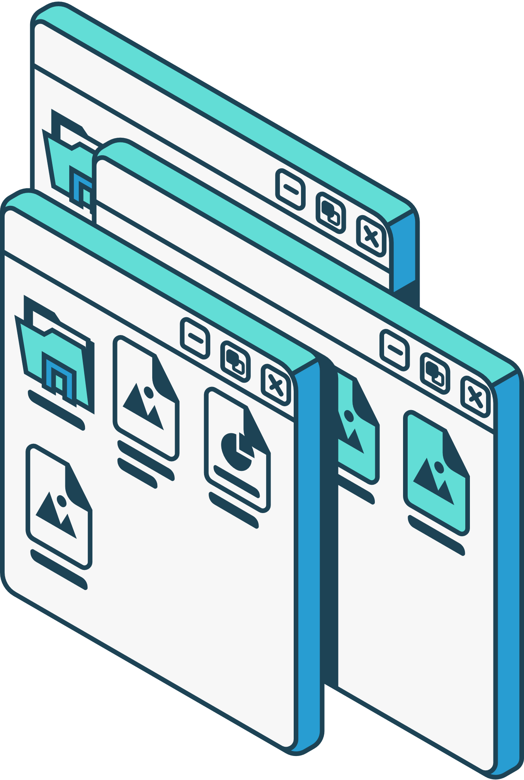
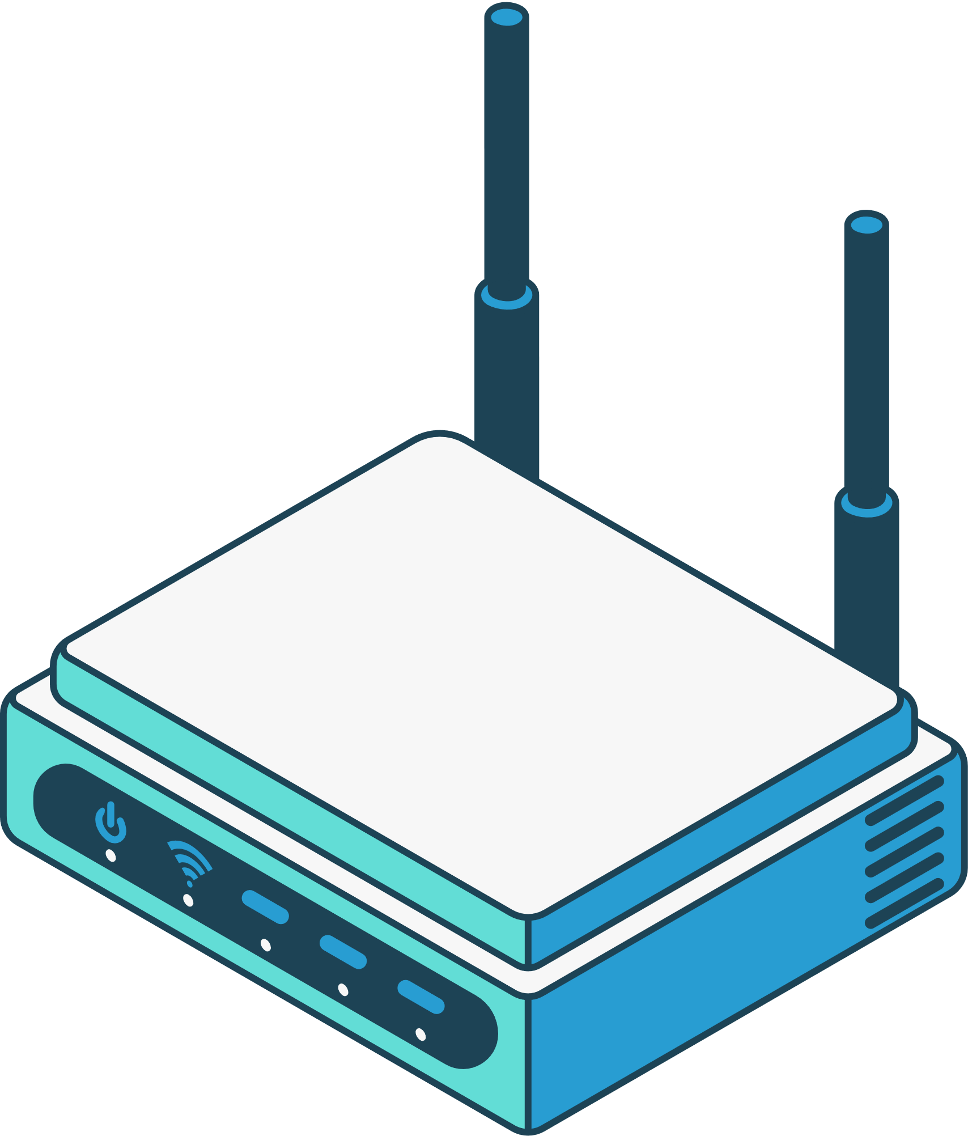
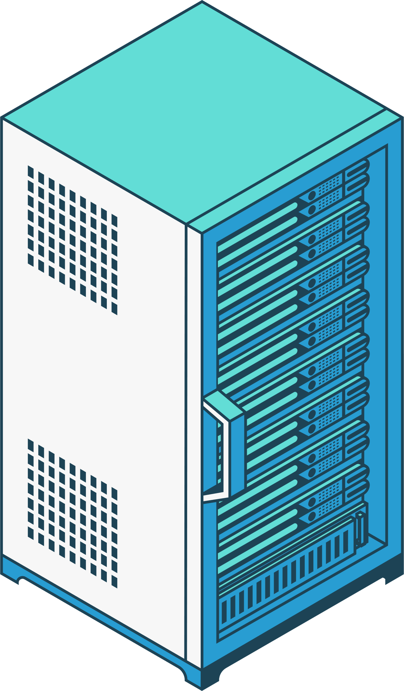
06
State of the Art Literature
1. Recent Advances in Wearable Sensing Technologies
by Alfredo J Perez, Sherali Zeadally
Focus: The safety measures discussed center around device communication reliability, data integrity during short-range transmission, and real-time local responsiveness
2. Recent Advances on IoT-Assisted Wearable Sensor Systems for Healthcare Monitoring
by Shwetank Dattatraya Mamdiwar, Akshith R, Kathiravan Srinivasan, Chuan-Yu Chang
Focus: The paper examines data transfer protocols and proximity-based patient monitoring, underscoring mechanisms for user and device authentication in closed environments.
3. The Rise of Wearable Devices during the COVID-19 Pandemic
by Asma Channa, Nirvana Popescu, ustyna Skibinska, Radim Burget
Focus: Systematic review of wearable devices deployed for real-time, short-range health monitoring

Slide 8
06
State of the Art Literature
- Explicit Long-Range Safety Support
- Unified Hybrid Network Architecture
- Edge Computing for Both Proximity and Remote Scenarios
- Energy Efficiency and Autonomous Operation
- Comprehensive Security Handling
- Real-World, Multi-Scenario Validation
- Network Scalability and Robustness

Slide 9
07
Why Resource Allocation Matters ?
Real-time health data (HR, SpO₂) is variable and continuous
Edge devices (e.g., Raspberry Pi) have limited power
Delays can risk patient safety
Smart allocation = low latency, high efficiency
KEY CHALLENGES ADDRESSED
Task Scheduling: Prioritize urgent health tasks
Task Offloading: Shift load → wearable → edge → cloud
Load Balancing: Prevent overload on nodes
Communication Overhead: Smart use of BLE & LoRa
Security & Efficiency: Lightweight protection for data

Slide 10
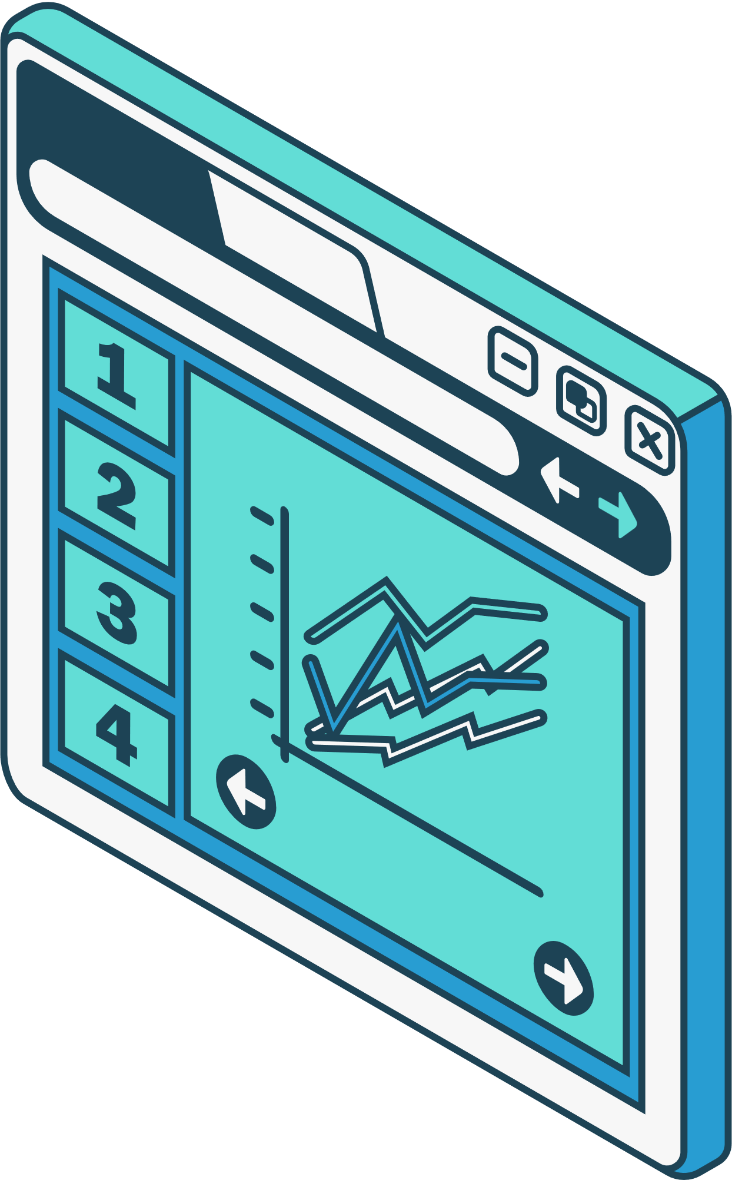


08
Task split up
Module understanding +Router programming
Gateway optimization + cloud synchronization
Edge tasks - data processing + filtering
Assembly and deployement of hardware

Slide 11
09
Thank You
BHUVANESHWARI D CB.SC.U4CSE23612
RAMA ROSHINEE S V CB.SC.U4CSE23645 SHRUTHILAYA A V CB.SC.U4CSE23653
SHARUMATHI PS CB.SC.U4CSE23665

