Slide 1

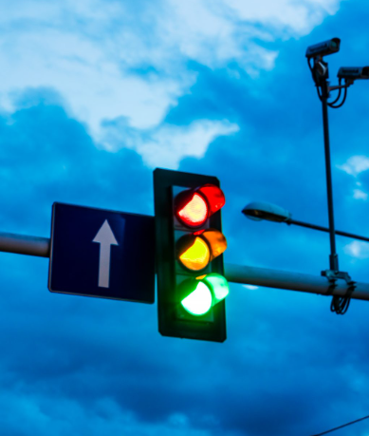

Adaptive and Traffic Signal
Control using Fog and RL
Review-2

Slide 2

Updates from Review 1
Place ANN at Edge
ANN is deployed at each Edge device.
Not only collects data , but computes a risk score
Fog Node as Coordinator (Not Controller)
Fog aggregates edge outputs and ensures multi-intersection coordination
Edges take priority in direct signal switching.
Edge-to-Edge Direct Communication
Neighboring Edges exchange risk scores and queue lengths
Promotes corridor-level smooth flow without waiting for Fog decisions.

Slide 3
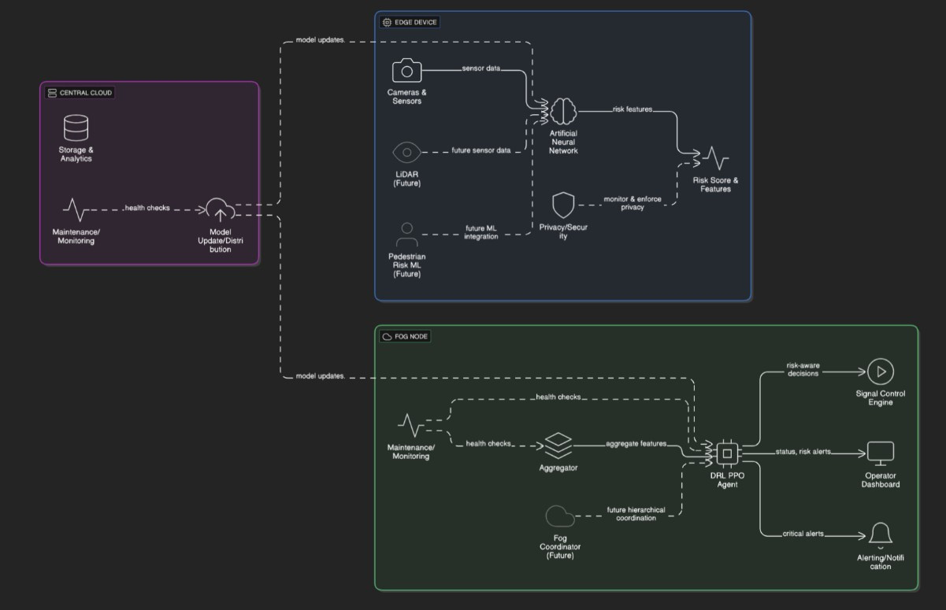
Combined Architecture

Slide 4

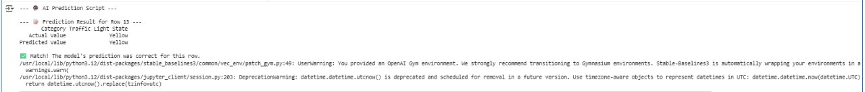
Algorithm
A Deep Reinforcement Learning (DRL) agent is used to decide on whether the traffic light should be green, yellow, or red based on the data from sensors.

Slide 5
An Artificial Neural Network (ANN) is used for this task. The ANN is trained to detect the objects on the road and calculate the risk score based on the image.
This risk score is taken into account after the DRL decides which traffic light should be turned on.
And the traffic light to be turned on will be decided.

Slide 6
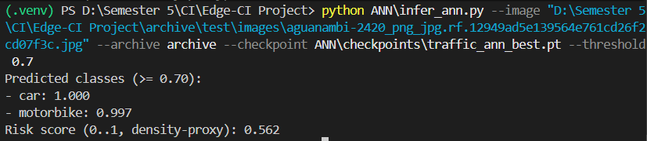
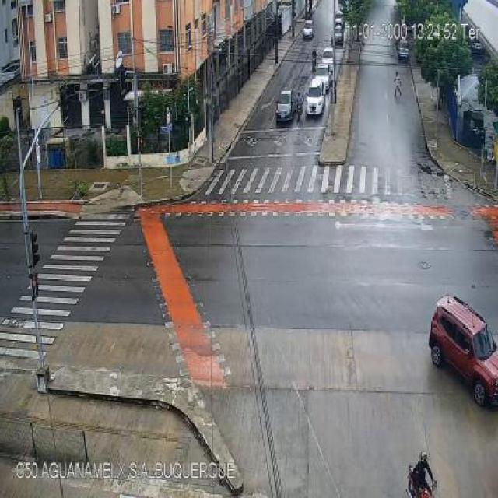

Slide 7
IMPLEMENTATION
python control_hybrid_with_ann.py --cfg osm.sumocfg --gui --ann traffic_ann_best.pt --yellow 30 --threshold 0.8 --steps 100
This script connects to SUMO via TRACI
and results gets saved to traffic_history.csv

Slide 8

Feel free to reach out for questions!
THANK YOU

