Slide 1
Zywa Analysis
Zywa Assignment Analysis

Slide 2
Financial Healthiness
Contents
01
02
Problem statement
03
Observations
04
SQL Queries
05
Data Visualization

Slide 3
payments app and card for
the next generation

Slide 4

Introduction
Harshitha Ajay
Thank You for providing me an opportunity by shortlisting to work at Zywa as Analyst
https://www.linkedin.com/in/harshitha-ajay-820441251/
https://www.datascienceportfol.io/Harshitha_Data_Lab

Slide 5

Vision and Mission
To shape the financial landscape for the next generation and beyond. We strive to create a future where financial freedom and literacy is a fundamental right for all, starting with Gen Z..
.
.

Slide 6

Problem Statement
Utilize SQL queries to extract and transform merchant data, integrating it into Power BI for comprehensive analysis. Investigate sales patterns, customer demographics, and product performance to derive actionable insights, facilitating strategic decisions and enhancing business profitability.

Slide 7
Monthly transactions
Need how much amount we have processed each month commutative and every month.
Daily Revenue Trend:
Formulate a SQL query to visualize the daily revenue trend over time.
Most Popular Products/Services:
Design a SQL query to identify the top 5 most popular products or services based on transaction counts.
Retention Rate:
Design a SQL query to calculate the Monthly Retention Rate, grouping users into monthly cohorts.
Average Transaction Amount by Product Category:
Formulate a SQL query to find the average transaction amount for each product category.
Transaction Funnel Analysis:
Create a SQL query to analyze the transaction funnel, including completed, pending, and cancelled transactions.

Slide 8
SQL Queries
SELECT YEAR(transaction_timestamp) AS year, MONTH(transaction_timestamp) AS month, SUM(transaction_amount) AS monthly_amount, SUM(SUM(transaction_amount)) OVER (ORDER BY YEAR(transaction_timestamp), MONTH(transaction_timestamp)) AS cumulative_amountFROM transactionsgroup by YEAR(transaction_timestamp), MONTH(transaction_timestamp)order by year, month;
2. SELECT count(merchant_type), merchant_type from transactions group by merchant_type order by 1 desc limit 5;
3. SELECT billing_amount, transaction_timestamp from transactions group by 2;SELECT YEAR(transaction_timestamp) AS year, MONTH(transaction_timestamp) AS month, SUM(billing_amount) AS monthly_amount, SUM(SUM(billing_amount)) OVER (ORDER BY YEAR(transaction_timestamp), MONTH(transaction_timestamp)) AS Total_amountFROM transactionsgroup by YEAR(transaction_timestamp), MONTH(transaction_timestamp)order by year, month;
4. SELECT avg(transaction_amount) as Avg_Trasaction_Amt, merchant_name from transactions group by 2;SELECT distinct(merchant_name) from transactions;
5. SELECT transaction_type, COUNT(*) AS total_transactions from transactions group by transaction_type;
6. with masters as(Select id, extract(month from transaction_timestamp) as months, transaction_timestamp from transactions),consolidated as (select this_month.months,this_month.id as current_month_customer, last_month.id as last_month_customer from masters this_monthleft join masters last_month on this_month.id = last_month.id and this_month.months-last_month.months=1)Select months, count(distinct(current_month_customer)) as current_month, count(distinct(last_month_customer)) as prev_customers from consolidatedgroup by months;

Slide 9
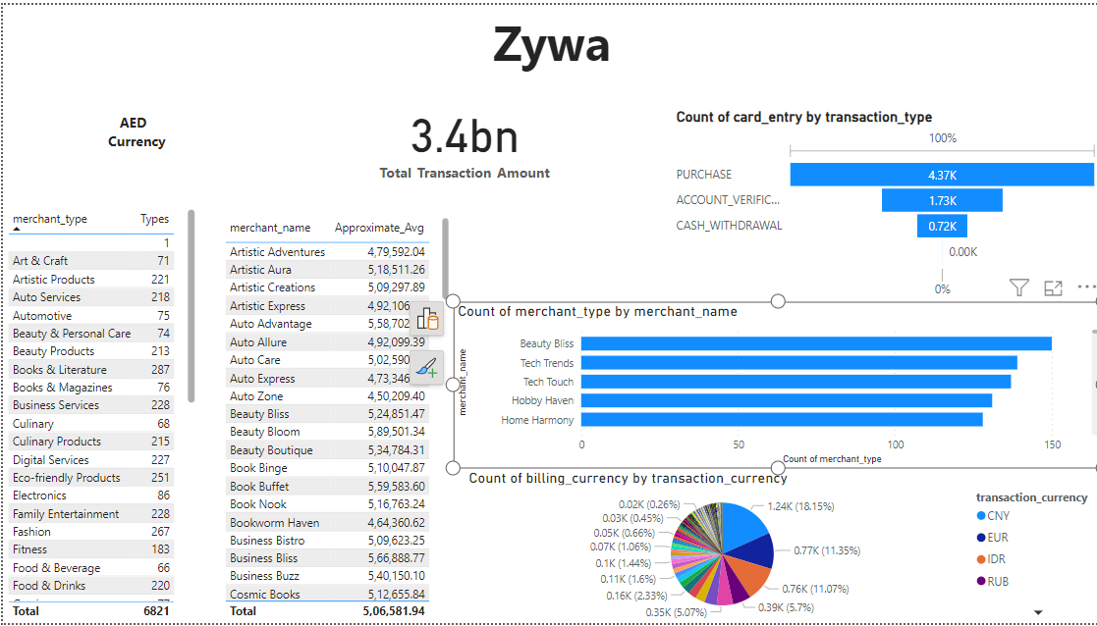

Slide 10
Thank You
Zywa

