Slide 1
Secure data hiding In image using steganography
Presented By: NANDINI TELE
Student Name : NANDINI TELE
College Name & Department :NRI Institute of Technology (CSE)

Slide 2
OUTLINE
Problem Statement
Technology used
Wow factor
End users
Result
Conclusion
Git-hub Link
Future scope

Slide 3
Problem Statement
The project focuses on embedding secret messages into images using steganography techniques. The goal is to provide a secure way to hide information inside images while maintaining their visual integrity. This involves developing methods to encode and decode hidden messages within images, ensuring that the hidden data is not easily detectable by unauthorized users. The project aims to enhance the security of data transmission and storage by leveraging the principles of steganography.

Slide 4
Technology used
Python:Widely used for developing steganography algorithms due to its simplicity and extensive libraries.
OpenCV: A robust library for image processing, allowing for manipulation and analysis of images.
Tkinter: A Python library used for creating graphical user interfaces (GUIs) to make the steganography application user-friendly.
Cryptography Libraries: Libraries such as PyCryptodome or cryptography are used to encrypt hidden data before embedding it into images, adding an extra layer of security.
Image formats: Common image formats like JPEG and PNG are utilized as carriers for the hidden data.
Least Significant Bit (LSB) Technique: A popular method for embedding data into images by modifying the least significant bits of pixel values.
Discrete Cosine Transform (DCT): Used in JPEG compression, this technique can also be employed for hiding data in the frequency domain of an image.
Wavelet Transform: Another method for embedding data in the frequency domain, providing better resistance to image processing attacks.

Slide 5
Wow factors
Incorporating “wow factors” into a project on secure data hiding in images using steganography can significantly enhance its appeal and effectiveness. Here are some innovative ideas and features that could serve as wow factors for your project: 1.Real-Time Data Hiding and Extraction Implement a feature that allows users to hide and extract data in real-time, providing instant feedback and visualization of the changes in the image. 2. Multi-Layered Security Combine steganography with encryption and watermarking. For example, encrypt the data before embedding it and add a digital watermark to the image to verify its authencity 3. Adaptive Steganography Use machine learning algorithms to adaptively choose the best pixels for data embedding based on the image content, ensuring minimal distortion and maximizing capacity. 4. User –Friendly Interface with Visual Feedback Create an intuitive graphical user interface (GUI) that visually represents the embedding process, showing how much data can be hidden and the quality of the stego image in real-time. 5. Support for Various Media Types Extend the application to support not just images but also audio and video files, allowing users to hide data in multiple formats.

Slide 6
End users
Cybersecurity Professionals: They use steganography to ensure secure communication and protect sensitive information from unauthorized access. Journalists and Whistleblowers: For discreet data sharing, steganography provides a way to hide information within images, making it less likely to be detected. Law Enforcement and Forensic Teams: They use steganography for evidence hiding and secure communication during investigations. Privacy-Conscious Individuals: People who want to communicate securely and privately can use steganography to hide their messages within images. Digital Watermarking Applications: Steganography is used to protect digital assets by embedding hidden data within images, ensuring the authenticity and ownership of the content. These end users benefit from the security, robustness, and versatility that steganography offers in hiding and protecting sensitive information.

Slide 7
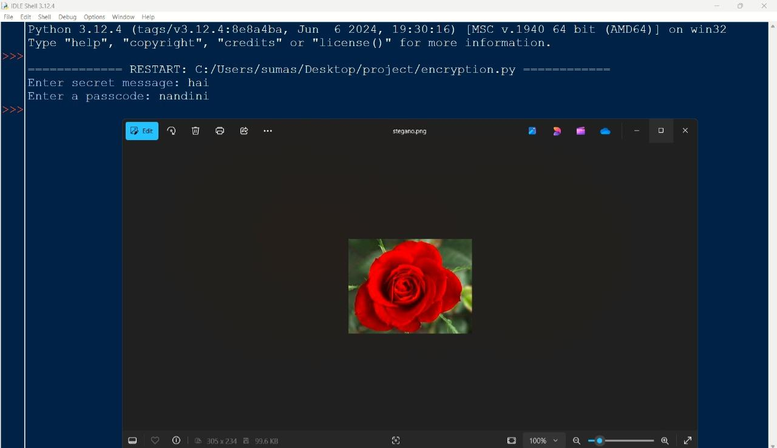
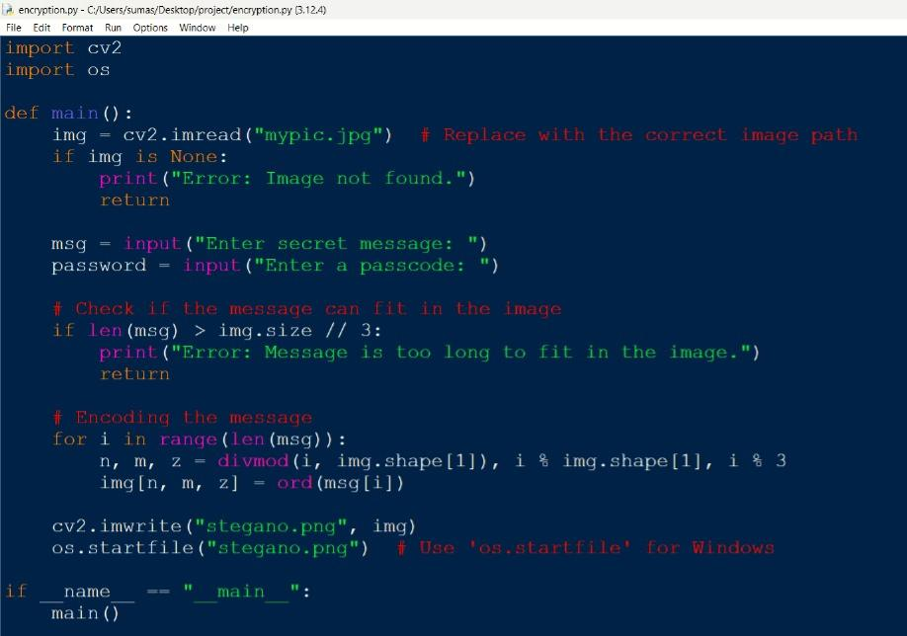
Results

Slide 8
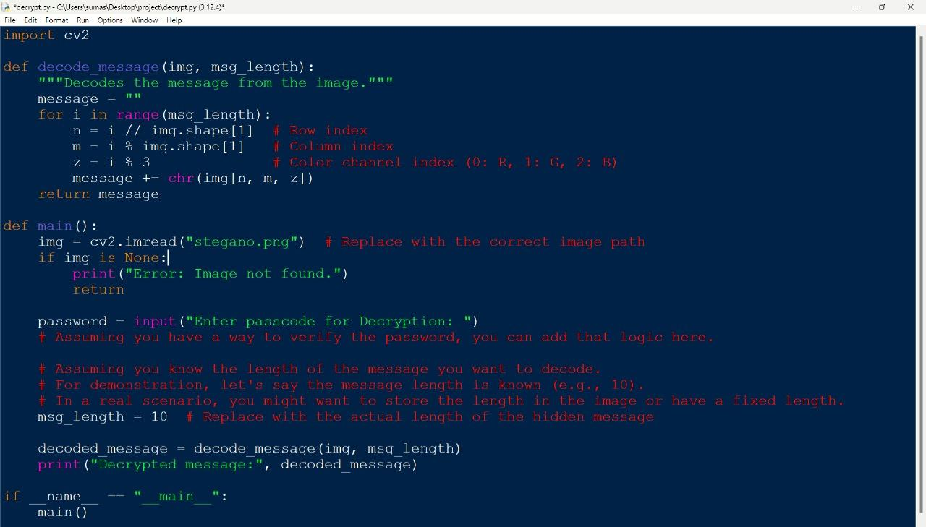
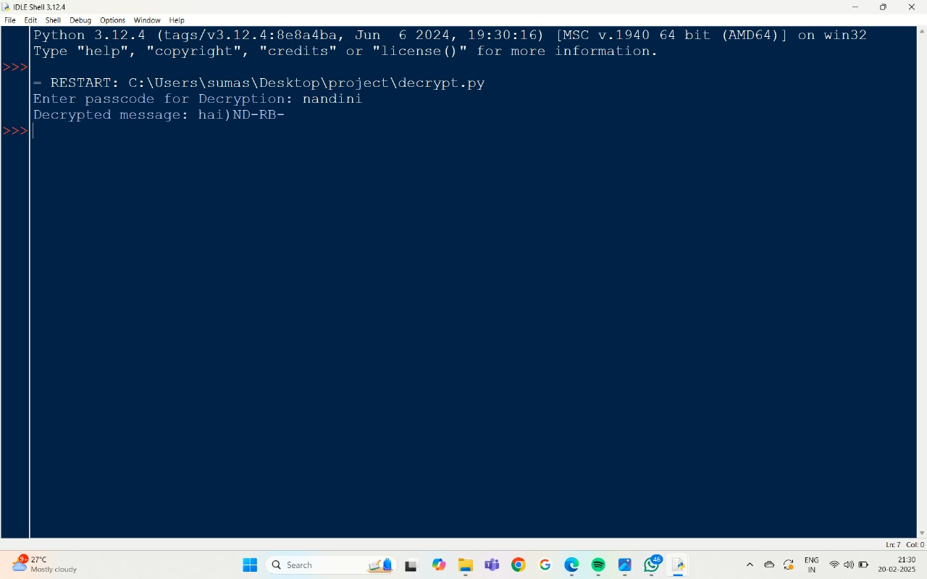
Results

Slide 9
Conclusion
Secure data hiding in images using steganography is a powerful technique for covert communication and data protection. It leverages the invisibility of hidden data, the robustness against image transformations, and the added security from encryption to ensure that sensitive information remains confidential. The versatility and capacity of modern steganographic methods make them suitable for various applications, including cybersecurity, digital watermarking, and secure communication. With its wide range of end users, from cybersecurity professionals to privacy-conscious individuals, steganography continues to be a valuable tool in the realm of data security and privacy.

Slide 10
GitHub Link
https://codespaces.new/23KN1A0560/descryption.py

Slide 11
Future scope(optional)
ADAPTIVE ALGORITHMS ANOMALY DETECTION AUDIO AND VEDIO STEGANOGRAPHY 3D MODELS AND TEXTURES ENHANCED SECURITY FEATURES

Slide 12


