Slide 1
Automated Insight Engine — Spotify Analysis
Auto-generated report

Slide 2
Dataset Summary
total_tracks: 3
unique_artists: 2
years_covered: 2018 - 2020
avg_popularity: 72.33333333333333
avg_duration_min: 3.3333333333333335

Slide 3
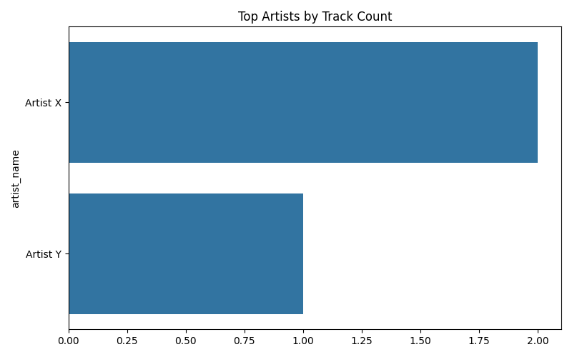
Top Artists

Slide 4
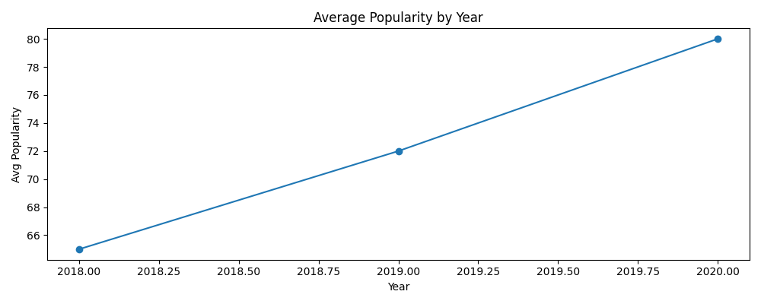
Popularity Trend

Slide 5
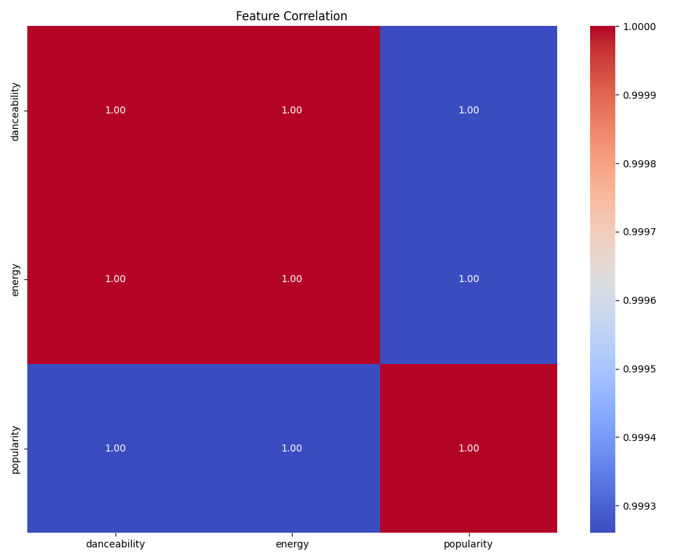
Feature Corr

