Slide 1
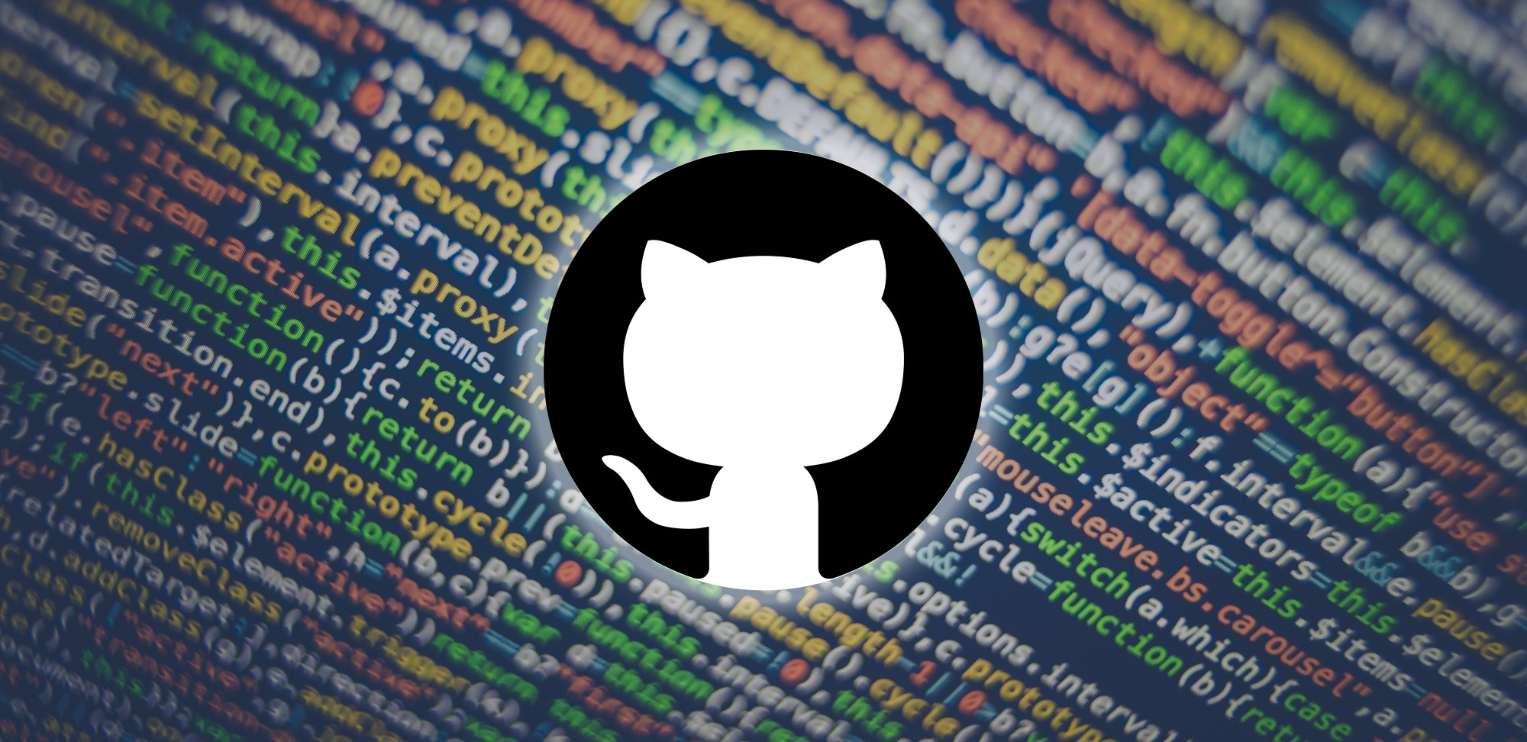
KHARAGPUR OPEN SOURCE SOCIETY
A LITTLE INSIGHT INTO GIT
AKANKSHAA PADHI

Slide 2
What is git:
It is a distributed version control system(vcs).
It is different from other vc systems because in Git, every developer's working copy of the code is also a repository that contains the full history of all changes.

Slide 3
Some concepts of git:
There are 4 important terms regarding Git:
Working repository: where you make your changes
Remote repository: the file you are wanting to clone. Its not in your system, you just make a clone of that file.
Local repository: a copy of the remote repo file in your system
Staging area: The new files you add and make changes in it before pushing the changes to the remote repository.

Slide 4
Suppose we have to make changes in this file:
https://github.com/UnseenWizzard/git_training.git
We first make a copy of the file:
git clone https://github.com/UnseenWizzard/git_training.git.
Then we copy it to our system:
git clone https://github.com/{YOUR USERNAME}/git_training.git
Now, the copy you have is the Local repository, the Working repository is changes you add in your file and the

Slide 5
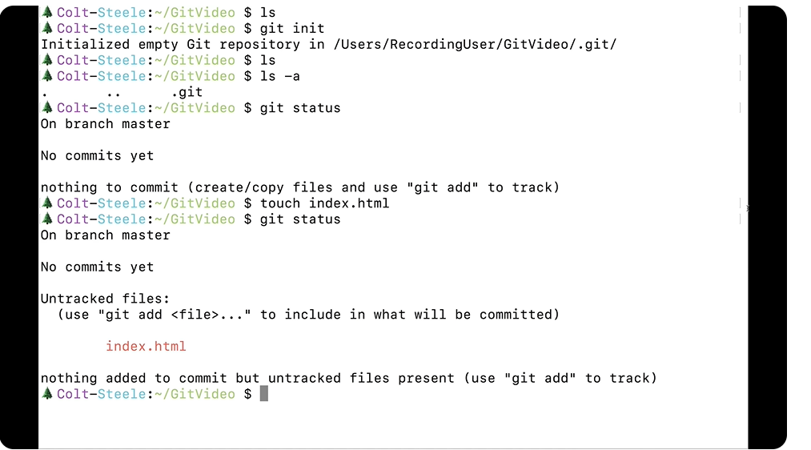

Slide 6
Some newer Git concepts:
git diff: Tells us about the changes we make after the last commit.
After we push our changes to the Remote Repo, we can make changes in our local repo and they are visible in by ‘git diff’ command.

Slide 7
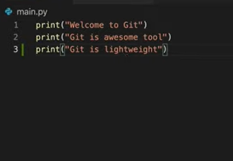
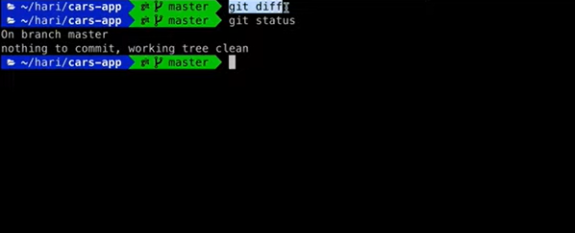
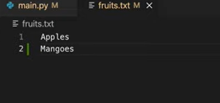
A code demo
Suppose we enter “git diff” immediately after last commit, we get this:
We add the last line in our .py file.
We add the last line in our .txt file
The working tree(working repo) is clean and devoid of any messages to commit.

Slide 8
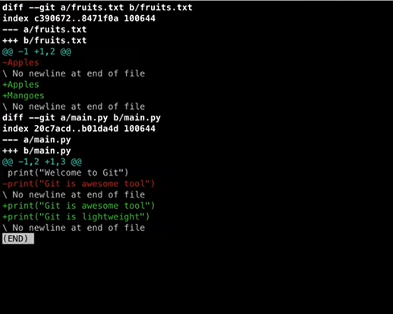
Let us see what happens if we enter our diff command again:
For little more clarity as to which changes are made after commit
we press git diff --color-words to highlight latest changes.
Notes:
git diff --color-words fruits.txt only shows changes in .txt file
git diff -m commit ‘Meaningful commit messages’

Slide 9
2. git stash:
Imagine you have 2 clean commits, 1 uncommitted code that is to be debugged and have to switch branches now…..
You use ‘git stash’ to “stash” or save your uncommitted code in the current feature.
You can apply ‘git stash apply’ for adding the temporarily saved code to working area.

Slide 10
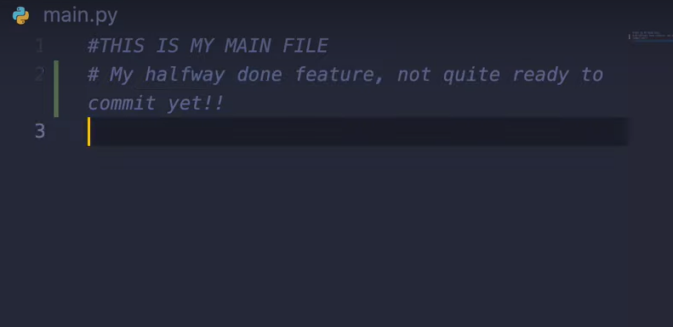

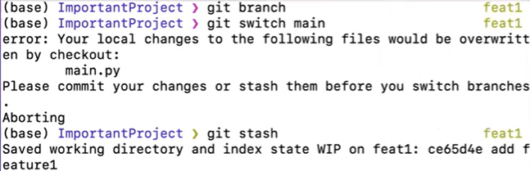
Suppose I have the following .py file with the last line as the uncommitted code.
After ‘git stash’ / ’git stash save’ we see that the working area has been cleaned and the uncommitted code has been saved in the current branch.
#THIS IS MY MAIN FILE is the latest commit
The stash ID is mentioned so that you can use it to commit.
Notes:
Git stash pop is used to add most recently stashed code into working area

Slide 11
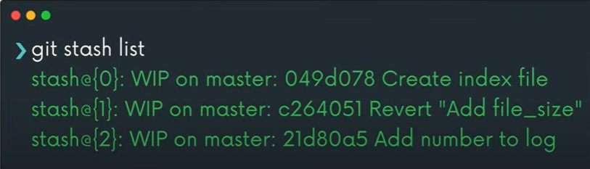


git stash more features:
git stash apply: applies the changes to multiple branches
git stash list:
Imagine you have 45 code snippets you gave stashed and have to add one to the working area. It is impossible to remember the stash order.
So just write ‘git stash list’ to obtain a whole list of recent stashed codes and apply accordingly.
Notes:
You can remove stashes individually by using git drop, or remove all stashes by using git stash clear.

Slide 12
3. git bisect: Detects which commit is good or bad
$ git bisect start
$ git bisect bad 8d4615b9a963ef235c2a7eef9103d3b3544f4ee1
This instructs the Git to start finding bad commits and remove them.

