Slide 1
Auto Assign and Escalate
Team: ESCALATION ENGINEERS
Team Members: YERRASMSETTI SAI TEJA
PINNINTI DIVYA
CHINTA ASRITHA
KANTIPUDI VARSHITHA
YALLA VINAY
MANDALA RAGHU

Slide 2
The Challenge & Our Solution
High volume support requests from multiple channels
Manual assignment delays & missed SLAs
Critical cases overlooked
ServiceNow automated workflow
Faster resolution & consistent service

Slide 3
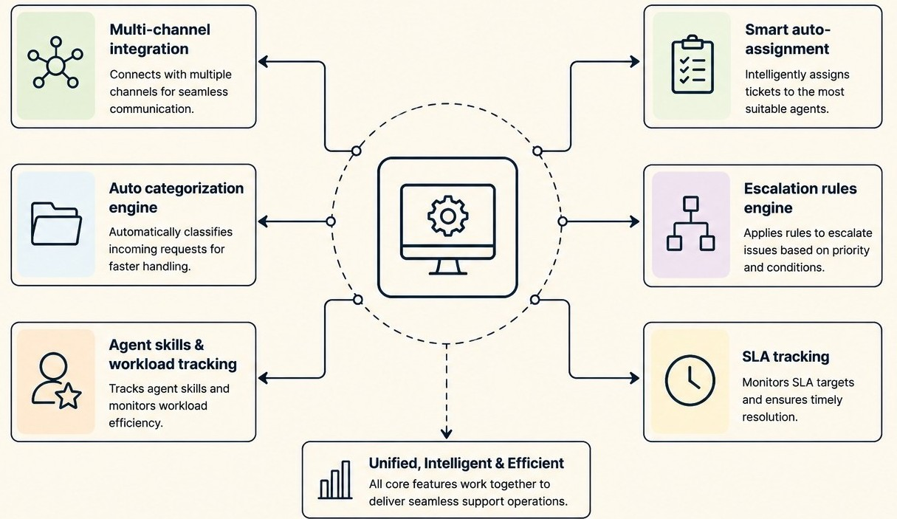
Core System Features
Multi-channel integration
Auto categorization engine
Agent skills & workload tracking
Smart auto-assignment
Escalation rules engine
SLA tracking

Slide 4
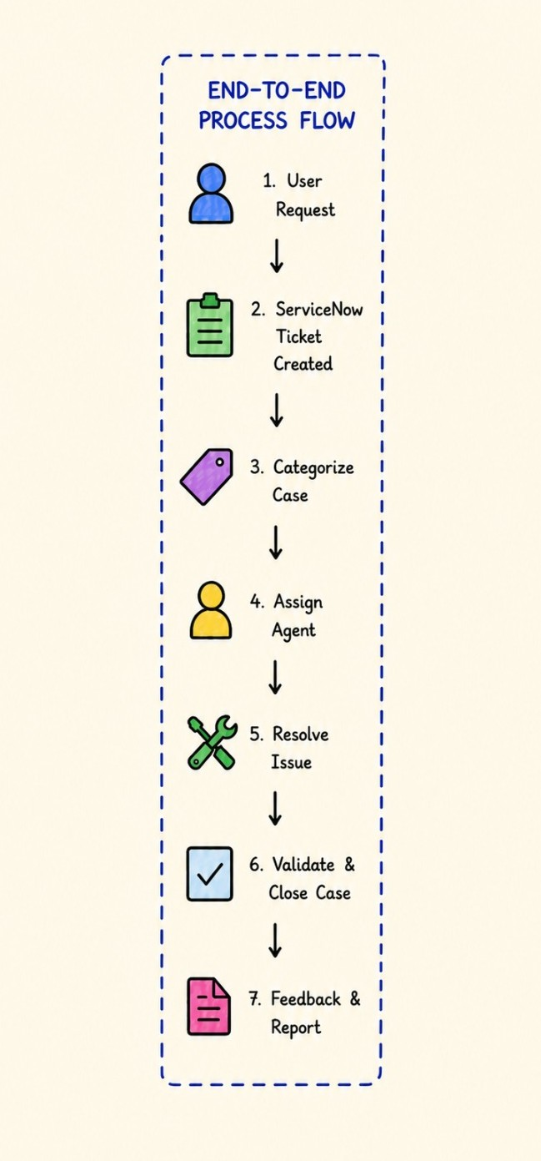
How It Works
Case received → categorized
Match skills & workload
Auto assign & start SLA
Monitor via dashboard
Escalate when needed

Slide 5
Team & Learnings
Escalation Engineers overview
Built automation workflow
Learned SLA & escalation logic
Hands-on ServiceNow
Thank You

