Slide 1

Department of Mechanical Engineering IIT Jodhpur ~6 May, 2022
Design Credit Project Title:
Design of significant joint motions of an upper body exoskeleton.
Submitted by: ~Nilesh(B20ME050)
Under Supervision of: ~Dr. Jayant Kumar Mohanta

Slide 2
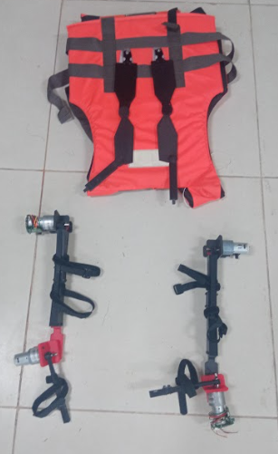
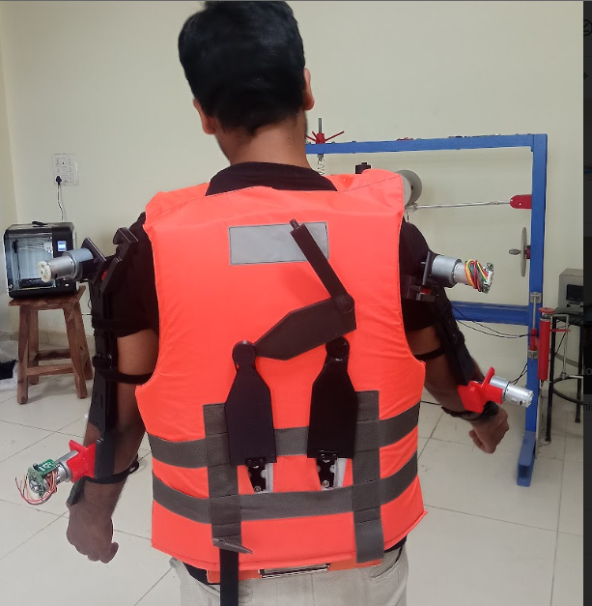

Exoskeleton
It is rigid envelope that supports and protects the soft tissues of certain animals.
Human exoskeletons, an invention that first showed up in the 1960s, designed for various applications.
Work :
They can replace kinematics and
dynamics of human bodies and
support upper limb motion.
Wide Applications:
Medical Rehabilitation(Disabled peoples)
Military(for heavy weapons)
Manufacturing(for load lifting)
In road accidents(cranes)

Slide 3
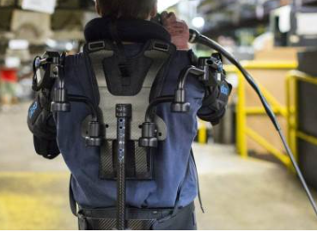
Objective
The objective of this project is to make such wearable machines
that can enhance human strength and endurance, thereby reducing
the risk of worker injury through the transference of weight and load
forces from the body to a motorized, external frame. In short, a human
exoskeleton makes lighter, easier work of heavy-duty
tasks.
Industrial Worker

Slide 4
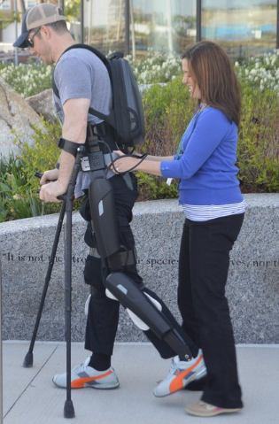
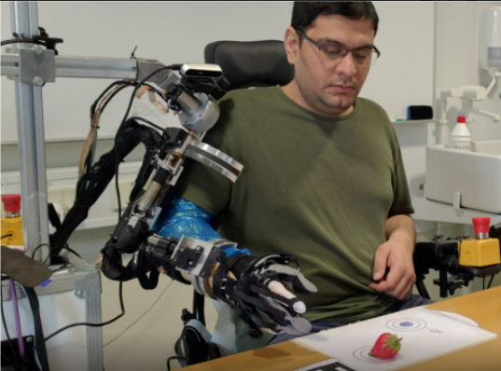
Motivation
Engineering is such wonderful thing which brings our imag-
-ination into reality, our morning dreams comes true which
are result of our passion. A lot of innovations have done and
some of areas are stabilized but still many are under progress,
one such field is improving our health condition using
engineering. Around the world we see many peoples are
disabled, some are paralyzed, some can’t walk or can’t lift
their hands or weights. So to help them out, we can introduce
an engineering model known as exoskeleton which are
wearable and have capability, so that disabled people can
walk, work, lift weights and many more things.
Medical Rehabilitation

Slide 5
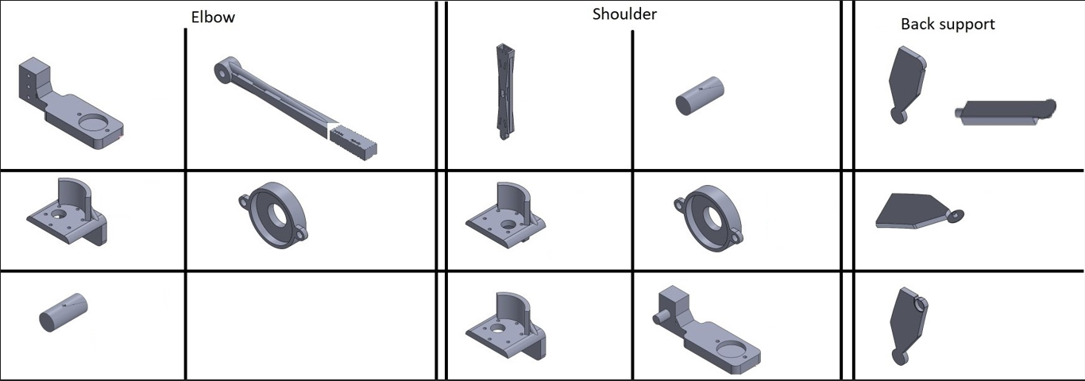
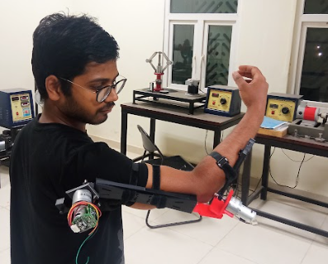
MY Design Parts
The purpose with this project is to design and make different joints needed, which can be combined together to make a wearable Exoskeleton for the upper half (above the waist) of a human body. I have used two types of joints in the whole model of the exoskeleton, which is the combination of Pivot and Hinge joint.

Slide 6
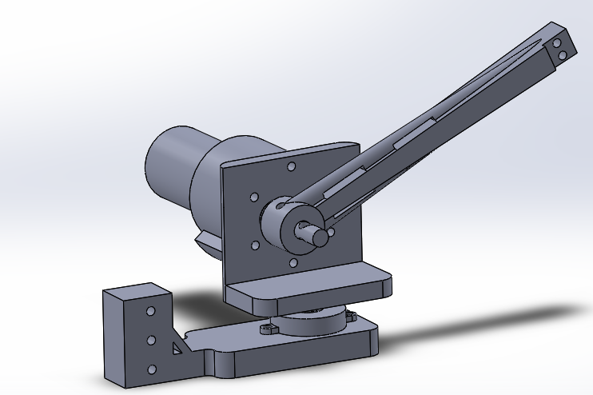
The work was done in 3 parts:
- Research
Firstly, we have studied the joints in the human skeleton i.e.
the degree of freedom in each joint in the upper half of the body.
· Design
In this part, we have used the knowledge gained in the research part to design a mechanical model of the wearable exoskeleton with the help of a 3D modeling software ‘SolidWorks’.
· 3D printing and joining
After making the modal, all the joints are made by a 3D printer and are joined together to make the exoskeleton.

Slide 7
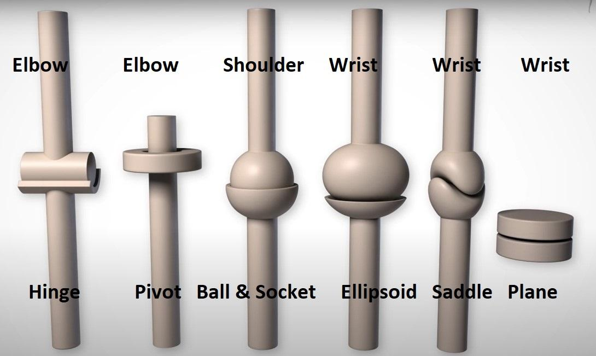
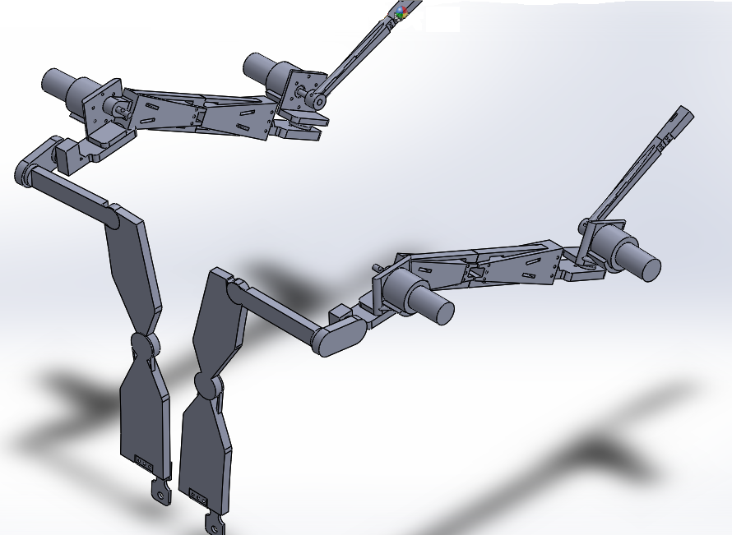
Joints And DOF
Elbow - 2 DOF(Hinge + Pivot Joint)
Shoulder - 3 DOF(Ball + Socket Joint)
Wrist - 2 DOF(Ellipsoid + Saddle + Plane Joint)
Complete Model
Joints and DOF

Slide 8
Thank You

