Slide 1
IT Security
Introduction

Slide 2
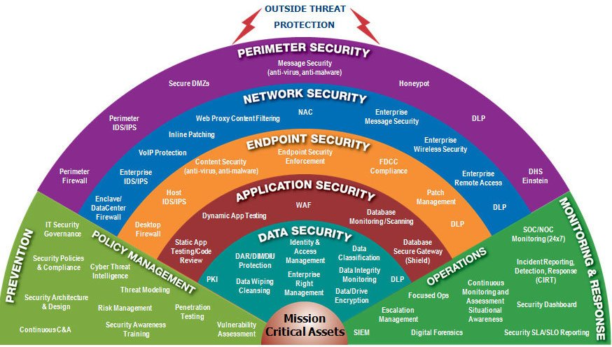
Information Security Layers
Image: https://twitter.com/TheCyberSecHub/status/890152658270646272

Slide 3
Focus of this semester
Image: https://twitter.com/TheCyberSecHub/status/890152658270646272

Slide 4
Preview of next semester
Image: https://twitter.com/TheCyberSecHub/status/890152658270646272

