Slide 1








Coursera Capstone Project IBM Data Analyst Capstone
SONAL PRADHAN
DATE :4/18/2024
“ Identifying Trends for Emerging Technologies in IT sector”

Slide 2



OUTLINE
Executive Summary
Introduction
Methodology
Results
Visualization – Charts
Dashboard
Discussion
Findings & Implications
Conclusion
Appendix

Slide 3

EXECUTIVE SUMMARY
In the dynamic realm of technology, remaining abreast of the most recent databases and programming languages holds immense importance for growth of the organization.
As businesses persist in adopting digital evolution, the call for adept developers well-versed in particular programming languages continues its upward trajectory.
This project analyses several datasets to help identify trends for emerging Technologies and skills for global IT and business consulting services.
The findings of the analyses will help understand better what are the current needs and steps that will help the IT organization to remain competitive in future.

Slide 4

INTRODUCTION
ABOUT :
Analyze trends for emerging Technologies and skills for global IT and business consulting services.
PURPOSE :
What are the top programming languages in demand ?
What are the top databases that are in demand ?
What are the most popular IDEs ?
Identify future skill requirements.
AUDIENCE: Human Resource and IT Head

Slide 5

METHODOLOGY
Data Collection Sources
Stack Overflow Developer 2019 Survey
GitHub Job Posting API
Programming Language Annual Salary
Data Wrangling/Cleaning
Exploratory Data Analysis using Python
Statistical Data Analysis using Python
Data Visualization Python and IBM Cognos
Presentation of Findings

Slide 6
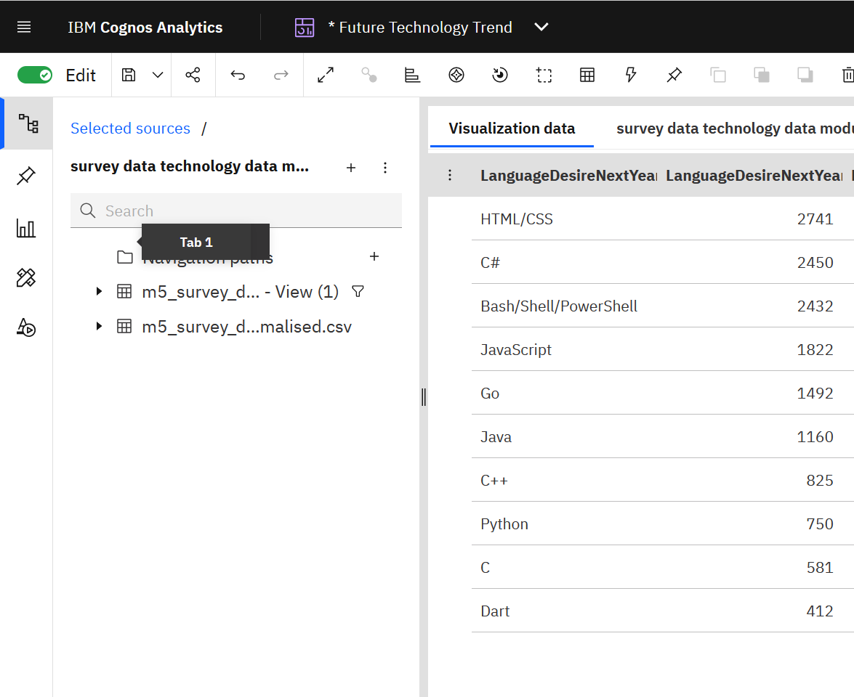
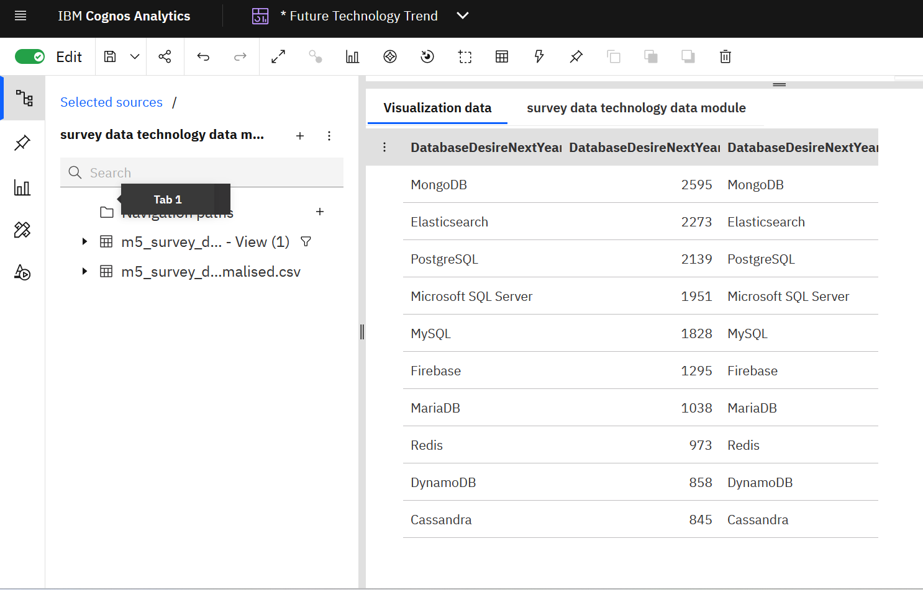
RESULTS

Slide 7
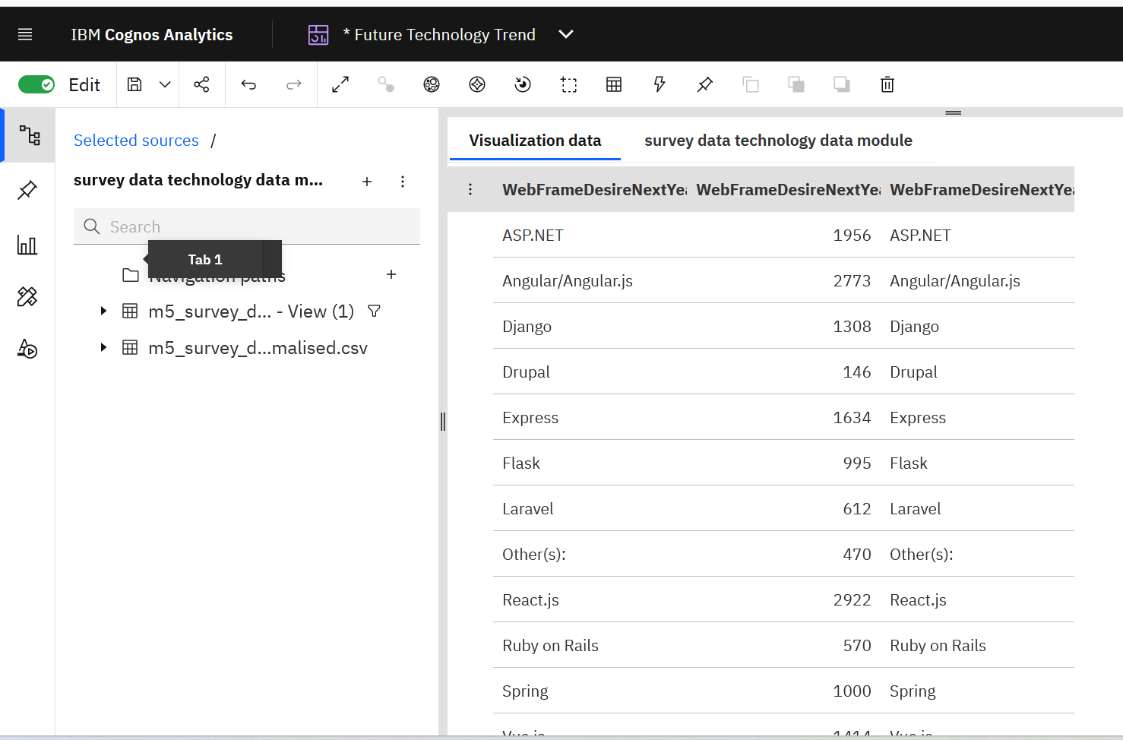
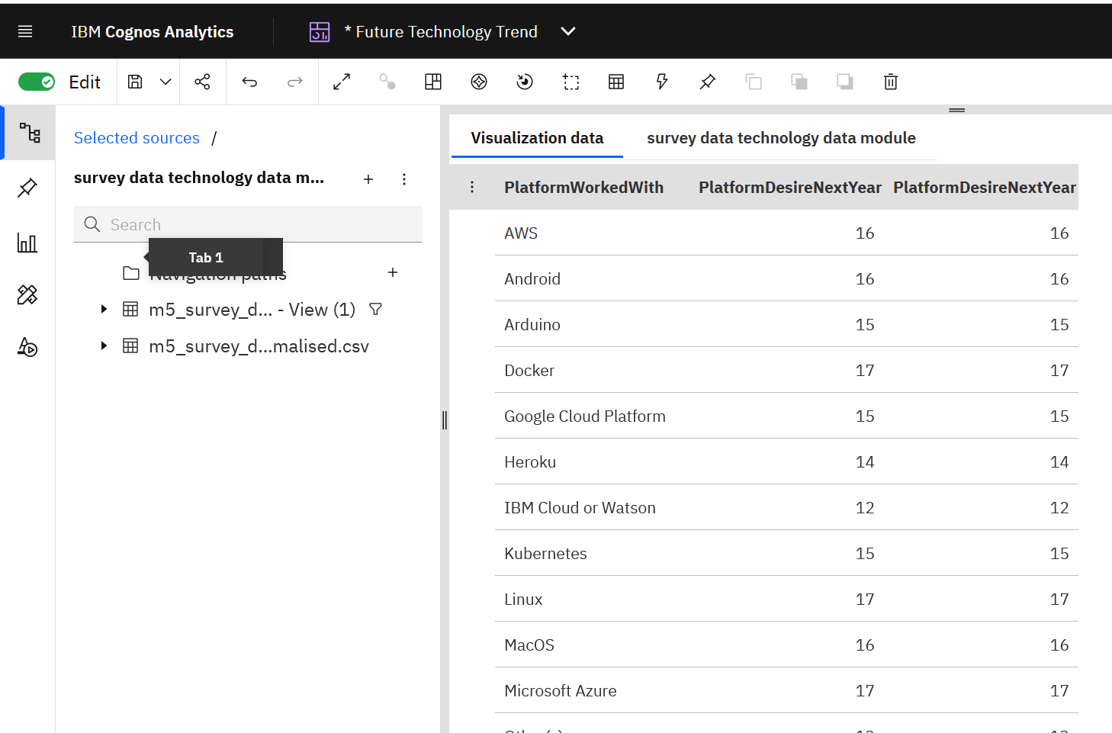
RESULTS

Slide 8
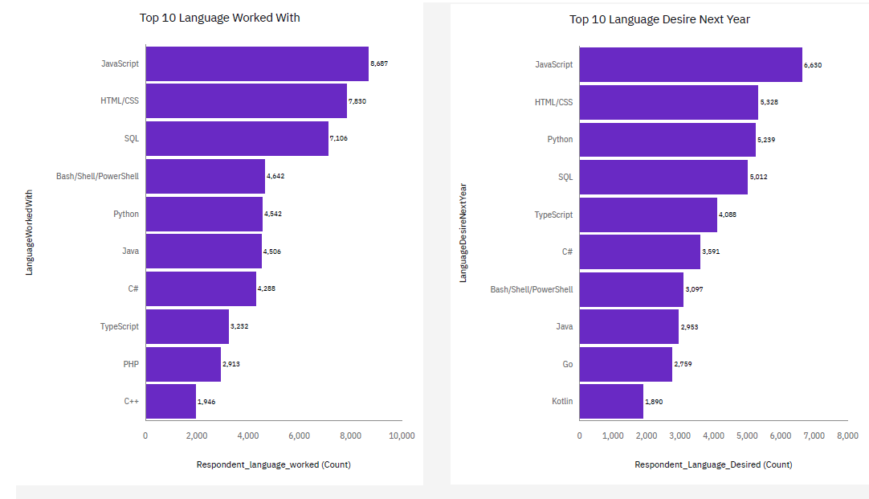
PROGRAMMING LANGUAGE TRENDS
Current Year
Next Year

Slide 9
PROGRAMMING LANGUAGE TRENDS - FINDINGS & IMPLICATIONS
Findings
JavaScript, HTML/CSS and SQL are the top choices for this year.
Powershell completely phases out for next year.
Python and Typescript becoming popular next year.
Implications
There is still a high demand in web development.
SQL skills are still popular when it comes to big data technology.
Python is still in demand, especially for AL and ML technology and advancements.

Slide 10
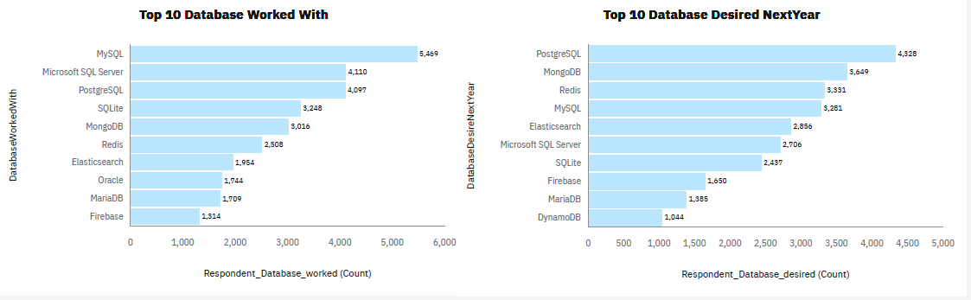
DATABASE TRENDS
Current Year
Next Year

Slide 11
DATABASE TRENDS - FINDINGS & IMPLICATIONS
Findings
MySQL is the top choice database, followed by Microsoft SQL server and PostgreSQL for current year.
Postgre SQL is most sorted after for next year.
MongoDB and Redis are upcoming favorites.
Elasticsearch rising up in chart for next year.
Implications
Companies still prefer open- source databases.
Cloud-based databases have largely taken over and cloud-native databases will dominate the market.
The rise of NoSQL databases, enabling faster data access and analytics.
Redis is gaining popularity due to its microservice and distributed architectures.

Slide 12

DASHBOARD
<IBM_cognos Dashboards (Current Technology/Demographics/Future Technology)

Slide 13
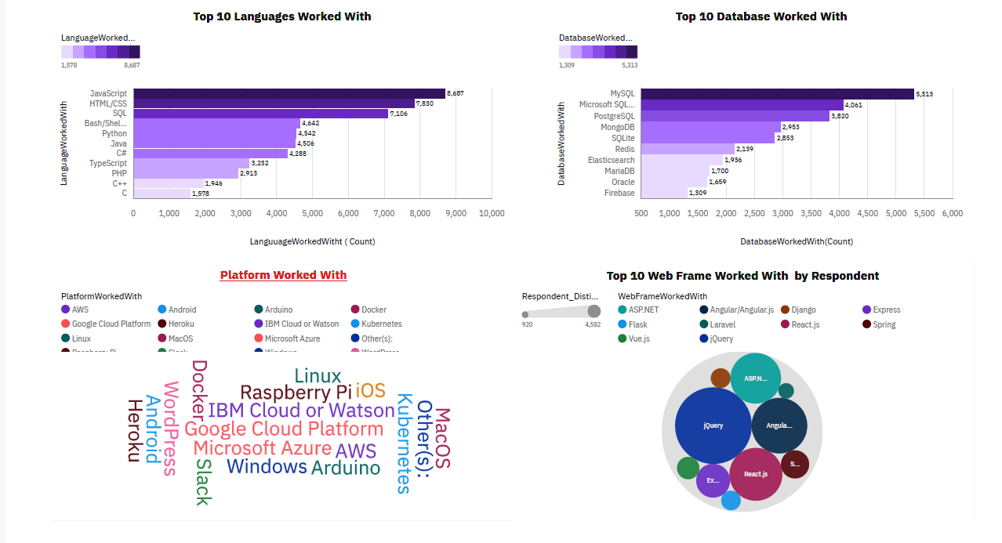
DASHBOARD TAB 1

Slide 14
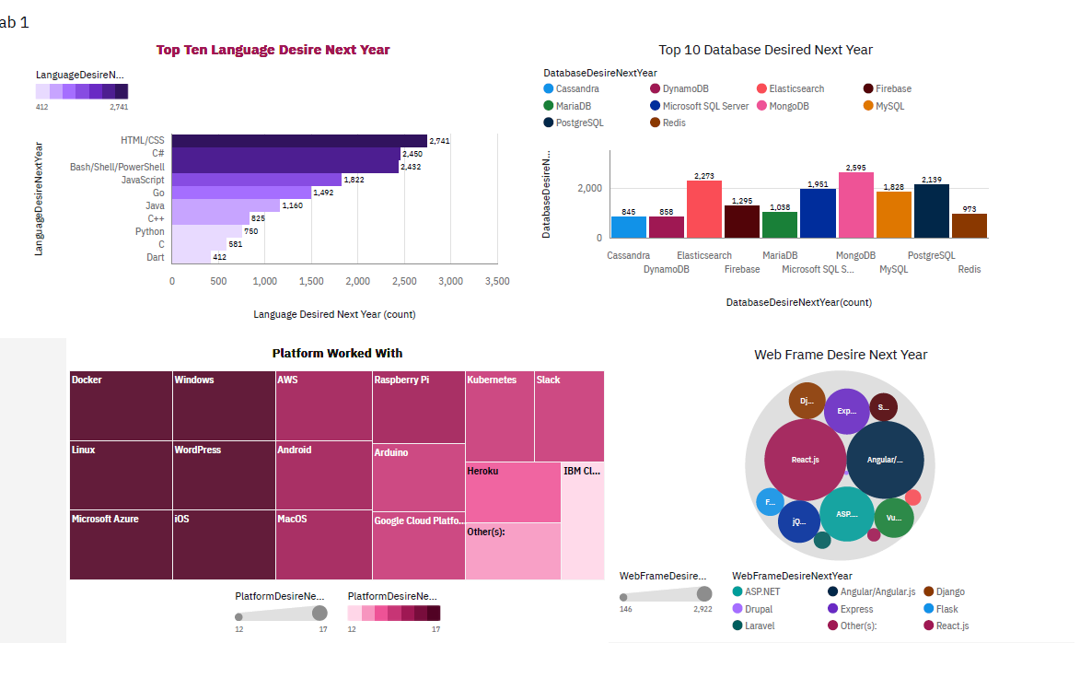
DASHBOARD TAB 2

Slide 15
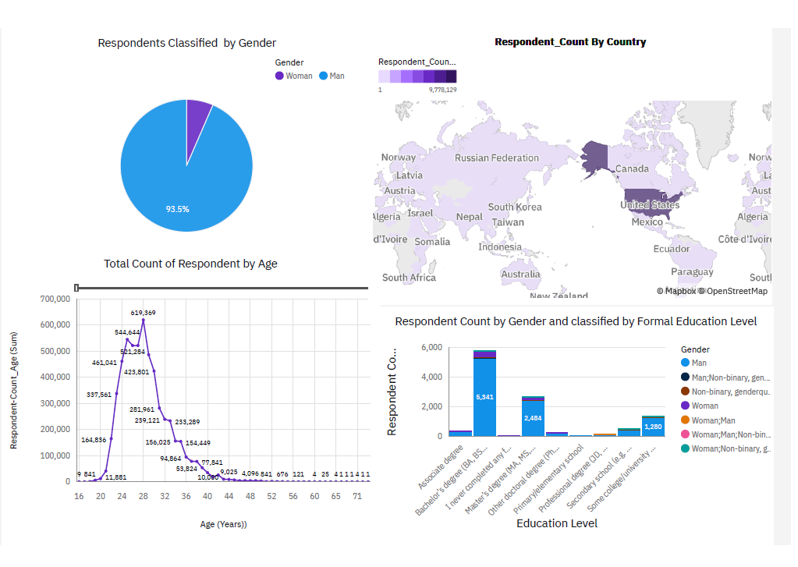
DASHBOARD TAB 3

Slide 16
DISCUSSION
Technology Trends now and future.
Need for training and new skills enhancement for web developers.
Focus on elimination of education levels and gender base discrimination in employment.
Role of Female participation in IT sector.
Improvising technology gaps in developing countries.

Slide 17
OVERALL FINDINGS & IMPLICATIONS
Findings
Emerging technologies, such as industrial robots, AL, and ML, are advancing at a rapid pace.
Developing nations require individuals with technical expertise to participate in high-tech marketplace.
Gender bias in technology
Growing cloud platform infrastructures
Implications
Organizations should depth to rapid changes in technological advancements.
Need to spread technologies and education in undeveloped nations.
Eliminate gender bias in job hiring
Adopt to faster app developments and service in future.

Slide 18

CONCLUSION
Technology Trends for Current & Next Year
Current and future top language skills
Overview of Database and Platforms usage
Role of Demographics in Technology
Actions to be taken to stay abreast with technology shifts
Incorporate AI and ML technologies to predict future trends and sales.

Slide 19

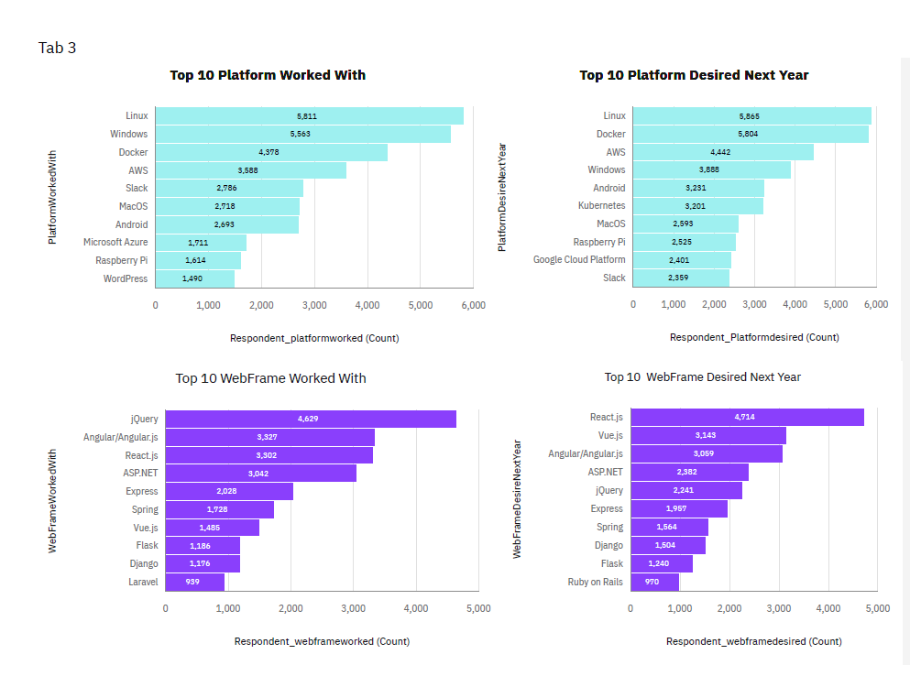
APPENDIX

Slide 20
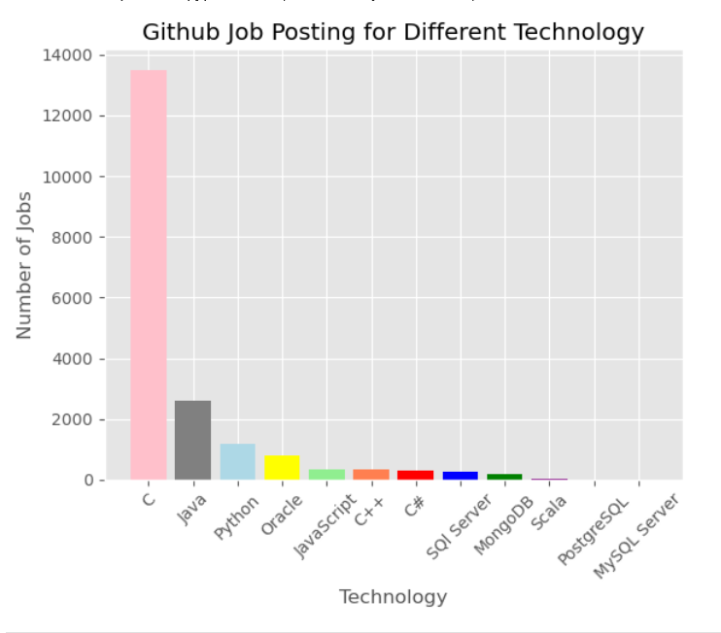
GITHUB JOB POSTINGS

Slide 21
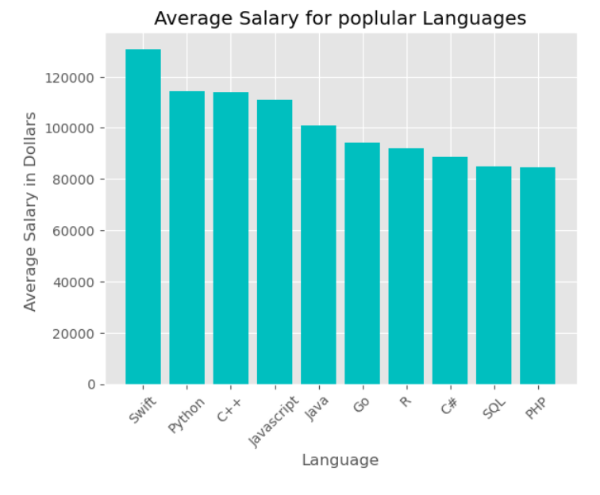
POPULAR LANGUAGES
The job postings data collected using web scraping, shows the relationship between Language and Average Salary.

