Slide 1

7C’S of DevOps lifecycle for business Agility
SE&DevOps Presentation :-
Name : Katta.Poojitha
Class : CSM – B
Roll no : 23B81A6699

Slide 2
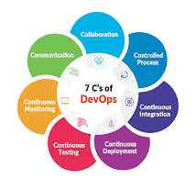
7C’s of DevOps :-
Agile focuses on faster software development through processes and tools. DevOps extends Agile adoption for operations team to enable faster delivery.
The 7C’s of DevOps are :
Continuous Business Planning
Continuous Development
Continuous Integration
Continuous Deployment
Continuous Testing
Continuous Delivery and Monitoring
Continuous Feedback

Slide 3
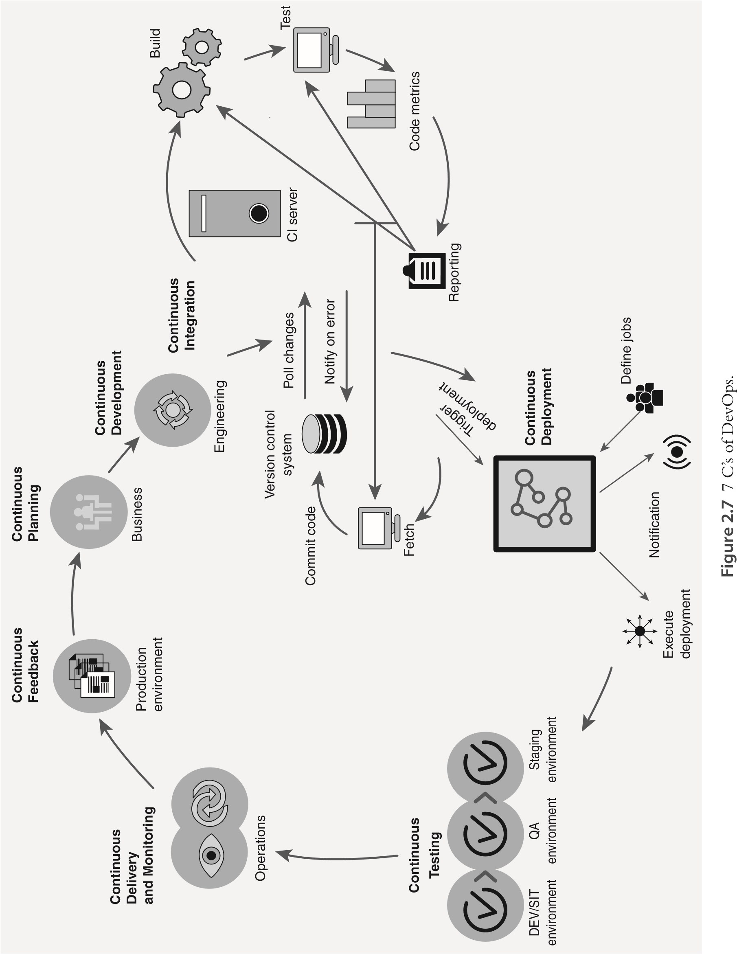

Slide 4
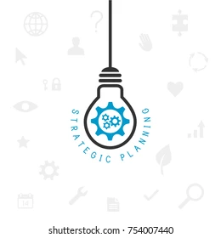
Continuous Planning :-
Enables businesses to plan and deliver new features continuously.
Includes new business requirements, changes in existing functionality, and prioritized defects etc...
Uses a prioritized “backlog” as input for the implementation team.
This process is supported by Agile methodologies and DevOps pipelines.
Requirement management tools, communication models, and feedback loops help establish continuous planning.
Continuous planning ensures better resource allocation and optimization for efficient project execution.

Slide 5

Continuous Development :-
Continuous development encompasses end-to-end software delivery, including continuous integration, continuous testing, continuous deployment, and continuous monitoring.
It ensures that planned requirements and features are seamlessly delivered to end users.
The process is repeatable for all features, irrespective of their type (requirement, configuration, etc.) and complexity level.
A development pipeline enables automation and streamlining of activities and processes.
Continuous development enhances efficiency by ensuring a structured and automated software delivery workflow.

Slide 6
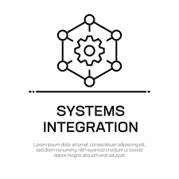
Continuous Integration :-
Integration of unit steps in the software coding stage is done through continuous integration.
It covers steps from feature assignment to delivering the implemented feature for testing.
When a developer checks in code to SCM, continuous integration performs automated code reviews, unit testing, compilation, and packaging.
Orchestration tools integrate code operations such as SCM retrieval, compilation, testing, and build.
Continuous integration schedules periodic code quality checks and notifies teams through dashboards and emails.

Slide 7
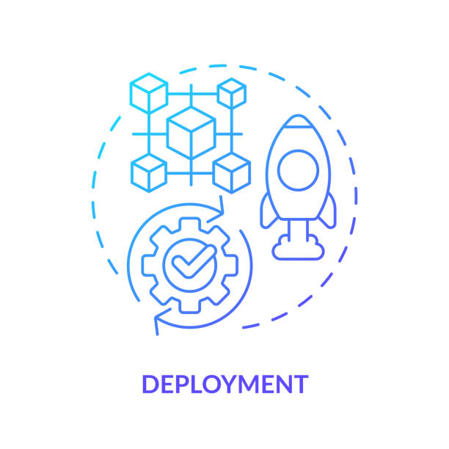
Continuous Deployment :-
Deployment of developed software artifacts on different environments is automated through continuous deployment.
It is also called release automation and requires automation of environment provisioning, build, packaging, and deployment.
Infrastructure as code enables configurability and programmability to build continuous deployment capability.
Continuous deployment tools help development and operations teams collaborate for seamless software transfer.
Development, Test (System Test, User Acceptance Test, Performance Test, etc.), Production, and Disaster Recovery environments are key candidates for continuous deployment.

Slide 8
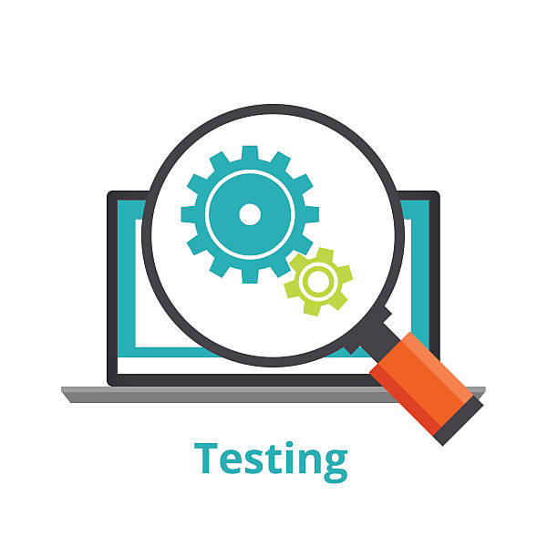
Continuous Testing :-
Continuous testing executes automated test cases within the software delivery pipeline for immediate feedback.
Ensures quality at speed by providing high-quality code quickly and avoiding human errors through test automation.
Follows a Shift Left approach, enabling early testing such as unit, system, regression, and performance testing.
Enables faster release cycles, making it ideal for Agile and DevOps methodologies.
Enhances collaboration between development, testing teams, product owners, and customers.
Cost-efficient, as early defect detection reduces schedule impact and automation minimizes repetitive tasks.
Reduces risk and increases confidence by validating individual components and their integration within the system.

Slide 9
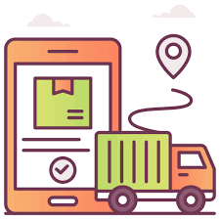
Continuous Delivery & Monitoring :-
Continuous delivery ensures rapid deployment of functional changes, configuration updates, and defect fixes.
All necessary processes are completed before deployment for a smooth and reliable release.
Continuous monitoring tracks application health, performance, and security in real time.
Monitoring tools analyze data to detect potential issues and take preventive actions.
Dashboards and reports help stakeholders assess the impact of changes and service quality.

Slide 10
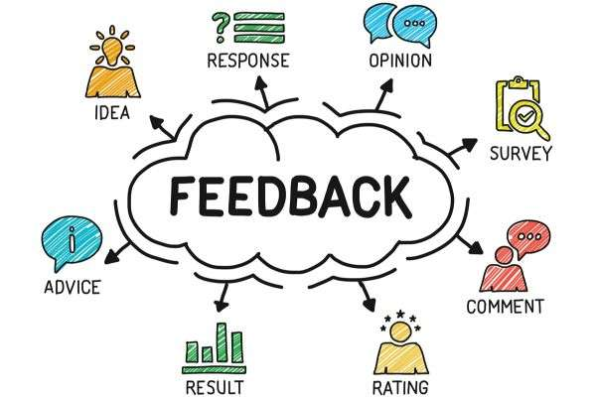
Continuous Feedback :-
Continuous feedback provides input on application performance, user experience, and service quality.
Feedback is gathered from stakeholders such as customers, operations, and development teams.
Quick feedback loops help teams make improvements in the next release iteration.
Delayed feedback can lead to increased costs and operational risks.
Timely issue detection and resolution prevent potential financial losses.

Slide 11


