Slide 1

AI Customer Support Automation
Handle support tickets faster with AI — while keeping a human in the loop for every sensitive, emotional, or complex case. Built for speed, safety, and operational visibility.
REACT + FASTAPI + GROQ LLM
HUMAN-IN-THE-LOOP
A Tejomayee
23EG107F01
AIML-F
23EG107F01

Slide 2

The Problem with Traditional Support
🔁 Repetitive Volume
Agents waste hours on routine queries that AI could resolve instantly.
⏳ Slow Response Times
No prioritization means urgent or emotional tickets sit in queue too long.
🔍 Zero Visibility
Managers lack real-time insight into AI performance, cost, or SLA compliance.
⚠️ Risky Escalations
Abusive, legal, or high-stakes cases slip through without proper human handoff.
23EG107F01

Slide 3
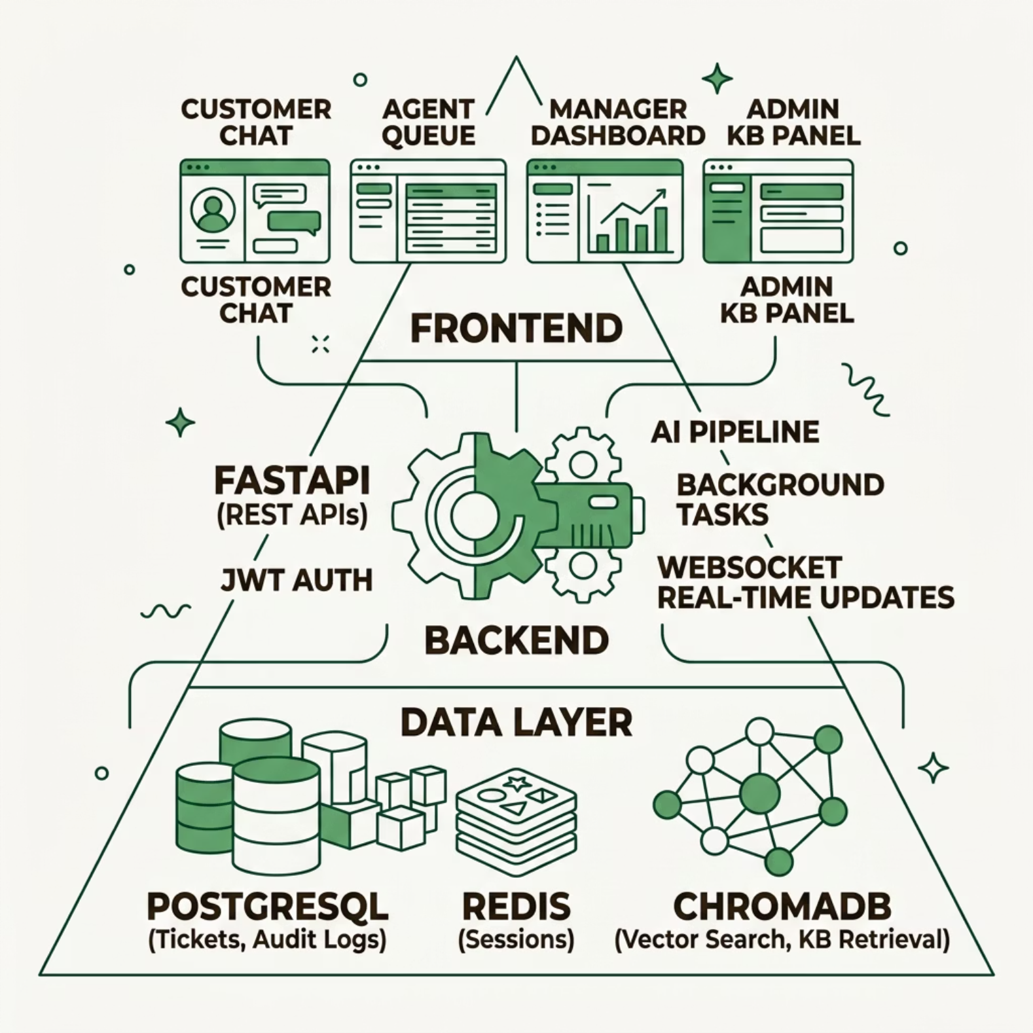

Architecture at a Glance
Built for Reliability
The stack is designed for production-grade support operations — with PostgreSQL for durable ticket storage, Redis for session management, and ChromaDB powering knowledge-base retrieval.
Key files: backend/routes/tickets.py (core AI logic), backend/services/groq_client.py (LLM wrapper), frontend/src/App.tsx (role-based routing)

Slide 4
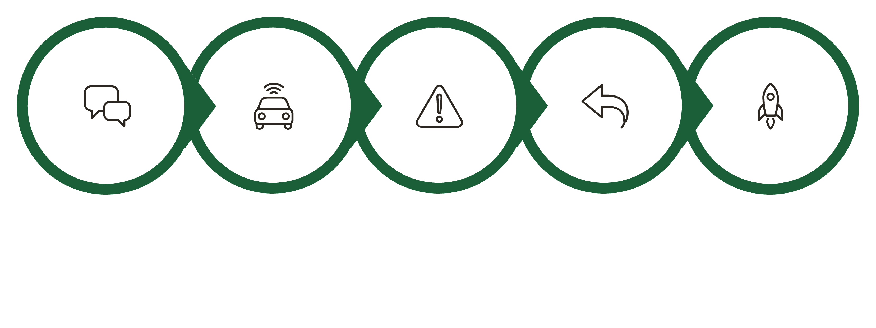
End-to-End System Flow
Customer Chat
Score & Deliver
AI Classify
Escalate Risk
AI Response
Every ticket is triaged in milliseconds. The system never drops a case — it either resolves it instantly or escalates it safely with full AI context packaged for the human reviewer.

Slide 5
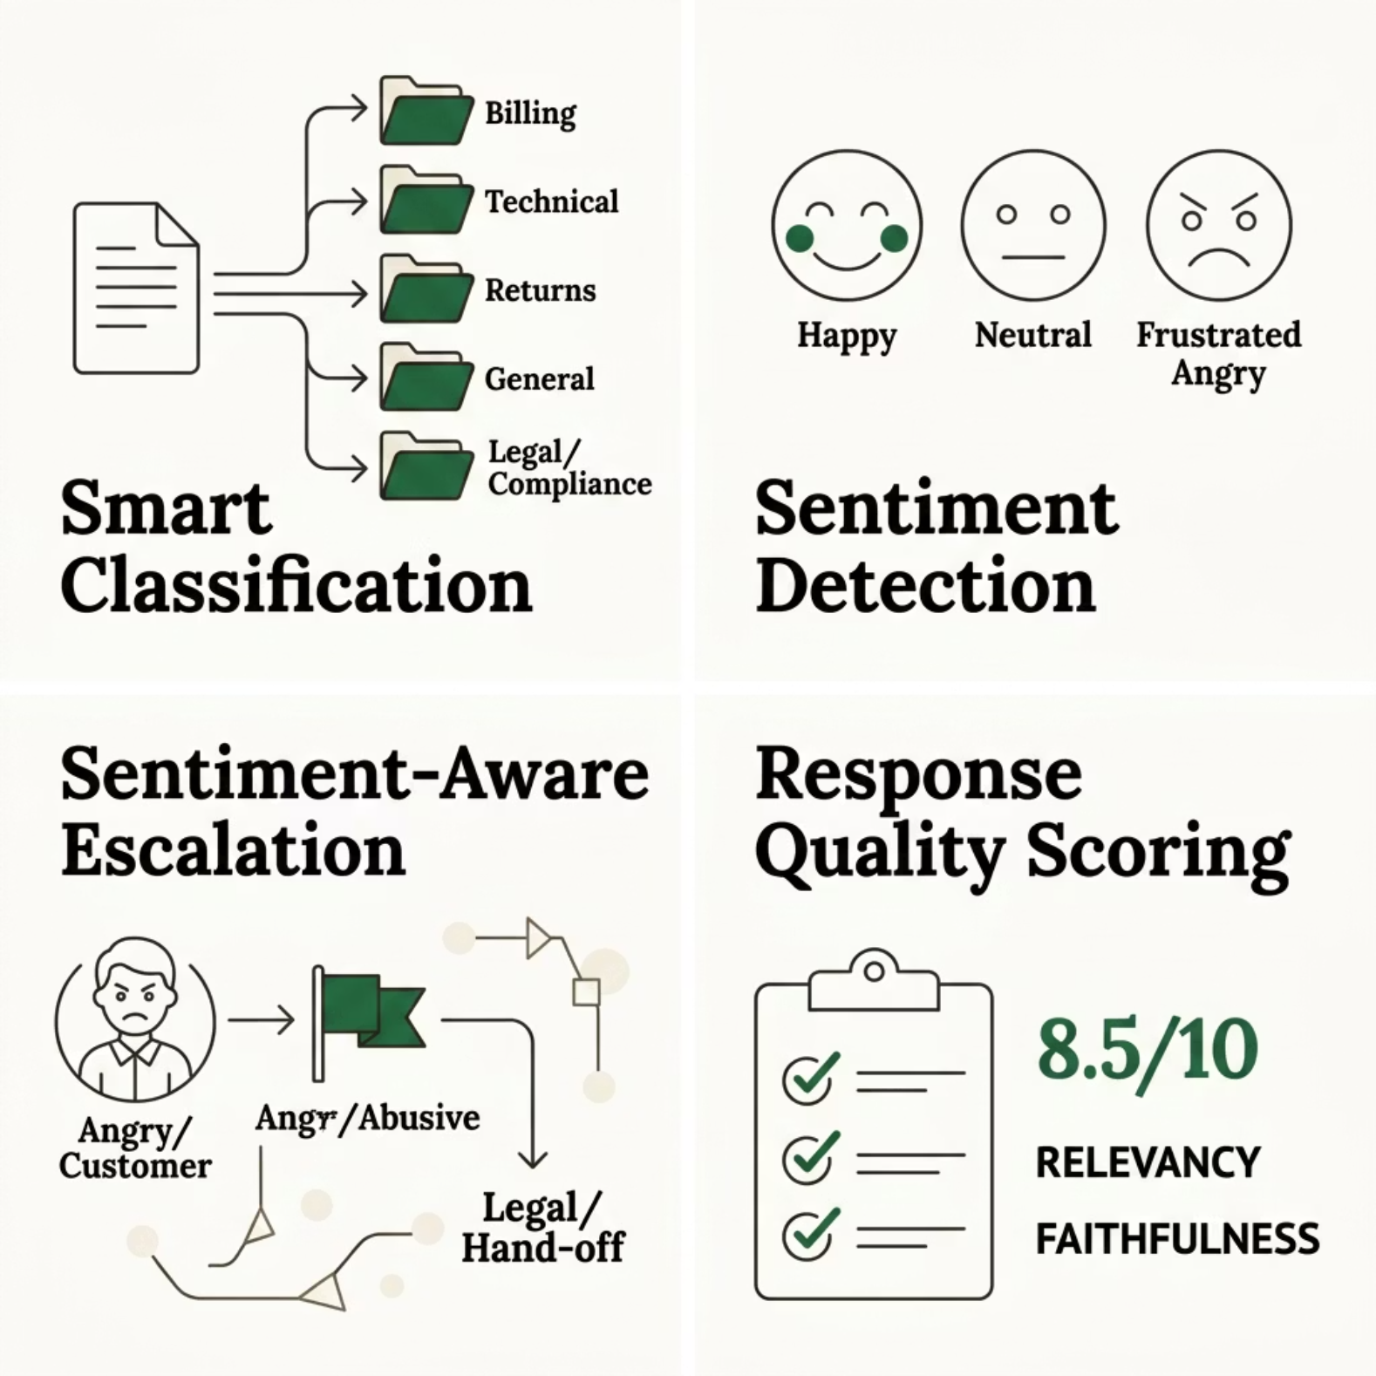

Core AI Capabilities
AI That Understands Context
The Groq LLM doesn't just reply — it reasons. Every incoming message is classified, scored for emotional tone, and routed based on urgency and risk.
Escalation triggers: abusive language, legal/compliance topics, explicit handoff requests, or low AI confidence.

Slide 6



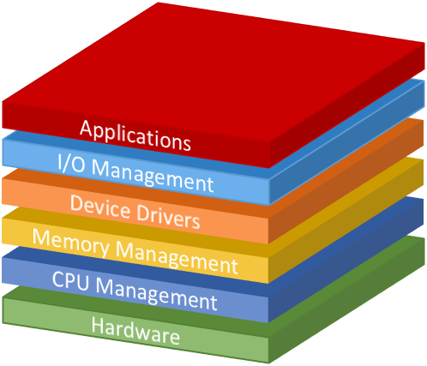

How to Use This System
Customer
Agent / Manager
Admin
Operations Team
Submits support requests through a chat-style interface. Gets instant AI responses or seamless human handoff.
Handles escalated tickets in a real-time queue with AI-generated summaries and suggested replies.
Manages knowledge-base documents for power AI retrieval.
Monitors live metrics: ticket volume, SLA breaches, escalation rate, AI cost, and quality scores.
This Photo by Unknown Author is licensed under CC BY-SA-NC

Slide 7


Human Handoff, Done Right
Escalated tickets arrive fully packaged
When a case is escalated, the manager doesn't start from scratch. Every handoff includes:
Replies are pushed back to the customer in real time via WebSocket.
Escalation reason
AI context summary
Suggested reply
Why the AI flagged it
Full ticket history and classification
AI-drafted response ready to edit and send

Slide 8





Live Dashboard & Operational Metrics
Ticket Volume & Categories
Real-time breakdown by issue type and sentiment distribution across all active tickets.
SLA & Response Time
Track average response time and flag SLA breaches before they become customer issues.
AI Token Cost
Monitor per-ticket AI cost and total spend — keeping operations transparent and accountable.
Quality Score
Every AI response is scored for faithfulness and relevancy, giving managers a quality baseline.

Slide 9


Security, Governance & Error Handling
🔐 Prompt Injection Detection
🛡️ Sensitive Data Redaction
Guardrails in backend/services/guardrails.py detect and block adversarial inputs before they reach the LLM.
Card numbers and PII are automatically redacted from ticket content before processing or storage.
📋 Full Audit Logging
⚡ Graceful Failure
Every AI action — classification, escalation, response generation — is logged for compliance and review.
If the LLM times out or returns invalid output, the system escalates safely to a human. It never breaks silently.

Slide 10

The Outcome
This project turns customer support from a slow, manual queue into an AI-assisted, sentiment-aware, escalation-safe system with real-time operational visibility.
Faster First Response
AI resolves routine tickets instantly, no agent wait time.
Smarter Prioritization
Urgent and emotional cases surface automatically.
Reduced Agent Load
Humans focus only on cases that truly need them.
Scalable & Safe
Guardrails, audit logs, and escalation keep AI adoption responsible.

