Slide 1
UCLEAN
OVERCOMING
OPERATIONAL
India's Largest
Laundry Chain
BOTTLENECKS
IIT MADRAS · BS DEGREE PROGRAM
in Laundry Services
A Case of UClean · Sector 37D, Gurgaon
Aditi Saxena | Roll: 23f1000290 | BDM Capstone Project
1,116
4
3
Orders Analyzed
Months of Data
Problem Statements
1

Slide 2
ORGANIZATION BACKGROUND
Who is UClean?
Asia's #1 Laundry & Dry-Cleaning Chain · India's Largest B2C Franchise Network · Founded 2016
UCLEAN
Location
Opened
Sector 37D, Gurgaon
January 2024
India's Largest Laundry & Dry-Cleaning Chain
Founded 2016 · Franchise Model
Monthly Revenue
Staff Members
B2C Laundry & Dry-Cleaning Services
~₹1.5 Lakh
5 Employees
Residential + Commercial Clients
Hotels, Hospitals, Corporate Offices
Avg Monthly Customers
Current Status
100–110
Operating at Loss
Subscription-Based Laundry Plans
Franchise Owner: Ritu Raj · Ex-Salesforce Developer turned Entrepreneur · Serving ₹1.5L/month revenue
2

Slide 3
PROBLEM STATEMENT
Three Core Operational Challenges
01
02
03
Long Turnaround Time
& Service Delays
High Order Cancellations
& Operational Disruptions
Seasonal Demand Fluctuation
Poor task distribution across 5 staff members causing delays. Only 37.9% orders delivered on time across 835 completed orders.
25.18% cancellation rate across 1,116 orders. Peak months April–May saw cancellation rates of ~29%, driven by late pickups.
Demand surged 14.9% in May then crashed 52.4% in June. Revenue gap of ₹3,84,645 between peak and trough months.
Primary Data · 1,116 Orders · April – July 2025 · Sector 37D, Gurgaon
3

Slide 4
DATA COLLECTION & METHODOLOGY
How We Built the Evidence Base
DATASET PROFILE
1
Primary Data Collection
Direct interaction with owner + physical receipts transcribed to Excel
1,116
Total Orders
2
Data Cleaning & Preprocessing
16
Data Variables
Currency symbols removed · Date standardization · Duplicate removal
4
Months (Apr–Jul '25)
3
Derived Variable: Delay (Days)
5
Service Types
Actual Delivery Date − Expected Delivery Date
₹150–₹1,500
Order Value Range
4
Data Analysis & Visualization
Pivot Tables · Bar/Line Charts · Percentage & Frequency Analysis in Excel
Formula: Delay (Days) = Actual Delivery − Expected Delivery
4

Slide 5
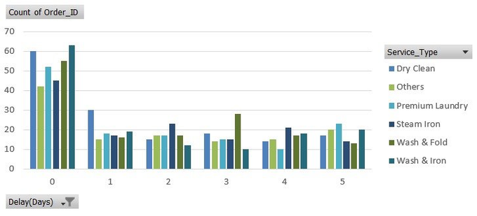
RESULTS & FINDINGS · PROBLEM 1
Long Turnaround Time & Service Delays
37.9%
62.1%
1.83
On-Time Delivery Rate
Orders Delayed
Avg Delay (Days)
KEY FINDINGS
62.1% of 835 completed orders were delayed
Y-Axis: Count of Orders
2–3 Days most common delay band across all service types
Wash & Fold highest volume at 0-day (on-time) AND highest at 3-day delays
Dry Clean largest group with 5-day severe delays
166–204 orders handled per staff — uneven workload distribution
No dynamic order reassignment mechanism existed
X-Axis: Delay (Days)
LEGEND:
Dry Clean
Others
Premium Laundry
Steam Iron
Wash & Fold
Wash & Iron
5
Chart: Delay(Days) vs Count of Orders by Service Type · Source: Primary Data — Excel Pivot

Slide 6
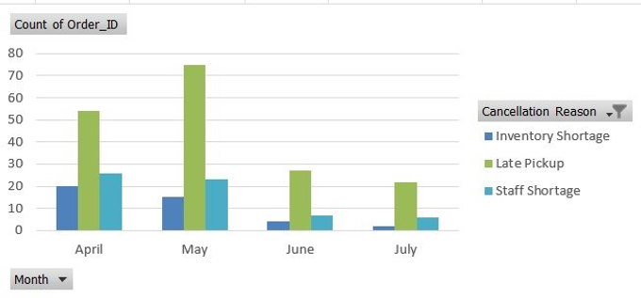
RESULTS & FINDINGS · PROBLEM 2
High Order Cancellations & Disruptions
25.18%
281
₹64,000+
Overall Cancellation Rate
Orders Cancelled
Recoverable Revenue
KEY FINDINGS
63.3% cancellations caused by Late Pickup (178 of 281)
Y-Axis: Count of Orders
22.1% caused by Staff Shortage (62 orders)
14.6% caused by Inventory Shortage (41 orders)
April–May highest cancellation months (~29% rate)
July lowest at 15.46% — drops when demand falls
1 in 4 orders placed were never completed
X-Axis: Month (Apr–Jul 2025)
LEGEND:
Inventory Shortage
Late Pickup
Staff Shortage
6
Chart: Cancellation Reasons by Month (Apr–Jul 2025) · Source: Primary Data — Excel Pivot

Slide 7
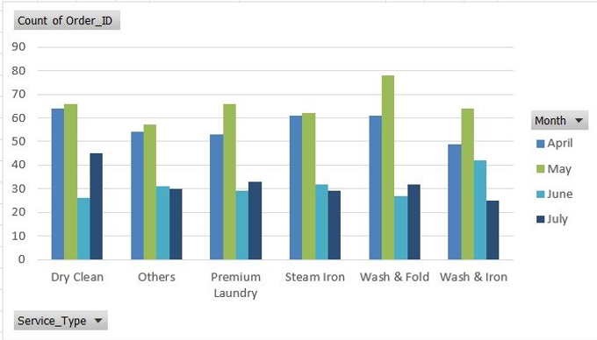
RESULTS & FINDINGS · PROBLEM 3
Seasonal Demand & Revenue Fluctuation
+14.9%
−52.4%
₹3.84L
Apr→May Orders
May→Jun Drop
Peak-to-Trough Gap
KEY FINDINGS
Wash & Fold peaked at 78 orders in May — highest volume
Y-Axis: Count of Orders
All services dropped sharply in June–July off-season
May peak 393 total orders — 14.9% above April
June crash 187 orders — 52.4% drop from May
Apr+May = 65.8% of all 1,116 orders combined
Revenue gap ₹3.84L between peak (May) and trough (June)
X-Axis: Service Type
LEGEND:
April
May
June
July
7
Chart: Service-wise Order Volume by Month (Apr–Jul 2025) · Source: Primary Data — Excel Pivot

Slide 8
INTERPRETATION
The Three Problems Are One Problem
FIXED CAPACITY
vs.
FLUCTUATING DEMAND PATTERNS
PS1: Delays
PS2: Cancellations
PS3: Seasonality
62.1% of 835 orders delayed
25.18% cancellation rate (~1 in 4 orders)
Apr–May = 65.8% of all orders
Avg delay: 1.83 days
Late pickup = 63.3% of cancellations
Significant drop in Jun–Jul (low demand)
Staff workload imbalance (166–204 orders)
Staff shortage contributes to delays
Revenue gap of ₹3.84L between peak and low
Delays increase during peak months
Lower cancellations in off-season
Fixed staffing despite demand variation
All three bottlenecks share one root cause: operational capacity does not scale with seasonal demand.
8

Slide 9
RECOMMENDATIONS
Data-Driven Action Plan
PS1 · Delays
PS2 · Cancellations
PS3 · Seasonality
Optimize Turnaround Time
& Workload Distribution
Reduce Cancellations &
Improve Pickup Efficiency
Manage Demand Fluctuation
& Plan Capacity
Track turnaround time (TAT) to identify delayed orders
Analyze cancellation trends across months
Identify peak months (Apr–May) vs low-demand (Jun–Jul)
Identify workload imbalance across staff members
Capacity-based booking limits (don't oversell)
Plan staff allocation based on demand patterns
Redistribute orders to reduce overload on specific staff
Improve pickup scheduling and route planning
Introduce off-season offers to stabilize demand
Hire 1–2 temporary workers during peak months
Allocate dedicated staff for pickups during peak demand
Focus on high-demand services during peak periods
Target: Improve on-time delivery (currently 37.9%)
Target: Reduce cancellations (currently 25.18%)
Target: Stabilize revenue across months
9

Slide 10
CONCLUSION & NEXT STEPS
From Data to Sustainable Growth
Key Finding
NEXT STEPS
All 3 bottlenecks share one root: fixed capacity vs. fluctuating demand. Peak months create workload pressure leading to delays and cancellations.
1. Implement daily TAT tracking system
2. Improve pickup scheduling and route planning
Biggest Win
Fixing late pickup (63.3% of cancellations) could recover ₹64,000+ in lost revenue immediately.
3. Apply capacity-based order management
4. Plan staffing based on demand trends
Data Impact
1,116 order records revealed 62.1% delay rate and 25.18% cancellation rate. These issues are data-supported and can be improved with better planning.
5. Hire temporary staff during peak months
6. Introduce off-season offers to stabilize demand
Aditi Saxena · Roll: 23f1000290 · BDM Capstone · IIT Madras Online BS Degree Program · 2026
10

