Slide 1
Node Importance

Slide 2

Broad Question
How to organize the Web?
First try: Human curated Web directories
Yahoo
Second try: Web Search
Information Retrieval investigates:
Treat webpages as document corpus
Tf-idf, Jaccard, etc.
Issues?
Easy to fool the system
Spam
Which webpages are more trustworthy?

Slide 3
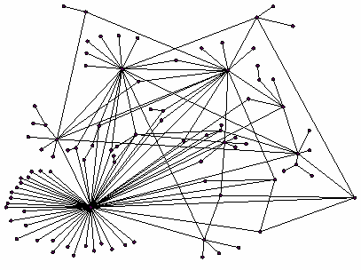
Ranking Nodes on the Graph
All web pages are not equally “important”
iitd.ac.in vs. www.myhomepage.com
Solution: Let’s rank the pages by the link structure!

Slide 4
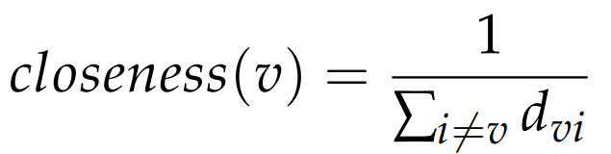
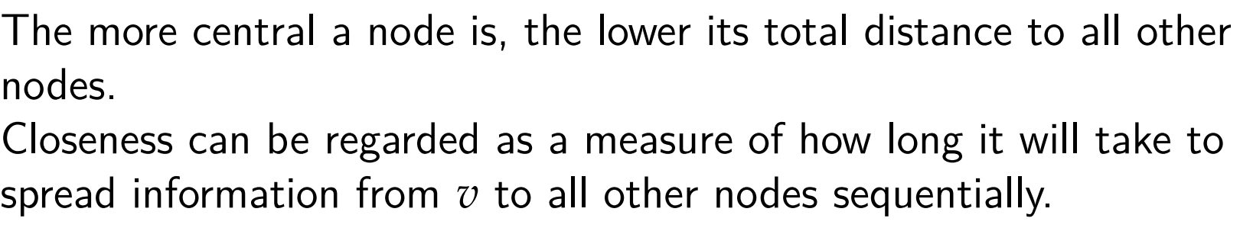

How important is a node?
Degree Centrality:
Same as the degree of the node
Closeness Centrality:
$d_{vi}:distance from v to i$

Slide 5
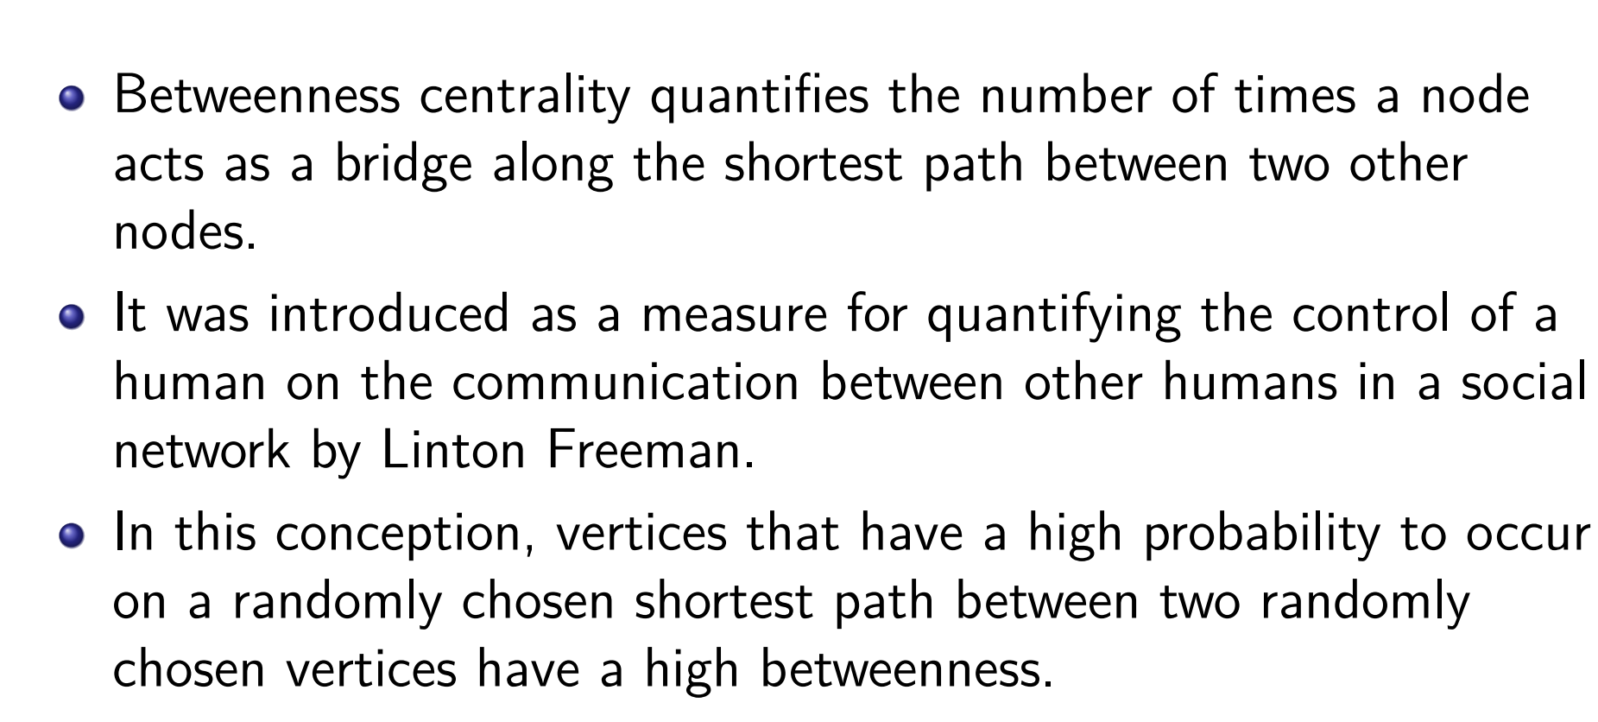
Betweenness Centrality

Slide 6
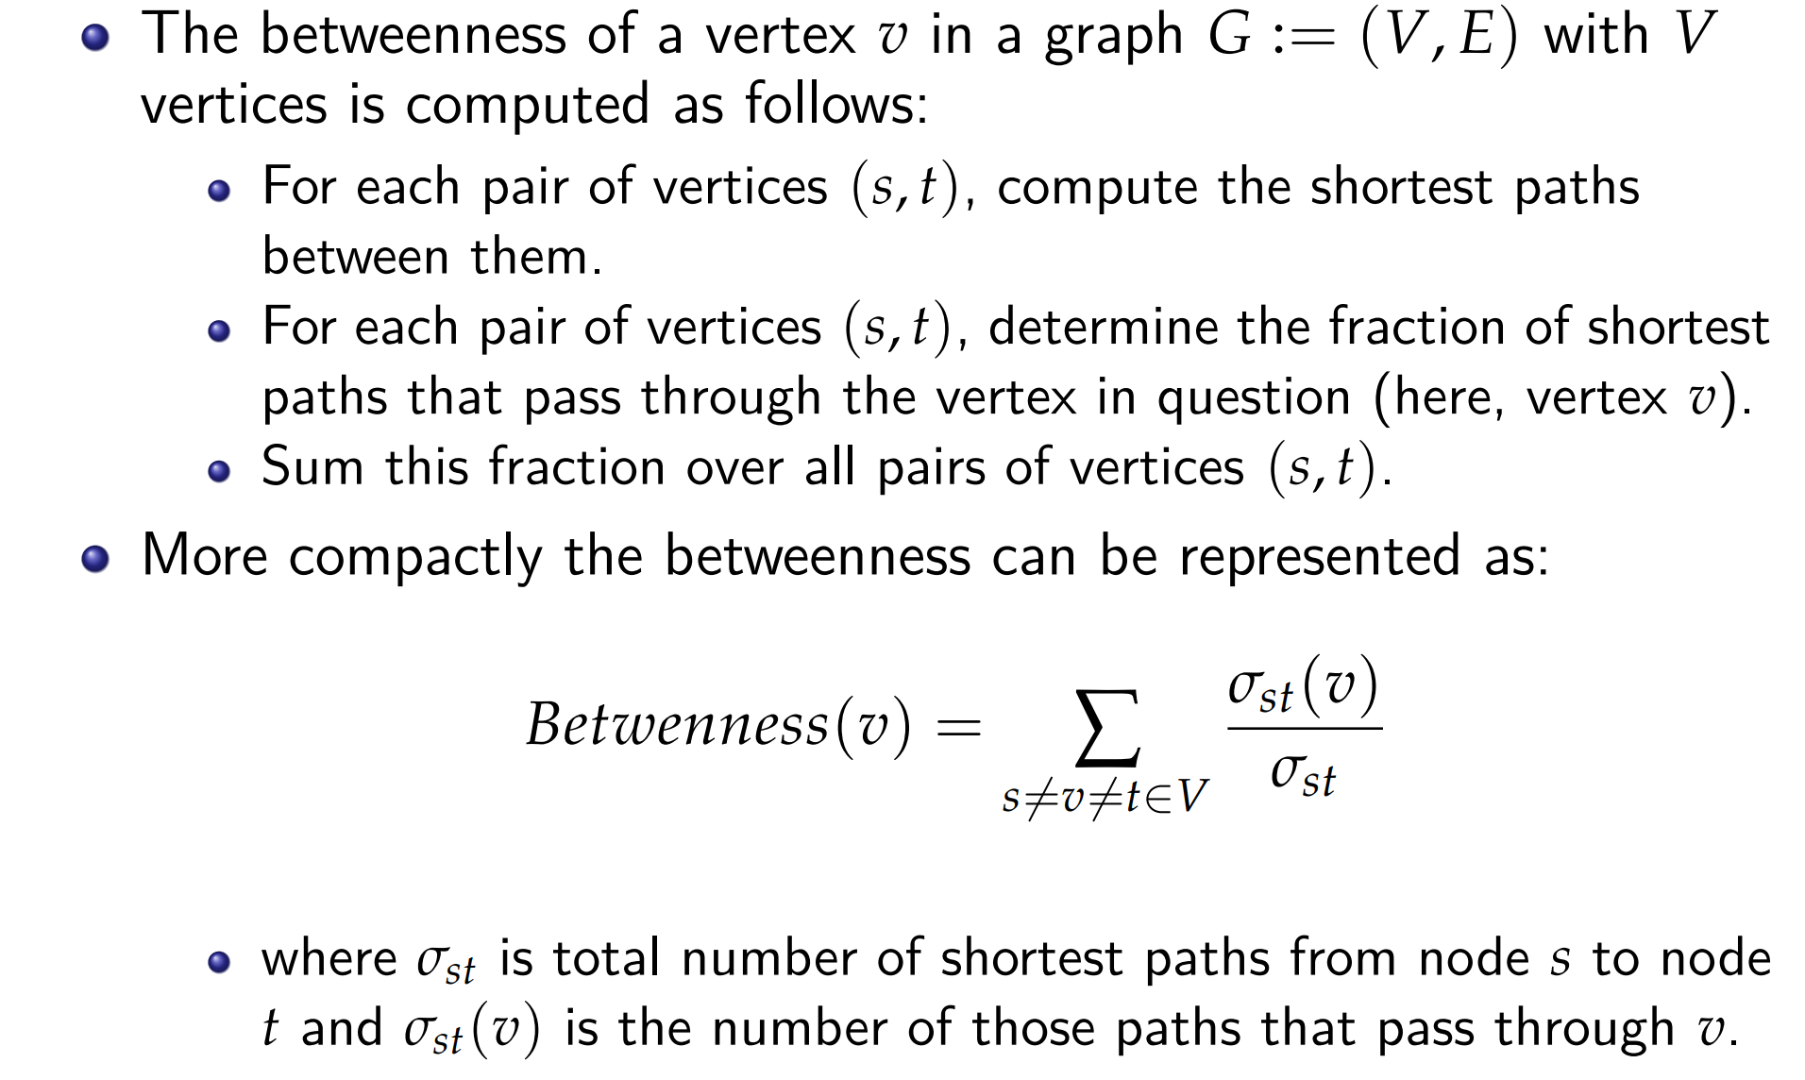

Betweenness centrality
$$s≠v, t≠v$$

Slide 7

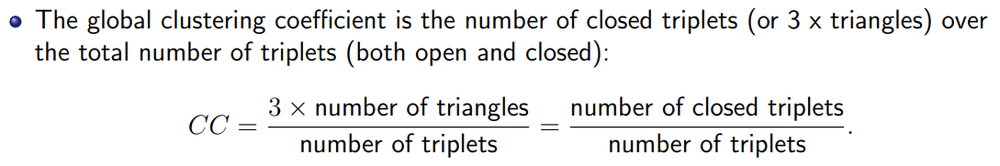
Clustering Coefficient
High clustering coefficient indicates the node plays a strong role in connecting his/her friends.
Therefore, influential

Slide 8
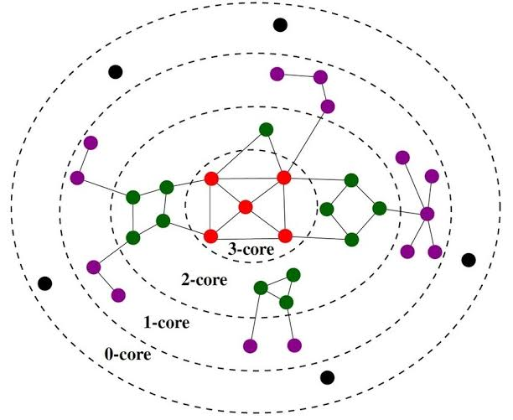
K- core
A k-core of a graph G is a maximal connected subgraph of G in which all vertices have degree at least k.
A vertex u have core-value c if it is part of c-core but not (c+1)-core

Slide 9
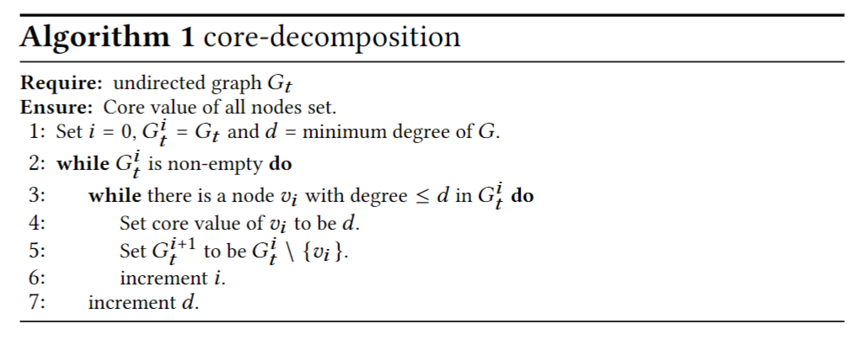
Core decomposition algorithm

Slide 10
PageRank

Slide 11
Example: PageRank Scores
B
38.4
C
34.3
A
3.3
D
3.9
E
8.1
F
3.9
1.6
1.6
1.6
1.6
1.6

Slide 12
Simple Recursive Formulation
Each link’s vote is proportional to the importance of its source page
If page j with importance r_{j} has n out-links, each link gets r_{j} / n votes
Page j’s own importance is the sum of the votes on its in-links
i
k
r_{i}/3
r_{k}/4
j
r_{j} = r_{i}/3+r_{k}/4
r_{j}/3
r_{j}/3
r_{j}/3

Slide 13
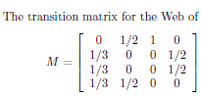
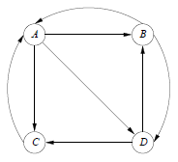
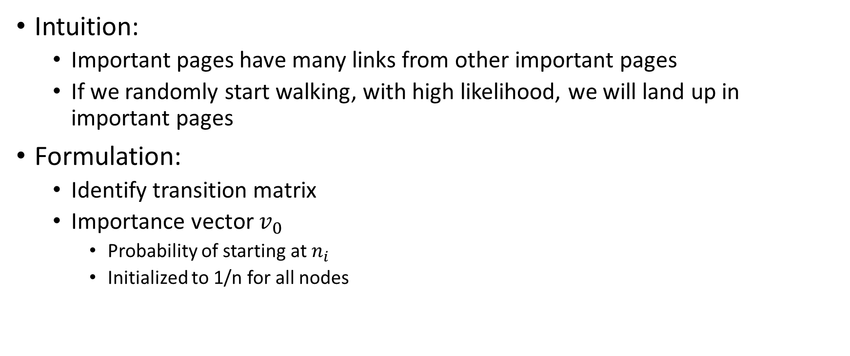
Google’s Idea: Random walks
Intuition:
Important pages have many links from other important pages
If we randomly start walking, with high likelihood, we will land up in important pages
Formulation:
Identify transition matrix
Importance vector $v_{0}$
Probability of starting at $n_{i}$
Initialized to 1/n for all nodes

Slide 14
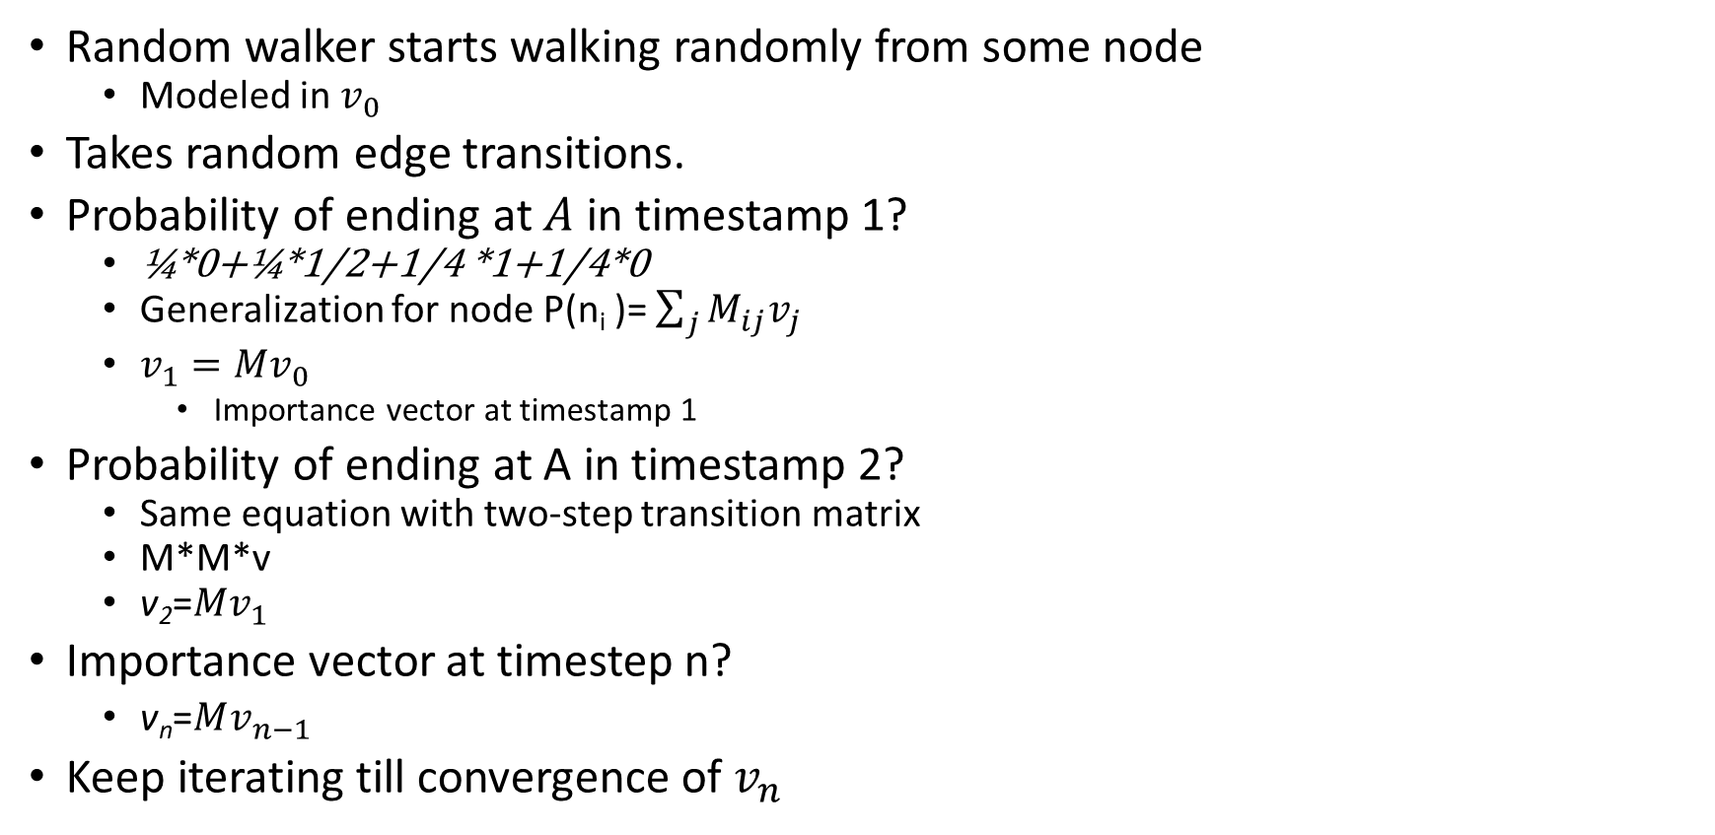
Simulating random walks
Random walker starts walking randomly from some node
Modeled in $v_{0}$
Takes random edge transitions.
Probability of ending at $A$ in timestamp 1?
¼*0+¼*1/2+1/4 *1+1/4*0
Generalization for node P(n_{i} )= $\sum_{j}{M_{ij}v_{j}}$
$v_{1}=Mv_{0}$
Importance vector at timestamp 1
Probability of ending at A in timestamp 2?
Same equation with two-step transition matrix
M*M*v
v₂=$Mv_{1}$
Importance vector at timestep n?
v_{n}=$Mv_{n−1}$
Keep iterating till convergence of $v_{n}$

Slide 15
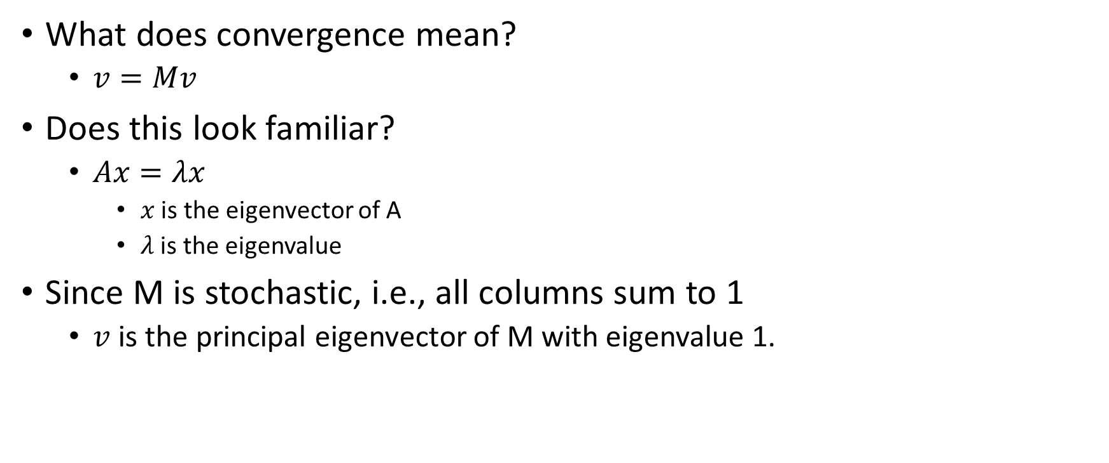
PageRank
What does convergence mean?
$v=Mv$
Does this look familiar?
$Ax=λx$
$x$ is the eigenvector of A
$λ$ is the eigenvalue
Since M is stochastic, i.e., all columns sum to 1
$v$ is the principal eigenvector of M with eigenvalue 1.

Slide 16
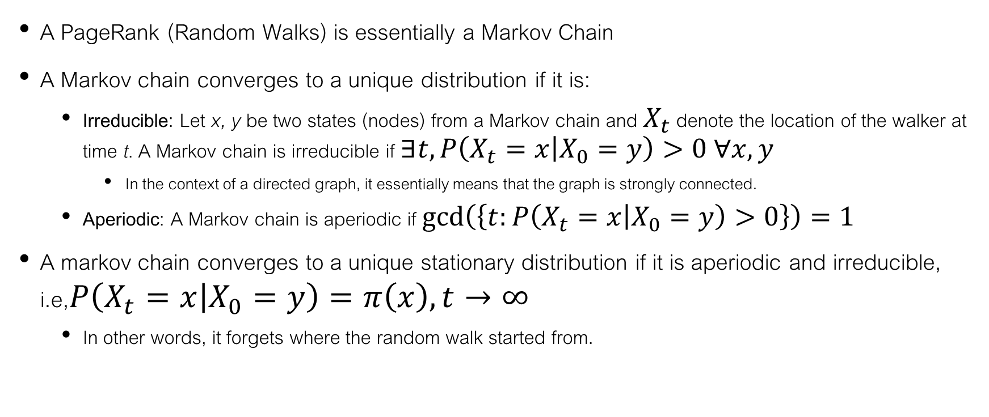
Are we guaranteed to converge?
A PageRank (Random Walks) is essentially a Markov Chain
A Markov chain converges to a unique distribution if it is:
Irreducible: Let x, y be two states (nodes) from a Markov chain and $X_{t}$ denote the location of the walker at time t. A Markov chain is irreducible if $∃t,P\left(X_{t}=x | X_{0}=y\right)>0 ∀x,y$
In the context of a directed graph, it essentially means that the graph is strongly connected.
Aperiodic: A Markov chain is aperiodic if $\gcd\left(\left\{t:P\left(X_{t}=x | X_{0}=y\right)>0\right\}\right)=1$
A markov chain converges to a unique stationary distribution if it is aperiodic and irreducible, i.e,$P\left(X_{t}=x | X_{0}=y\right)=π\left(x\right), t→∞$
In other words, it forgets where the random walk started from.

Slide 17
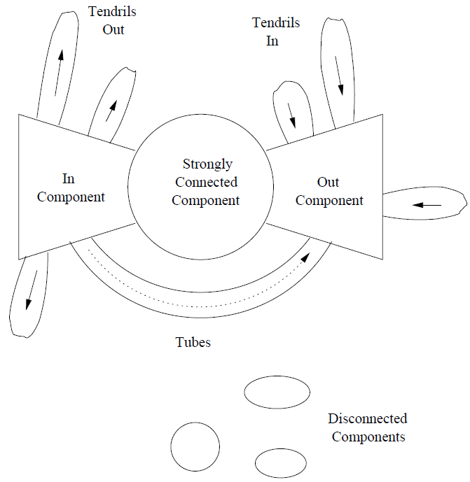
Typical structure of the web
In-components: outgoing links to SCC
Out-components: incoming links from SCC
Tubes links IC to OC
Tendrils out: outgoing links from IC
Tendrils In: Incoming links to OC
What would the stationary distribution look like?
All mass consumed by OC or TO

Slide 18
Two key issues to avoid
Dead end
dead ends (have no out-links)
Spider traps: (all out-links are within the group)
Spider trap

Slide 19
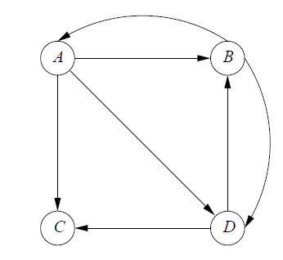
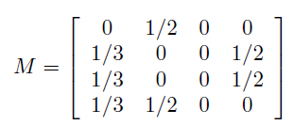
Dead Ends
What happens to the stationary distribution?
A 0-vector
The transition matrix is a sub-stochastic matrix
Columns sum up to at most 1.

Slide 20
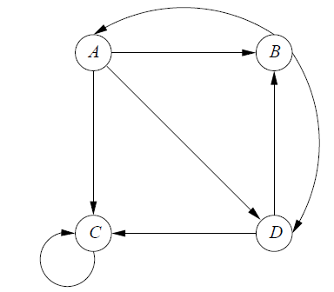
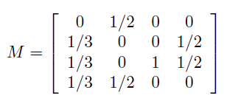
Spider traps
What happens to stationary distribution?
All probability mass accumulates at C.

Slide 21
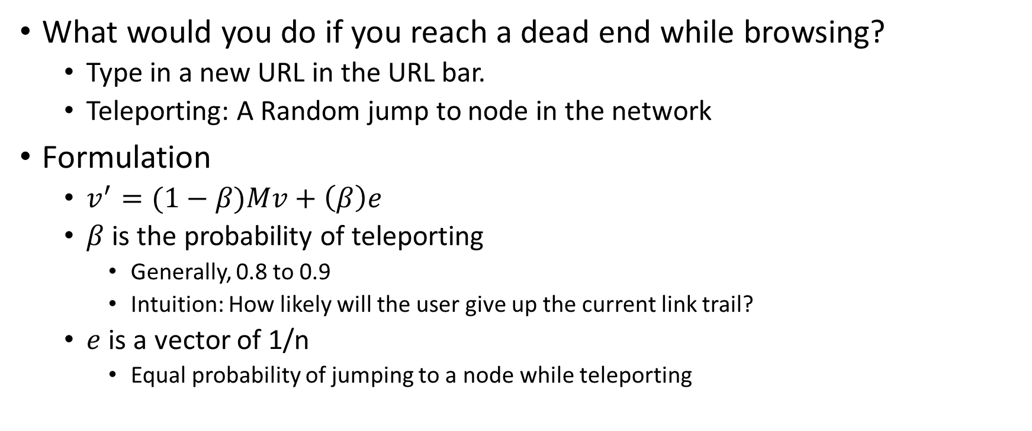
Solution
What would you do if you reach a dead end while browsing?
Type in a new URL in the URL bar.
Teleporting: A Random jump to node in the network
Formulation
$v^{′}=(1−β)Mv+\left(β\right)e$
$β$ is the probability of teleporting
Generally, 0.8 to 0.9
Intuition: How likely will the user give up the current link trail?
$e$ is a vector of 1/n
Equal probability of jumping to a node while teleporting

Slide 22
Is it a solution to all our problems?
Is the Markov chain with teleportation irreducible and aperiodic?
Yes
Random restarts is a self loop and therefore makes it aperiodic
Random jumps also make the graph strongly connected
Will the stationary distribution sum up to 1? That is no effect of dead ends?
No.
Will spider traps continue to accumulate mass?
Yes, but the effect is reduced

Slide 23
The “actual” PageRank
Combination of tf-idf, entity linking, pageRank, knowledge graphs, and many other optimizations
Personalized pagerank
Cluster users based on interest groups such as sports, politics, etc.
Set e for each cluster proportional to the interests

Slide 24
Does PageRank solve spamming issues?
Initial efforts were directed at boosting text scores
Can they boost PageRank?
Create artificial links
What could possibly be the structure?

Slide 25
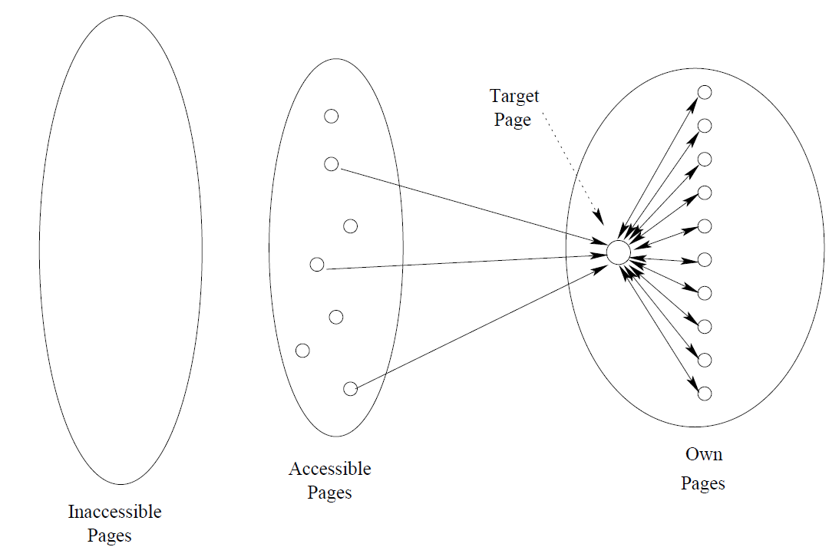
Spam Farm

Slide 26
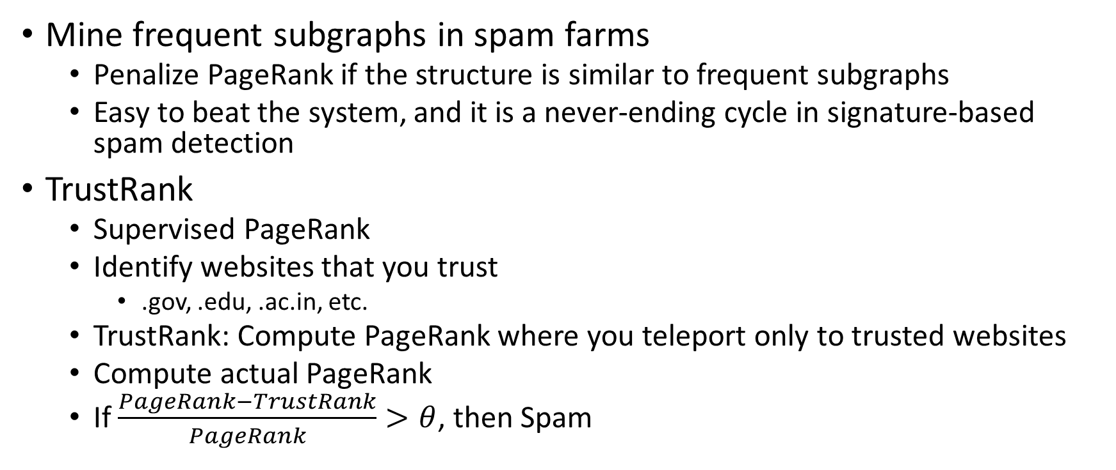
Tackling Spam
Mine frequent subgraphs in spam farms
Penalize PageRank if the structure is similar to frequent subgraphs
Easy to beat the system, and it is a never-ending cycle in signature-based spam detection
TrustRank
Supervised PageRank
Identify websites that you trust
.gov, .edu, .ac.in, etc.
TrustRank: Compute PageRank where you teleport only to trusted websites
Compute actual PageRank
If $\frac{PageRank−TrustRank}{PageRank}>θ$, then Spam

Slide 27
Computing PageRank in real life
Key step is matrix-vector multiplication
r^{new} = A ∙ r^{old}
Easy if we have enough main memory to hold A, r^{old}, r^{new}
Say N = 1 billion pages
We need 4 bytes for each entry (say)
2 billion entries for vectors, approx 8GB
Matrix A has N² entries
10¹⁸ is a large number!
~4 million TB
A = β∙M + (1-β) [1/N]_{NxN}
½ ½ 0
½ 0 0
0 ½ 1
1/3 1/3 1/3
1/3 1/3 1/3
1/3 1/3 1/3
A =
0.8
+0.2
7/15 7/15 1/15
7/15 1/15 1/15
1/15 7/15 13/15
=

Slide 28
Sparse Matrix Formulation
10 links per node, approx 10N entries
So in each iteration, we need to:
Compute r^{new} = β M ∙ r^{old}
Add a constant value (1-β)/N to each entry in r^{new}

Slide 29
Basic Algorithm: Update Step
Assume enough RAM to fit r^{new} into memory
Store r^{old} and matrix M on disk
1 step of power-iteration is:
Initialize all entries of r^{new} = (1-β) / N
For each page i (of out-degree d_{i}):
Read into memory: i, d_{i}, dest₁, …, dest_{di}, r^{old}(i)
For j = 1…d_{i}
r^{new}(dest_{j}) += β r^{old}(i) / d_{i}
0
r^{new}
source
degree
destination
r^{old}
0
1
0 | 3 | 1, 5, 6
1 | 4 | 17, 64, 113, 117
2 | 2 | 13, 23
1
2
2
3
3
4
4
5
5
6
6
Notes:
Remember to say that we first initialize r^new to 1-beta/n

Slide 30
Sparse Matrix Encoding
Encode sparse matrix using only nonzero entries
Space proportional roughly to number of links
Say 10N, or 4*10*1 billion = 40GB
Still won’t fit in memory, but will fit on disk
source
node
degree
destination nodes
0 | 3 | 1, 5, 7
1 | 5 | 17, 64, 113, 117, 245
2 | 2 | 13, 23

Slide 31
Analysis
In each iteration, we have to:
Read r^{old} and M
Write r^{new} back to disk
Cost per iteration of Power method: = 2|r| + |M|
Question:
What if we could not even fit r^{new} in memory?

Slide 32
Block-based Update Algorithm
r^{new}
src
degree
destination
r^{old}
0
0 | 4 | 0, 1, 3, 5
1 | 2 | 0, 5
2 | 2 | 3, 4
0
1
1
2
2
3
4
3
M
5
4
5
Break r^{new} into k blocks that fit in memory
Scan M and r^{old} once for each block

Slide 33
Analysis of Block Update
Total cost:
k scans of M and r^{old}
Cost per iteration of Power method: k(|M| + |r|) + |r| = k|M| + (k+1)|r|
Can we do better?
Hint: M is much bigger than r (approx 10-20x), so we must avoid reading it k times per iteration

Slide 34
Block-Stripe Update Algorithm
src
degree
destination
r^{new}
0 | 4 | 0, 1
1 | 3 | 0
2 | 2 | 1
0
1
r^{old}
0
1
2
2
0 | 4 | 3
2 | 2 | 3
3
4
3
5
0 | 4 | 5
1 | 3 | 5
2 | 2 | 4
4
5
Break M into stripes! Each stripe contains only destination nodes in the corresponding block of r^{new}

Slide 35
Block-Stripe Analysis
Some additional overhead per stripe
But it is usually worth it
Cost per iteration of Power method: =|M|(1+ε) + (k+1)|r|

Slide 36
HITS

Slide 37
HITS
HITS (Hypertext-Induced Topic Selection)
Is a measure of importance of pages or documents, similar to PageRank
Proposed at around same time as PageRank (‘98)
Goal: Same as PageRank, which is to rank nodes

Slide 38
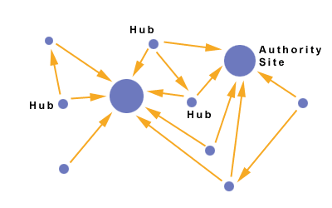
Hubs and Authorities
Authorities are pages containing useful information
Newspaper articles
Wikipedia
Hubs are pages that link to authorities
Facebook
Newspaper homepages

Slide 39
Hubs and Authorities
A good hub points to good authorities
A good authority is pointed to by good hubs
Recursive definition

Slide 40
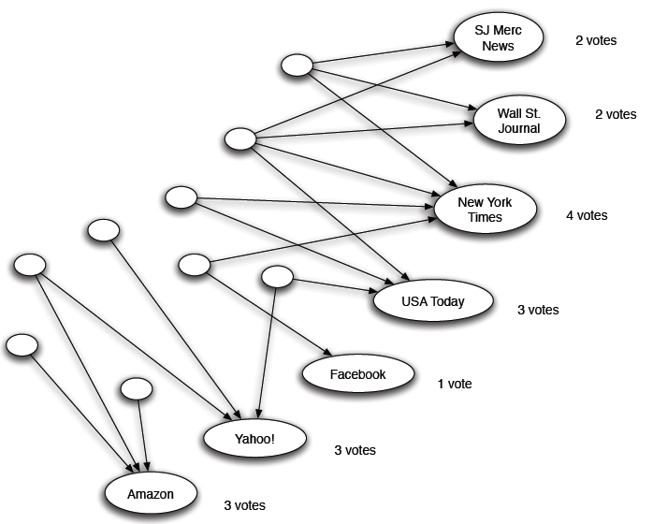
Counting in-links: Authority
Each page starts with hub score 1. Authorities collect their votes
(Note this is idealized example. In reality graph is not bipartite and each page has both the hub and authority score)

Slide 41
Counting in-links: Authority
Sum of hub scores of nodes pointing to NYT.
Each page starts with hub score 1. Authorities collect their votes
(Note this is idealized example. In reality graph is not bipartite and each page has both the hub and authority score)

Slide 42
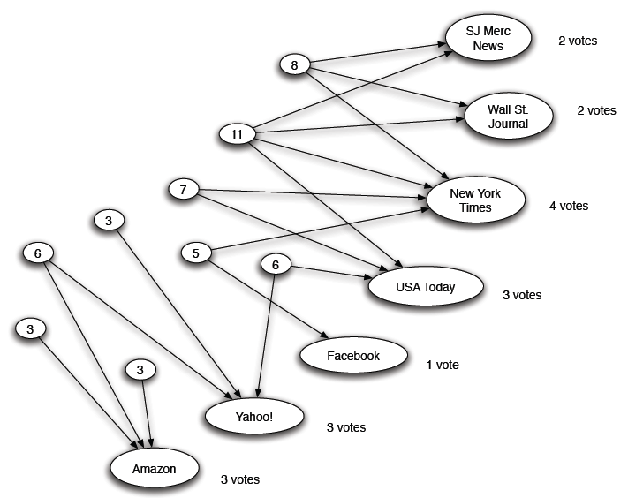
Expert Quality: Hub
Sum of authority scores of nodes that the node points to.
Hubs collect authority scores
(Note this is idealized example. In reality graph is not bipartite and each page has both the hub and authority score)

Slide 43
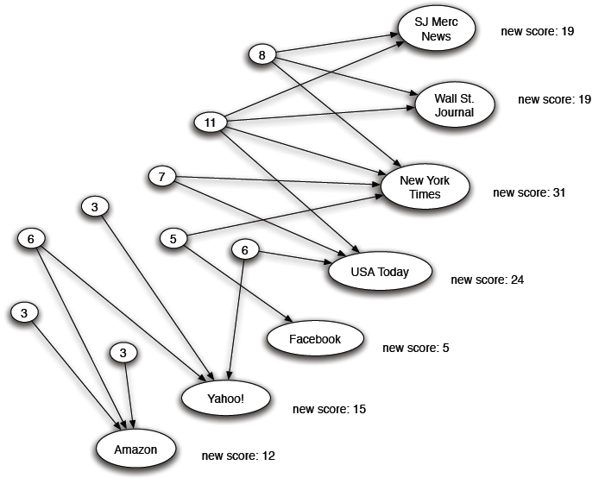
Reweighting
Authorities again collect the hub scores
(Note this is idealized example. In reality graph is not bipartite and each page has both the hub and authority score)

Slide 44
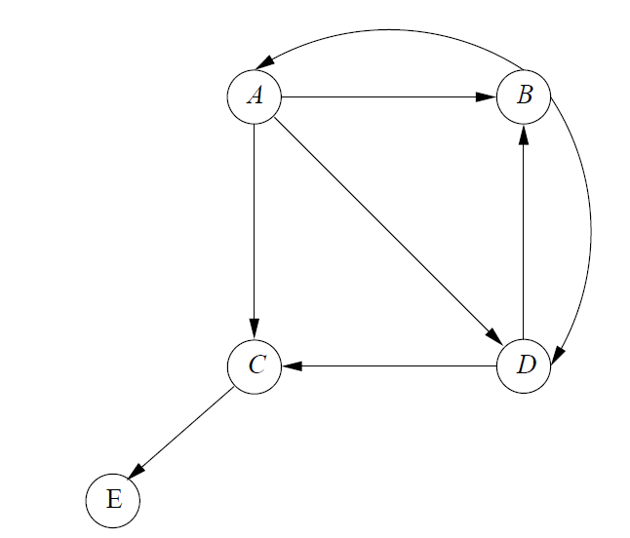
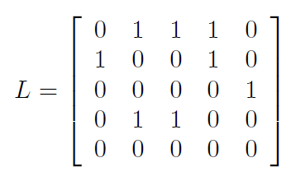

Formulation
h=$λLa$
Hubbiness vector
a=$μL^{T}h$
Authority vector
$λ, μ:$ normalizing parameters

Slide 45
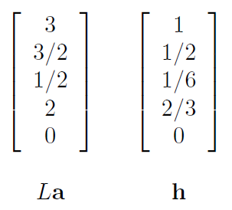
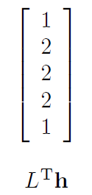
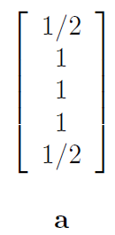

Procedure
Set all nodes as hubs of equal value and compute a
h=vector of 1s
Normalize such that the maximum value is 1
$μ=1/2$
Compute h

Slide 46
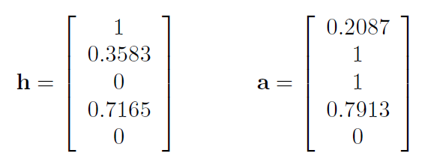
Iterate till convergence
Does it make sense?
B and C have identical incoming links, so same Authority
A has highest no. of outgoing links, so hub score of 1
B and D have same no. of outgoing links, but D points to better authorities. So D has a higher hub score.

