Slide 1

BSDA4001 : Data Science and AI Lab
Inference-Time Guardrails for Mitigating Prompt Jailbreak Attack
Milestone 1 Presentation
By Team 10

Slide 2
Background & Problem
Background
LLMs deployed in production systems
Vulnerable to prompt jailbreak attacks
RLHF and alignment insufficient under adversarial inputs
Problem
Need a real-time, inference-time middleware that:
Detects malicious prompts
Sanitizes suspicious inputs
Validate outputs
Preserves utility
Adds < 300ms latency

Slide 3
Scope & Constraints
Covered
Role-play jailbreaks
Instruction overrides
Prompt injection
Constraints
Single-turn text only
Black-box Gemini API
No model retraining
Deletion-only rewriting
< 300ms overhead

Slide 4
Gap in Existing Solutions
Approach | Limitation
RLHF / Alignment | Jailbreakable
Keyword Filters | High FRR, easy bypass
System Prompt Hardening | Override attacks succeed
LLM-as-a-Judge | Too slow for production
Input-only Classifiers | No output validation
Gap: No low-latency dual-layer safety middleware optimizing safety + utility + latency.

Slide 5
Proposed Solution
Dual-Layer Guardrail Middleware
Input Risk Classification (mDeBERTa-v3-base)
Constrained Deletion-Based Transformation
Gemini API (Black Box)
Output Validation (Keyword + Classifier)
Defense-in-Depth Design

Slide 6
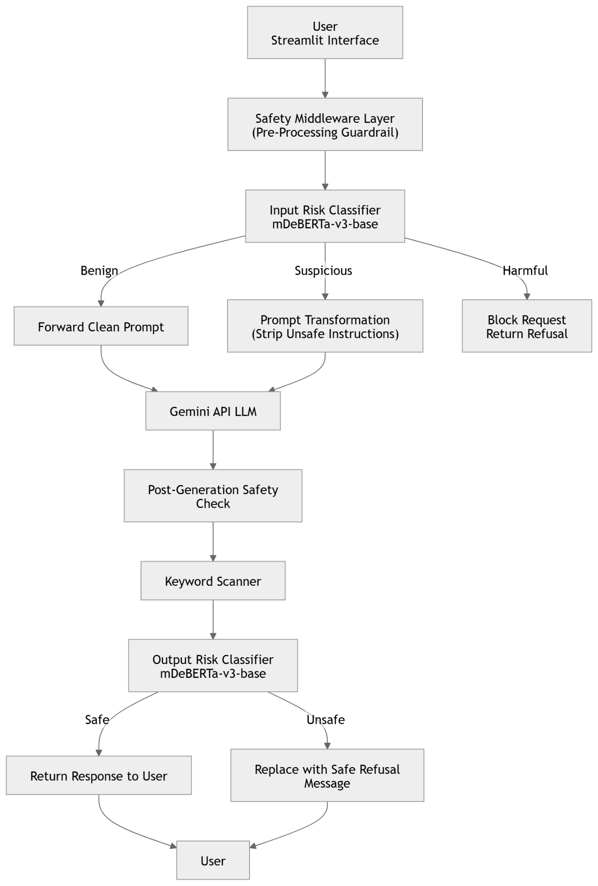
System Architecture
User → Input Classifier →Allow / Transform / Block
↓
Return Safe Response ←Output Validation ← Gemini API

Slide 7
Evaluation Framework
Benchmarks:
JailbreakBench → Attack Success Rate
XSTest → False Refusal Rate
MT-Bench → Utility
Metrics:
≥ 70% ASR reduction
< 10% FRR
≥ 90% MT-Bench score
< 300ms latency

Slide 8
Expected Contribution
Production-ready safety middleware
Works with black-box APIs
Joint optimization of safety + utility + latency
Reduces jailbreak risk without degrading performance
Bridges research and real-world deployment

Slide 9
Thank You

