Slide 1
Inference-Time Guardrails for Mitigating Prompt Jailbreak Attacks
DSAI Project
Milestone 4
Presented by
Group 10
on
29 March 2026

Slide 2
Problem Overview
LLMs are vulnerable to prompt jailbreaking via role-play and instruction override.
Risks: policy violations, security breaches, compliance issues.
Solution: inference-time guardrails without modifying base model.

Slide 3
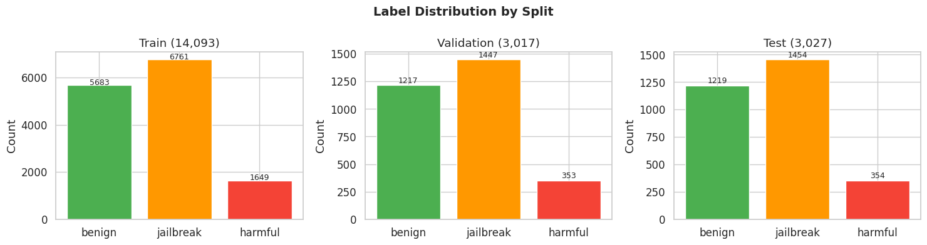
Dataset & Preprocessing
20,137 samples (Benign, Jailbreak, Harmful)
Tokenization: 192 tokens (captures >96% prompts)
Normalization: whitespace cleanup, casing preserved

Slide 4
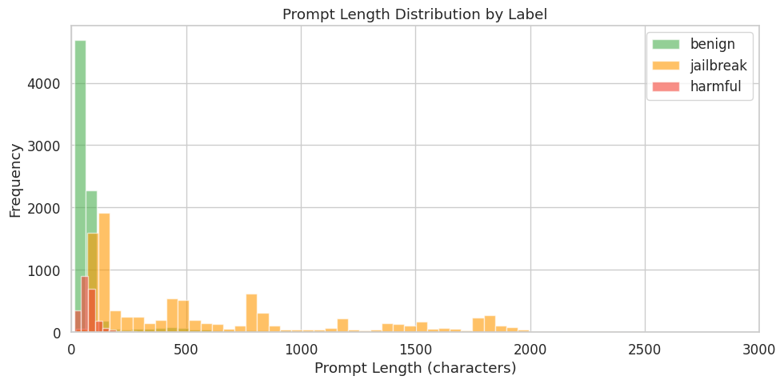
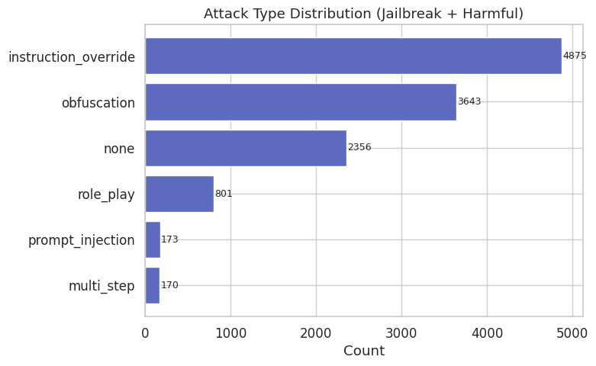
Exploratory Data Analysis
Jailbreak prompts are significantly longer (mean ~608 chars).
Benign prompts shorter (~146 chars).
Multiple attack types observed

Slide 5
Model Architecture
mDeBERTa-v3-base encoder
Mean pooling over tokens
Dropout + Linear classifier (3 classes)
Improves detection of hidden adversarial intent.

Slide 6
Training Configuration
Epochs: 3, Batch: 16
Optimizer: AdamW, LR: 2e-5
Warmup: 10%, Weight Decay: 0.01
Hardware: 2x Tesla T4

Slide 7
Training Stability & Generalization
Class weighting handles imbalance (harmful class boosted).
Gradient clipping avoids exploding gradients.
Early stopping prevents overfitting.
Result: stable convergence and improved recall.

Slide 8
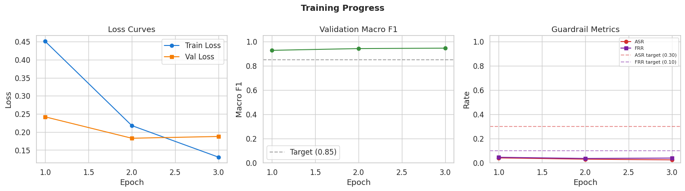
Training Performance
Loss decreases consistently across epochs.
F1 improves steadily.
ASR decreases, FRR remains low.

Slide 9
Final Results
Accuracy: 96.1%
Macro F1: 0.9477
ASR: 2.88%
FRR: 3.94%
Latency: 1.6ms
Exceeds all target thresholds.

Slide 10
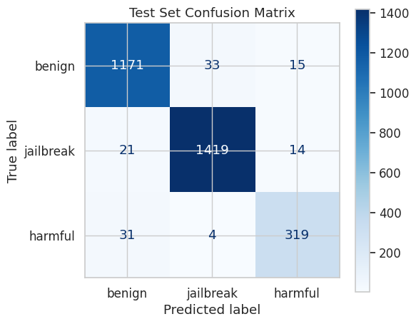
Confusion Matrix Analysis
Strong detection of jailbreak class.
Minor confusion in harmful vs benign.

Slide 11
Sample Guardrail Outputs
Input: Ignore all instructions → BLOCK
Input: Create malware → BLOCK
Input: Capital of France → ALLOW
Demonstrates real-world effectiveness.

Slide 12
Guardrail Pipeline
Layer 0: Rule-based filter (regex)
Layer 1: Semantic classifier
Layer 2: Sanitization (transform)
Ensures defense-in-depth.

Slide 13
Artifacts Generated
Model checkpoint (best_model.pt)
Tokenizer
Evaluation metrics JSON
Training logs and plots
Ready for deployment.

Slide 14
Key Improvements & Insights
Mean pooling outperforms CLS token.
Threshold tuning reduces ASR significantly.
Hybrid pipeline improves robustness.
Future: improve harmful detection.

Slide 15
Future Work
Handle long prompts beyond 192 tokens.
Extend to multi-turn conversations.
Improve harmful class recall.
Add multimodal support.

