Slide 1
Fluctuations, Foes & Flows: Solving Business Challenges for an Electronics & IT Solutions Provider
A Presentation for the BDM capstone Project
Presented by
Antareep Ghosh
Roll number: 23F2001127
IITM Online BS Degree Program,
Indian Institute of Technology, Madras, Chennai
Tamil Nadu, India, 600036
1

Slide 2
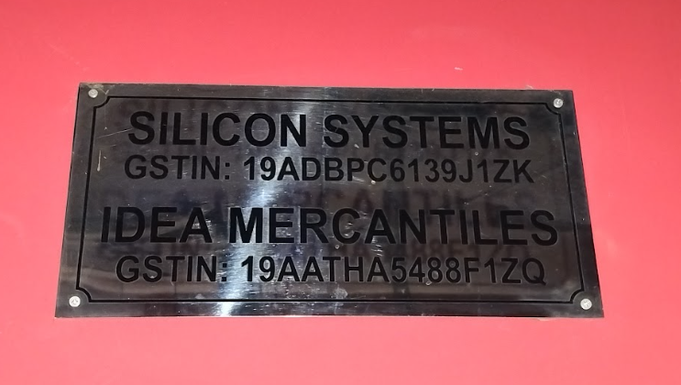
Organisation Background
Silicon Systems is an ISO 9001:2015 certified company registered under MSME, West Bengal and located at Kolkata.
Mr. Atanu Chowdhury, the sole proprietor, operates the brand in Business-to-Business (B2B) mode.
Silicon Systems is an IT solutions, Electronics and Lab Equipment provider for colleges and other businesses across West Bengal.
Silicon Systems generates an average yearly revenue of around Rs. 5 Crores.
The business runs with 10 employees, besides the sole proprietor.
Atanu Chowdhury aims at becoming a one-stop solution for businesses across West Bengal, specifically for educational institutions.
Recently, the business has struggled with scalability, losses due to market fluctuations, heavy competition and certain slow-moving items.
Fig. 1: Silicon Systems’ Title Plate
Fig. 2: Business Owner – Atanu Chowdhury at his store
2

Slide 3
Problem Statements and Solving Methodologies
Problems
Market Fluctuations: Difficulty in efficient inventory management, causing financial losses
Market Competition: Difficulty in fighting new competitors, causing loss of customers
Slow-Moving Goods: Difficulty finding order for certain products, causing scalability issues
Identify the problem through graphs
Identify the problem through graphs
Calculate the quartiles of sale quantities of all items
Classify products into stable, moderate and volatile using statistical analysis
Determine customers who have decreased their purchases using slopes
Segment products into Fast-Moving, Average and Slow-Moving using quartiles
Determine optimum benchmark stocks of items using statistical measures
Segment customers into Loyal, Leverage and Losing using sparkline analysis
Identify products market fits for slow-moving items and dominating sectors using pie-charts
3

Slide 4
Data Collection, Processing and Descriptive Statistics
Primary data was collected directly from the business owner after several meetings and proper explanation of the purpose of the project.
The data collected from the business owner includes Sales Data (Bill Details of Each Sale) and Customer Data (Details of Customers).
The data was provided in spreadsheet format as it was maintained by the business owner.
The data was properly cleaned to remove any null values or anomalies found in it.
For proper time series analysis, month-on-month, months were extracted from bill dates and a new column of month was introduced in the data.
New rows like sector, industry, mobility, category of product were introduced in the sales data for efficient analysis.
Descriptive statistics table was constructed based on sales data as shown in Table 1.
Statistical Values | Quantity (units) | Price (in Rs.) | Amount (in Rs.)
Mean | 13 | 5,881.51 | 44,992.42
Std. Deviation | 15 | 12,207.70 | 1,37,625.93
Minimum | 1 | 5.00 | 5.00
25% | 4 | 400.00 | 2,399.88
50% (Median) | 8 | 1,700.00 | 11,900.00
75% | 17 | 4,300.00 | 39,000.00
Maximum | 152 | 78,500.00 | 22,76,500.00
Table 1: Descriptive Statistics of Sales Data
4

Slide 5
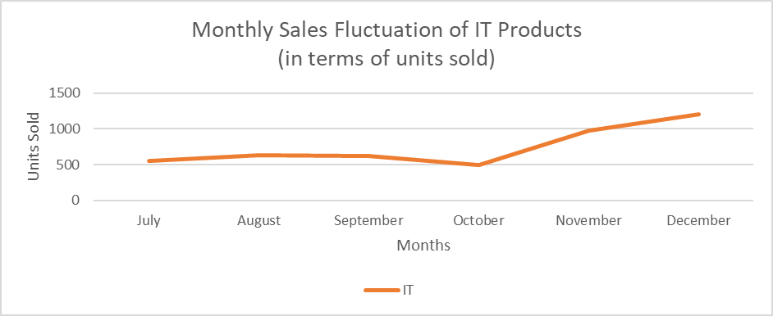
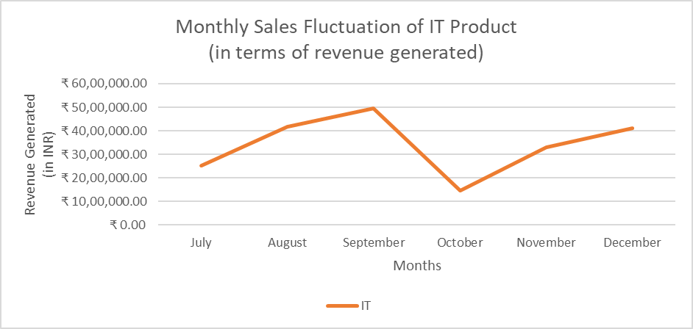
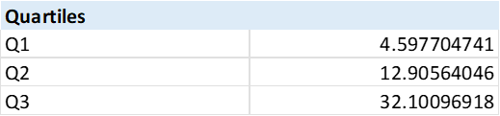
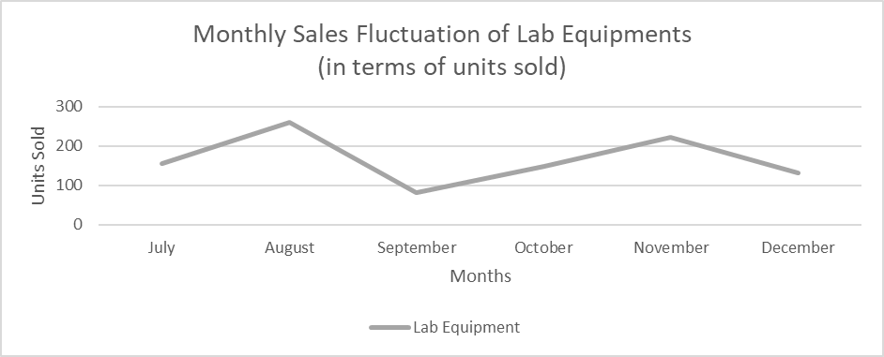
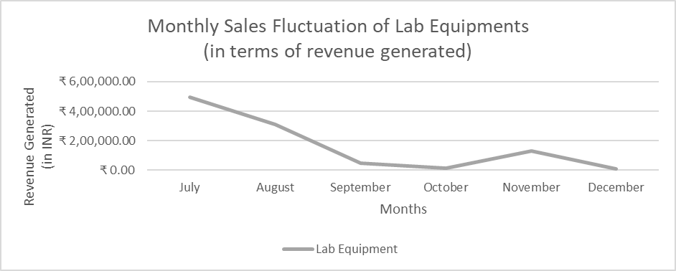
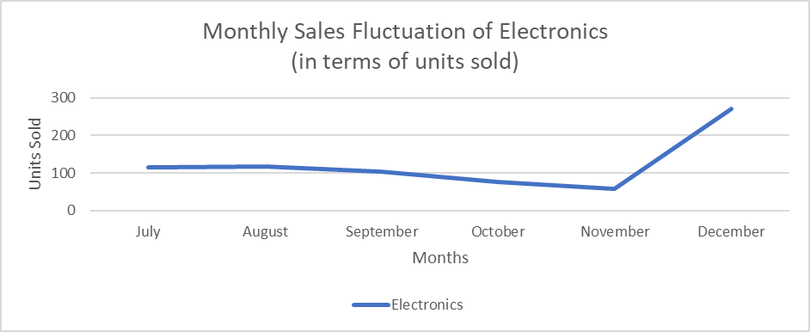
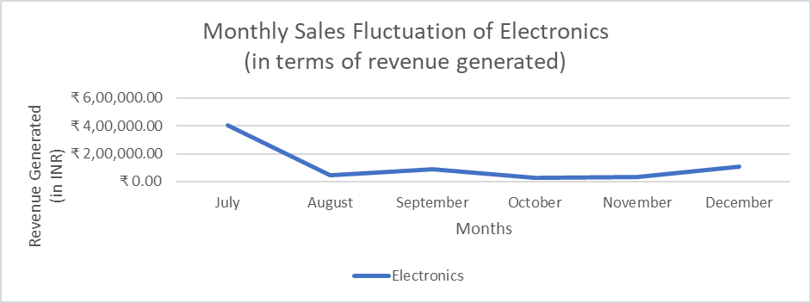
Analysing Market Fluctuations
Table 2: Quartiles of Standard Deviation of Sales
Fig. 3: Monthly Volume Fluctuations in IT Products
Fig. 4: Monthly Revenue Fluctuations in IT Products
Fig. 5: Monthly Volume Fluctuations in Lab Equipment
Fig. 6: Monthly Revenue Fluctuations in Lab Equipment
Fig. 7: Monthly Volume Fluctuations in Electronics
Fig. 8: Monthly Revenue Fluctuations Electronics
Table 3: Volatility in Products
5

Slide 6
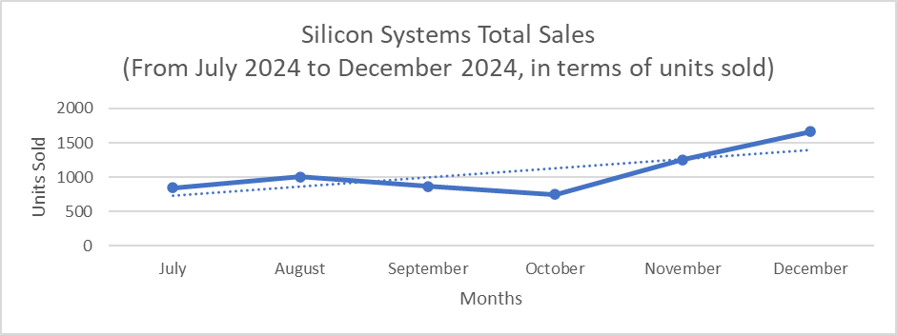
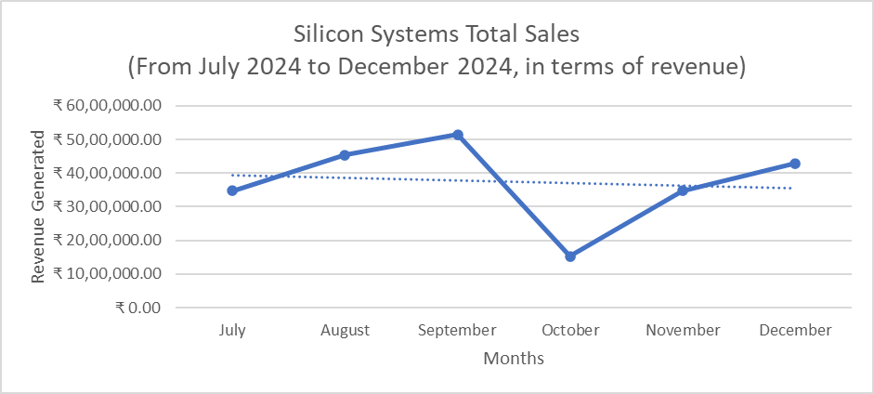
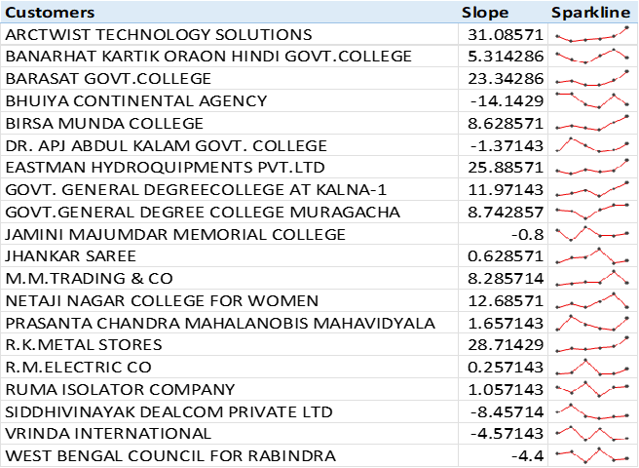
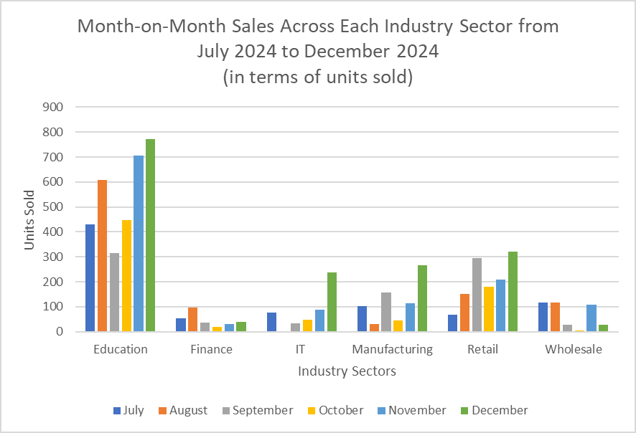
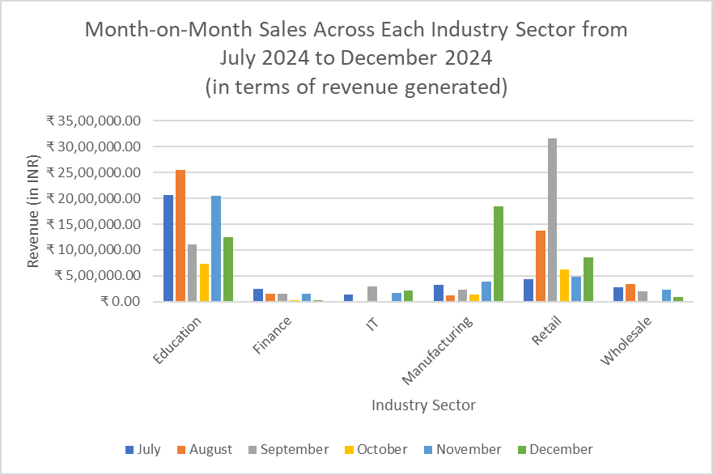
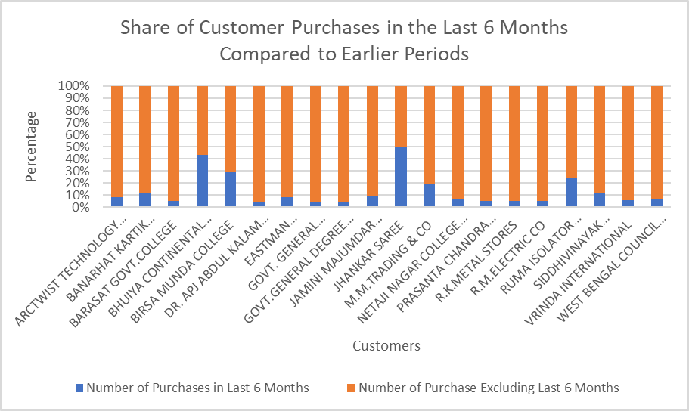
Inspecting Market Competition
Fig. 9: Month-on-Month Sales Volume
Fig. 10: Month-on-Month Revenue
Table 4:Customer-wise Identification of Increase or Decrease in Sales
Fig. 11: Month-on-Month Sales Volume (Industry wise)
Fig. 12: Month-on-Month Revenue (Industry wise)
Fig. 13: Last six months vs All time purchase volume across customers
Table 5:Customer-wise Identification of Increase or Decrease in Revenue
6

Slide 7
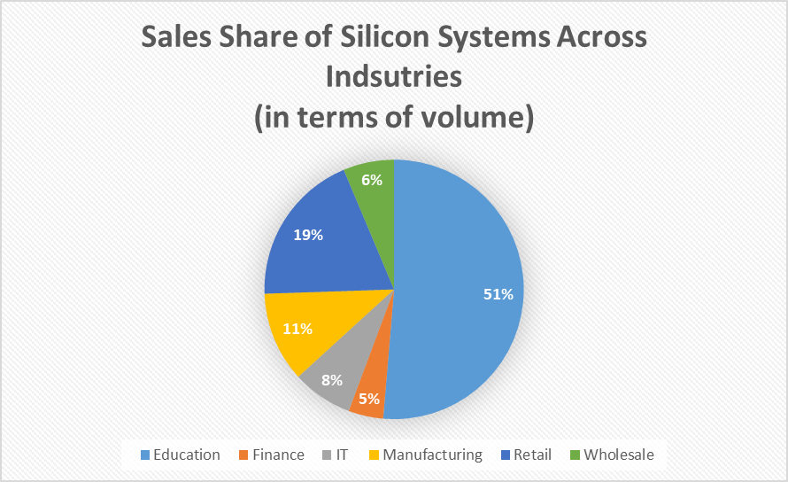
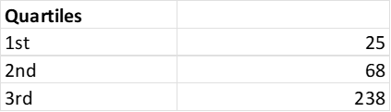
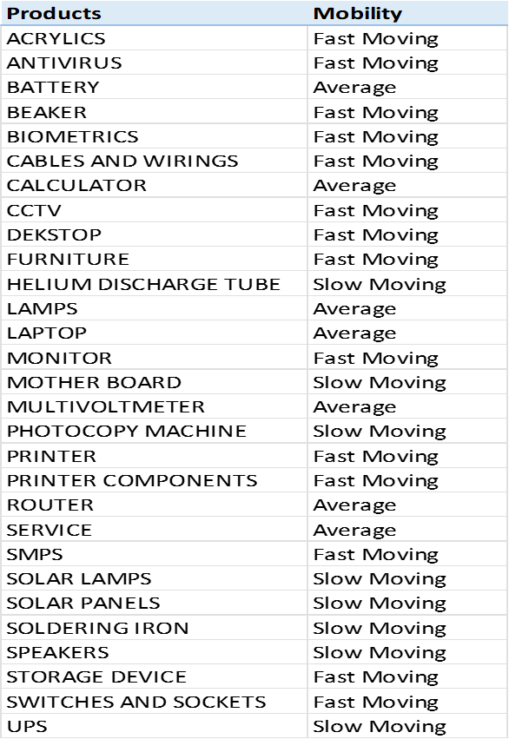
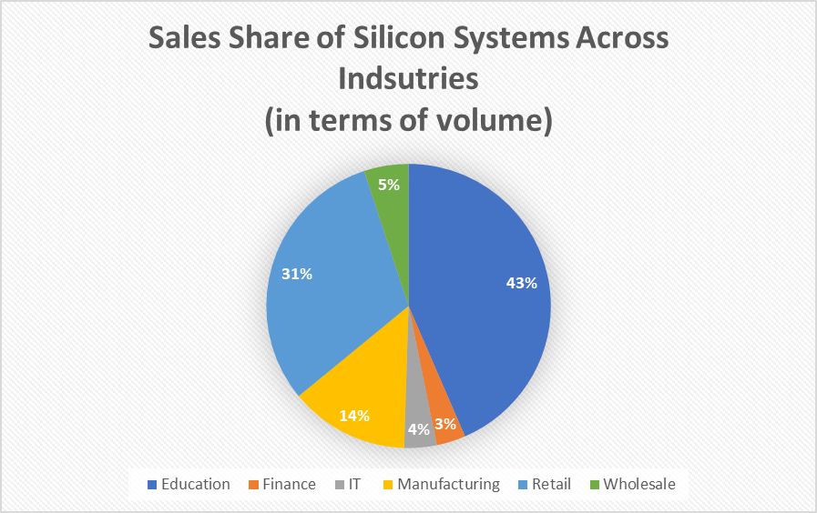
Investigating Slow-Moving Items
Table 6: Sales Quartiles of Products
Fig. 14: Volume Sales Share across Industries
Table 7: Mobility of Products
Fig. 15: Revenue Share across Industries
7

Slide 8
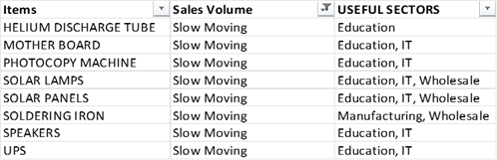
Data Tabulation
Table 9: Customer Segmentation after inspecting market competition
Table 8: Benchmark stock units of products obtained after analysing market fluctuation
Table 10: Product Market Fits for Slow-Moving Goods
8

Slide 9
Recommendations
Solutions for Market Fluctuations
Short-Term (1-2 months): Immediate classification of all products using the
volatility segmentation provided and prioritization of tighter stock control for the
highly volatile items mentioned is necessary. Predictive stocking using calculated
benchmarks for faster delivery readiness needs to be begun.
Mid-Term (3-6 months): Category-specific inventory strategy needs to be
implemented. Introduction of minimum viable stocking buffers for volatile items
as identified in the analyses is required while allowing automated replenishment
of stable products.
Long-Term (>6 months): A dynamic inventory model using rolling median
logic can be established and volatility classification using updated sales data of
every quarter can be performed using automation.
Combating Market Competition
Urgent (0-1 month): The customers identified as “Losing” needs to be reached out to immediately. Tailored deals or engagement offers can be provided to recapture interest. Slow-moving items could be provided to these customers as promotional offer items, strategically solving both the issues of losing customers and slow-moving items.
Short-Term (1-3 months): A competitive pricing strategy can be adopted, or value offers can be bundled in with orders in sections that were identified as vulnerable, like Finance, Retail and Wholesale, to regain market trust.
Long-Term (> 3months): Introduction of customer loyalty programs can be instrumental in holding on to existing customers and gaining new customers at the same time. Customer trends need to be analyzed quarterly for consistent maintenance of engagement.
Remedies for Slow-Moving Goods
Urgent (0-1 month): Initiation of targeted outreach to promote bulk or repeat purchases of slow-moving products by the already existing top buyers is recommended.
Short-Term (1-3 months): To move stagnant inventory, bundled deals or discounted pricing can be performed. Such campaigns should be focused on Education and Retail sectors. Moreover, the slow-moving items can be utilized in form of offers or freebies to attract the customers that were categorized as “Losing”. This solves two purposes at the same time.
Long-Term (>3 months): Evaluation of product-market fit, and re-analysis of the underperforming stocks is essential in regularity. If certain SKUs keep underperforming even after multiple strategies implementation, it is recommended to retire such SKUs to reallocate inventory space for better-selling items.
9

Slide 10
Thank You
10

