Slide 1
Enhancing Gym Profitability by Optimizing Member Retention & Acquisition
BDM Capstone Project
Submitted by:
NAME: Daksh
ROLL NO: 23F2001398

Slide 2

Executive Summary
F4 Fitness Gym
Objective: Enhance profitability of F4 Fitness , a gym located in Pochanpur, Sector –23, Dwarka, Delhi by addressing member retention, acquisition, and overcrowding issues.
Key Challenges: Member retention, member acquisition, and managing peak hour overcrowding.
Goals: Improve profitability through actionable insights and recommendations.

Slide 3
Data Analysis Overview
Data Collection : Demographics Data {Collected for a 1-month period (i.e. August).} Member Behavior Data {Collected for a 1-month period (i.e. August).} Member Distribution Data {Collected for 8 months period (i.e. Jan – August 2024).} Overcrowding Data {Collected for a 1-month period (i.e. August).}
Data Cleaning : The data has been cleaned to ensure the exactness and stability of the analysis because the record was not maintained properly.
Analysis Tools: Line charts, pie charts, column charts for visualization

Slide 4
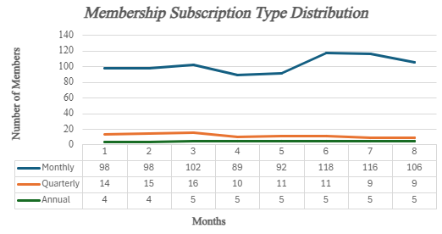
Key Findings: Membership Trends
Monthly memberships are the most preferred but have a high dropout rate.
Annual and quarterly memberships show higher retention.
Total revenue (Jan-Aug): INR 11,61,600.

Slide 5
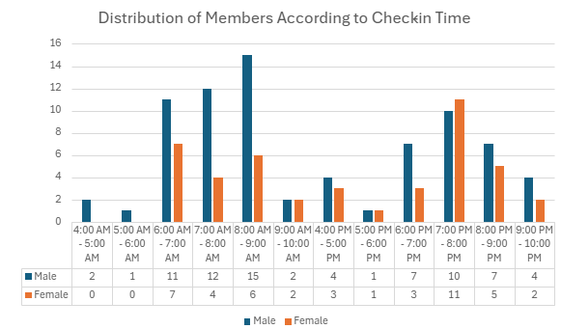
Key Findings: Overcrowding Patterns
Peak Hours: 6 AM - 9 AM and 6 PM - 9 PM.
Off-Peak Hours: 4 AM - 6 AM, 9 AM - 10 AM, 4 PM - 6 PM, 9 PM - 10 PM.
Overcrowding leads to higher equipment waiting times and dropouts.

Slide 6
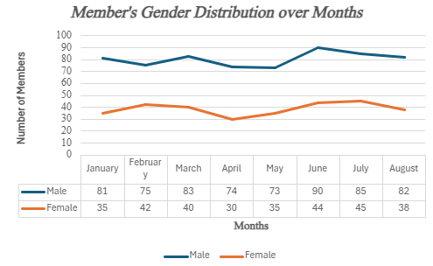
Key Findings: Gender Distribution & Monthly Trends
Male members consistently outnumber female members (Jan-Aug).
Membership increases in March, June, and July due to school/college vacations.
Declines observed in April-May due to reopening of institutions.

Slide 7
Interpretation of Results
Monthly memberships cater to short-term goals, causing higher dropout rates.
Overcrowding during peak hours reduces member satisfaction.
Gender imbalance indicates untapped potential in female memberships.

Slide 8
Recommendations: Retention & Acquisition
Loyalty programs for monthly members.
Seasonal promotions targeting students (March, June, July).
Flexible membership options (e.g., pay-per-visit).
Free trial periods and health workshops for new members.

Slide 9
Thank You

