Slide 1



Enhancing Efficiency in Retail Pharmacies
Challenges and Solutions
PRESENTATION BY
PARAS
ROLL NO. 23f2003850

Slide 2
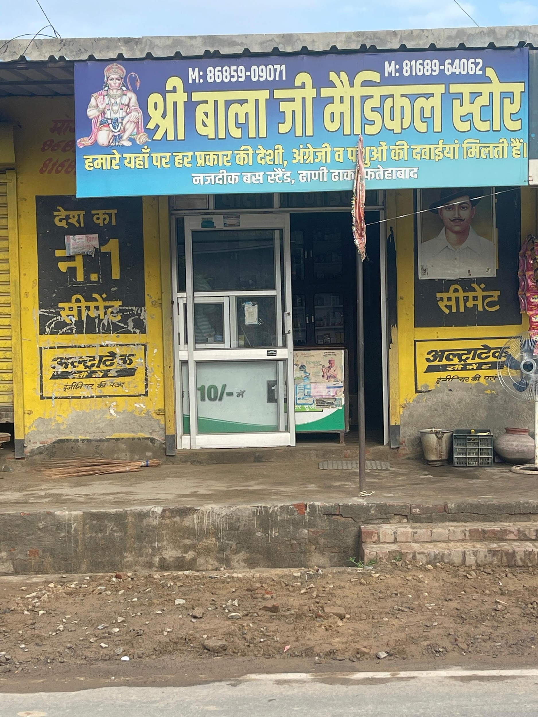



ABOUT THE PROJECT
A retail pharmacy namely ‘SHRI BALAJI MEDICAL STORE' was chosen for the data analysis purpose. 17-week data was collected, processed and analyzed.
Objective of the project was to identify the business problems and find a way out to solve those problems to help the pharmacy owner run the business in a better way.
PROBLEM STATEMENTS
1
2
3
1
2
3
Fluctuating daily sales and frequent stock-outs.
Mismatch between inventory and local demand.
Project Objective: Improve inventory management, sales forecasting, and customer satisfaction.

Slide 3




PROBLEM SOLVING APPROACH
Reaching a large customer base :
Leveraged health camps, local awareness drives, and personalized community engagement to expand outreach and build trust among rural customers.
Utilized targeted inventory stocking and affordable pricing aligned with seasonal and local health needs to attract and retain a broader customer base.
Analyzing time-based Stocks :
Tracked inventory turnover rates by monitoring purchase and sale dates, identifying slow-moving and fast-moving medicines over specific periods.
Used monthly and seasonal stock analysis to optimize reorder schedules and minimize overstock or expiry risks.
Generation of Revenue :
Focused on stocking high-demand and high-margin products to maximize daily sales and overall profitability.
Implemented targeted promotions and bundled offers to boost sales volume and attract recurring customers.

Slide 4
DATA COLLECTED
Time Period of Data Collected : 17-weeks (January 2025 to May 2025)
The project dataset contains detailed pharmacy records, with each column serving a key role:
‘Doctor’ identifies the prescribing medical professional.
‘Purchaser/Patient’ tracks the recipient.
‘Qty.’ lists the quantity dispensed.
‘Particulars’ specifies the exact medicine.
‘Manufacturing Comp.’ notes the manufacturer.
‘Batch No.’ records product traceability.
‘Expiry Date’ ensures quality control.
‘Amount(Rs.)’ captures transaction value.
‘Dated’ logs the date of sale or prescription.
Together, these columns provide a comprehensive view of business operations and stock movement.

Slide 5

ANALYSIS PROCESS
Data was collected from the pharmacy’s sales and inventory records, covering daily transactions, medicine details, quantities, suppliers, expiry dates, and revenue figures.
Pre-processing :
Data entered manually
Use of Excel’s data cleaning tools
Formulas to organize weekly and monthly sheets for key metrics
Descriptive Analysis :
With the help of Excel, different formulas could be used to get the Summary Statistics of the data
The descriptive statistics were calculated using Excel formulas like MAX, MIN and SUM
Further to understand the data precisely and easily, pictorial representations were used
Visualizations such as bar charts, line graphs, and summary tables were generated to clarify demand patterns, identify top and low-selling medicines, and track inventory movement.
Diagnostic Analysis :
The trends across the weeks were very helpful
helped pinpoint periods of peak sales, stockouts, and expiry risks, enabling deeper understanding of operational issues and strategic opportunities for improvement

Slide 6
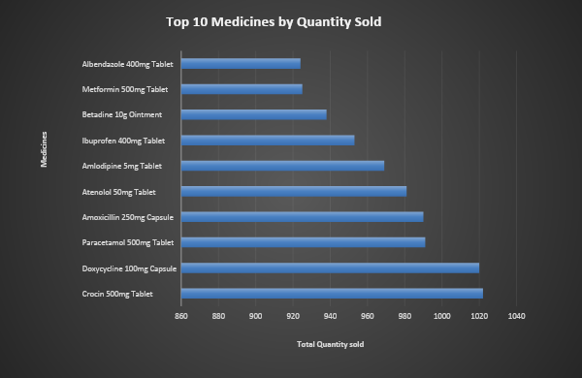
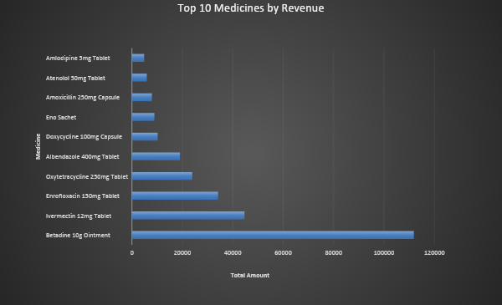
RESULTS
On the basis of sales and revenue, the best 10 products were filtered out.
From both the charts it can be concluded that
‘Crocin 500mg Tablet’ and ‘Betadine 10g Ointment’
dominate the overall sales and revenue generation of the shop respectively.

Slide 7
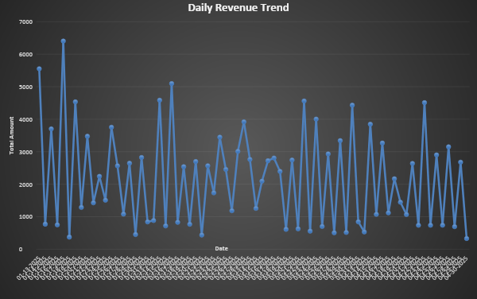
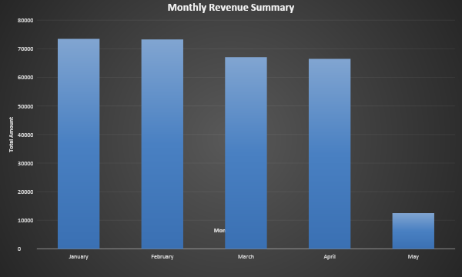
RESULTS
Daily Revenue of all products altogether.
Generally, sales tend to be consistent, but there are clear peaks and valleys
Monthly Revenue of all products altogether.
May's revenue is lower since we only have data up to the 5th.

Slide 8
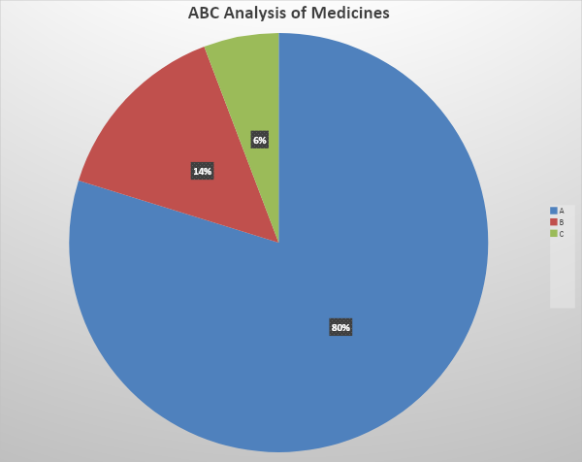
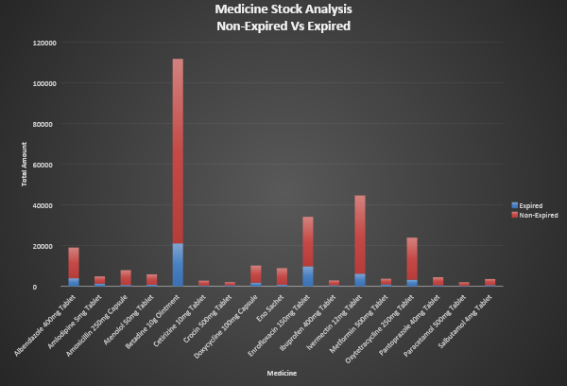
RESULTS
This highlights that just a small selection of medicines is responsible for the majority of the income.
Higher revenue contributing medicines are also contributing higher in loss due to expired medicine.

Slide 9




RECOMMENDATIONS
Launch local health awareness drives and targeted promotions during slow months to attract new customers. Bundle popular products with low-cost health items or offer discounts to increase basket size and build loyalty in the rural community.
Focus on the top-10 products of the shop as they generate more than 90% of the revenue.
Make sure that the inventory of these products is always well-stocked to avoid running out of stock
during peak sales periods.
Monitor and adjust inventory levels before expected seasonal demand shifts (like monsoon or winter illnesses). Use sales data trends to proactively avoid stockouts and reduce deadstock, improving business resilience.
STRATEGY N°1
STRATEGY N°2
STRATEGY N°3

Slide 10

THANK YOU

