Slide 1

DEMAND FORECASTING AND REVENUE OPTIMIZATION
for an E-Commerce Marketplace
BDM Capstone Project · Final Viva Presentation · Secondary Data Route
Nishika Chapra
Roll Number: 23F3000862
23f3000862@ds.study.iitm.ac.in
Dataset: Olist Brazilian E-Commerce Public Dataset (Kaggle) · 99,441 orders · 9 relational tables
IITM Online BS Degree Programme · Indian Institute of Technology, Madras
Org Background
Problem
Data & Method
Cleaning
EDA
Delivery
Segments
Regression
Recommendations
Notes:
Logo is on THIS slide specifically. State name, roll number, dataset (Kaggle Olist, secondary route) up front, calmly.

Slide 2
ORGANIZATION BACKGROUND
Olist — Brazil’s B2C Marketplace
Decentralised marketplace — thousands of independent sellers, one platform
Olist does not sell directly — facilitates listings + logistics support
Sellers list products; customers browse, buy, review
Olist earns a commission per transaction
THE ANALYST’S BRIEF
No in-house logistics fleet — relies on partner carriers
Treats demand, delivery, and customers as unknowns
Brought in to turn transaction data into decisions
99,441
27
~3,000
Orders Processed
Brazilian States
Independent Sellers
~96,000
9
25
Unique Customers
Relational Tables
Months (Sep ’16–Oct ’18)
IITM Online BS Degree Programme | Nishika Chapra (23F3000862)
2
Notes:
Olist is a decentralised B2C marketplace connecting thousands of independent sellers to consumers nationwide, with no in-house logistics fleet. If asked "why secondary, not primary": time constraints; this dataset gives a large, real, multi-year transactional dataset a small primary collection effort could not match in scale.

Slide 3
PROBLEM STATEMENT
Three Objectives
01
02
03
Unpredictable Demand
Delivery Delays
No Segmentation
Order volume swings month to month
Inventory & seller planning suffers
Objective: quantify the pattern
Late orders hurt satisfaction
Root cause unknown
Objective: find what drives delay
Every customer treated the same
High-value vs. one-time — unknown
Objective: build data-driven segments
IITM Online BS Degree Programme | Nishika Chapra (23F3000862)
3
Notes:
These three objectives structure everything that follows -- refer back to "Objective 1/2/3" by number when presenting later results slides.

Slide 4
DATA COLLECTION & METHODOLOGY
Nine Tables, Four Methods
DATA
METHODS
orders — status, purchase/delivery timestamps
order_items — price, freight, product, seller
order_payments — method + value, instalments
order_reviews — 1–5 star rating
customers, sellers — IDs + state
products + category translation table
geolocation — zip coordinates (not used in this analysis)
1. EDA
Tukey’s principle — explore before modelling
2. Time-Series Trend
Linear fit — quantifies growth rate
3. RFM + K-Means (k=4)
Z-score standardised, elbow-validated
4. Multiple Regression
Signed, interpretable delay drivers
WHY KAGGLE, NOT UCI?
Only large-scale dataset covering full order lifecycle: purchase → delivery → review
One coherent source supports all 3 objectives — demand, delay, segmentation
Alternatives were smaller, synthetic, or missing delivery timestamps/reviews
IITM Online BS Degree Programme | Nishika Chapra (23F3000862)
4
Notes:
UCI-vs-Kaggle answer lives on this slide -- read it almost verbatim if asked directly, the one guaranteed secondary-route question. Methods: EDA first (Tukey 1977), then trend, then RFM clustering, then regression -- in that order because each stage justifies the next.

Slide 5
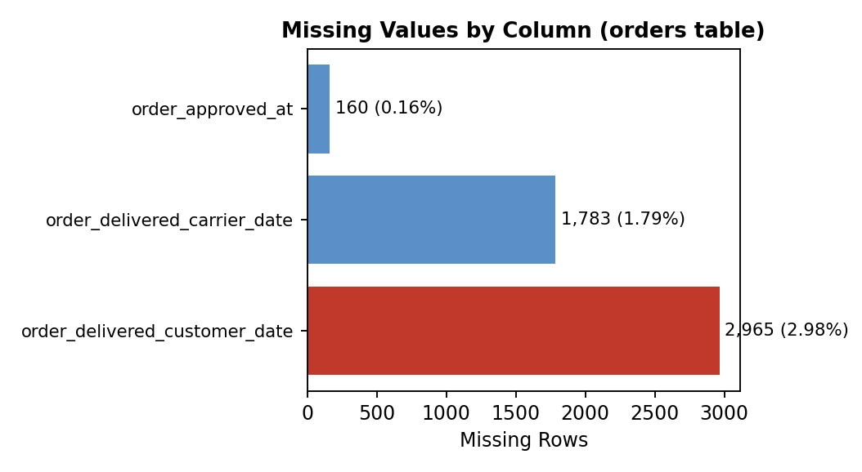
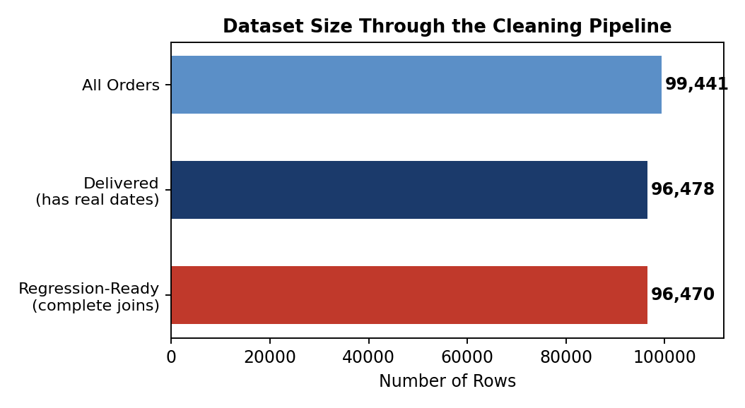
DATA CLEANING & PREPROCESSING
Missing Values, Joins, and the Impact of Each Fix
Missing timestamps = structural (order never delivered) — excluded, not imputed
Payments: 103,886 rows → grouped + summed → 99,441 one-row-per-order
customer_id → customer_unique_id for RFM — avoids duplicate identity
Regression set: 96,470 clean rows after dropping incomplete joins
THE DIFFERENCE IT MADE: Imputing missing delivery dates would have fabricated ~2,965 outcomes; excluding them instead keeps every delay figure in this deck 100% real.
IITM Online BS Degree Programme | Nishika Chapra (23F3000862)
5
Notes:
This slide IS the "problems faced / how resolved" answer -- have 160/1,783/2,965 and 103,886-vs-99,441 and 96,470 on the tip of your tongue. Missing values are structural (cancelled/undelivered orders), not random -- imputing would fabricate outcomes that never happened.

Slide 6
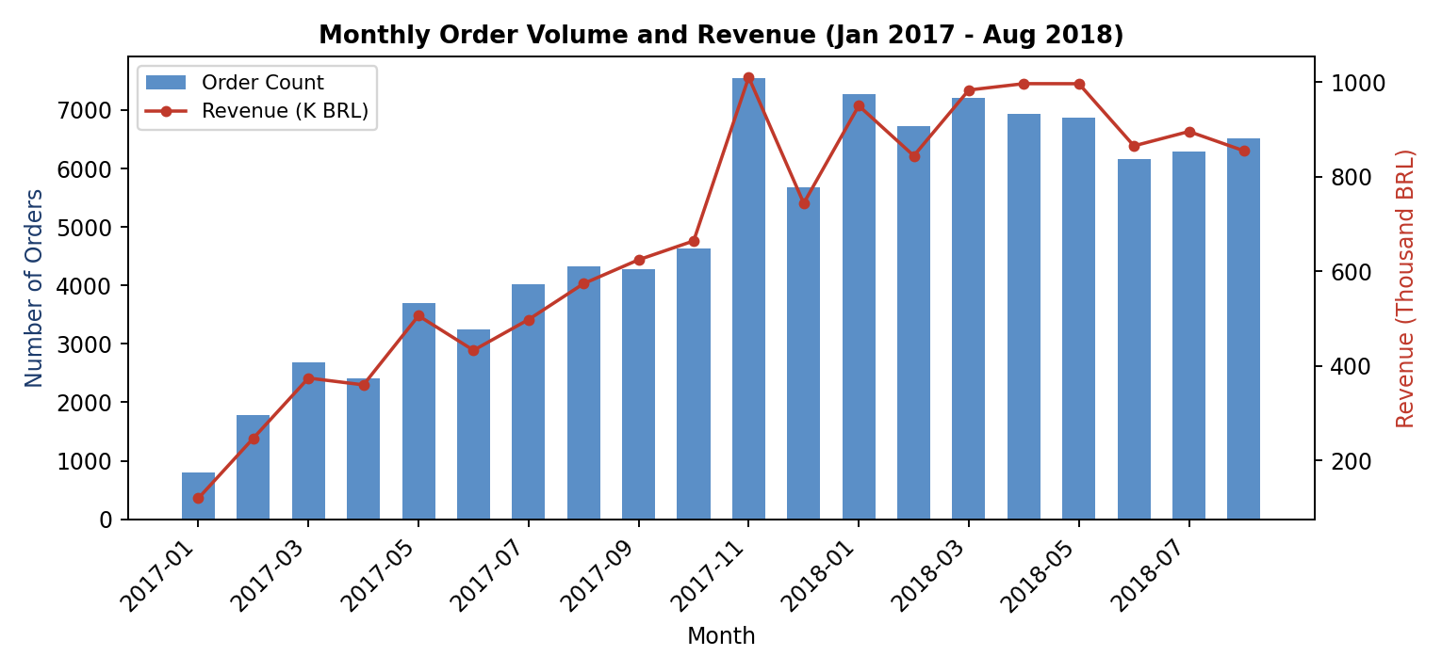
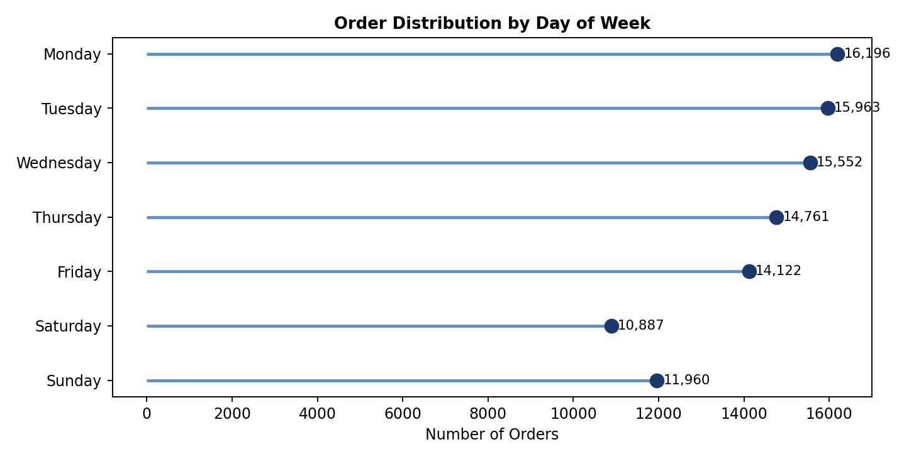
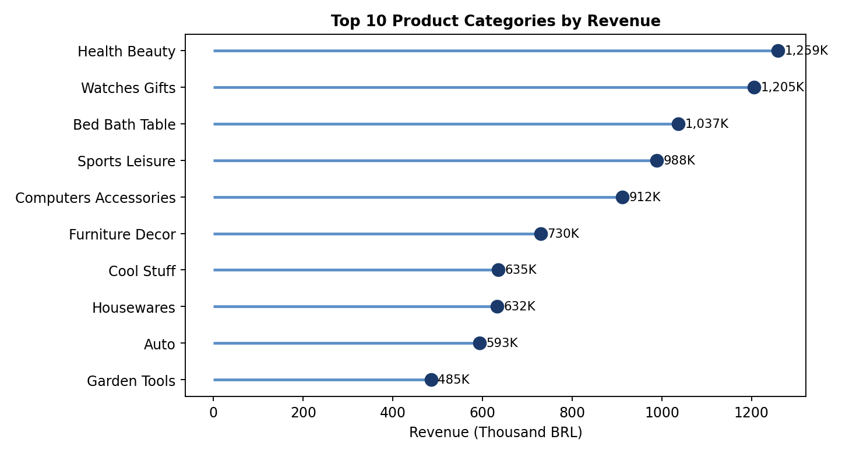
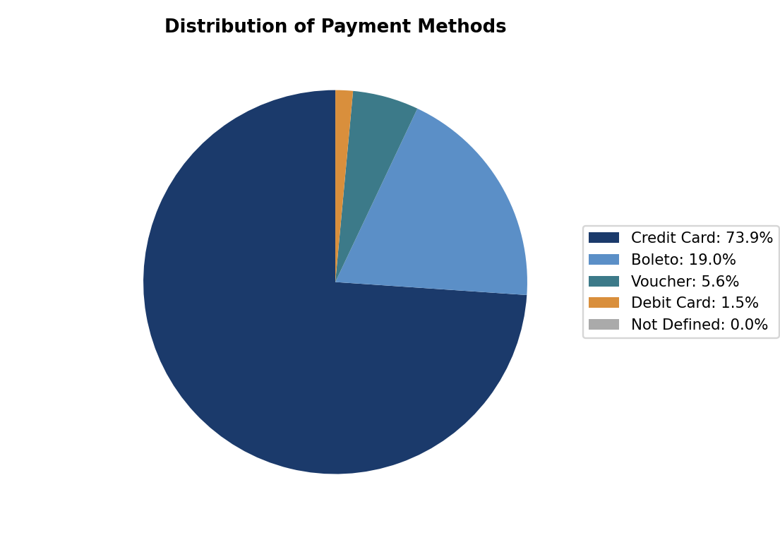
RESULTS 1 OF 4 · FIGURES 1–4
Exploratory Analysis — Demand & Behaviour
Steady growth 2017–18, sharp November (Black Friday) spike
Monday busiest (~16,196 orders), tapers to weekend
Health & Beauty leads; top 10 = ~63% of revenue
Credit card = 73.9% — cheapest campaign audience
IITM Online BS Degree Programme | Nishika Chapra (23F3000862)
6
Notes:
Figure 1: dual-axis, bars=count, line=revenue, two scales one time axis. Figure 2/3: lollipop for ranked categories, less ink than a bar. Figure 4: pie only because payment_type is a composition question, not a ranked one.

Slide 7
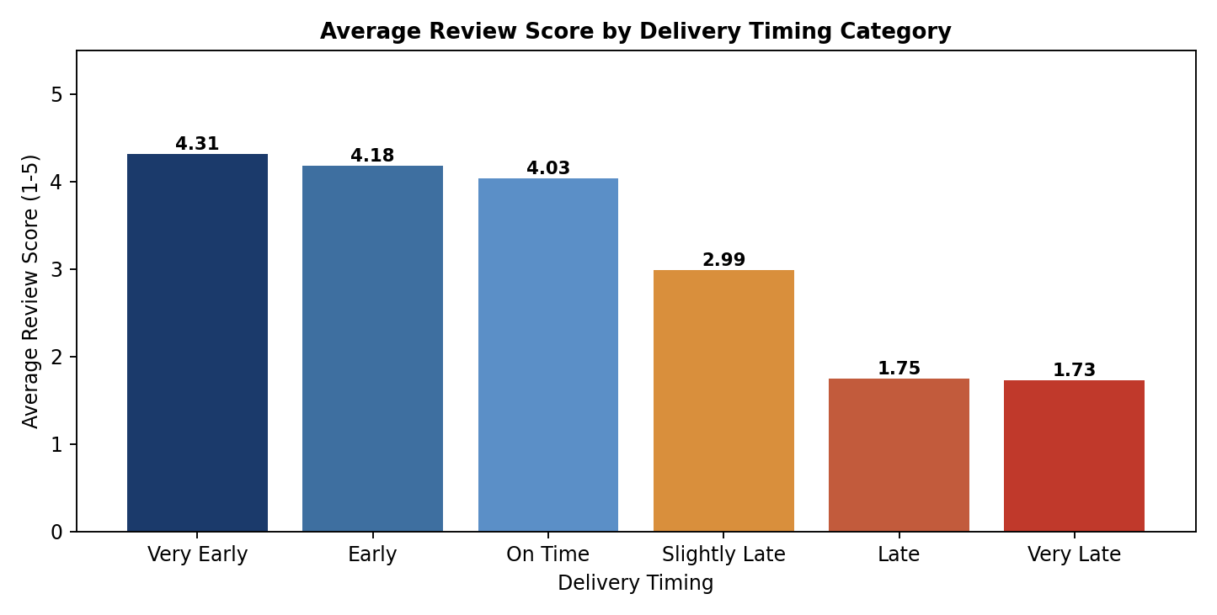
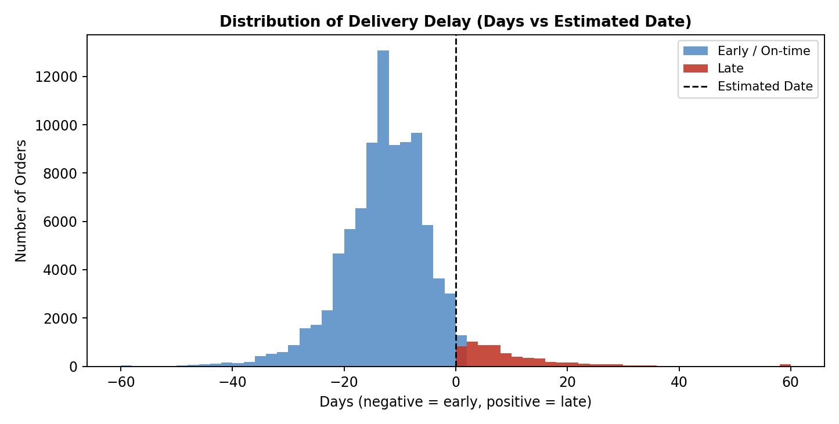
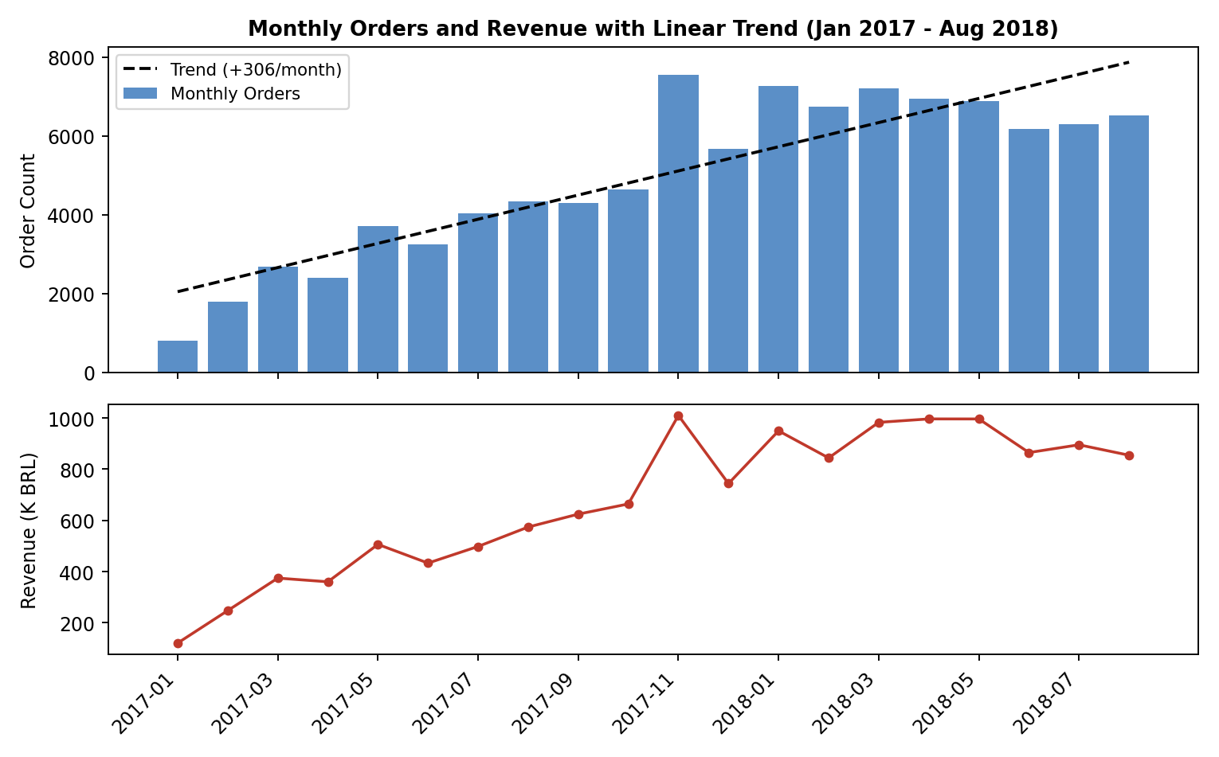
RESULTS 2 OF 4 · FIGURES 5–7
Delivery Timing, Satisfaction & Growth
Review score: 4.31 (very early) → 1.73 (very late) — near-monotonic drop
No other variable moves satisfaction this much
93.2% deliveries arrive early (avg +13.51 days)
Only 6.8% late — but overrun averages 10.62 days
Linear trend: +307 orders/month
AOV flat at ~BRL 161 — growth is volume-driven, not order-size-driven
KEY TAKEAWAYS
Delivery timing is the single biggest lever on customer happiness — answers Objective 2 directly
Delivery-window recalibration is the highest-leverage recommendation in this project
November demand spike is predictable — give sellers 8 weeks’ notice
IITM Online BS Degree Programme | Nishika Chapra (23F3000862)
7
Notes:
Figure 5 is the single most important chart in the whole project -- the review-score-vs-timing bar. Figure 6 dual-colour histogram because the question is about two sub-populations (early vs late), not one distribution. Figure 7: linear trend chosen over ARIMA/Prophet from the proposal because it was sufficient to quantify growth for this scope -- ARIMA/Prophet is the natural next step, say this plainly if asked why you deviated from the proposal.

Slide 8
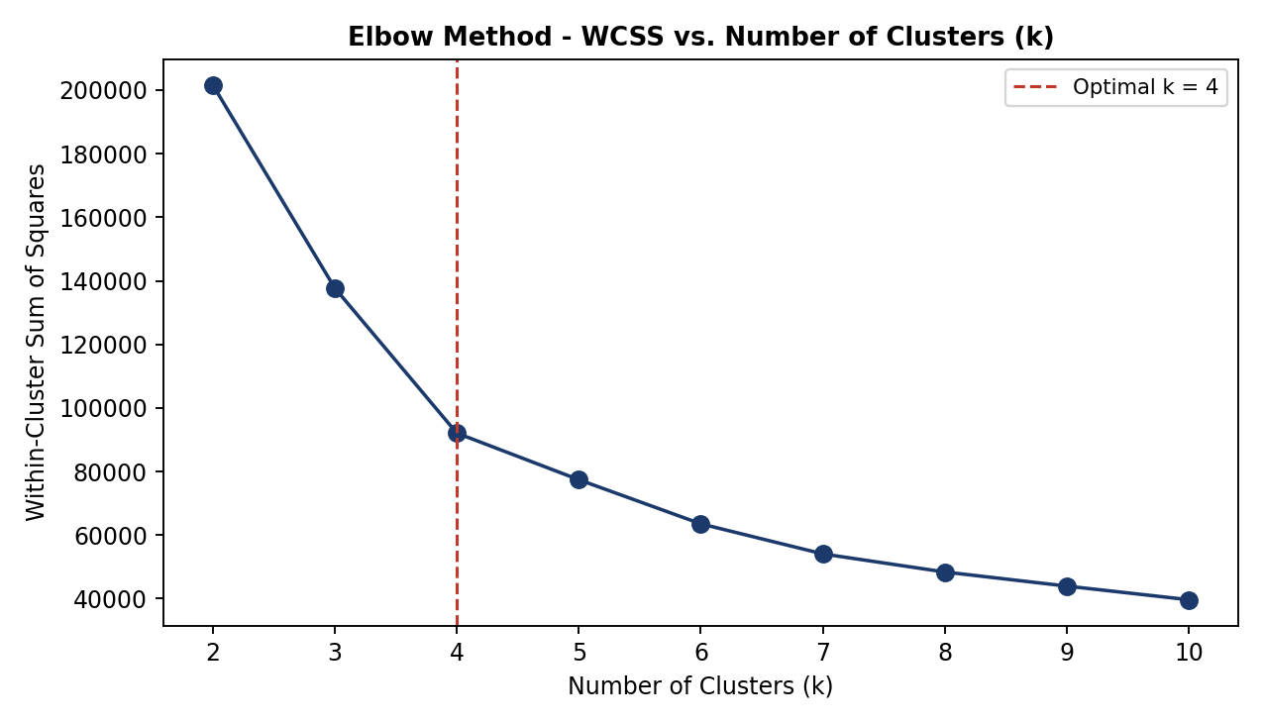
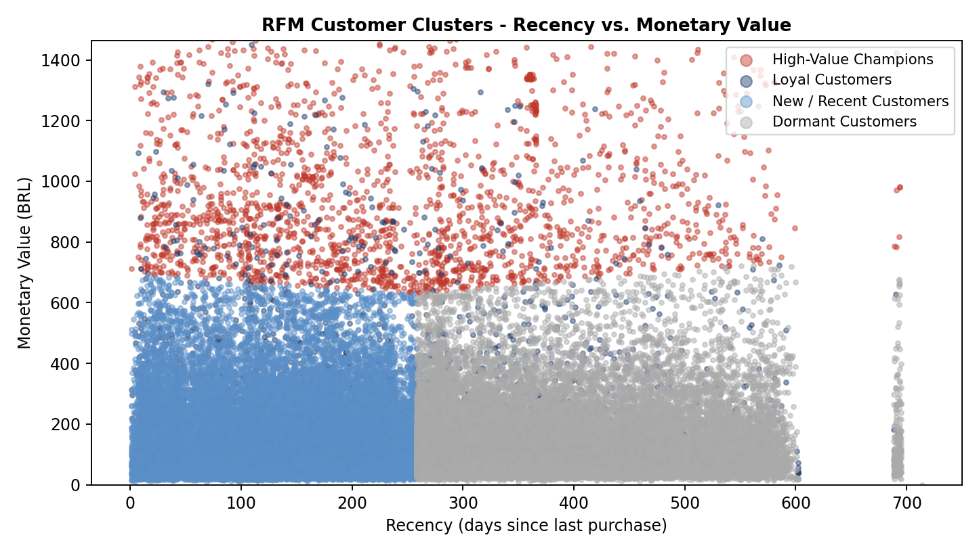
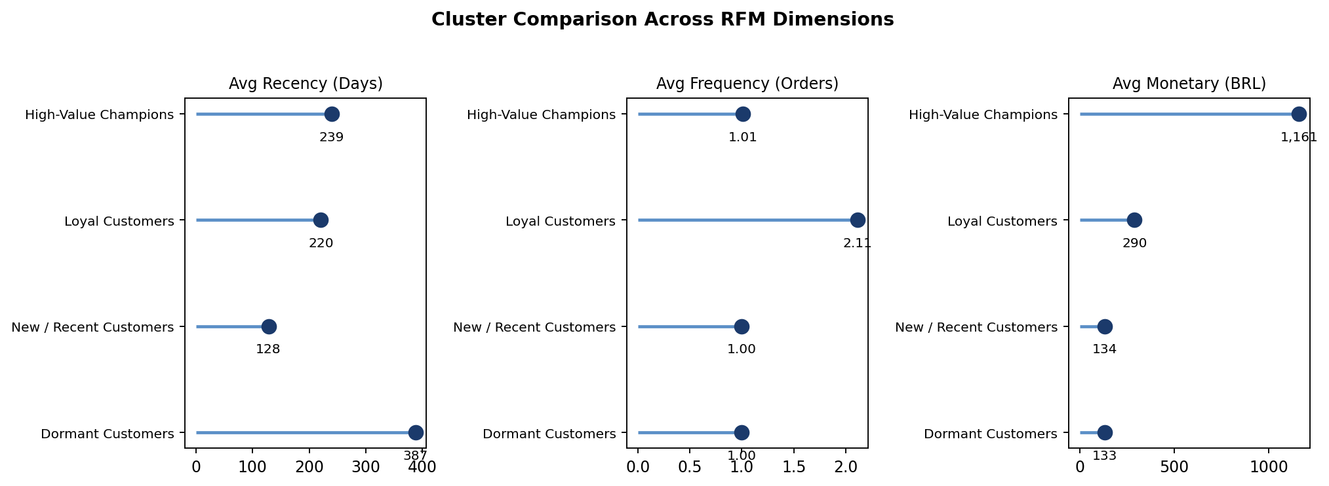
RESULTS 3 OF 4 · FIGURES 8–10, TABLE 3
Customer Segmentation — RFM + K-Means
Segment | n | BRL
High-Value Champions | 2,418 | 1,161
Loyal | 2,772 | 290
New/Recent | 50,642 | 134
Dormant | 37,526 | 133
Elbow bends at k=4 — optimal cluster count
4 distinct clusters, colour-separated by RFM
94.4% of customers are essentially one-time buyers — headline insight
High-Value Champions spend ~7× the platform average per order
Losing 10% of Champions = real revenue hit
Loyal (2,772) proves repeat purchase is achievable, just rare
Segmentation directly answers Objective 3
IITM Online BS Degree Programme | Nishika Chapra (23F3000862)
8
Notes:
Figure 9 is NOT a correlation plot -- it is cluster visualization across two RFM dimensions, colour = cluster membership. If pushed: "I was visualizing cluster membership, not testing correlation; I can compute Pearson r as a side calculation." Elbow (Figure 8) justifies k=4. RFM standardised via z-score so Monetary (thousands of BRL) does not swamp Frequency (1-20) in the K-Means distance calculation.

Slide 9
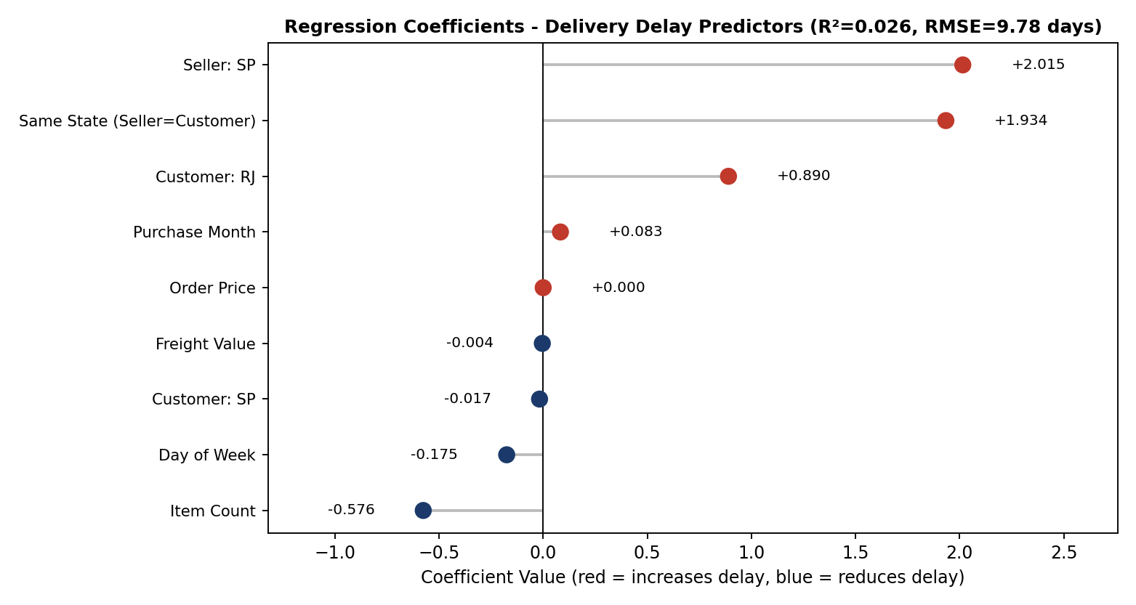
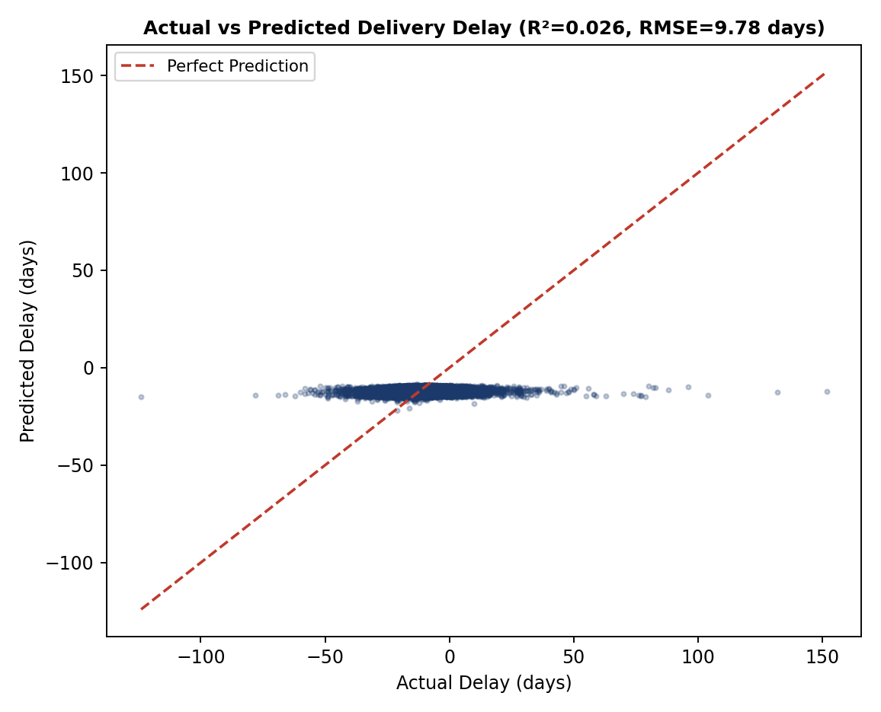
RESULTS 4 OF 4 · FIGURES 11–12, EQUATION 6
Regression — What Drives Delivery Delay
TWO SURPRISES
Seller: São Paulo → +2.02 days — hub congestion beats geography
Same-state → +1.93 days — also a routing artifact, not distance
Item count → −0.58 days — multi-item orders are batched, faster
R² = 0.026 — honest limitation, not hidden
No carrier-level routing data in this secondary dataset
IITM Online BS Degree Programme | Nishika Chapra (23F3000862)
9
Notes:
Figure 12 correlation IS meaningful: r-squared relates directly to R2=0.026 -- weak positive relationship, consistent with the loose scatter around the diagonal. Standard deviation fact if asked generally: payment_value mean=160.99, SD=221.95 -- SD greater than mean because the distribution is heavily right-skewed. Outlier fallback: "kept intentionally -- a BRL 13,664 order is a real high-value sale, not a data error; capping delay_days would be a next step for regression stability." IQR-capping code if pushed: Q1,Q3=df[col].quantile([.25,.75]); IQR=Q3-Q1; lower,upper=Q1-1.5*IQR,Q3+1.5*IQR.

Slide 10
INTERPRETATION & RECOMMENDATIONS
Quantified Actions, Honest Limits
Recalibrate delivery windows + decongest São Paulo hub
LIMITATIONS
≈2,434 orders late → on-time (6.8% → 4.0–4.5%)
No carrier-level data — R² capped at 0.026
Window predates post-pandemic shifts
product_weight_g not joinable at order level
One-time-buyer rate may be a dataset artifact
14-day re-engagement, target 73.9% credit-card users
50,642 × 8% conv ≈ BRL 652,230
VIP programme for High-Value Champions
2,418 × 10% risk × BRL 1,161 = BRL 280,708 protected
8-week seller notice before November spike
37,526 Dormant × 5% win-back ≈ BRL 302,066
CONCLUSION
One-time buyers = primary growth lever
Next step: ARIMA/Prophet forecast + carrier-level data
Thank You · Nishika Chapra · 23F3000862 · 23f3000862@ds.study.iitm.ac.in
Notes:
AI-usage question: answer plainly and once -- "yes, I used AI assistance for parts of the code and drafting, and I can explain and rebuild any piece of it live." Every recommendation number has a stated conversion-rate ASSUMPTION -- say so upfront if asked "is this mathematical." If asked "what would you tell the business owner tomorrow morning": recalibrate delivery windows first (policy not tech, highest leverage), then the 14-day re-engagement email (94.4% one-time buyers), then brief the SP logistics team on hub congestion.

