Slide 1

NutriVision –
AI-Powered Indian Food Nutrition Estimator
BS IN DATA SCIENCE AND APPLICATIONS, IIT MADRAS
GROUP 2

Slide 2
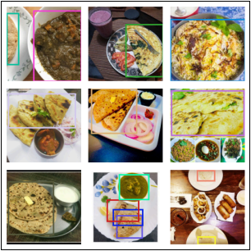
Problem Statement
Content
Estimating nutrition intake from meals is difficult because:
Indian meals contain multiple food items on one plate
Portion sizes vary significantly
Manual calorie logging is inconvenient
Existing apps require manual food entry
Our Solution
NutriVision uses Computer Vision + AI + RAG to automatically estimate:
Food type
Portion weight
Nutritional intake
Personalised diet suggestions

Slide 3
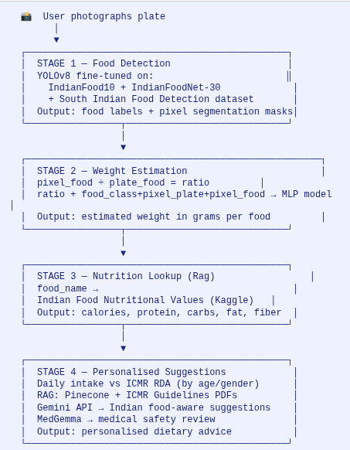
NutriVision – AI-Powered Indian Food Nutrition Estimator
Milestone 2: Dataset Analysis, EDA & System Architecture
Team: Group 2
Objective
Build an AI system that detects Indian food from a plate image
Estimate portion size
Calculate nutrition values
Provide personalized diet suggestions
The system consists of 4 major stages
Food Detection : Model: YOLOv8
Weight Estimation : Model: MLP regression model
Nutrition Lookup : Source: Indian Food Nutrition Dataset
Personalised Suggestions : RAG + Gemini + MedGemma

Slide 4
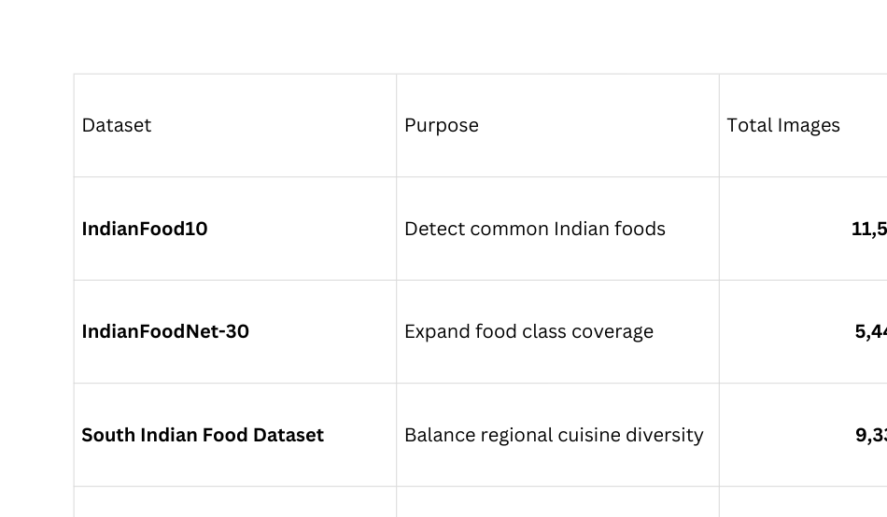
Datasets Used

Slide 5
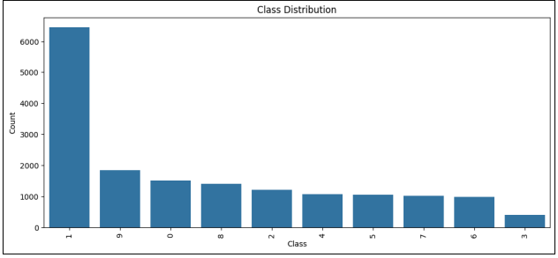
IndianFood10 Dataset
Source: Roboflow Universe
11,547 images
10 food classes
Annotated with bounding boxes
842 multi-dish plates
Classes include:
chapati
rice
dal
idli
vada
sambar
poha
pongal
Problem observed:
Class imbalance across categories: Class 1 has 6000 images
Data augmentation for minority classes

Slide 6
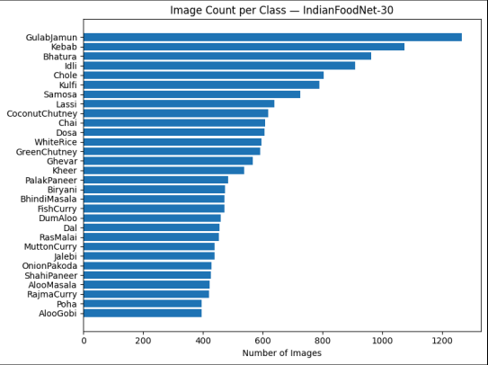
IndianFoodNet-30 Dataset
Purpose: Increase food class coverage.
5,446 images
30 Indian dishes
Bounding box annotations
Examples of added foods:
biryani
butter chicken
dosa
rajma
aloo paratha
chole
Problem observed:
Class imbalance across categories
Solution:
Data augmentation for minority classes

Slide 7
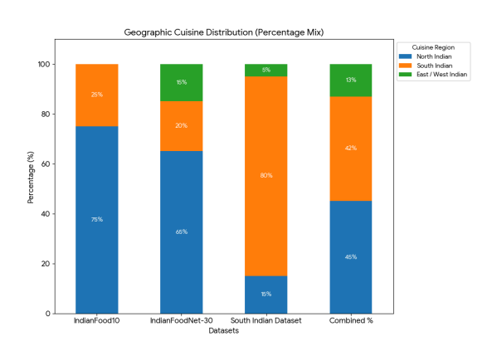
South Indian Food Dataset
Purpose :
Balance regional representation.
9,338 images
Focus on South Indian cuisine
Key foods:
dosa
idli
vada
rasam
uttapam
payasam
chutney
Impact
Without dataset
South Indian representation: 23%
After combining datasets
South Indian representation: 42%

Slide 8
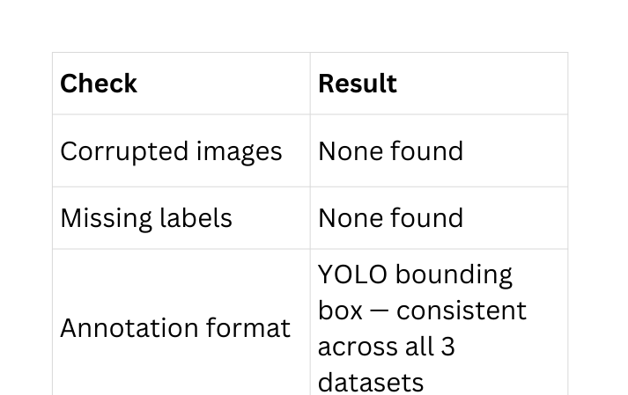
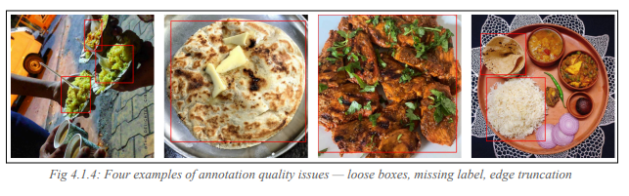
Dataset Quality Analysis
Annotation quality check results:

Slide 9
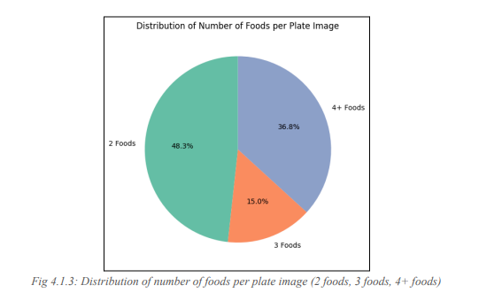
Multi-Dish Plate Analysis
Multi-dish plates are critical because:
Real Indian meals contain multiple foods
Model must detect multiple items simultaneously
Statistics:
2 foods: 68%
3 foods: 24%
4+ foods: 8%
Most common plate combination:
Rice + Dal + Roti

Slide 10
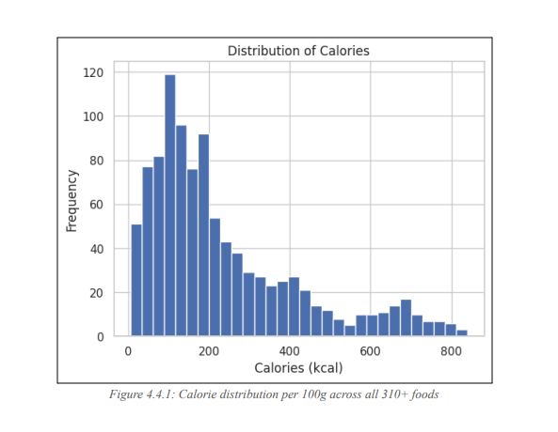
Nutrition Dataset
Source: Kaggle Indian Food Nutrition Dataset
1014 rows
Nutritional values per 100g
Features include:
calories
protein
carbohydrates
fat
fiber
sodium
calcium
iron
Used for nutrition lookup after weight estimation.

Slide 11
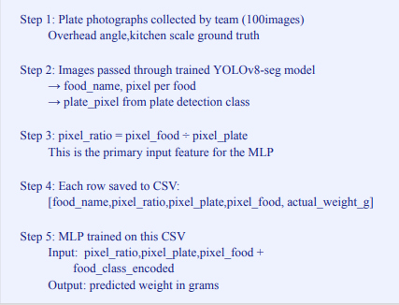
Weight Estimation Dataset
Problem:
No public dataset exists for food weight estimation.
Solution:
Custom dataset will be created by the team.
Dataset:
100 plate images
Ground truth weight measured with kitchen scale
Pipeline:
Capture plate image
Run YOLO segmentation
Calculate pixel ratio
pixel_ratio = food_pixels / plate_pixels
Train MLP to predict weight.

Slide 12
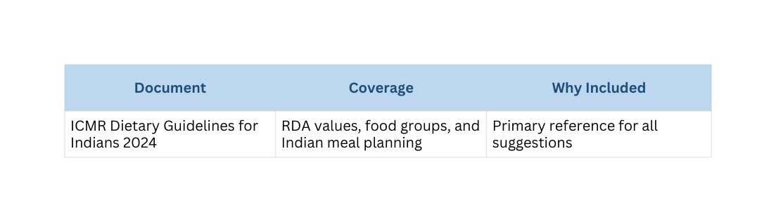
RAG Nutrition Suggestion Pipeline
After nutrition calculation, the system generates diet suggestions.
Components:
Gemini API → reasoning engine
Pinecone → vector database
ICMR guidelines → nutrition reference
Process:
Detect nutrient deficit
Retrieve ICMR guideline passages
Generate personalised recommendations

Slide 13
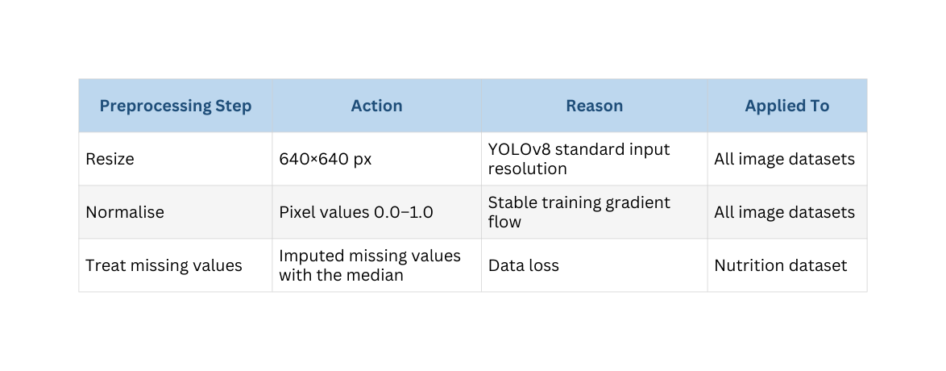
Alternative Plan
To ensure consistent model training:
Image preprocessing:
Resize → 640×640
Augmentation:
brightness adjustment
rotation
scaling
Annotation preparation:
segmentation masks generated using SAM-2

Slide 14
Conclusion
Key achievements of Milestone-2:
Multiple datasets identified and analysed
Dataset quality assessed
Class imbalance identified and addressed
Custom dataset created for weight estimation
Preprocessing pipeline defined
Result:
Dataset is now ready for model training in Milestone-3.

