Slide 1


DeepTrace: Orchestrating Long-Context OCR
and
Causal Explainability for Document Intelligence
Team Members: Sibani Tiwari 23XV1M6758(DS)
Harini Chopperla 23XV1M6752(DS)
Saika Brinda 23XV1M6730(DS)
Zoya Fatima 23XV1M0534(CSE)
Guide Name : Dr. Ramesh Babu Pittala

Slide 2

Introduction & Motivation
1. Why Is This Needed?
Enterprise documents are long, complex, and information-dense.
Existing systems struggle with long-context understanding and often cannot clearly explain their predictions.
There is a need to connect text, layout, and structural information in document analysis.
2. Motivation
Develop a transparent and trustworthy Document Intelligence system.
Combine Long-Context OCR + Hierarchical Layout Understanding + XAI.
Use Integrated Gradients to identify which document content influences predictions.
3. Relevance
Important for enterprise and high-stakes applications where incorrect interpretations can have consequences.
Traceable explanations support human verification and trust.
Can support multi-page and structurally complex documents.

Slide 3

Problem Statement
1
Background
Current systems can increasingly answer “What is the answer?”, but DeepTrace focuses on answering “What evidence in the document led to this answer?”
2
Problem Definition
How can feature-attribution information from a document understanding model be mapped back to the corresponding OCR-derived text and spatial regions of a medical or legal document to produce a human-interpretable explanation of the model's prediction?
3
Need for the Project
Trust: Users need to verify AI-generated results against the source document.
Transparency: Models should provide evidence rather than only predictions.
Efficiency: Highlighting relevant regions can reduce manual document verification.
Reliability: Evidence localization can help identify incorrect or irrelevant model reasoning.
High-impact applications: Particularly valuable for medical and legal research, with potential applications in government, academia, finance, and other complex document-processing workflows.

Slide 4
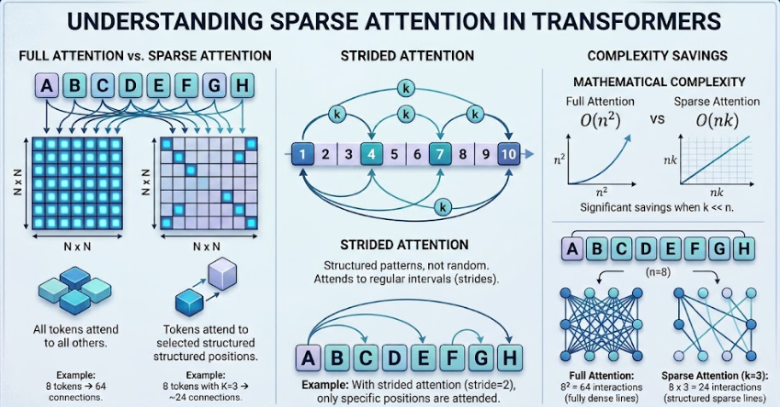
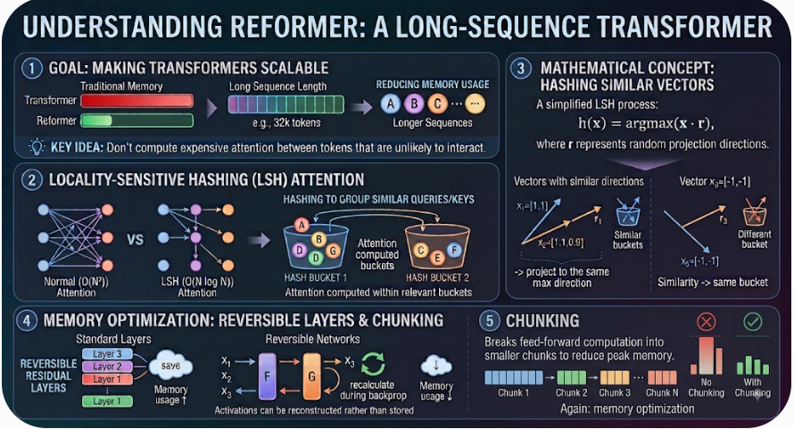
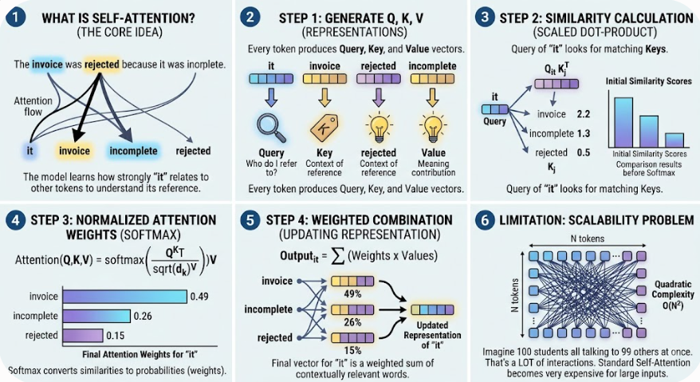
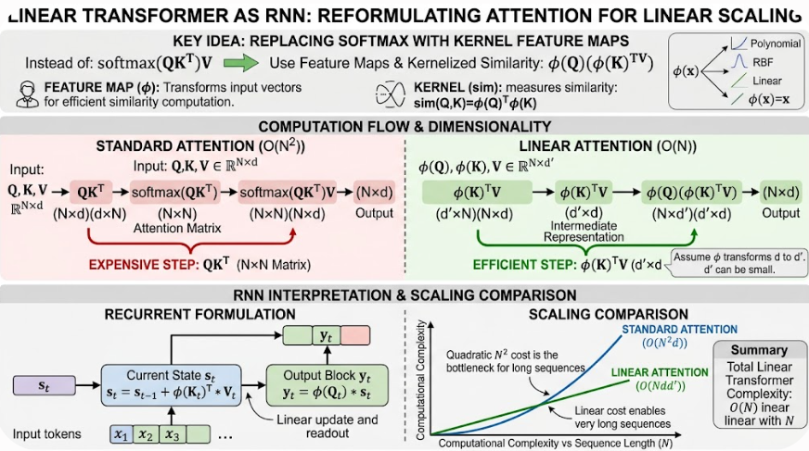
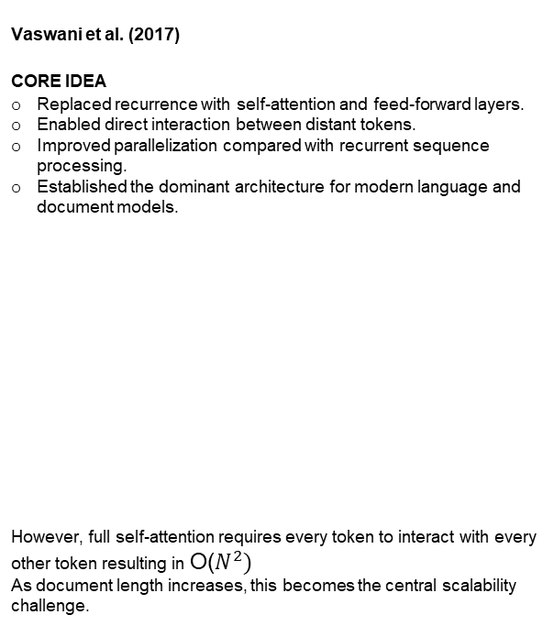
2.1 Long Context Document Understanding
1) Attention Is All You Need
Vaswani et al. (2017)
CORE IDEA
Replaced recurrence with self-attention and feed-forward layers.
Enabled direct interaction between distant tokens.
Improved parallelization compared with recurrent sequence processing.
Established the dominant architecture for modern language and document models.
However, full self-attention requires every token to interact with every other token resulting in O($N^{2})$
As document length increases, this becomes the central scalability challenge.
Limitation

Slide 5
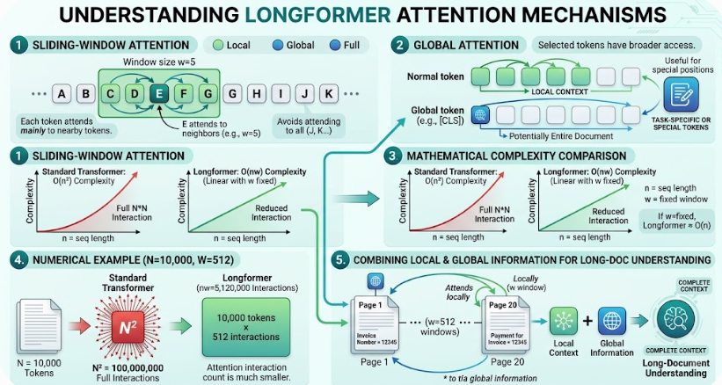
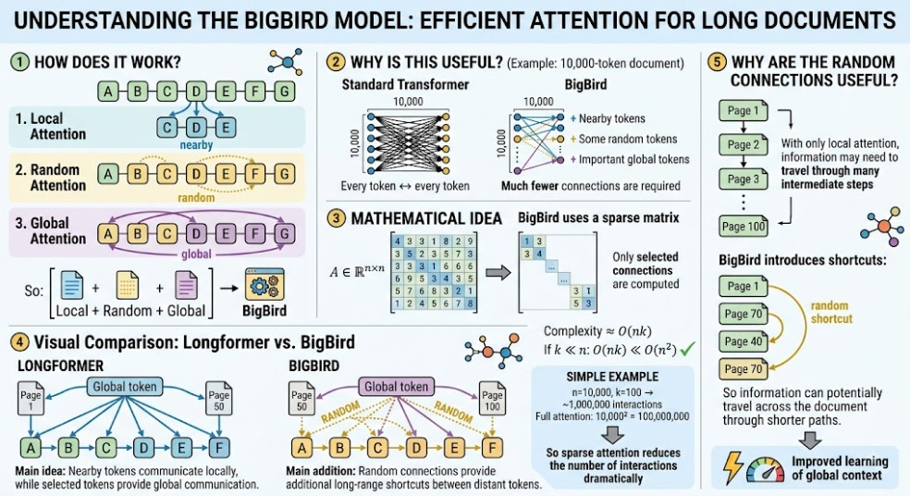
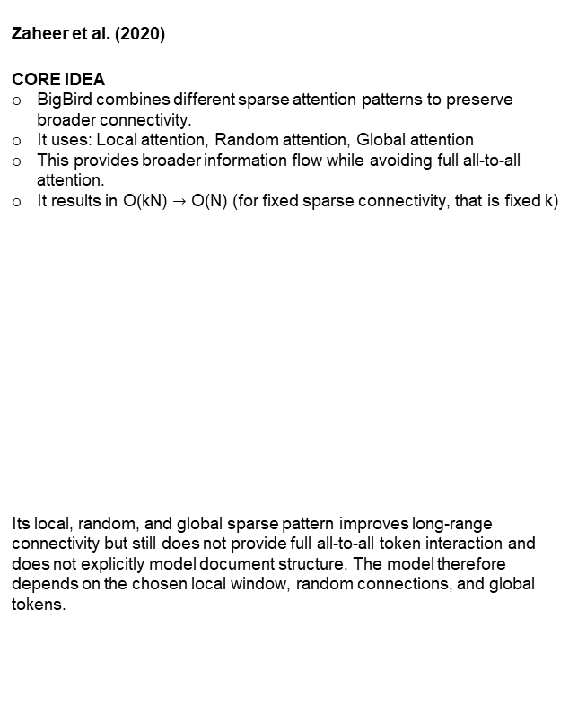
5) Longformer
6) BigBird
Beltagy et al. (2020)
CORE IDEA
Combines local sliding-window attention with global attention.
Most tokens attend locally to nearby context.
Selected tokens receive broader global attention.
Reduces attention complexity to approximately: O(Nw) where w is the attention window.
Local attention restricts direct interaction between distant tokens, thus, may miss direct relationships between distant tokens unless information is propagated through multiple layers or connected through globally attended tokens.
Global attention requires deciding which tokens receive global connectivity, making its effectiveness partly task-dependent.
Zaheer et al. (2020)
CORE IDEA
BigBird combines different sparse attention patterns to preserve broader connectivity.
It uses: Local attention, Random attention, Global attention
This provides broader information flow while avoiding full all-to-all attention.
It results in O(kN) $→$ O(N) (for fixed sparse connectivity, that is fixed k)
Its local, random, and global sparse pattern improves long-range connectivity but still does not provide full all-to-all token interaction and does not explicitly model document structure. The model therefore depends on the chosen local window, random connections, and global tokens.

Slide 6
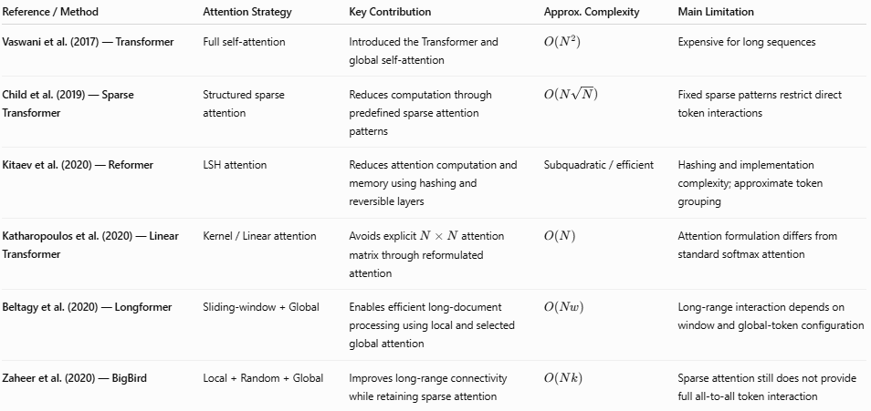
Comparison of Long Context Architectures in Existing Research

Slide 7
While the above approaches address the scalability of Transformer-based sequence processing, document intelligence introduces an additional challenge: documents are not merely long sequences of tokens. They contain visual, spatial, and multi-page information that must also be preserved.
Unlimited OCR - Yin et al. (2026)
Main Idea
Long / Multi-page Document
↓
Document Images
↓
Visual Encoder
↓
Compress the visual information
↓
Visual Tokens
↓
R-SWA Decoder Attention
↓
┌───────────────────────┐
│ Original visual │
│ document information │
│ + │
│ Recent generated text │
└───────────────────────┘
↓
Generate OCR text
one token at a time
↓
Continue across pages
↓
Extracted document text
+ useful visual/location
information
Extends long-context modeling specifically to OCR and document processing.
Meaning, all previous model architectures ask "How can we process longer sequences efficiently?“ where as Unlimited OCR asks a more specific question:
"How can an OCR model continuously read a very long visual document without its decoding memory growing with the amount of text generated?"
So it takes the long-context idea and applies it to a vision-language/OCR generation problem.
Longformer and BigBird mainly deal with very long text. Unlimited OCR applies the idea to very long document images, where the model first has to read the document and produce the text.
Uses Reference Sliding Window Attention (R-SWA) for long-horizon processing.
R-SWA lets the model keep the original document information available while keeping only a small amount of recently generated text. This prevents the memory requirement from continuously increasing as more pages are read.
Enables multi-page document transcription within a long-context framework.
Instead of treating every page as a completely separate OCR task, the model can continue reading through multiple pages while maintaining access to the document information.
Retains textual and spatial information needed for document understanding.
Because the model can continue referring to the original document information while generating text, it can use not only the words but also where and how those words appear on the page.

Slide 8
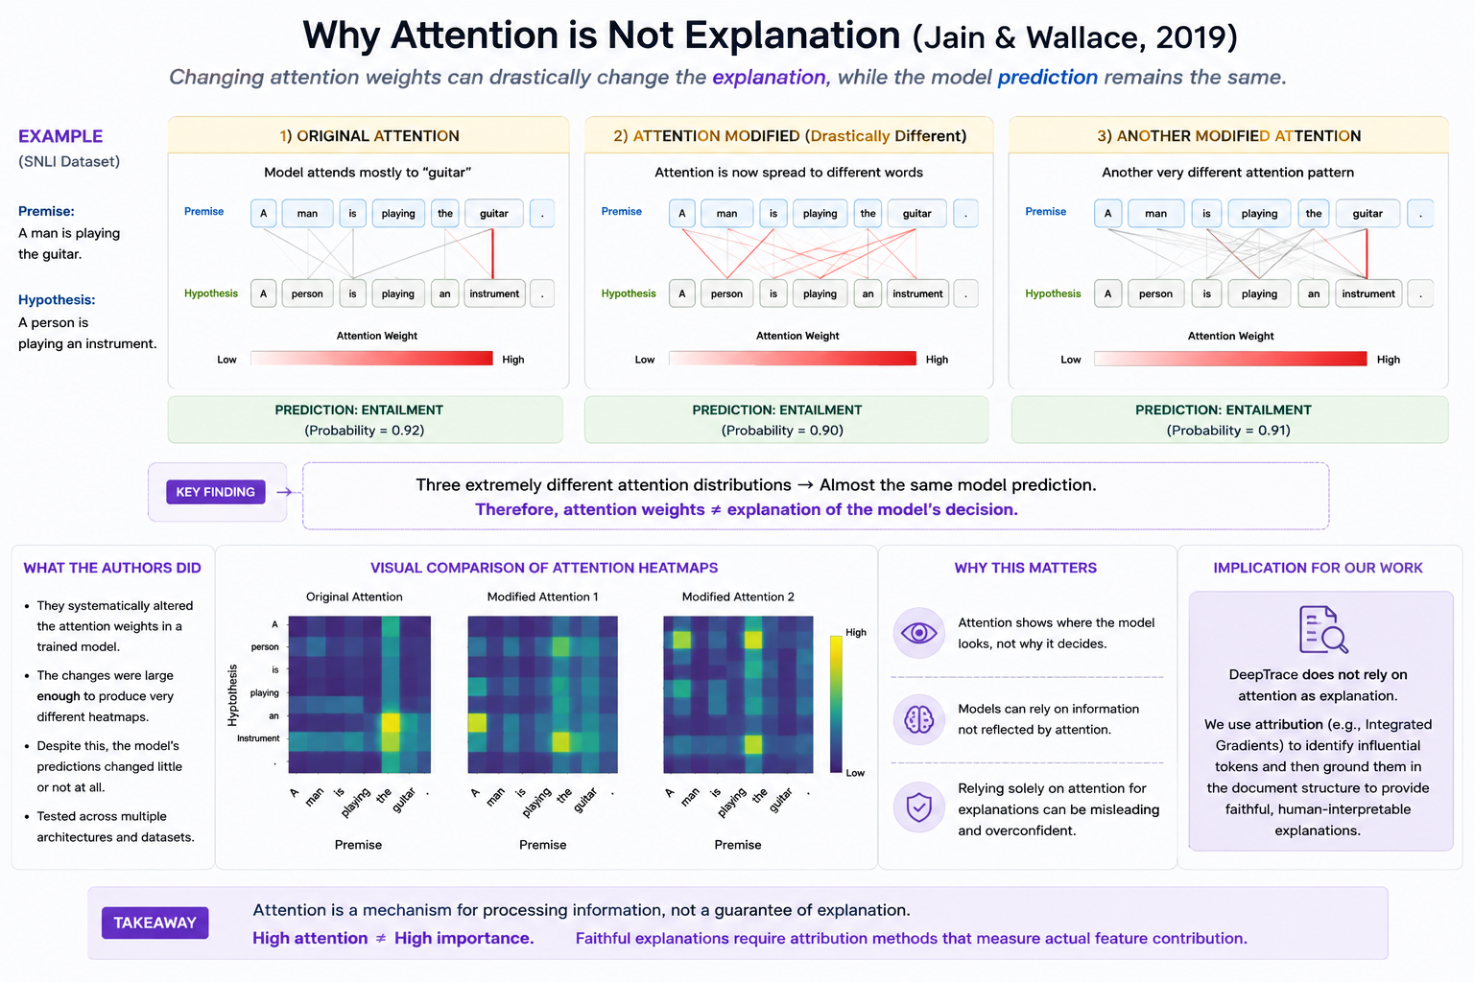
2.2 Explainability and Feature Attribution
Visual Representation
1) Attention is Not Explanation
Jain & Wallace, 2019
APPROACH
Empirical investigation of whether attention weights can be considered faithful explanations of neural network predictions.
CORE IDEA
The paper questions the assumption that a model's attention distribution directly represents the information responsible for its output. It investigates whether changing attention necessarily changes the prediction.
KEY CONTRIBUTION
Demonstrates that attention weights can sometimes be substantially altered while maintaining similar model predictions. Therefore, high attention does not automatically mean high explanatory importance.
SIGNIFICANCE
Establishes an important distinction between model behavior and model explanation. A visualization showing where a model attends may be intuitive, but intuition alone does not guarantee that the visualization faithfully represents the decision process.

Slide 9
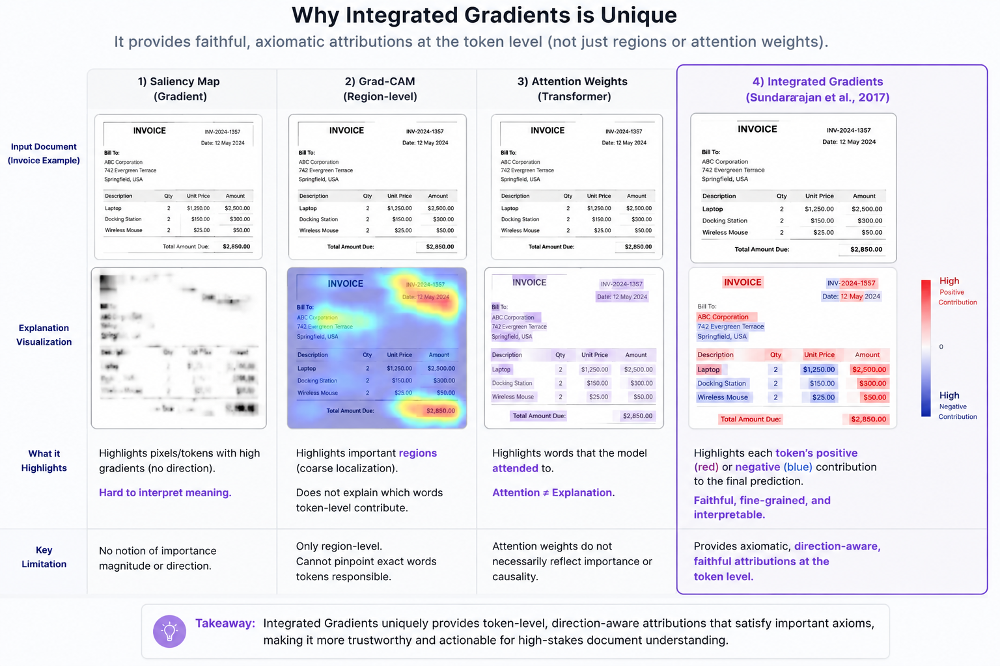
Visual Representation
2) Integrated Gradients
Sundararajan et al., 2017
APPROACH
Gradient-based feature attribution that quantifies how individual input features contribute to a model's prediction.
CORE IDEA
Integrated Gradients compares a real input with a chosen baseline and accumulates the gradients along the path between them. This produces an attribution score for each input feature.
KEY CONTRIBUTION
Introduces a mathematically motivated attribution framework based on desirable axioms such as Sensitivity and Implementation Invariance. This provides a more principled alternative to simply visualizing model activations.
RELEVANCE TO DOCUMENT AI
Attribution scores can potentially be assigned to OCR tokens or textual elements, allowing the system to identify which pieces of extracted text contributed most strongly to a prediction.

Slide 10
Comparison of Explainability Methods in Existing Research
Reference / Method | Approach | Key Contribution | Limitation
1) Sundararajan et al. (2017) — Integrated Gradients | Gradient-based feature attribution | Provides mathematically grounded attribution scores by integrating gradients from a baseline to the input; satisfies Sensitivity and Implementation Invariance. | Identifies influential features but does not inherently capture spatial layout, hierarchical relationships, or document structure.
2) Jain & Wallace (2019) — Attention is Not Explanation | Attention-based interpretability | Demonstrates that attention distributions can change substantially without significantly changing predictions, challenging the assumption that attention = explanation. | Attention weights alone may not provide faithful feature importance or establish why specific evidence drives a prediction.

Slide 11
Research Gap
Gap 1: Long-Context and Structural Understanding
Existing approaches for long-context document processing and document layout understanding are not sufficiently integrated. Processing information across multiple pages does not by itself capture the hierarchical and spatial relationships between document elements.
Gap 2: Explainability within Document Understanding
Existing explainability and attribution methods are not sufficiently integrated with long-context and structure-aware document reasoning. This makes it difficult to associate model-level attribution with meaningful elements of a complex document.
Gap 3: Evidence-Level Traceability
There is limited connection between model predictions and the corresponding textual, layout, and structural evidence in the original document. Users may therefore be unable to clearly verify why a particular prediction was produced.
Motivation to Bridge the Gap
DeepTrace addresses these gaps by integrating the major components into a unified Document AI framework.
Gap 1 → Long-context + structural perception:
DeepTrace combines Unlimited OCR with R-SWA and Hierarchical Layout Parsing (HLP) to process multi-page documents while preserving their textual, spatial, and hierarchical information.
Gap 2 → Integrated explainability:
Integrated Gadients (IG) is incorporated to identify information contributing to model predictions and associate attribution with the document representation.
Gap 3 → Evidence grounding:
DeepTrace maps Integrated Gradients attribution scores to OCR tokens and their spatial coordinates, and uses Hierarchical Layout Parsing (HLP) to associate these tokens with meaningful document elements such as paragraphs, tables, headers, and sections. This allows model predictions to be traced back to specific evidence in the original document.
Identified Gaps

Slide 12
Objectives
Primary Objective
Specific Objective 1
To design and develop a unified Document AI framework that integrates long-context perception, structural document understanding, and evidence-grounded explainability for transparent and traceable analysis of complex documents.
To design an integrated pipeline that combines long-context document perception, hierarchical document representation, document-level reasoning, and evidence attribution within a unified framework.
Specific Objective 2
Specific Objective 3
To implement the proposed framework by integrating long-context OCR, hierarchical layout processing, feature attribution, and multi-level evidence grounding to connect predictions with their supporting document evidence.
To evaluate the proposed framework using suitable document datasets and evaluation criteria for document understanding, explanation quality, evidence grounding, and traceability

Slide 13
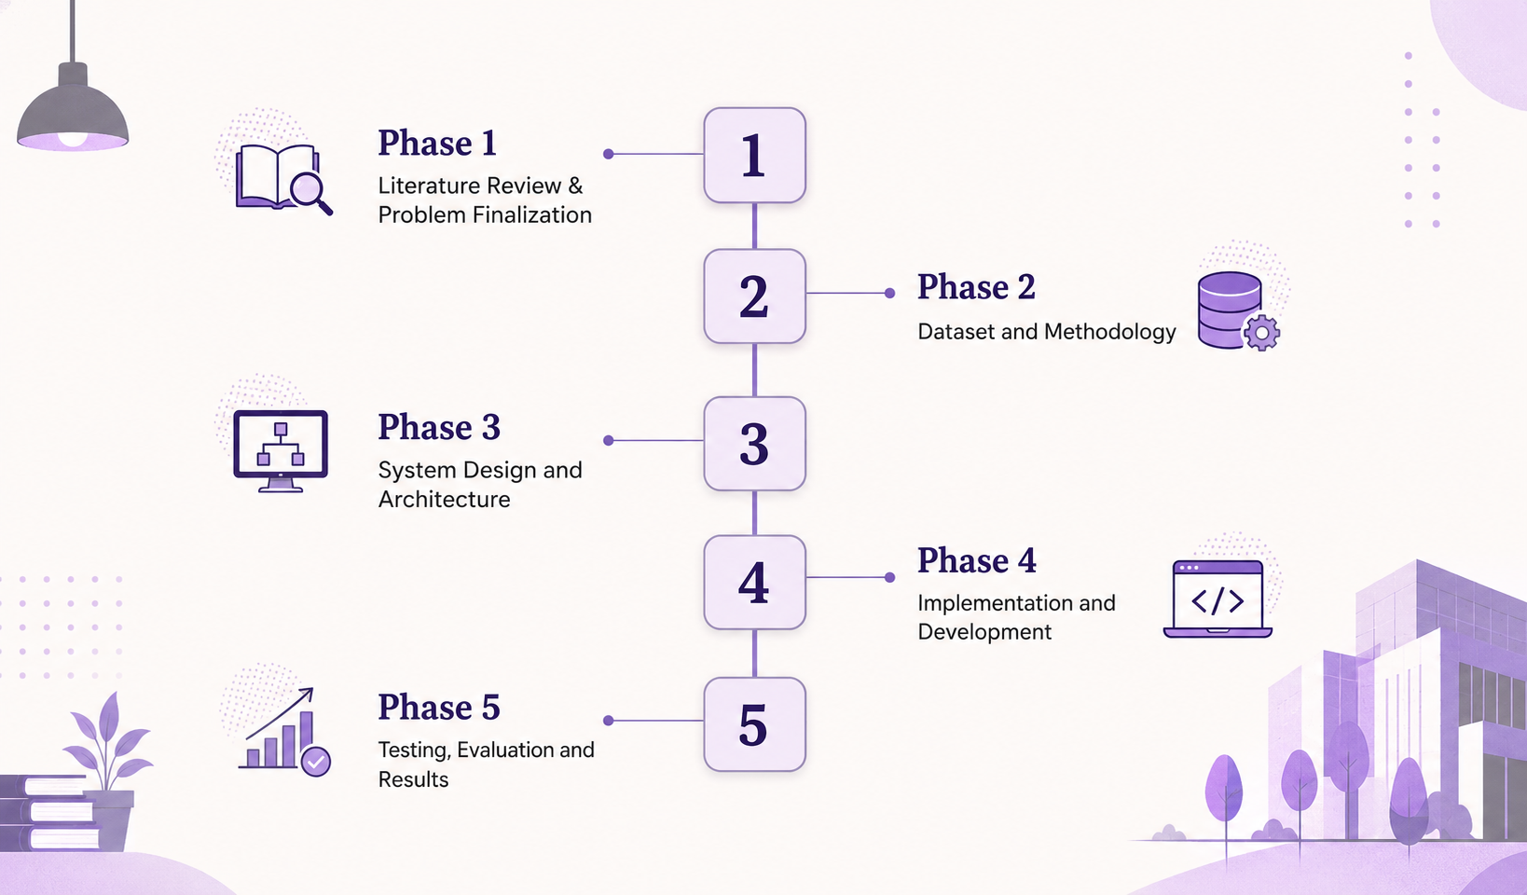
Project Plan

Slide 14
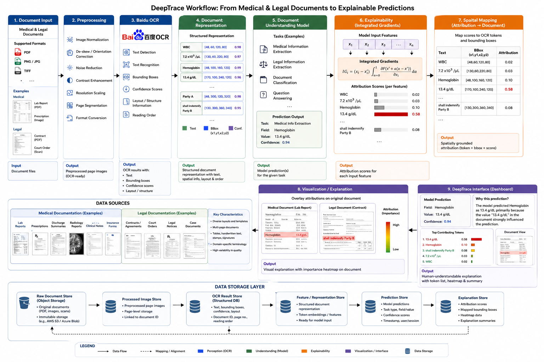

Slide 15

Expected Outcomes
Anticipated Results
Applications
Accurate extraction of text along with bounding-box/spatial information from medical and legal documents.
A functional and experimentally validated prototype capable of producing document predictions together with visually grounded explanations, rather than predictions alone.
Hospitals and healthcare organizations
Medical researchers and clinical data analysts
Law firms and legal departments
Legal document management systems
Enterprise AI systems
Future Scope
More domains/datasets, additional XAI methods, multimodal documents, more document understanding tasks, human evaluation, and integration with enterprise systems

Slide 16
Thank You
Questions & Discussion
We welcome your feedback, suggestions, and questions. This project is a work in progress and your insights will help us refine our approach.

