Slide 1
POLICYLENS AI
ANTHROPIC HACKATHON · 2026
01 / 10
PolicyLens AI.
PL · AI · BHARAT
"कोई भी सरकारी policy — समझो अपनी भाषा में…" Understand any government policy — in your own language.
TEAM
Perceus
POWERED BY CLAUDE AI · BUILT FOR INDIA
MOHD. SHOEB · PERCEUS

Slide 2
POLICYLENS AI
THE PROBLEM
02 / 10
Government policies don't speak the people's language.
A 1.4 BILLION-PERSON PROBLEM
1.4 Bn
✕
Policies are drafted in complex legal English & Hindi — opaque to the average reader.
✕
Citizens don't know how a policy actually affects them — as a student, worker, owner, or family.
Indians live under thousands of acts, bills, and schemes — most of which they can't read, let alone interpret for themselves.
No tool explains policy in regional languages — Bengali, Tamil, Telugu, Marathi, and beyond.
✕
RESULT · PEOPLE REMAIN UNINFORMED ABOUT LAWS THAT GOVERN THEIR LIVES.

Slide 3
POLICYLENS AI
THE SOLUTION
03 / 10
INTRODUCING
PolicyLens
AI.
✓
Plain language, zero jargon
No legalese. No bureaucratic noise. Written like a friend explaining it over chai.
✓
Personalised to who you are
Student, job seeker, business owner, or general citizen — the impact section is tailored.
✓
11 Indian languages
Hinglish, Hindi, Bengali, Tamil, Telugu, Marathi, Gujarati, Kannada, Malayalam, Punjabi, Odia.
Type any policy name. Pick who you are. Pick your language. Get an instant, plain-language explanation — built for how you actually live.
✓
Pros, cons, summary — one card
A complete decision-ready breakdown, copyable in one click.

Slide 4
POLICYLENS AI
HOW IT WORKS
04 / 10
Three steps. Seconds, not hours.
Real-time search grounds every answer in current information before the model writes a word.
STEP 01
STEP 02
STEP 03
Type.
Tune.
Explain.
Enter any policy name — an act, bill, scheme, budget, or law.
Pick who you are and the language you think in.
Get a complete six-section breakdown in seconds. Copy & share.
→
→
policy → "GST" policy → "NEP 2020" policy → "MGNREGA"
user → Business Owner lang → Hinglish lang → বাংলা · தமிழ் · हिंदी
⚡ output → Simple · Why · Impact Pros · Cons · Summary

Slide 5
POLICYLENS AI
FEATURES
05 / 10
What's inside the lens.
PERSONALISED IMPACT
STRUCTURED OUTPUT
11 INDIAN LANGUAGES
Tailored to you.
Six sections, every time.
Speaks how India speaks.
The impact section adapts to who's asking — same policy, different lived reality.
Simple Explanation
Why It Was Introduced
From Hinglish on the metro to ଓଡ଼ିଆ at home — every explanation is rendered in native script with the cadence of a fluent speaker.
🎓 Student
💼 Job Seeker
🏪 Owner
🧑 Citizen
Your Impact
Pros
Cons
2-line Summary
Hinglish
Hinglish
Hindi
हिंदी
Bengali
বাংলা
Tamil
தமிழ்
ONE-CLICK COPY
REAL-TIME GROUNDING
Share in a tap.
Always current.
Telugu
తెలుగు
Marathi
मराठी
Copy the full breakdown — formatted — to paste into WhatsApp, notes, or a group chat.
Every query pulls fresh web context before generation, so answers reflect today's policies — not yesterday's training data.
Gujarati
ગુજરાતી
Kannada
ಕನ್ನಡ
Malayalam
മലയാളം
Punjabi
ਪੰਜਾਬੀ
Odia
ଓଡ଼ିଆ
+ more soon
→

Slide 6
POLICYLENS AI
TECH STACK
06 / 10
Lean. Fast. Free to run.
Single-file React, a thin Flask backend, and a 70B model on a free inference tier — designed so it can keep running for the citizens it serves.
FRONTEND
HTML+CSS+JS+React
BACKEND
Python Flask
AI MODEL
Claude API
By Anthropic
GROUNDING
DuckDuckGo Search
— live web context
DEPLOYMENT
render.com
LANGUAGES
11 Indian regional languages
— prompt-engineered

Slide 7
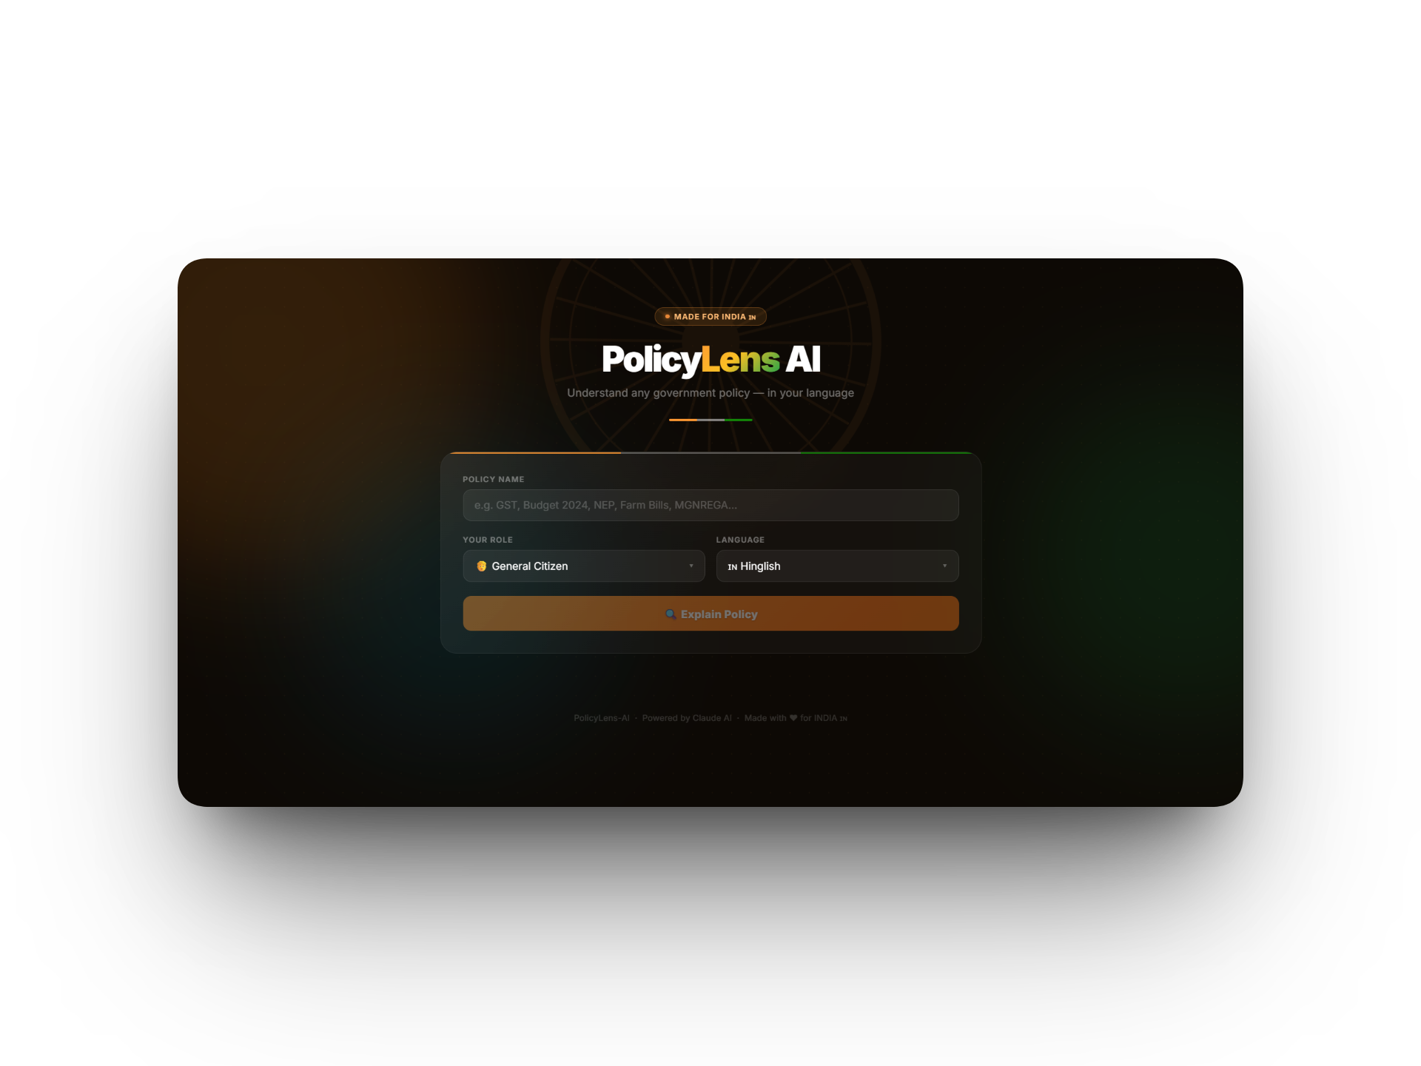
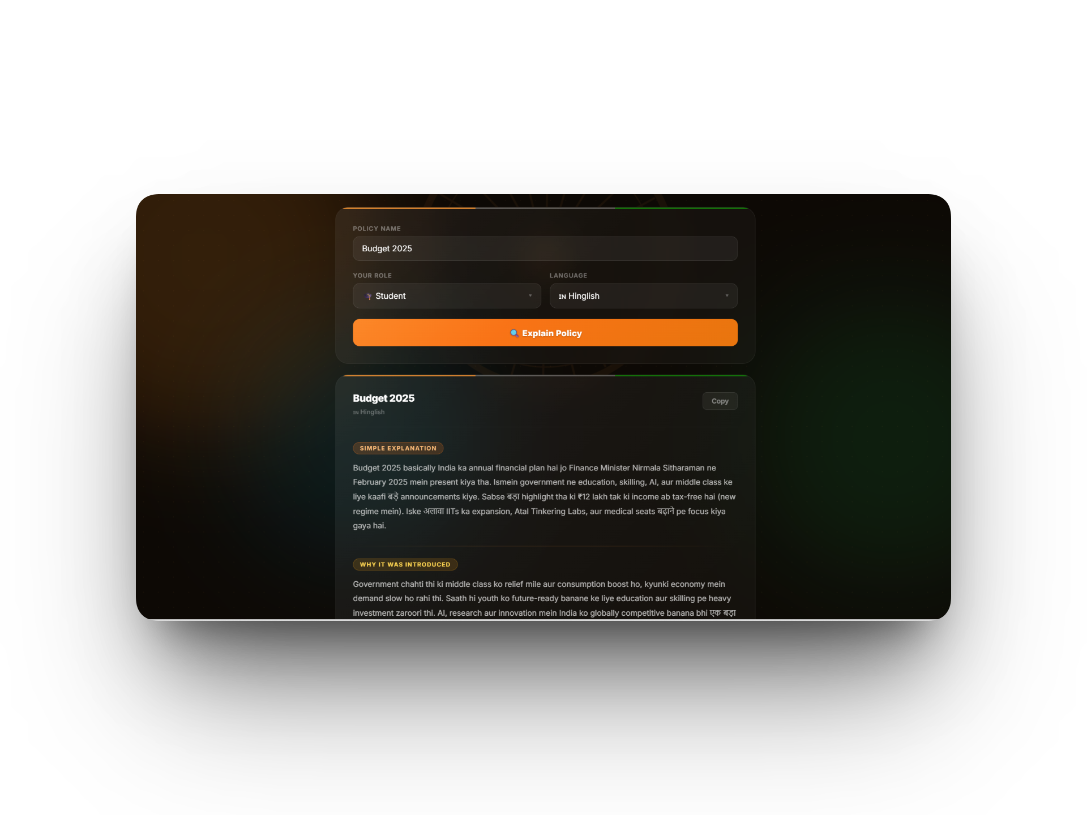
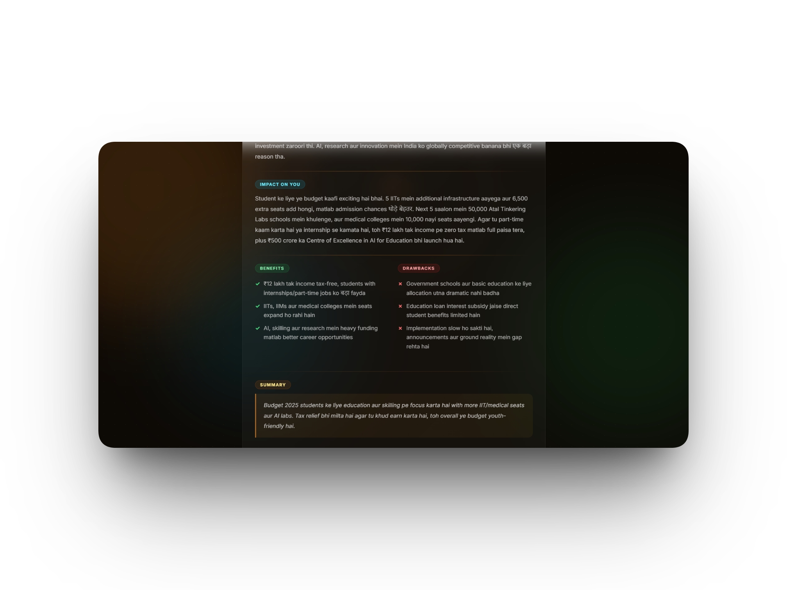
POLICYLENS AI
LIVE DEMO
07 / 10
See it in action.
POLICY
USER
LANGUAGE
GST
Business Owner
Hinglish

Slide 8
POLICYLENS AI
IMPACT & REACH
08 / 10
Built for everyone a policy actually touches.
One model, four lived realities — each gets the section that matters most to them, in the language they think in.
USER 01
USER 02
USER 03
USER 04
🎓 Students
💼 Job Seekers
🏪 Business Owners
🧑 Citizens
Decode education policies — from NEP 2020 to scholarship eligibility — without paraphrasing 400-page PDFs.
Find which employment schemes — MGNREGA, Skill India, PMKVY — actually apply to them and how to enrol.
Decode GST, MSME schemes, startup tax holidays — the rules a founder needs the day they're announced.
Stay informed on the Union Budget, healthcare, farming bills — the laws that shape everyday life at home.
Asks: "NEP 2020" Gets: credit-system impact on their degree.
Asks: "Skill India" Gets: eligibility, stipend, certified trades.
Asks: "Startup India" Gets: tax exemption rules & timelines.
Asks: "Budget 2025" Gets: what changed for their household.
India has 22 official languages. PolicyLens AI bridges the gap between government and people.
22
OFFICIAL LANGUAGES
OF INDIA

Slide 9
POLICYLENS AI
FUTURE SCOPE
09 / 10
What's next.
🔊
📱
🔔
Mobile App
Policy Alerts
Voice Output
Native Android & iOS app for on-the-go access
Listen to policy explanations — accessibility for all literacy levels
Notify users instantly when new policies are announced
📚
🤝
🗳️
WhatsApp Bot
Election Mode
Policy History
Send policy name on WhatsApp → get instant explanation
Explain party manifestos before elections — informed voting
Track how policies have changed and evolved over time

Slide 10
POLICYLENS AI
THANK YOU
10 / 10
CLOSING
PolicyLens
AI.
BUILT BY
Mohd. Shoeb
TEAM
Perceus
HACKATHON
Anthropic Hackathon · 24 hours
"Democracy works best when citizens understand the laws governing them."
CODE
github.com/23f3003455/policylens-ai
"लोकतंत्र तभी सफल है जब हर नागरिक अपने कानून समझ सके।"
LIVE DEMO
https://policylens-ai-ugow.onrender.com/
MOHD. SHOEB · PERCEUS
ANTHROPIC HACKATHON · 2026

