Slide 1
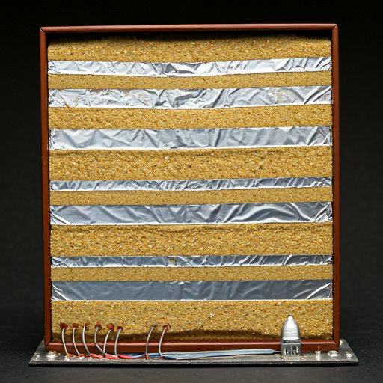
Sand Battery
Problem Description
Increased utilization of renewable energy sources has immensely resulted in the generation of large amounts of wind and solar energy. However, the challenge that arises from this aspect is the proper storage of this excess energy generated during peak energy production times since conventional storage systems, like lithium ion batteries, become costly and have minimal capacities, which eventually further leads to additional waste of energy due to degradation. According to a report issued by the International Renewable Energy Agency, 20-30% of the renewable energy produced is lost due to underdevelopment in the storage sector. In addition, application fields like industrial and residential space heating continue to be fossil-fuel-based, contributing to carbon emissions and dashing hopes for the achievement of sustainability globally
Problem Validation
The renewable energy sector has expanded significantly; renewables now account for nearly 29% of the global electricity generated in 2022, but the sore point remains a lack of efficient and long-term storage solutions. It can be noted in Germany, for example, where it has reached an unparalleled level of producing renewable energies, but there is instability in the grid due to peaking generation. Additionally, sectors using fossil fuel heating systems are still facing challenges in shifting to renewable energy.
Existing Solutions and Their Limitations
Lithium-ion batteries are mainly being employed as energy storers, but they do possess some important limitations. For instance, in 2021, the cost per kilowatt-hour stood at 137 dollars. These batteries also lose their capacities after undergoing multiple charge cycles. In addition, these batteries can have a limited capacity and scale up for long-term energy storage has been perceived to be challenging. Other solutions such as pumped hydro storage cannot be considered for widespread usage due to the large geography setup. In addition to that, available existing thermal storage technologies like molten salt storage suffer from high material costs and relatively low efficiency.
Your Solution and Its Uniqueness
The sand battery is a novel, green, and economic method to solve the problems of the storage issue. Using sand or sand-like materials as a thermal storage medium, the battery can subsequently store surplus renewable source-generated energy in the form of heat for later use in space heating, industrial processes, or even converted back to electricity. Since sand is abundant, inexpensive, and extremely durable, an absolutely scalable and long-lasting option exists here. Compared to traditional batteries, the biggest advantage of the sand battery is that it is built of the cheapest material with an extremely long lifetime, which makes it an almost viable solution for large-scale and long-term energy storage.
Brief Technical Description and Feasibility
The principle of the sand battery is basically transformation of surplus electricity generated from renewable sources into thermal energy by electric heating elements. The heat is thus saved in the sand, a material that is very good at retaining heat. Storage capacity can be tapped when needed, which can be used for residential or industrial heating applications. The use of IoT with energy management software allows the sensors to be controlled and, consequently, to monitor and optimize in real-time. Its feasibility for various residential, industrial, and grid-level applications makes the solution, based on sand's long-lasting storage capability and cost-effectiveness, further validate the concept.

