Slide 1


Lean & Mean Tokyo Cabinet Recipes
Ilya Grigorik
@igrigorik

Slide 2

postrank.com/topic/ruby
The slides…
Twitter
My blog

Slide 3



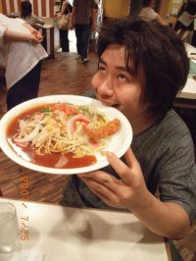
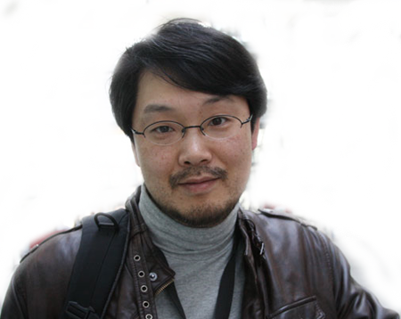
Mikio Hirabayashi
Yukihiro Matsumoto

Slide 4

Mikio Hirabayashi
Yukihiro Matsumoto
???

Slide 5
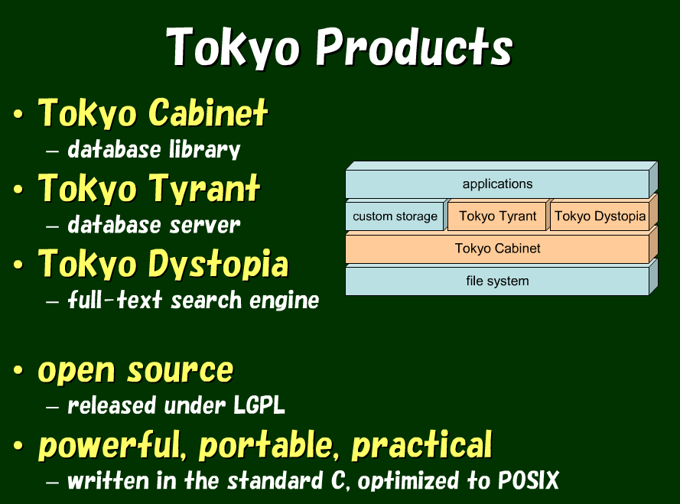

Slide 6
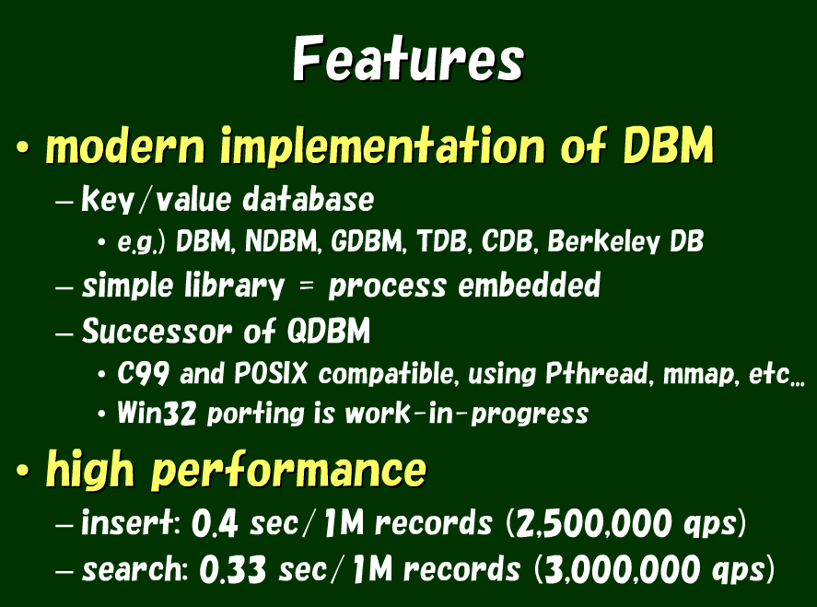

Slide 7
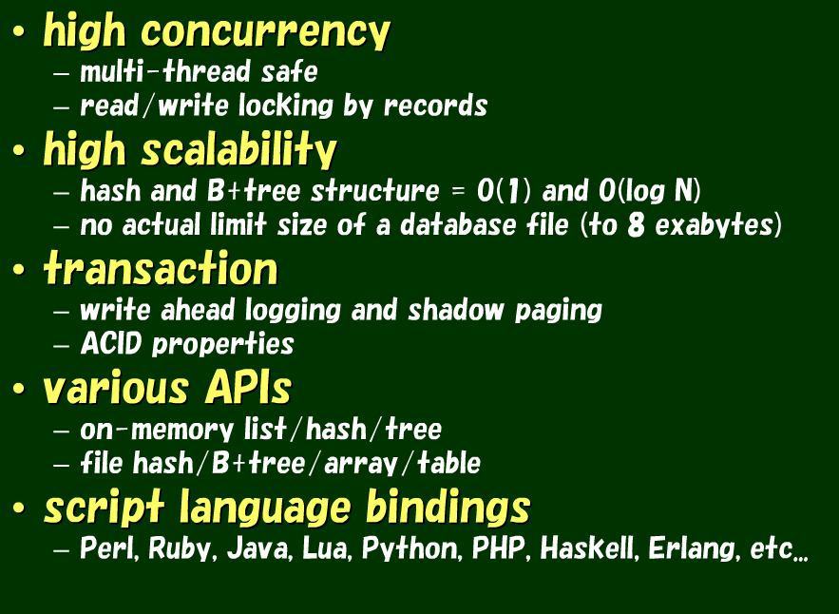

Slide 8
Hashtable
Berkeley DB, DBM, QDB, TDB…
B-Tree Table
Key-Value with duplicates & ordering
3. Fixed-length
An in memory array.. No hashing.
4. Table Engine
Schemaless, indexes & queries
Choose your engine

Slide 9
gem install rufus-tokyo
require 'rubygems' require 'rufus/tokyo' db = Rufus::Tokyo::Cabinet.new('data.tch') db['nada'] = 'surf' p db['nada'] # => 'surf' p db['lost'] # => nil db.close
TC: Hashtable

Slide 10
require 'rubygems' require 'rufus/tokyo' db = Rufus::Tokyo::Cabinet.new('data.tch') db['nada'] = 'surf' p db['nada'] # => 'surf' p db['lost'] # => nil db.close
~ Ruby Hash
TC: Hashtable

Slide 11
require 'rubygems' require 'rufus/tokyo' t = Rufus::Tokyo::Table.new('table.tct') t['pk0'] = { 'name' => 'alfred', 'age' => '22' } t['pk1'] = { 'name' => 'bob', 'age' => '18', 'sex' => 'male' } t['pk2'] = { 'name' => 'charly', 'age' => '45' } t['pk4'] = { 'name' => 'ephrem', 'age' => '32' } p t.query { |q| q.add_condition 'age', :numge, '32' q.order_by 'age' } # => [ {"name"=>"ephrem", :pk=>"pk4", age"=>"32"}, # {"name"=>"charly", :pk=>"pk2", "age"=>"45"} ] t.close
Table Engine
TC: Table Engine

Slide 12
require 'rubygems' require 'rufus/tokyo' t = Rufus::Tokyo::Table.new('table.tct') t['pk0'] = { 'name' => 'alfred', 'age' => '22' } t['pk1'] = { 'name' => 'bob', 'age' => '18', 'sex' => 'male' } t['pk2'] = { 'name' => 'charly', 'age' => '45' } t['pk4'] = { 'name' => 'ephrem', 'age' => '32' } p t.query { |q| q.add_condition 'age', :numge, '32' q.order_by 'age' } # => [ {"name"=>"ephrem", :pk=>"pk4", age"=>"32"}, # {"name"=>"charly", :pk=>"pk2", "age"=>"45"} ] t.close
age > 32 order by age
TC: Table Engine

Slide 13
p t.size # => 0 t.transaction do t['pk0'] = { 'name' => 'alfred', 'age' => '22' } t['pk1'] = { 'name' => 'bob', 'age' => '18' } t.abort end p t.size # => 0
Uh oh…
TC: Table Engine Transactions

Slide 14
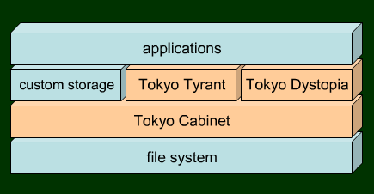
Network
Embedded

Slide 15
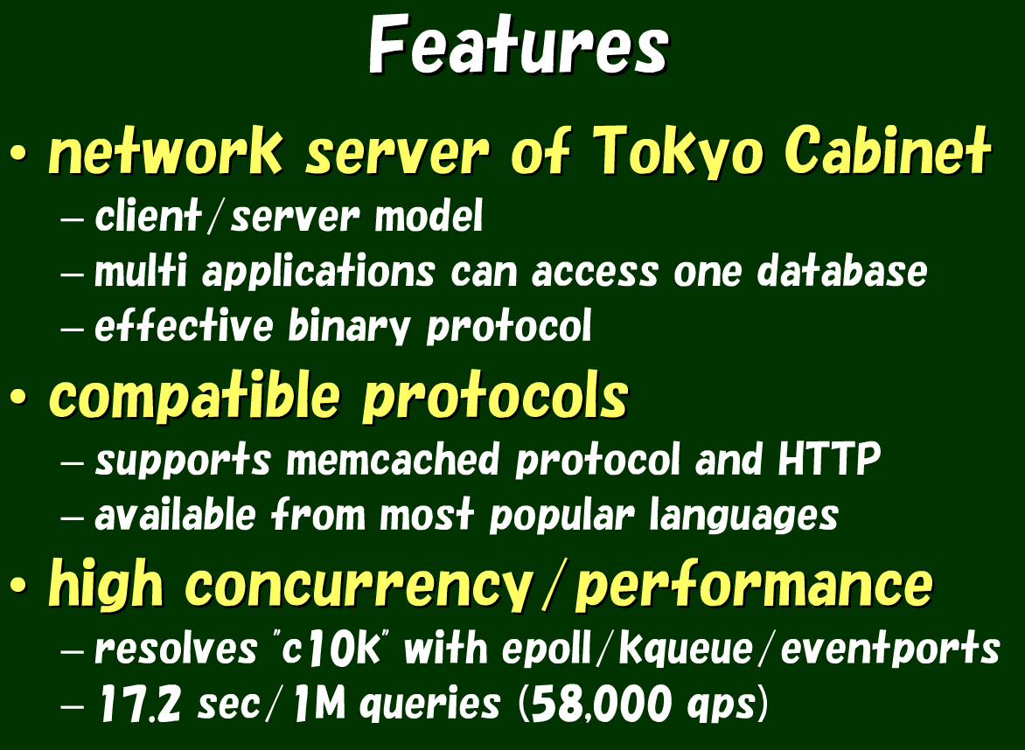

Slide 16
require "rubygems" require "rest_client" # Interacting with TokyoTyrant via RESTful HTTP! db = RestClient::Resource.new("http://localhost:1978") db["key"].put "value 1" # insert via HTTP db["key"].put "value 2" # update via HTTP puts db["key"].get # get via HTTP # => "value 2" db["key"].delete # delete via HTTP puts db["key"].get rescue RestClient::ResourceNotFound
RESTful Tokyo Tyrant

Slide 17
require "rubygems" require "rest_client" # Interacting with TokyoTyrant via HTTP! db = RestClient::Resource.new("http://localhost:1978") db["key"].put "value 1" # insert via HTTP db["key"].put "value 2" # update via HTTP puts db["key"].get # get via HTTP # => "value 2" db["key"].delete # delete via HTTP puts db["key"].get rescue RestClient::ResourceNotFound
RESTful Tokyo Tyrant
Awesome.

Slide 18
“Recently, I sophisticated Hanami and the Sumida River in a houseboat, I was sad that day and not even a minute yet mikio bloom …”
… so I added Lua scripting to Tyrant.
http://alpha.mixi.co.jp/blog/?p=236

Slide 19




“Powerful, fast, lightweight, embeddable scripting language”
Procedural syntax
Everything is an associatiave array
Dynamically typed
Interpreted bytecode
Garbage collection
GZIP(Source + Docs + Examples) = 212 Kb
What is Lua?
It’s like Ruby.. except it’s not.
Fast + Lightweight = Great for embedded apps

Slide 20


+
CREATE FUNCTION json_members RETURNS STRING SONAME 'lib_mysqludf_json.so';
SELECT json_object(customer_id, first_name) FROM customer;
+---------------------------------------------------+
| customer |
+---------------------------------------------------+
| {customer_id:1,first_name:"MARY"} |
+---------------------------------------------------+
Extending the Database?
MySQL User Defined Functions
JSON Response
http://www.mysqludf.org/lib_mysqludf_json/index.php

Slide 21
+
= C/C++
+
= Lua
TC+Lua? Why?
To make our lives easier, and more fun!
Easy to learn & easy to extend!

Slide 22
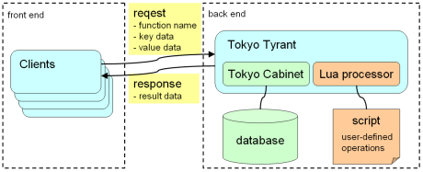
Lua extension within Tokyo Cabinet
_put(key, value)
_putkeep(key, value)
_putcat(key, value)
_rnum() _vanish()
_mapreduce(mapper, reducer, keys)
_out(key)
_get(key)
_vsiz(key)
_addint(key, value)
TC + Lua Extensions
Request / Response data-flow
http://tokyocabinet.sourceforge.net/tyrantdoc/#luaext

Slide 23
-- -- echo.lua -- function echo(key, value) return key .. ":" .. value end
[ilya@igvita] > ttserver -ext echo.lua test.tch
[ilya@igvita] > tcrmgr ext localhost echo foo bar
foo:bar
require 'rubygems' require 'rufus/tokyo/tyrant' # sudo gem install rufus-tokyo t = Rufus::Tokyo::Tyrant.new('127.0.0.1', 1978) puts t.ext(:echo, 'hello', 'world') t.close
Lua + TC Echo Server

Slide 24
-- -- echo.lua -- function echo(key, value) return key .. ":" .. value end
[ilya@igvita] > ttserver -ext echo.lua test.tch
[ilya@igvita] > tcrmgr ext localhost echo foo bar
foo:bar
require 'rubygems' require 'rufus/tokyo/tyrant' # sudo gem install rufus-tokyo t = Rufus::Tokyo::Tyrant.new('127.0.0.1', 1978) puts t.ext(:echo, 'hello', 'world') t.close
Lua + TC Echo Server

Slide 25
-- -- echo.lua -- function echo(key, value) return key .. ":" .. value end
[ilya@igvita] > ttserver -ext echo.lua test.tch
[ilya@igvita] > tcrmgr ext localhost echo foo bar
foo:bar
require 'rubygems' require 'rufus/tokyo/tyrant' # sudo gem install rufus-tokyo t = Rufus::Tokyo::Tyrant.new('127.0.0.1', 1978) puts t.ext(:echo, 'hello', 'world') t.close
Lua + TC Echo Server

Slide 26
-- -- incr.lua -- function incr (key, i) i = tonumber(i) if not i then return nil end local old = tonumber(_get(key)) if old then i = old + i end if not _put(key, i) then return nil end return i end
Verify input
Implementing INCR in Lua+TC
Notes:
Ok, so echo is a cute example, but let’s look at something slightly more interesting. We’re going to build an increment command in Lua. Now, TC already has this in it’s API, but we’re going to do this for the same of an example.

Slide 27
-- -- incr.lua -- function incr (key, i) i = tonumber(i) if not i then return nil end local old = tonumber(_get(key)) if old then i = old + i end if not _put(key, i) then return nil end return i end
Get old value & increment it
Implementing INCR in Lua+TC

Slide 28
-- -- incr.lua -- function incr (key, i) i = tonumber(i) if not i then return nil end local old = tonumber(_get(key)) if old then i = old + i end if not _put(key, i) then return nil end return i end
Save new value
Implementing INCR in Lua+TC

Slide 29
[ilya@igvita] > ttserver -ext incr.lua test.tch
[ilya@igvita] > tcrmgr ext localhost incr keyname 1
1
[ilya@igvita] > tcrmgr ext localhost incr keyname 5
6
require 'rubygems' require 'rufus/tokyo/tyrant' # sudo gem install rufus-tokyo t = Rufus::Tokyo::Tyrant.new('127.0.0.1', 1978) 5.times do puts t.ext(:incr, 'my-counter', 2).to_i end t.close
Implementing INCR in Lua+TC

Slide 30
[ilya@igvita] > ttserver -ext incr.lua test.tch
[ilya@igvita] > tcrmgr ext localhost incr keyname 1
1
[ilya@igvita] > tcrmgr ext localhost incr keyname 5
6
require 'rubygems' require 'rufus/tokyo/tyrant' # sudo gem install rufus-tokyo t = Rufus::Tokyo::Tyrant.new('127.0.0.1', 1978) 5.times do puts t.ext(:incr, 'my-counter', 2).to_i end t.close
Implementing INCR in Lua+TC

Slide 31

Lua + TC = Database Kung-fu
TTL, Sets & Caching

Slide 32

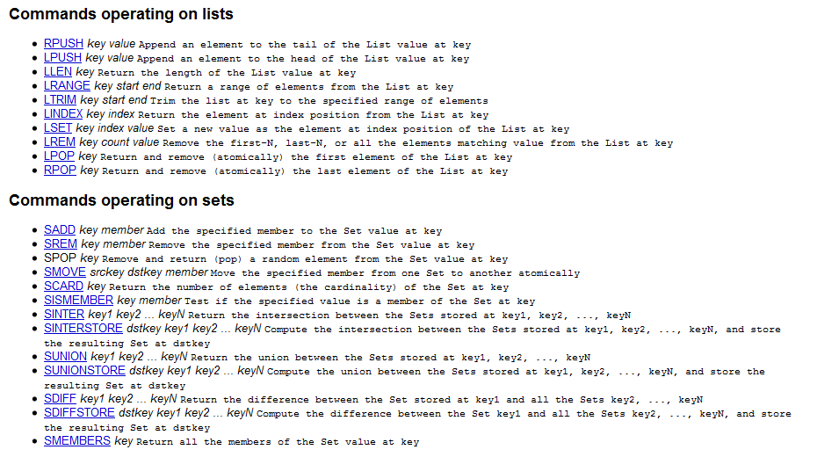
“Redis as a data structures server, it is not just another key-value DB”

Slide 33
function set_append(key, value) local stream = _get(key) if not stream then _put(key, value) else local set_len = _set_len(stream) if set_len == 1 then if stream == value then return nil end elseif set_len > 1 then for _, element in ipairs(_split(stream, SEP)) do if element == value then return nil end end end if not _putcat(key, SEP .. value) then return nil end end return value end
Empty Set
Implementing Set operations in TC

Slide 34
function set_append(key, value) local stream = _get(key) if not stream then _put(key, value) else local set_len = _set_len(stream) if set_len == 1 then if stream == value then return nil end elseif set_len > 1 then for _, element in ipairs(_split(stream, SEP)) do if element == value then return nil end end end if not _putcat(key, SEP .. value) then return nil end end return value end
Append key if unique
Implementing Set operations in TC

Slide 35

+
= ?
set_length
set_get
set_delete
set_append
[ilya@igvita] > ttserver -ext set.lua test.tch
[ilya@igvita] > tcrmgr ext localhost set_append key 1
[ilya@igvita] > tcrmgr ext localhost set_append key 2
[ilya@igvita] > tcrmgr ext localhost set_append key 1
[ilya@igvita] > tcrmgr ext localhost set_get key
1
2
Implementing Set operations in TC

Slide 36

“memcached is a general-purpose distributed memory caching system that is used by many top sites on the internet”
Key Value Time
key1
value1
10
Time = 15
key2
value2
20
key2
value2
30
Implementing TTL’s in TC

Slide 37
DELETE where x > Time.now
function expire() local args = {} local cdate = string.format("%d", _time()) table.insert(args, "addcond\0x\0NUMLE\0" .. cdate) table.insert(args, "out") local res = _misc("search", args) if not res then _log("expiration was failed") end print("rnum=" .. _rnum() .. " size=" .. _size()) end
Expiring Records with Lua

Slide 38
+
= ?
[ilya@igvita] > ttserver -ext expire.lua -extpc expire 5 "casket.tct#idx=x:dec"
Invoke “expire” command every 5 seconds
Table database, with index on expiry column (x)
Implementing Set operations in TC

Slide 39
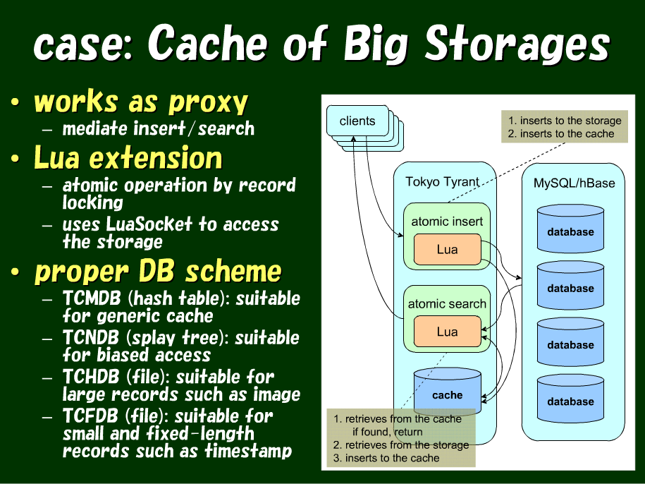

Slide 40
[ilya@igvita] > ttserver -ext session-trail.lua test.tch
[ilya@igvita] > tcrmgr ext localhost add 1 123
[ilya@igvita] > tcrmgr ext localhost add 1 256
[ilya@igvita] > tcrmgr ext localhost add 1 987
[ilya@igvita] > tcrmgr ext localhost add 2 987
[ilya@igvita] > tcrmgr ext localhost list 1
987 1247008220
256 1247008216
123 1247008123
Session-trail with Lua
Timestamped session trail

Slide 41
Lua + TC = Map Reduce!
Just for kicks.

Slide 42
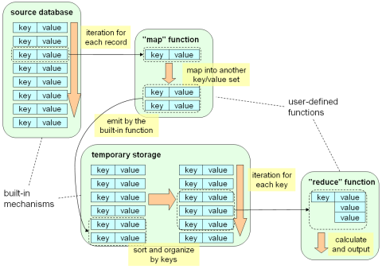
_out(key)
_get(key)
_vsiz(key)
_addint(key, value)
_mapreduce(mapper, reducer, keys)
Executing MR jobs within Tokyo Cabinet

Slide 43
function wordcount() function mapper(key, value, mapemit) for word in string.gmatch(string.lower(value), "%w+") do mapemit(word, 1) end return true end local res = "" function reducer(key, values) res = res .. key .. "\t" .. #values .. "\n" return true end if not _mapreduce(mapper, reducer) then res = nil end return res end
Emit: {word: 1}
Map-Reduce within Tokyo Cabinet

Slide 44
function wordcount() function mapper(key, value, mapemit) for word in string.gmatch(string.lower(value), "%w+") do mapemit(word, 1) end return true end local res = "" function reducer(key, values) res = res .. key .. "\t" .. #values .. "\n" return true end if not _mapreduce(mapper, reducer) then res = nil end return res end
Emit: {word: 1}
sizeof(values)
Map-Reduce within Tokyo Cabinet

Slide 45
[ilya@igvita] > ttserver -ext wordcount.lua test.tch
[ilya@igvita] > tcrmgr put localhost 1 “This is a pen.“
[ilya@igvita] > tcrmgr put localhost 1 “Hello World“
[ilya@igvita] > tcrmgr put localhost 1 “Life is good“
[ilya@igvita] > tcrmgr ext localhost wordcount
a 1
good 1
is 2
life 1
pen 1
this 1
Execute Map-Reduce Job
Map-Reduce within Tokyo Cabinet

Slide 46
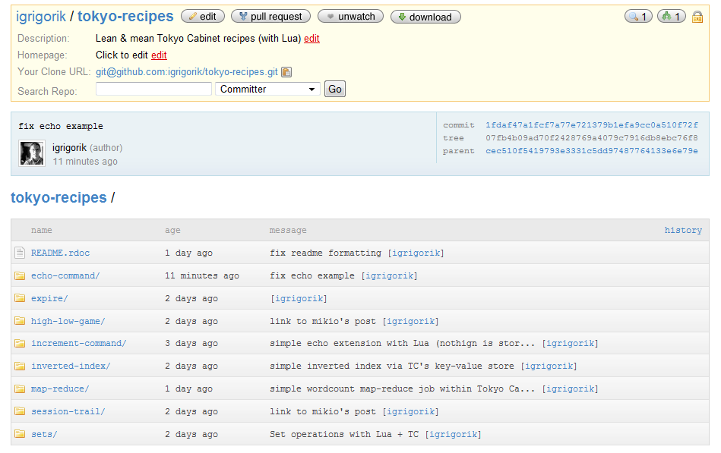
github.com/igrigorik/tokyo-recipes
The slides…
Twitter
My blog

