Slide 1


Ruby Proxies for Scale, Performance and Monitoring
Ilya Grigorik
CTO / AideRSS
Event-Driven Architectures
http://bit.ly/eda
@igrigorik #meshu #eda

Slide 2

postrank.com/topic/ruby
The slides…
Twitter
My blog

Slide 3





Proxy Love
Notes:
Proxy servers have become a popular solution as a tool for horizontal scalability. Just add more servers, and we’re good!

Slide 4
“Rails, Django, Seaside, Grails…” cant scale.
Myth: Slow Frameworks

Slide 5
The Proxy Solution
Notes:
Proxy servers have become a popular solution as a tool for horizontal scalability. Just add more servers, and we’re good!

Slide 6
The “More” Proxy Solution
Notes:
More proxy, more better.
Like it or not, this is more or less, the current tool of the trade. We love proxy servers!

Slide 7
90% use case
%w[Transparent Intercepting Caching …] There are many different types!
Notes:
Content-filtering, anonymizing, hostile, intercepting, caching…

Slide 8
Transparent
Transparent, Cut-Through Proxy
Notes:
The client is not aware of the proxy, unless the proxy injects custom headers. Most proxies that operate in this way are also cut-through proxies, which means that they don’t have to buffer the request, but can stream it to the application server as the data arrives, which helps with performance.

Slide 9
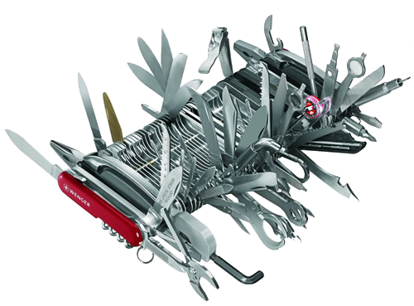
Transparent Proxy = Scalability Power Tool
Notes:
Passenger is awesome, but the proxy, while it does add some complexity is architect’s powertool, as it allows to abstract entire service layers, partition your workload, and make your life easier all around.

Slide 10

Proxies for Monitoring, Performance and Scale welcome to the wonderful world of…

Slide 11
Problem: Staging Environment
Production
Notes:
Staging environments are a necessary evil. Can’t live without them, but boy are they annoying to maintain.

Slide 12
Simulating traffic?
Duplication
“Representative Load / Staging”
Notes:
First, you have duplication of your infrastructure, which means added cost. But the biggest pet peeve is: simulating traffic. You’re at the mercy of your users.
- Profile of your ‘typical’ queries / load changes on a daily basis.
- What you had yesterday, is no longer true today.
- Timing the queries, recording query profiling, etc.

Slide 13
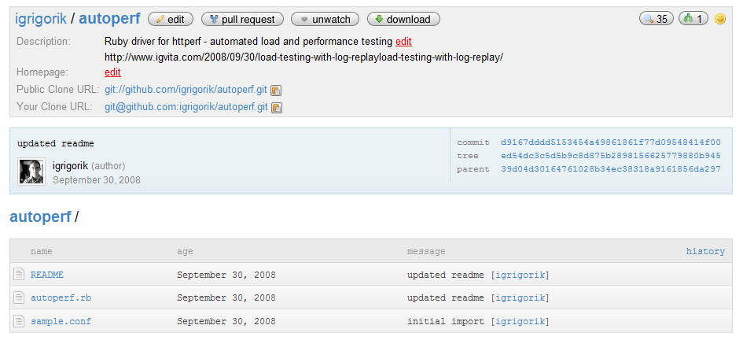
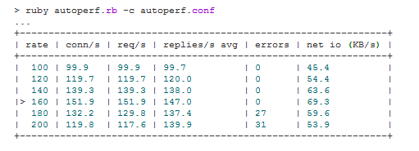
github.com/igrigorik/autoperf
Replay log data, rinse, repeat

Slide 14
Profile of queries has changed Fail
Load on production has changed Fail
Parallel environment Fail
Slower release cycle Fail
Staging fail.

Slide 15

Duplex Ruby Proxy, FTW!
Real (production) traffic
Benchmarking Proxy
flash of the obvious

Slide 16
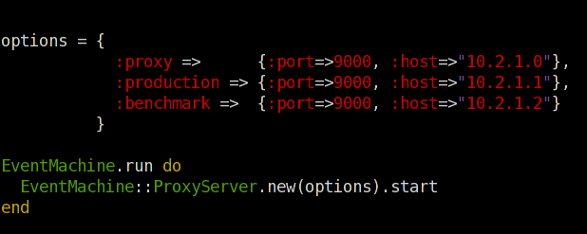
Transparent Duplex Proxy

Slide 17
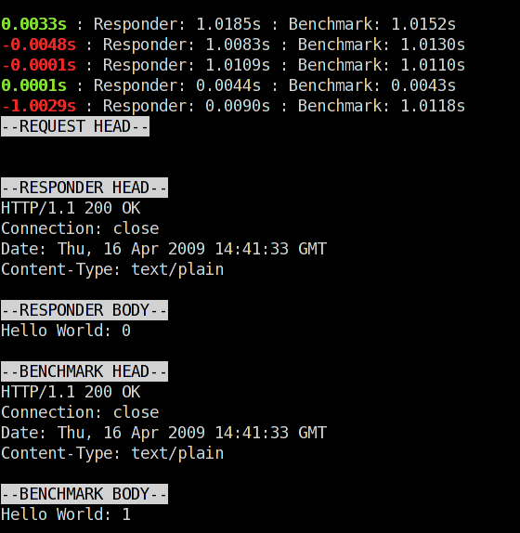
Same response, different turnaround time
Different response body!

Slide 18
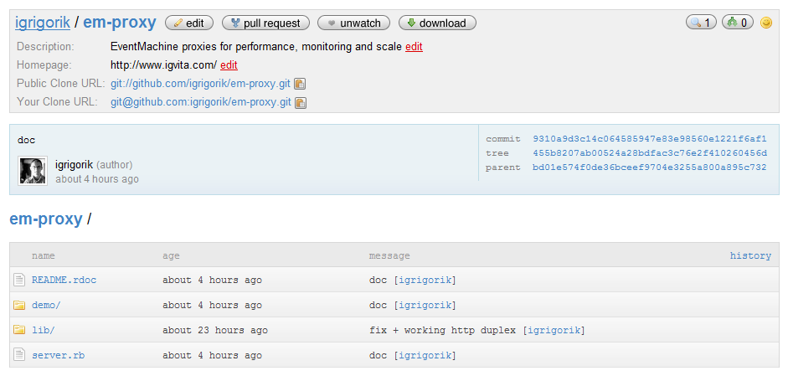
github.com/igrigorik/em-proxy
Duplex Ruby Proxy, FTW!

Slide 19
1. Accept connection
- Connect & Forward to Production
- Connect & Forward to Staging
2. Stream response to client from Production
- Buffer response from Staging
3. Run “Processor / Analyzer” once both return
EM-Proxy Workflow

Slide 20
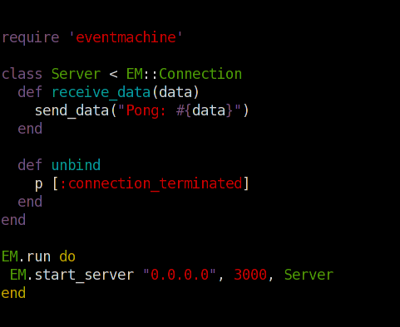
EM::Connection
#receive_data
- new data ready for processing
#unbind
- connection terminated
#connection_completed
- connected
Ruby EventMachine
crash course

Slide 21
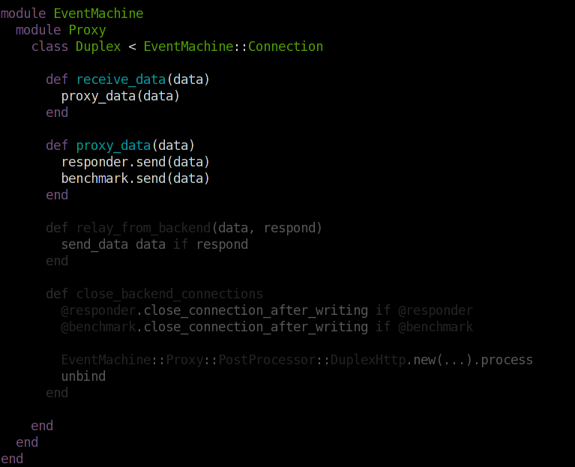
Duplex incoming data

Slide 22
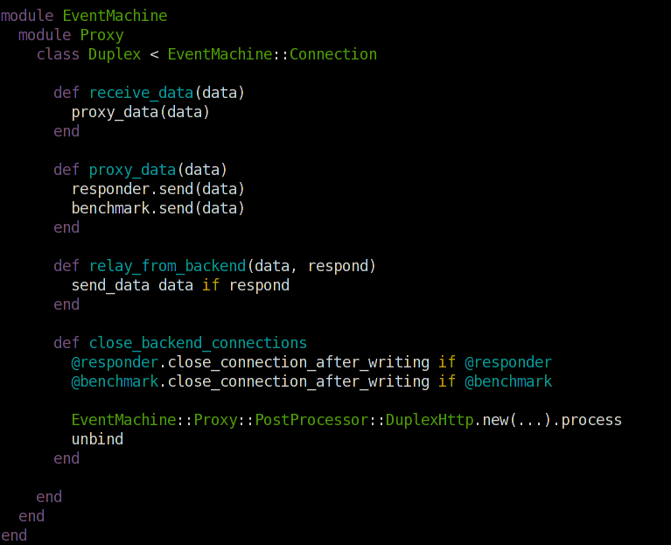
Forward Production Response
Analyze Results

Slide 23
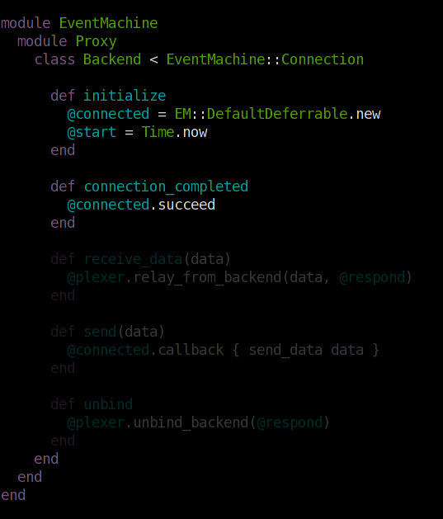
Open connection to
application server

Slide 24
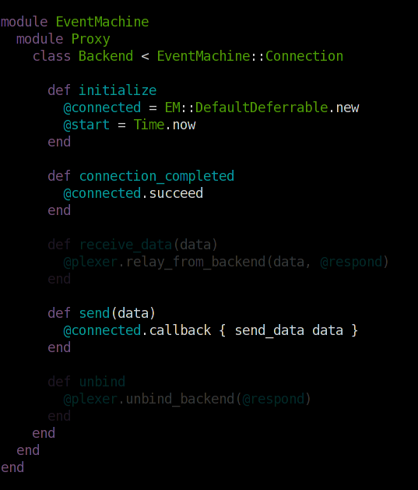
Buffer until connected

Slide 25
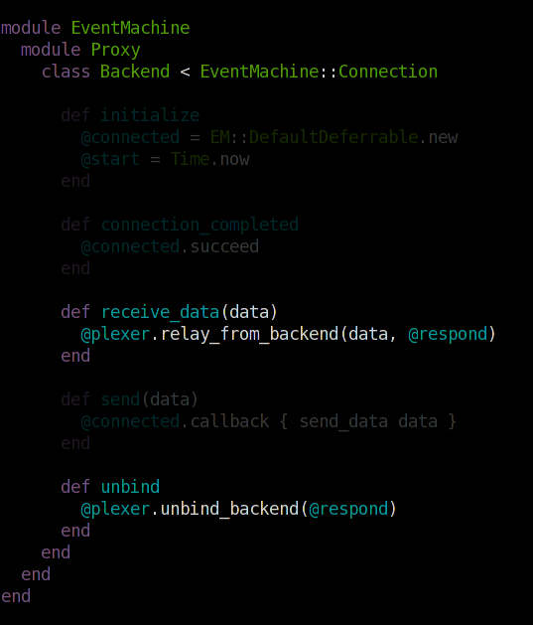
Pass response to Duplex
Notify when done

Slide 26
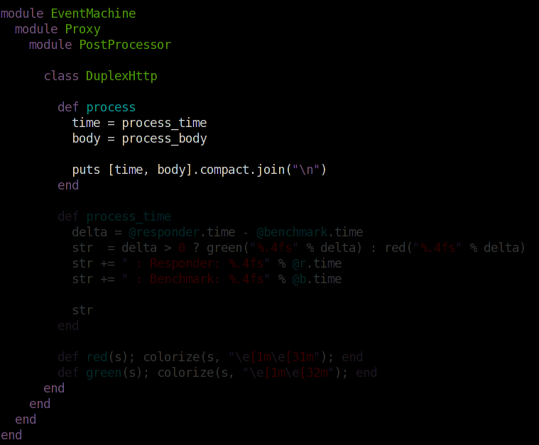
Analyze Time, Response…

Slide 27
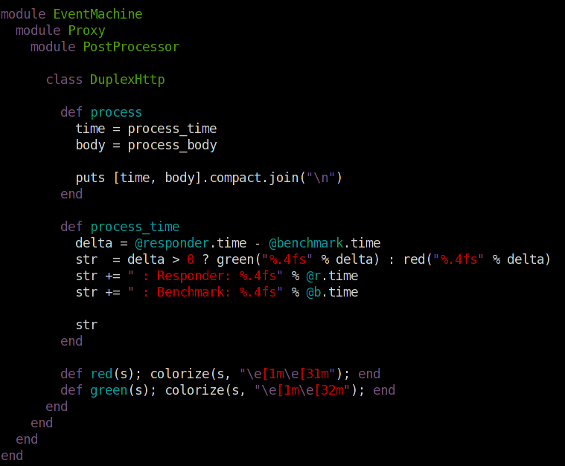
Analyze Time, Response…
Response Time

Slide 28
Cute, right?
but so what…

Slide 29

%w[ <Transparent> Intercepting Caching … ] solution for every problem

Slide 30
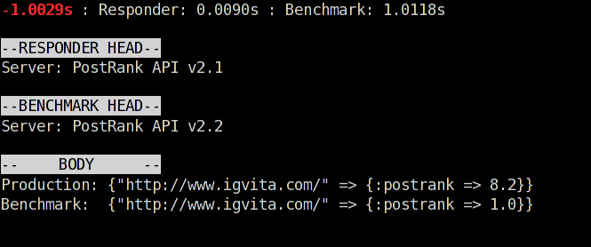
Woops!
Validating Proxy
easy, real-time diagnostics

Slide 31
Who said you’re not allowed to touch the data?
Intercepting Proxy
for those hard-to-reach spots

Slide 32
SMTP / Mail: inject SPAM detection
ShoutCast: insert some audio ads? ;-)
MySQL: inject sharding logic.
Intercepting Proxy
for those hard-to-reach spots

Slide 33
@PostRank: Beanstalkd + Ruby Proxy
because RAM is still expensive

Slide 34
~ 93 Bytes of overhead per job
~300 Bytes of data / job
x 80,000,000 jobs in memory
~ 30 GB of RAM = 2 X-Large EC2 instances
Oi, expensive!
Beanstalkd Math

Slide 35
Observations:
1. Each job is rescheduled several times
2. > 95% are scheduled for > 3 hours into the future
3. Beanstalkd does not have overflow page-to-disk
Memory is wasted…
Extending Beanstalkd
We’ll add it ourselves!

Slide 36
Intercepting Proxy
1 “Medium” EC2 Instance
@PostRank: “Chronos Scheduler”

Slide 37
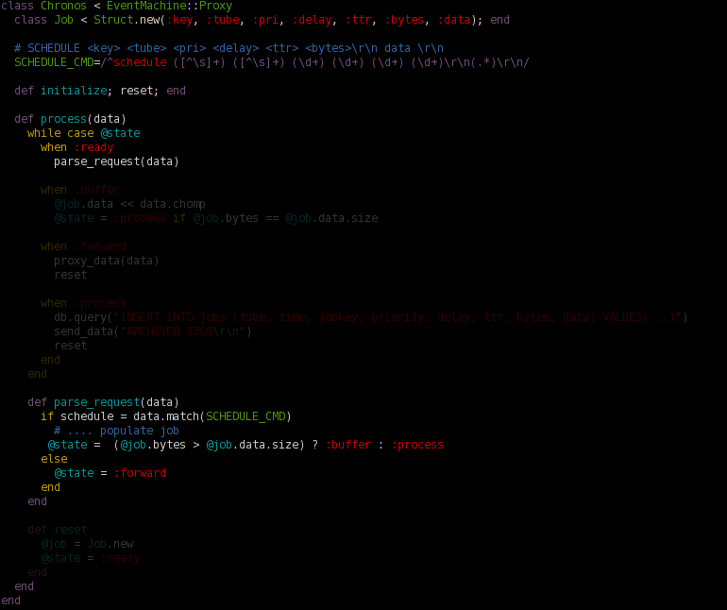
Extend the protocol
Process incoming data
Buffer “SCHEDULE” requests, otherwise forward
Chronos Scheduler
Beanstalkd persistence

Slide 38
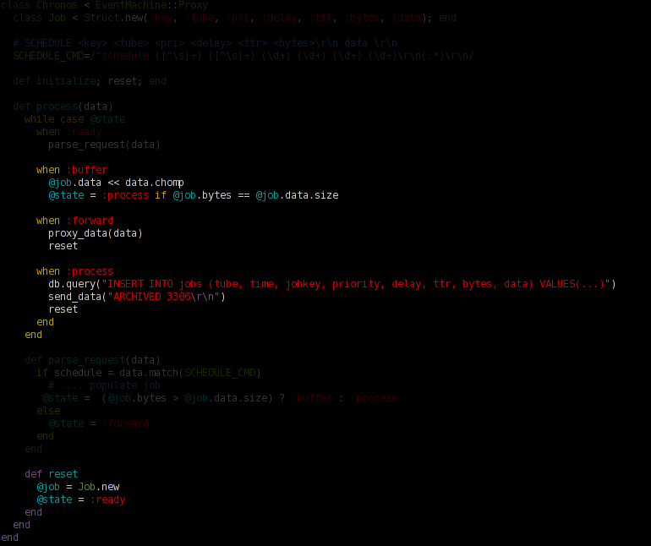
Buffer “SCHEDULE”
Archive to MySQL
Chronos Scheduler
Beanstalkd persistence

Slide 39
Extend the protocol
ARCHIVE
10 line patch to client:
queue.archive(job)
RESERVE, …
@PostRank: “Chronos Scheduler”

Slide 40
400% cheaper + extensible!
~79,000,000 jobs, 4GB RAM
ARCHIVE
Upcoming jobs: ~ 1M
RESERVE, …
@PostRank: “Chronos Scheduler”

Slide 41
%w[ Transparent <Intercepting> Caching … ] Easy to make & a powerful hammer
Notes:
That’s transparent and intercepting.. And I encourage you to think about the other applications: authentication, caching, validation, (de)encryption and so on.

Slide 42
Thanks. Questions?
The slides…
Twitter
My blog

