Slide 1


Event-Driven Architectures
Ilya Grigorik
CTO / AideRSS
Event-Driven Architectures
http://bit.ly/eda
@igrigorik #meshu #eda

Slide 2

Apr 7th launch: Bestest Blog discovery!

Slide 3
Request, Response Cycle
Event Driven Architectures
Cloud Computing
Real-time Web!
XMPP & AMQP
Example
Fully buzzword compliant!
The slides…
Questions & Comments
My blog

Slide 4
Elastic, Event-Driven, Real-time, Staged, Services Oriented Architecture (Ready, ready? Go.)
Notes:
Believe it or not, we will actually assemble this. And not only that, but it will actually make sense.

Slide 5
GET /home
GET /home
GET /home
Response
Request, Response
Notes:
Starting from the beginning, the good old request, response cycle.
How many developers in the crowd?
Familiar model, right. The server is responsible for servicing each of the requests, and it’s up to the server to figure out how to, or in which order to service each of the clients.
Worst case: serial processing.

Slide 6
Google: +200ms = -10% searches
Amazon: +100ms = -5% purchases
GET /home
Response
Response Time is Everything
Notes:
Every request ties up resources on the server.
The faster you can process the requests, the better off you are, the more clients you can serve.

Slide 7
Bottleneck
Complexity and Time
Notes:
With time, the complexity of our system grows, which places a lot of stress on the web-server, since it’s responsible for coordinating the entire workflow.

Slide 8
“Rails, Django, Seaside, Grails…” cant scale.
Myth: Slow Frameworks
Notes:
As developers, we tend to focus on the web-server as well, since that’s where we spend much of our time. But in reality, while it never hurts for the framework to be faster, most of the time any web application spends, is in the database, or in querying some other external web services.

Slide 9
Application server: 1-1000+ req/s
“Fast Enough” Frameworks
Notes:
Performance of the web-server can wary wildly based on the requirements and complexity of the application. It is just as easy to write a Ruby application which will serve over 1000 req/s, as it is, a C-based web server which will process less than 1 req/s.

Slide 10
5 ms: Process request
30 ms: Authenticate user
90 ms: Contact database & other services
30 ms: Render response
Request, Response assembly
Total: 155 ms, 0.5 MB / conn OR 6.5 req / s
Notes:
A typical profile of a request-response cycle.

Slide 11
The Proxy Solution
Notes:
Proxy servers have become a popular solution as a tool for horizontal scalability. Just add more servers, and we’re good!

Slide 12
The “More” Proxy Solution
Notes:
More proxy, more better.
Like it or not, this is more or less, the current tool of the trade. We love proxy servers!

Slide 13
This is madness.
(after a certain point)
Notes:
Facebook has thousands of servers, hidden behind proxies.

Slide 14
Receive
Verify
Dispatch
Aggregate
Handle errors
Render
Throughput != Response Time
Notes:
The inherent problem with this model is the single bottleneck that is our webserver.
As the complexity of our application grows, it has to do more and more work, contact more external services, do more verification and data integrity checks, and spend more time rendering data. Try scaling that! You can increase throughput by adding more servers, but that divorces the response time equation.
We can now serve a lot clients, slowly! Doh.

Slide 15
Buzzword: Event-Driven Architectures
(aka, reinventing the wheel)
Notes:
We like to assign complex sounding names to simple concepts, and event-driven architecture is exactly that.
How many people here feel that they understand what event-driven architectures actualy entails?
I’m going to claim, that all of you do, the name is just confusing. And to figure out what it means, we have to look back roughly a century ago…

Slide 16
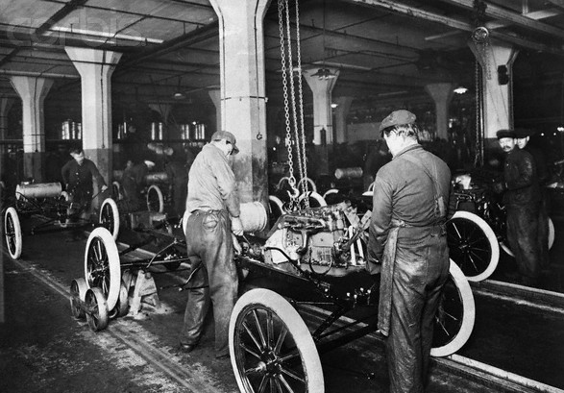
Auto Manufacturing circa 1910
2-3 men, 1-2 days / car
Notes:
Say Hello to the Detroit, circa 1910.
At the time, the accepted manufacturing method is to assign two or three people who will assemble the car start to finish. And it usually somewhere in the region of one or two days.

Slide 17
More workers!
Scaling the manufacturing process
Notes:
Hmm, does that look familiar? It’s the proxy pattern, all over. More workers, means more throughput. Which means, just keeping adding more and more workers, right?

Slide 18
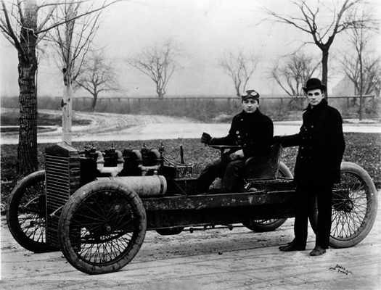
Then Henry Ford came along…

Slide 19
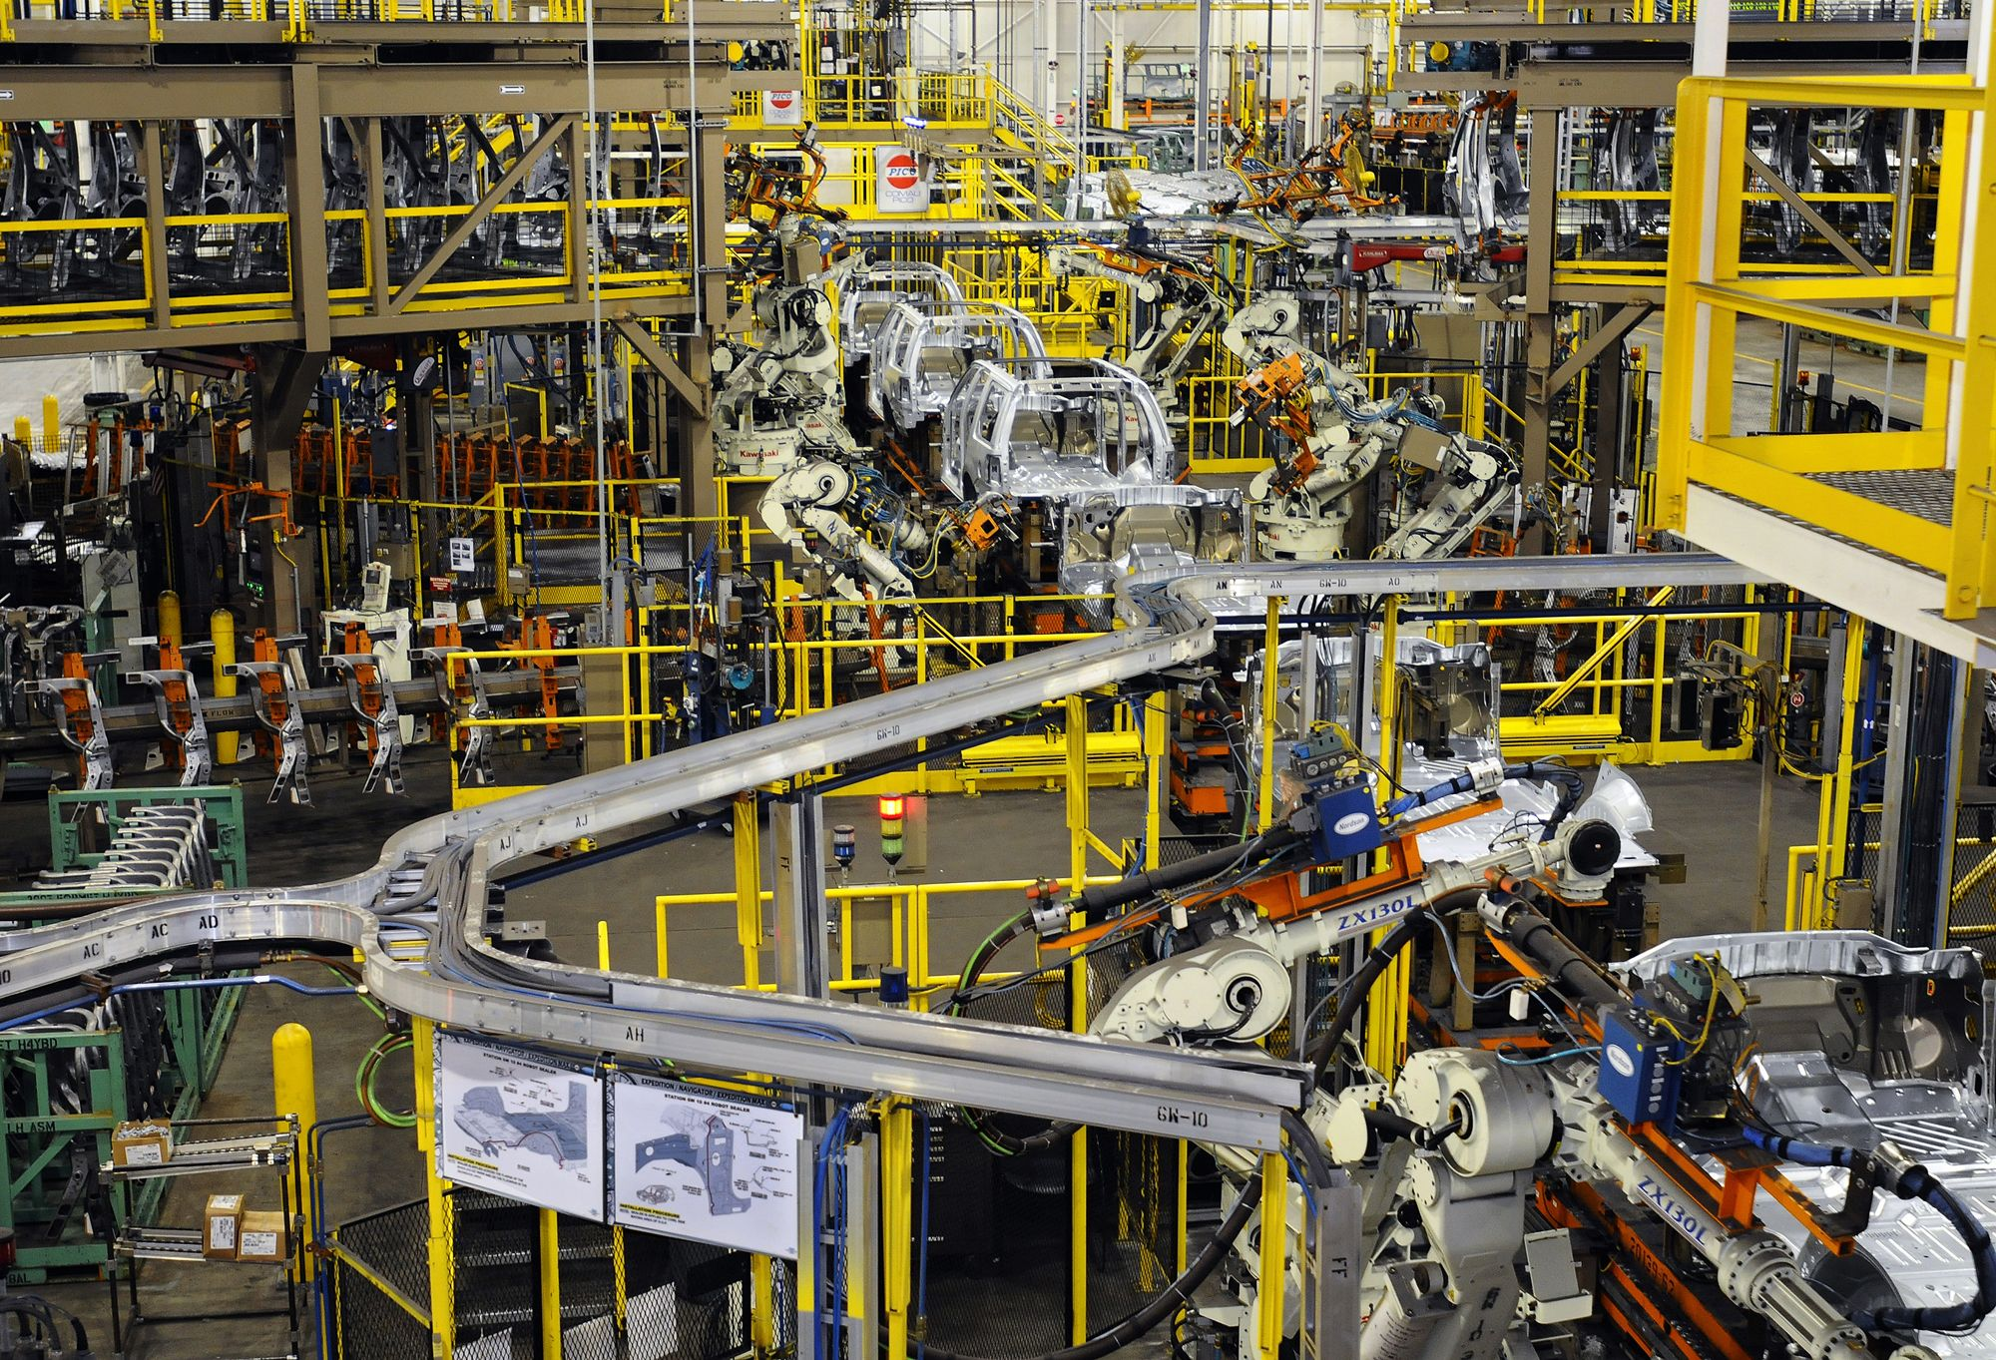
Scaling the manufacturing process
And gave us the assembly line!

Slide 20

Queuing theory
Lean manufacturing
Just in time
93 seconds / car
1M + cars / year
Lower response time,
higher throughput!
Notes:
Queuing theory – mathematical study of waiting in lines. Lean and Just in Time are both deriviatives on the same concept, all building on Henry Ford’s innovation.

Slide 21
Event Driven Architecture (EDA) = Assembly line
except, we’re not building cars here…
Notes:
It’s easy to underestimate the innovation that is inherent to the assembly line. The guy that’s working on the engine, doesn’t necessarily have to worry about installing the electronics.

Slide 22
5 ms - Receive
30 ms - Verify
30 ms - Save
200 ms – Generate PDF
50 ms - Email
50 ms - Render
Total: 365 ms, ~ 3 req / s
GET /purchase
OK
Monolith Order Processing (example)
Notes:
Getting back to the web examples…
Good but not great.

Slide 23
Total: 115 ms, ~ 3 req / s
~ 70% improvement in response time!
Can someone else do it?
5 ms – Receive No
30 ms - Verify No
30 ms – Save No
200 ms – Generate PDF Yes
50 ms – Email Yes
50 ms – Render Yes
GET /purchase
OK
Assembly Line Order Processing (example)
Notes:
In reality, we don’t have to do all the work in the same server. We can easily defer some of it to another process elsewhere, which also means, we can significantly cut down the response time.
Huge win!

Slide 24
5 ms - Receive
30 ms - Verify
30 ms - Save
10 ms – Dispatch
50 ms – Render
Total: 125 ms
Generate PDF
Dispatch
Email PDF
GET /purchase
OK
Assembly Line Order Processing (example)
Notes:
Imagine an assembly line workflow where the work is separated between different services.

Slide 25
5 ms - Receive
30 ms - Verify
30 ms - Save
10 ms – Dispatch
50 ms – Render
Total: 125 ms
Generate PDF
Dispatch
Email PDF
GET /purchase
OK
Event-Driven Staged Architecture (SEDA)
Notes:
What you’re looking at is Event-driven staged architecture

Slide 26
Don’t keep the client waiting!
“Can I defer it?”
Notes:
Acknowledge the receipt of the request and process offline!
- Record it into a database
- Fork it into another process
- Record into a work queue or a messaging queue

Slide 27
PDF service layer
Email service layer
GET /purchase
OK
Services Oriented Architecture (SOA)
helps you maintain your sanity
Notes:
Creating a processing pipeline also has another benefit of creating loose coupling between your architecture components. You can now abstract the PDF and Email functionality into their own service layers, which can exist independent of the web server. Application specific code is limited to the service, and only a simplified API is available to the user. End result, simplified & sane architecture.

Slide 28
Scalability of service layer
GET /purchase
OK
SOA = Simple(r) Scalability
Notes:
From our example, we know that generating the PDF files is the single slowest operation in our stack. Hence, since the PDF service is hidden into its own component and abstracted behind an API, we can easily add more servers to increase the throughput of this service.

Slide 29
Elastic Computing
EC2 & Virtualization
Notes:
More buzzwords! Elastic computing, or more commonly known as cloud computing is all the rage, currently.

Slide 30
$0.10 / hour
3 servers (always): $216 / month
3 servers (elastic): $120 / month
0AM – 8AM
8AM – 24PM
Elastic Computing (Pay by the sip)
Notes:
First interesting property:
Because the provisioning cost of a server is $0.00, an entirely new class of applications is becoming possible.. These applications are much, much more efficient, and can operate on much larger datasets. After all, since the cost is 0.00, you

Slide 31
100 computers * 1 hour = 1 computer * 100 hours
Elastic Computing (Pay by the sip)
Notes:
Second interesting property:
So why the hype.. It’s this new transitivity. You should be salivating at this notion.
The cost of 100 computers for one hour is the same as 1 computer for 100 hours.
In other words, you can process A LOT more data, A LOT quicker.

Slide 32
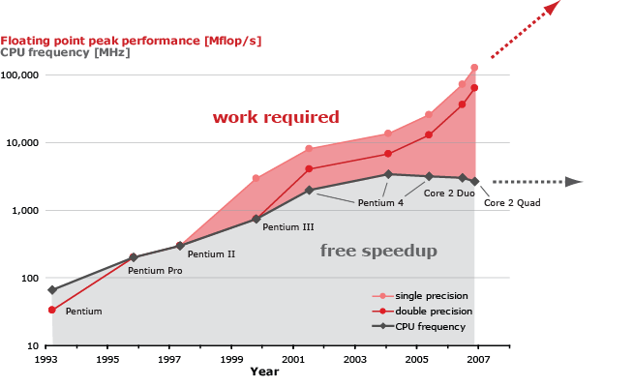
Era of Parallelism
Notes:
Third property, driver:
Another interesting, and somewhat unfortunate driver behind the adoption of elastic computing is the era of parallelism. As of about 2004, Moore’s law for CPU frequency is no longer true. The CPU speeds have stopped increasing, because the manufacturers are having an increasingly hard time managing the heat generated by all the transistors, amongst many other challenges.
What this means it that, if before we could simply wait a year, get faster hardware, and not worry much about performance, all of the sudden, the CPU speed is not going up. So, if we want to deal with more data, we need to migrate to parallel processing. Cloud / Elastic computing is our best answer.

Slide 33
Elastic car manufacturing?
High capital investment
People & Unions
Notes:
Elastic computing is as much of an innovation as the assembly line in the early 1900’s. All of the sudden, we have a much more efficient model for building our services.
Elastic car manufacturing? You could argue that Toyota’s just-in-time process is basically that, but it still lacks some of the properties. First, factories require high capital investment, cluster of machines require zero. Second, once you’ve deployed a factory or hired a thousand people, you’re not going to fire and re-hire them on an hourly basis. Plus, you have to maintain the darn factory!

Slide 34
Elastic Computing = Assembly Line 2.0
EC2 & Virtualization
Notes:
More buzzwords! Elastic computing, or more commonly known as cloud computing is all the rage, currently.
And I say that seriously because I think we tend to underestimate how much of an innovation an assembly line is / was.
This is huge.

Slide 35
Elastic, Event-Driven, Staged, Services Oriented Architecture (that’s a mouthful)
Notes:
Phew. Faster processing, services oriented architecture which exposes an API which enables us to easily scale a service, deployed in the cloud, which allows us to dynamically scale to the required throughput.

Slide 36

Phew.
Notes:
Phew. Faster processing, services oriented architecture which exposes an API which enables us to easily scale a service, deployed in the cloud, which allows us to dynamically scale to the required throughput.

Slide 37
Buzzword: Real-time web
Scientific translation: really, really, really, fast
Notes:
Real-time web is the new meme. Not only do we expect our favorite services to handle millions of requests, but we also expect them to be faster than ever!

Slide 38
Ouch!
Millions of users
Really fast response time
Real-time pain
Notes:
While we’ve built systems that can support millions of users, and we can figure out how to build services with very fast response times, the intersection of these two requirements is an especially hard problem for any architect.
For example, when you type in a query in google, you are in fact, accessing a supercomputer. Your query is distributed across thousands of computers, all of which combined maintain the entire index of the web in memory.
Facebook and LinkedIn both use a similar strategy. They keep the entire social graph in memory. Using the last release numbers, facebook maintains about 800 cache servers, which add up to roughly 28TB of memory.
Twitter occasionally throws a failwhale. ;-)

Slide 39
HTTP? DB? …
HTTP? Queue? …
Real-time communication
Notes:
Coming back to our example, let’s refine our model. Namely, while we assumed that the communication happens transparently, let’s dig into the details. How exactly are we going to pass around these events from service to service?
We could certainly use HTTP, perhaps store the messages in the database? What if we want it “real-time”?

Slide 40
Emerging Standards: XMPP & AMQP
Notes:
Both of these protocols have been around for a while, so it may be a little unfair to call them emerging. Having said that, both of them have seen a recent wave of adoption in a number of distributed applications. Let’s take a look behind the curtain…

Slide 41

From: A, To: B
Hello!
From: A, To: B
Hello!
Extensible Messaging and Presence Protocol (XMPP)
Notes:
XMPP is a real-time messaging system/protocol for routing small snippets of XML. In fact, the architecture of XMPP is vaguely reminiscent to that of SMTP and the email system we’re all used to. One major difference, it’s realtime.

Slide 42
Event-stream protocol
Persistent connections
Presence
XMPP Features
Identity and authentication
Notes:
Unlike HTTP or SMTP, one of the core features of XMPP is persistent and stateful connections between the server and the client. When a client comes online, it opens a connection, and then keeps it open, listening for events. This means we don’t have to poll or ping the server (like SMTP, for example), but just listen to the events. Hence the need for an event-stream protocol, instead of using the request, response cycle, an XMPP server simply routes pieces of XML which in themselves are fully fledged messages or status updates.
Next up, identity and authentication. Both of these concepts are built right into XMPP, which means we can verify and establish the identity of each connected user, and then also authenticate them to get access to their account information, and so on.
Last but not least, there is presence. This one is often overlooked but very powerful. Because we maintain persistent connections, the XMPP server is able to maintain state on each client. Which means we can find out who’s online, or what state their in at any point in time.

Slide 43

User
Domain
Resource
ilya@aiderss.com/office
Jabber Software Foundation
JID: Federation, Identity & Authentication
Notes:
Jabber.org is the original IM service based on XMPP, the open standard for instant messaging. The service is run by a small group of volunteers. For that reason, you’ll often find people using Jabber and XMPP as synonyms. For all intents and purposes though, they are exactly the same.
Having said that, each XMPP user has a “JID” or “Jabber ID”, which captures the following components: user, domain and resource.
If you discard the resource component for a second, you’re left with an email address! Hence, as you may guess, the user identification and authentication will be done by a jabber server running on aiderss.com. And then the resource component simply assigns a unique handle, or location for that user. Unlike SMTP, which is stateless, we can have multiple clients be connected to our jabber server, which means we need a unique ID for each one.

Slide 44
<message from="ilya@aiderss.com/office" type="chat" to="ilya@igvita.com" id="aae1a">
<body>hello</body>
<active xmlns="http://jabber.org/protocol/chatstates"/>
</message>
Very verbose protocol (XML)
Example: Message Routing with XMPP
Notes:
Putting all of the pieces together, we can now route a message from user A to user B. XMPP uses a chatty, and very verbose protocol based on XML. The good news is, it’s easy to read, the bad news is, there is usually hundreds of lines of output for any interaction.
One interesting thing to point out in this example is federation. Notice that we are not connecting to any central server to exchange messages. Instead, each domain, in our case, aiderss.com and igvita.com run their own XMPP servers. When a user from aiderss.com wants to send a message to igvita.com, the XMPP server contacts the Jabber server on igvita.com and routes the message. This is called federation, and it is one of the core benefits to XMPP – it can run in a distributed fashion. In fact, you could boot up your own XMPP server at any point and start sending and receiving XMPP messages. Not unlike SMTP…

Slide 45
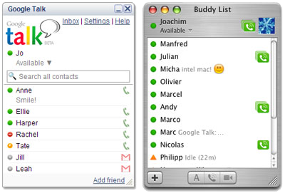
XMPP in the wild: Google Talk
Notes:
Google Talk is based on XMPP and Jabber. Something you may or may not have known.

Slide 46
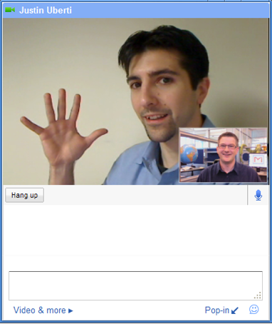
XMPP in the wild: Google Talk + Video
Notes:
XMPP is also not limited to routing text snippets. Recently, Google integrated video chat into their products, once again, using XMPP. You can use XMPP to transfer binary files, real-time video, or anything else that your heart desires (not that it’s a necessarily good idea to do that though).

Slide 47
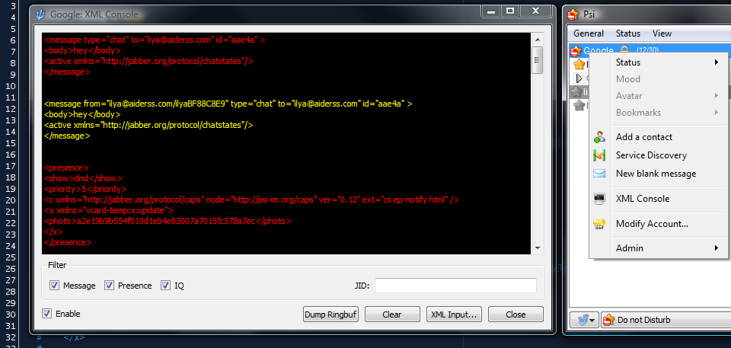
Psi: cross-platform Jabber/XMPP client
Notes:
If you’re interested, an easy way to get started with XMPP is to download the Psi Jabber client. With it, you can connect to your google talk account, or any other XMPP server. One of the best features of this client is the ability to listen in on the protocol. Right click on your connection and bring up the XML console. In this window you can see the full client-server exchange. Also, you can manually feed XML snippets into the console. This is a very nifty way to test your messages or protocol if you’re writing an XMPP application.

Slide 48
require "rubygems"
require "xmpp4r"
jid = Jabber::JID::new("ilya@aiderss.com")
client = Jabber::Client.new(jid)
client.connect("talk.google.com")
client.auth("password")
to = "ilya@aiderss.com"
subject = "Jabber client"
message = "Hello XMPP World!"
piclient.send Jabber::Message::new(to, message).set_subject(subject)
# <message to='ilya@igvita.com'>
# <body>Hello XMPP World!</body>
# <subject>Jabber client</subject>
# </message>
XMPP4R (Ruby) Demo
Notes:
You’ll find an XMPP client library in virtually every language out there: java, perl, php, python… In this case, we’re going to take a quick look at a Ruby example.
First, we need to create a Jabber ID. Then we establish a client connection to the google servers and authenticate the user. Simple.

Slide 49
require "rubygems"
require "xmpp4r"
jid = Jabber::JID::new("ilya@aiderss.com")
client = Jabber::Client.new(jid)
client.connect("talk.google.com")
client.auth("password")
to = "ilya@aiderss.com"
subject = "Jabber client"
message = "Hello XMPP World!"
piclient.send Jabber::Message::new(to, message).set_subject(subject)
# <message to='ilya@igvita.com'>
# <body>Hello XMPP World!</body>
# <subject>Jabber client</subject>
# </message>
XMPP4R (Ruby) Demo
Notes:
You’ll find an XMPP client library in virtually every language out there: java, perl, php, python… In this case, we’re going to take a quick look at a Ruby example.
First, we need to create a Jabber ID. Then we establish a client connection to the google servers and authenticate the user. Simple.

Slide 50
client.send(Jabber::Presence.new.set_type(:away))
# <presence from='daniel@aiderss.com/iMac8D2CB97D' to='ilya@aiderss.com/0EDD826C' xmlns='jabber:client'>
# <show>away</show>
# <priority>0</priority>
# <x xmlns='http://www.apple.com/xmpp/idle'>
# <idle-since>2009-04-01T21:48:15Z</idle-since>
# </x>
# </presence>
client.add_message_callback do |m|
puts "#{m.from} -- #{m.body}"
end
# > daniel@aiderss.com -- Hey!
Client Idle…
XMPP4R (Ruby) Demo
Notes:
Presence is also very simple. Each user has a ‘roster’ of friends, and you can notify your friends in realtime of your status. For example, in the Google Chat client you can set your state to be away, do not disturb, etc. This generates a message on the wire that the XMPP server then routes to everyone on your roster.

Slide 51
client.send(Jabber::Presence.new.set_type(:available))
# <presence from='daniel@aiderss.com/iMac8D2CB97D' to='ilya@aiderss.com/0EDD826C' xmlns='jabber:client'>
# <show>away</show>
# <priority>0</priority>
# <x xmlns='http://www.apple.com/xmpp/idle'>
# <idle-since>2009-04-01T21:48:15Z</idle-since>
# </x>
# </presence>
client.add_message_callback do |m|
puts "#{m.from} -- #{m.body}"
end
# > daniel@aiderss.com -- Hey!
Client Idle…
XMPP4R (Ruby) Demo
Notes:
Finally, how do we receive messages? Simple, the XMPP4R gem allows you to define a callback method in Ruby, which will get executed anytime a message comes in over the wire.

Slide 52
One-to-many distribution
Notes:
One nice property of XMPP is the possibility of one-to-many distribution . Namely, anytime you change your status, your local XMPP server scans your entire roster of friends, and notifies them of a status update in real-time. Initially, this was only possible for presence information, but this technique very quickly found other users…

Slide 53
XEP-0060: Publish-Subscribe (Pubsub)
Notes:
Building on this pattern, an XMPP extension was proposed for simplified Publish-Subscribe interaction, or more affectionately known in the community as PubSub.
The realization there is of course, that the generator of the event doesn’t have to be a user, at the notification doesn’t have to be presence. Likewise, the consumer doesn’t have to be a user either. It could be another service.
Nowadays, every Jabber server worth its salt supports XMPP PubSub.

Slide 54
Many wasteful checks
Data?
No
Data?
No
Data?
Yes
HTTP / SMTP Polling: painful, wasteful
Notes:
A common way to check for status, including SMTP, is to periodically poll a service endpoint to see if anything new is available for consumption.
The problem with this approach is the wasteful nature of the vast majority of these checks.. Most return no data! This ties up resources on the server side, and also wastes resources on the client side. A great example of this is Blackberry. By migrating to push email, the user gets immediate delivery AND gets a better battery life, because the mobile device no longer has to poll the server every x minutes. Instead it can sleep and be notified when a new message is available.

Slide 55
Persistent connection
Subscribe
New message!
Publish-Subscribe
Notes:
PubSub allows us to eliminate all the intermediate requests. Very nice!

Slide 56
<iq type='set‘ from='hamlet@denmark.lit/blogbot' to='pubsub.shakespeare.lit' id='pub1'>
<pubsub xmlns='http://jabber.org/protocol/pubsub'>
<publish node='princely_musings'>
<item>
<entry xmlns='http://www.w3.org/2005/Atom'>
<title>Soliloquy<title>
<summary>
To be, or not to be: that is the question!
<summary>
<link rel='alternate' type='text/html'
href='http://denmark.lit/2003/12/13/atom03'/>
<id>tag:denmark.lit,2003:entry-32397</id>
<published>2003-12-13T18:30:02Z</published>
<updated>2003-12-13T18:30:02Z</updated>
</entry>
</item>
</publish>
</pubsub>
</iq>
IQ Stanza
PubSub Protocol: Client XML
Notes:
Pubsub notifications are wrapped in IQ stanzas, which specify the originator and pubsub node.

Slide 57
<iq type='set‘ from='hamlet@denmark.lit/blogbot' to='pubsub.shakespeare.lit' id='pub1'>
<pubsub xmlns='http://jabber.org/protocol/pubsub'>
<publish node='princely_musings'>
<item>
<entry xmlns='http://www.w3.org/2005/Atom'>
<title>Soliloquy<title>
<summary>
To be, or not to be: that is the question!
<summary>
<link rel='alternate' type='text/html'
href='http://denmark.lit/2003/12/13/atom03'/>
<id>tag:denmark.lit,2003:entry-32397</id>
<published>2003-12-13T18:30:02Z</published>
<updated>2003-12-13T18:30:02Z</updated>
</entry>
</item>
</publish>
</pubsub>
</iq>
AtomPub
PubSub Protocol: Client XML
Notes:
Finally, how do we receive messages? Simple, the XMPP4R gem allows you to define a callback method in Ruby, which will get executed anytime a message comes in over the wire.

Slide 58
Distribute
XEP-0060: Publish-Subscribe (Pubsub)
Publish
Notes:
Putting it all together, we can actually have a web service which generates events and the XMPP server is responsible for distribution.

Slide 59
<message from='pubsub.shakespeare.lit' to='francisco@denmark.lit' id='foo'>
<event xmlns='http://jabber.org/protocol/pubsub#event'>
<items node='princely_musings'>
<item id='ae890ac52d0df67ed7cfdf51b644e901'>
[ ... ENTRY ... ]
</item>
</items>
</event>
</message>
<message from='pubsub.shakespeare.lit' to='bernardo@denmark.lit' id='bar'>
<event xmlns='http://jabber.org/protocol/pubsub#event'>
<items node='princely_musings'>
<item id='ae890ac52d0df67ed7cfdf51b644e901'>
[ ... ENTRY ... ]
</item>
</items>
</event>
</message>
Subscriber A
Subscriber B
XEP-0060: Publish-Subscribe (Pubsub)

Slide 60
Seems neat, but so what?

Slide 61
XMPP
XMPP
Real-time communication
Notes:
Remember this diagram? Well, depending on your application, we can now think about substituting some of the communication channels with XMPP. Instead of reinventing the wheel, we can hook up our Web and PDF and Email services via XMPP. Each server will listen for messages and process them on the fly. No need to build SOAP, or RESTful interfaces, all we need is simple message passing to invoke commands.
Client-side is also interesting. While this is definitely still niche, you can expose an XMPP endpoint to push updates to your clients, instead of asking them to poll for updates.

Slide 62
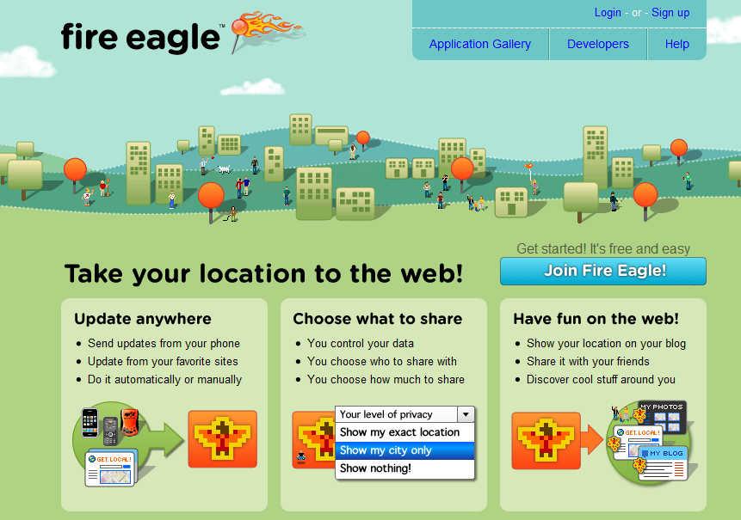
XMPP
XMPP
XMPP
Real-time communication
Notes:
Fire Eagle is a great example of XMPP use. This is a product offered by Yahoo, which allows you to send out location updates to any user or application that wants to consume it. In by itself, it’s not even that useful, it’s just a piece of intermediate glue. As a user, I can publish updates to fire eagle, and then other applications can consume it, in any way they want.
Having said that, Fire eagle does provide a nice security layer.

Slide 63
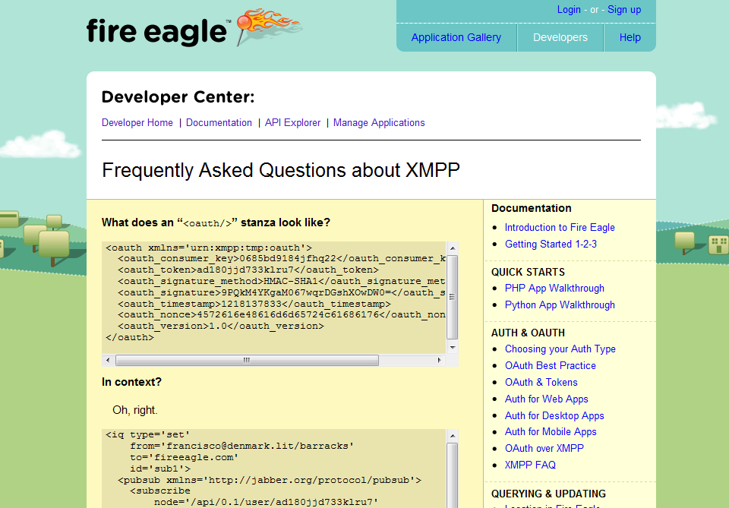
Notes:
Fire eagle exposes an XMPP endpoint which anyone can consume to receive your location updates. This saves them a lot of bandwidth and server resources, since the clients don’t have to poll for updates!

Slide 64
require 'fire_hydrant'
require 'yaml'
hydrant = FireHydrant.new(YAML.load(File.read("config.yml")))
hydrant.on_location_update do |user|
puts "#{user.token} has moved to #{user.locations.first}."
end
hydrant.run!
Push notifications
Ruby + FireEagle via XMPP
Notes:
Want realtime location updates? No polling required. Check out fire hydrant gem on github.

Slide 65
Presence: available
GET /purchase
OK
Elastic Computing + Presence
Notes:
Another interesting and fairly popular use for XMPP is the dynamic scalability. Instead of trying to build your own glue to detect and register new servers in the cloud, you could use XMPP and presence to solve this for you: whenever a server comes online, it logs into the XMPP server announcing it’s presence as available. Under load? Set it to “do not disturb”.
If the server falls off the network, the XMPP server will detect that and remove it from its roster.

Slide 66
Ejabberd Erlang
Djabberd Perl
OpenFire Java
Tigase Java
Defacto XMPP server
RPM, GUI, shiny
XMPP / Jabber Servers
Notes:
Another interesting and fairly popular use for XMPP is the dynamic scalability. Instead of trying to build your own glue to detect and register new servers in the cloud, you could use XMPP and presence to solve this for you: whenever a server comes online, it logs into the XMPP server announcing it’s presence as available. Under load? Set it to “do not disturb”.
If the server falls off the network, the XMPP server will detect that and remove it from its roster.

Slide 67
Advanced Message Queuing Protocol (AMQP)

Slide 68






“AMQP is an open Internet Protocol for Business Messaging”
AMQP Working Group (16 companies)
Notes:
AMQP was a project that was started by the financial community. Feeling the need for real-time data updates (stock quotes), each of the major companies was inventing their own messaging systems, which meant that the interoperability was a major pain. No two systems, or any two vendors could agree on what the protocol should look like.
Hence, AMQP was born, which specifies the wire protocol (which is language agnostic), and the client/broker interfaces.

Slide 69
AMQP Broker
Consumer
AMQP Architecture
Publisher
Notes:
Unlike XMPP, AMQP does not worry about federation. While it is possible to do, the primary use case for the broker is that of a message router. In fact the AMQP server is primarily that: router.

Slide 70
Broker Clustering
AMQP Clustering
Notes:
Message latency and throughput is a much bigger concern in the AMQP world. Instead of worry about federation, most broker implementations will offer a clustering mode, where multiple servers can be joined in a cluster such that more consumers or more messages could be passed through.

Slide 71
Routing key: usd.stock.amz Message: I like AMZ!
Direct Exchange
Topic Exchange
Fanout Exchange
AMQP Broker Internals
Notes:
Unlike XMPP, AMQP is much more flexible in its routing capabilities. When you start interacting with the broker, first you have to declare or connect to an exchange, which can be one of the following types: direct, topic, or fanout.

Slide 72
Routing key: usd.stock.amz Message: I like AMZ!
Direct Exchange
Topic Exchange
Fanout Exchange
Queue
Name: amazon Bind: usd.stock.amz
AMQP Direct Exchange
Notes:
Direct exchange does a direct match between the routing key in the message and the queues that are bound in the exhange. In this case, a client sends a message with a routing key usd.stock.amz to a direct exchange, and another client binds a message queue to it. The router, then determines where the messages need to go.

Slide 73
Routing key: usd.stock.amz Message: I like AMZ!
Direct Exchange
Topic Exchange
Fanout Exchange
Queue
Queue
Message: I like AMZ!
AMQP Direct Exchange
Notes:
If two clients bind two different queues, then the message gets multiplexed to both queues. Nice.

Slide 74
Routing key: usd.stock.msft Message: I like Microsoft!
Direct Exchange
Topic Exchange
Fanout Exchange
Queue
Name: stocks Bind: usd.stock.*
AMQP Topic Exchange
Notes:
Topic exchange allows more flexibility in your routing. Instead of doing an exact match, you can do prefix matching with wildcards. In this example, a client wants to receive any notification related to stocks, hence he binds to a topic exchange. Whenever another client publishes to that topic exchange and the key matches, the message will be routed to the client.

Slide 75
Routing key: usd.stock.msft Message: I like Microsoft!
Direct Exchange
Topic Exchange
Fanout Exchange
Queue
Message: I like Microsoft!
AMQP Topic Exchange
Notes:
In this case, since we bound to stock.*, the client receives a notification about msft stock.

Slide 76
Routing key: usd.stock.msft Message: I like Microsoft!
Direct Exchange
Topic Exchange
Fanout Exchange
Queue 1
Queue 2
Name: stocks Bind: “”
AMQP Fanout Exchange
Notes:
Last but not least, there is the fanout exchange. Instead of worrying about the routing, it simply forwards messages to every single attached queue. In this case, the client doesn’t have to provide any routing keys, just bind to the exchange.

Slide 77
Routing key: usd.stock.msft Message: I like Microsoft!
Direct Exchange
Topic Exchange
Fanout Exchange
Queue 1
Queue 2
Message: I like Microsoft
AMQP Fanout Exchange
Notes:
Whenever a new message comes in, it gets routed to all of the attached queues.

Slide 78

AMQP Kung-fu: Load-balancing

Slide 79
Routing key: usd.stock.amz Message: I like AMZ!
Direct Exchange
Topic Exchange
Fanout Exchange
Queue
Only one client gets the message!
AMQP Load Balancing
Notes:
Here’s a nice pattern that can come as a bit of a surprise, but is actually a very, very useful architectural tool. If instead of declaring multiple queues, you connect two clients to the same queue, then the exchange will round-robin between the clients. Free load-balancing! Woohoo!

Slide 80
Bind: purchase.pdf
GET /purchase
OK
Elastic AMQP Load-balancing
Notes:
Now, we can easily grow our service layer without worrying about distributing the work. Whenever each server comes online, it can bind to a single message queue. From there, the AMQP broker will automatically distribute the work in round-robin fashion.

Slide 81
AMQP Kung-fu: Persistence & Durability

Slide 82
Routing key: usd.stock.amz Message: I like AMZ!
Direct Exchange
Topic Exchange
Fanout Exchange
Queue
Durable: True
Persistent: True
AMQP Persistence & Durability
Notes:
When a client creates a queue, a message, or an exchange, he or she can set the ‘durable’ and ‘persistent’ flags. Let’s pick an example:
Durable queue: if the client disconnects, the queue will continue to exist. And if queue is also persistent, then it will store messages for the client. When the client comes back online, it can consume the messages. On other other hand, if the queue is not durable, then it is deleted as soon as the client disconnects.
Similarly, you can declare messages and exchanges as persistent or durable. Yes, it can be a bit confusing at times.

Slide 83

Almost there :)

Slide 84
require 'mq'
AMQP.start(:host => 'amqp-server.com') do
mq = MQ.new
mq.topic('stocks').publish("5.95", :key => "usd.amz")
end
AMQP.start(:host => 'amqp-server.com') do
mq = MQ.new
mq.queue('amazon stock').bind(mq.topic('stocks'), :key => 'usd.amz').subscribe{ |price|
print 'apple stock', price
}
end
Publisher
AMQP + Ruby Example
Notes:
Publisher example.
http://github.com/tmm1/amqp/tree/master

Slide 85
require 'mq'
AMQP.start(:host => 'amqp-server.com') do
mq = MQ.new
mq.topic('stocks').publish("5.95", :key => "usd.amz")
end
AMQP.start(:host => 'amqp-server.com') do
mq = MQ.new
mq.queue('amazon stock').bind(mq.topic('stocks'), :key => 'usd.amz').subscribe{ |price|
print ‘amazon stock', price
}
end
Consumer
AMQP + Ruby Example
Notes:
Consumer example.
http://github.com/tmm1/amqp/tree/master

Slide 86
Elastic, Event-Driven, <Real-time>, Staged, Services Oriented Architecture (oi…)

Slide 87
XMPP / AMQP
Publisher
Elastic Architecture
Notes:
Refining our previous model, we can now add either XMPP or AMQP as a messaging layer into our architecture. Now, whenever a request comes in, the web-server can publish an event to a pubsub node, or an exchange and the workers will pickup the work. Fully elastic, transparent scalability, and no need to reinvent the wheel.

Slide 88
XMPP / AMQP
Exposing Publish-Subscribe API
Subscribe
Notes:
Best of all, you are now in position to expose a real-time API, and move a lot of your clients off that nasty poll loop, and into a publish-subscribe model. Because your infrastructure is already event driven, you just have to expose an authenticated (or not) endpoint and you’re good to go.

Slide 89

Thanks.
The slides…
Questions & Comments
My blog

