Slide 1

Building Mini-Google in Ruby
Ilya Grigorik
@igrigorik

Slide 2

postrank.com/topic/ruby
The slides…
Twitter
My blog

Slide 3
Ruby + Math
Optimization
PageRank
Misc Fun
Examples
Indexing
Notes:
Familiar with treemaps?
How many people here have rolled their own search in their Rails app? Ferret, SQL, Sphinx, anything goes.
- How many would like to make it better? … I promise you, whatever the app, from a social network to an ecommerce site, a solid understanding of the concepts we’ll discuss can help you make it better.
When I started making the talk I thought I should spend most of the time on the Math and optimization parts in Ruby, but the further I got into it, the more clear it became that while optimization is an interesting, the actual subject of PageRank is something we tend to take for granted, and for most part have very superficial understanding of it.
In fact, it is one of those concepts which the further you get into, the more you start appreciate the elegance of the simple core. It becomes a giant hammer. So instead…

Slide 4
PageRank
PageRank + Ruby
Tools
+
Optimization
Examples
Indexing
Notes:
We’re actually going to spend some time exploring PageRank – think of it advanced SEO, we’ll then look at how to do it Ruby, as well as, explore some examples.
Why? Well, I think

Slide 5

Consume with care…
everything that follows is based on released / public domain info

Slide 6







Search-engine graveyard
Google did pretty well…
Notes:
Anyone remembers using these search engines? It’s been a while huh..
Of course the question you should be asking is, what happened?
What was it about google that killed all of these guys? And while you’re thinking about that, you should also recall that when google first came out, it was far far from obvious that ‘the killer search engine’.

Slide 7
Query: Ruby
Results
1. Crawl
2. Index
3. Rank
Search pipeline
50,000-foot view
Notes:
Extremely simplified.. But more or less acurate. There are 3 major steps:
Crawl – sweep under the rug
Index – DIY, Ferret, things to look out for.. Creating a good inverted index is a tricky thing.
Rank – the secret juice goes here.. What is PageRank, how does it work, why, and how can we apply it?

Slide 8
Query: Ruby
Results
1. Crawl
2. Index
3. Rank
Bah
Interesting
Fun
Notes:
Crawling is a pretty well understood and almost purely technological problem.
Indexing: media types, languages, encodings, etc.
Ranking: where all the secret juice goes.

Slide 9

CPU Speed 333Mhz
RAM 32-64MB
Index 27,000,000 documents
Index refresh once a month~ish
PageRank computation several days
Laptop CPU 2.1Ghz
VM RAM 1GB
1-Million page web ~10 minutes
circa 1997-1998
Notes:
Index updates were rolled out every couple of months initially
Now index updates are done on the fly, and pagerank scores are adjusted as well … “Real-time web”
With a little sweat, you can crunch 27M web on your laptop.

Slide 10
Creating & Maintaining an Inverted Index DIY and the gotchas within

Slide 11
require 'set' pages = { "1" => "it is what it is", "2" => "what is it", "3" => "it is a banana" } index = {} pages.each do |page, content| content.split(/\s/).each do |word| if index[word] index[word] << page else index[word] = Set.new(page) end end end
{ "it"=>#<Set: {"1", "2", "3"}>, "a"=>#<Set: {"3"}>, "banana"=>#<Set: {"3"}>, "what"=>#<Set: {"1", "2"}>, "is"=>#<Set: {"1", "2", "3"}>} }
Building an Inverted Index

Slide 12
require 'set' pages = { "1" => "it is what it is", "2" => "what is it", "3" => "it is a banana" } index = {} pages.each do |page, content| content.split(/\s/).each do |word| if index[word] index[word] << page else index[word] = Set.new(page) end end end
{ "it"=>#<Set: {"1", "2", "3"}>, "a"=>#<Set: {"3"}>, "banana"=>#<Set: {"3"}>, "what"=>#<Set: {"1", "2"}>, "is"=>#<Set: {"1", "2", "3"}>} }
Building an Inverted Index

Slide 13
require 'set' pages = { "1" => "it is what it is", "2" => "what is it", "3" => "it is a banana" } index = {} pages.each do |page, content| content.split(/\s/).each do |word| if index[word] index[word] << page else index[word] = Set.new(page) end end end
{ "it"=>#<Set: {"1", "2", "3"}>, "a"=>#<Set: {"3"}>, "banana"=>#<Set: {"3"}>, "what"=>#<Set: {"1", "2"}>, "is"=>#<Set: {"1", "2", "3"}>} }
Word => [Document]
Building an Inverted Index

Slide 14
# query: "what is banana" p index["what"] & index["is"] & index["banana"] # > #<Set: {}>
# query: "a banana" p index["a"] & index["banana"] # > #<Set: {"3"}>
# query: "what is" p index["what"] & index["is"] # > #<Set: {"1", "2"}>
1
3
2
{ "it"=>#<Set: {"1", "2", "3"}>, "a"=>#<Set: {"3"}>, "banana"=>#<Set: {"3"}>, "what"=>#<Set: {"1", "2"}>, "is"=>#<Set: {"1", "2", "3"}>} }
Querying the index

Slide 15
# query: "what is banana" p index["what"] & index["is"] & index["banana"] # > #<Set: {}>
# query: "a banana" p index["a"] & index["banana"] # > #<Set: {"3"}>
# query: "what is" p index["what"] & index["is"] # > #<Set: {"1", "2"}>
1
3
2
{ "it"=>#<Set: {"1", "2", "3"}>, "a"=>#<Set: {"3"}>, "banana"=>#<Set: {"3"}>, "what"=>#<Set: {"1", "2"}>, "is"=>#<Set: {"1", "2", "3"}>} }
Querying the index

Slide 16
# query: "what is banana" p index["what"] & index["is"] & index["banana"] # > #<Set: {}>
# query: "a banana" p index["a"] & index["banana"] # > #<Set: {"3"}>
# query: "what is" p index["what"] & index["is"] # > #<Set: {"1", "2"}>
1
3
2
{ "it"=>#<Set: {"1", "2", "3"}>, "a"=>#<Set: {"3"}>, "banana"=>#<Set: {"3"}>, "what"=>#<Set: {"1", "2"}>, "is"=>#<Set: {"1", "2", "3"}>} }
Querying the index

Slide 17
# query: "what is banana" p index["what"] & index["is"] & index["banana"] # > #<Set: {}>
# query: "a banana" p index["a"] & index["banana"] # > #<Set: {"3"}>
# query: "what is" p index["what"] & index["is"] # > #<Set: {"1", "2"}>
What order?
[1, 2] or [2,1]
{ "it"=>#<Set: {"1", "2", "3"}>, "a"=>#<Set: {"3"}>, "banana"=>#<Set: {"3"}>, "what"=>#<Set: {"1", "2"}>, "is"=>#<Set: {"1", "2", "3"}>} }
Querying the index

Slide 18
require 'set' pages = { "1" => "it is what it is", "2" => "what is it", "3" => "it is a banana" } index = {} pages.each do |page, content| content.split(/\s/).each do |word| if index[word] index[word] << page else index[word] = Set.new(page) end end end
PDF, HTML, RSS?
Lowercase / Upcase?
Compact Index?
Stop words?
Persistence?
Hmmm?
Building an Inverted Index
Notes:
Is this a good tokenizer? We swept a lot of details under the rug.
How about maintaining and storing this index? It can get huge!

Slide 19
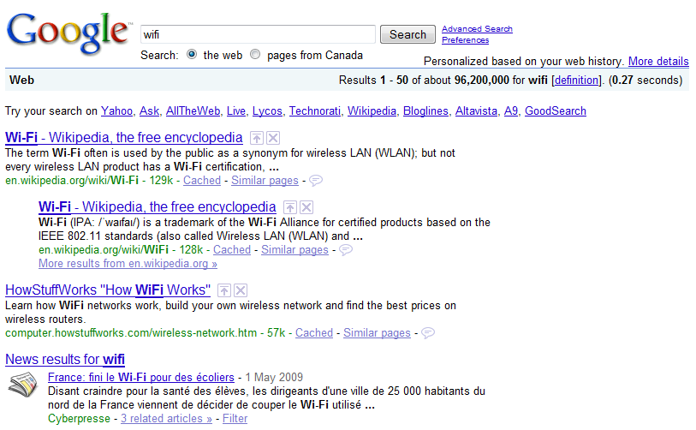
Notes:
5 different variants of “wifi” on the first page of Google Results

Slide 20





Ferret is a high-performance, full-featured text search engine library written for Ruby

Slide 21
require 'ferret' include Ferret index = Index::Index.new() index << {:title => "1", :content => "it is what it is"} index << {:title => "2", :content => "what is it"} index << {:title => "3", :content => "it is a banana"} index.search_each('content:"banana"') do |id, score| puts "Score: #{score}, #{index[id][:title]} " end
> Score: 1.0, 3
Notes:
Searching for “what” does not return any results!
Ferret automatically detects stop words and removes them from the index

Slide 22
require 'ferret' include Ferret index = Index::Index.new() index << {:title => "1", :content => "it is what it is"} index << {:title => "2", :content => "what is it"} index << {:title => "3", :content => "it is a banana"} index.search_each('content:"banana"') do |id, score| puts "Score: #{score}, #{index[id][:title]} " end
> Score: 1.0, 3
Hmmm?
Notes:
Searching for “what” does not return any results!
Ferret automatically detects stop words and removes them from the index

Slide 23
class Ferret::Analysis::Analyzer class Ferret::Analysis::AsciiLetterAnalyzer class Ferret::Analysis::AsciiLetterTokenizer class Ferret::Analysis::AsciiLowerCaseFilter class Ferret::Analysis::AsciiStandardAnalyzer class Ferret::Analysis::AsciiStandardTokenizer class Ferret::Analysis::AsciiWhiteSpaceAnalyzer class Ferret::Analysis::AsciiWhiteSpaceTokenizer class Ferret::Analysis::HyphenFilter class Ferret::Analysis::LetterAnalyzer class Ferret::Analysis::LetterTokenizer class Ferret::Analysis::LowerCaseFilter class Ferret::Analysis::MappingFilter class Ferret::Analysis::PerFieldAnalyzer class Ferret::Analysis::RegExpAnalyzer class Ferret::Analysis::RegExpTokenizer class Ferret::Analysis::StandardAnalyzer class Ferret::Analysis::StandardTokenizer class Ferret::Analysis::StemFilter class Ferret::Analysis::StopFilter class Ferret::Analysis::Token class Ferret::Analysis::TokenStream class Ferret::Analysis::WhiteSpaceAnalyzer class Ferret::Analysis::WhiteSpaceTokenizer
class Ferret::Search::BooleanQuery class Ferret::Search::ConstantScoreQuery class Ferret::Search::Explanation class Ferret::Search::Filter class Ferret::Search::FilteredQuery class Ferret::Search::FuzzyQuery class Ferret::Search::Hit class Ferret::Search::MatchAllQuery class Ferret::Search::MultiSearcher class Ferret::Search::MultiTermQuery class Ferret::Search::PhraseQuery class Ferret::Search::PrefixQuery class Ferret::Search::Query class Ferret::Search::QueryFilter class Ferret::Search::RangeFilter class Ferret::Search::RangeQuery class Ferret::Search::Searcher class Ferret::Search::Sort class Ferret::Search::SortField class Ferret::Search::TermQuery class Ferret::Search::TopDocs class Ferret::Search::TypedRangeFilter class Ferret::Search::TypedRangeQuery class Ferret::Search::WildcardQuery
Notes:
Searching for “what” does not return any results!
Ferret automatically detects stop words and removes them from the index

Slide 24
ferret.davebalmain.com/trac
Notes:
Searching for “what” does not return any results!
Ferret automatically detects stop words and removes them from the index

Slide 25
Ranking Results 0-60 with PageRank…

Slide 26
index.search_each('content:"the brown cow"') do |id, score| puts "Score: #{score}, #{index[id][:title]} " end
> Score: 0.827, 3
> Score: 0.523, 5
> Score: 0.125, 4
Relevance?
 | 3 | 5 | 4
the | 4 | 3 | 5
brown | 1 | 3 | 1
cow | 1 | 4 | 1
Naïve: Term Frequency
Score | 6 | 10 | 7
Notes:
How did it do that?
A naïve approach would be to look at the frequency of each word in the document. Intuition being, if you have two documents talking about brown cows, and one mentions it only once, and second repeats it two dozen times, than it’s probably the case that the latter is more relevant!

Slide 27
index.search_each('content:"the brown cow"') do |id, score| puts "Score: #{score}, #{index[id][:title]} " end
> Score: 0.827, 3
> Score: 0.523, 5
> Score: 0.125, 4
 | 3 | 5 | 4
the | 4 | 3 | 5
brown | 1 | 3 | 1
cow | 1 | 4 | 1
Skew
Naïve: Term Frequency
Score | 6 | 10 | 7
Notes:
Our relevance score might not actually be all that great after all…

Slide 28
 | 3 | 5 | 4
the | 4 | 3 | 5
brown | 1 | 3 | 1
cow | 1 | 4 | 1
Skew
 | # of docs
the | 6
brown | 3
cow | 4
Score = TF * IDF
TF = # occurrences / # words
IDF = # docs / # docs with W
TF-IDF
Term Frequency * Inverse Document Frequency
Total # of documents: 10
Notes:
Measure the surface area of a word in the document (TF)
Guard against “the” cases, by multiplying that number by the frequency with which that word occures in ALL other documents. Intuition: word the will appear in virtually all documents, so the IDF factor will decrease the impact of word “the” to entire set to virtually nothing.

Slide 29
 | 3 | 5 | 4
the | 4 | 3 | 5
brown | 1 | 3 | 1
cow | 1 | 4 | 1
 | # of docs
the | 6
brown | 3
cow | 4
Doc # 3 score for ‘the’:
4/10 * ln(10/6) = 0.204
Doc # 3 score for ‘brown’:
1/10 * ln(10/3) = 0.120
Doc # 3 score for ‘cow’:
1/10 * ln(10/4) = 0.092
TF-IDF
Total # of documents: 10
# words in document: 10
Score = 0.204 + 0.120 + 0.092 = 0.416

Slide 30
 | W1 | W2 | … | … | … | … | … | … | WN
Doc 1 | 15 | 23 | …
Doc 2 | 24 | 12 | …
… | … | … | …
…
Doc K
Size = N * K * size of Ruby object
Ouch.
Frequency Matrix
Pages = N = 10,000
Words = K = 2,000
Ruby Object = 20+ bytes
Footprint = 384 MB
Notes:
Multidimensional arrays in Ruby… Good luck!
Size of ruby object 20+ bytes..
In other words, you’re not getting very far.

Slide 31
NArray is an Numerical N-dimensional Array class (implemented in C)
NArray.new(typecode, size, ...)
NArray.byte(size,...)
NArray.sint(size,...)
NArray.int(size,...)
NArray.sfloat(size,...)
NArray.float(size,...)
NArray.scomplex(size,...)
NArray.complex(size,...)
NArray.object(size,...)
# create new NArray. initialize with 0.
# 1 byte unsigned integer
# 2 byte signed integer
# 4 byte signed integer
# single precision float
# double precision float
# single precision complex
# double precision complex
# Ruby object
NArray
http://narray.rubyforge.org/
Notes:
By Masahiro Tanaka
This extension library incorporates fast calculation and easy manipulation of large numerical arrays into the Ruby language.
NArray has features similar to NumPy, but NArray has vector and matrix subclasses.

Slide 32
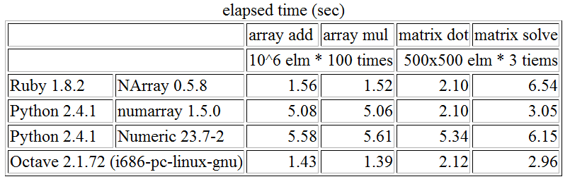
NArray is an Numerical N-dimensional Array class (implemented in C)
NArray
http://narray.rubyforge.org/
Notes:
This extension library incorporates fast calculation and easy manipulation of large numerical arrays into the Ruby language.
NArray has features similar to NumPy, but NArray has vector and matrix subclasses.

Slide 33
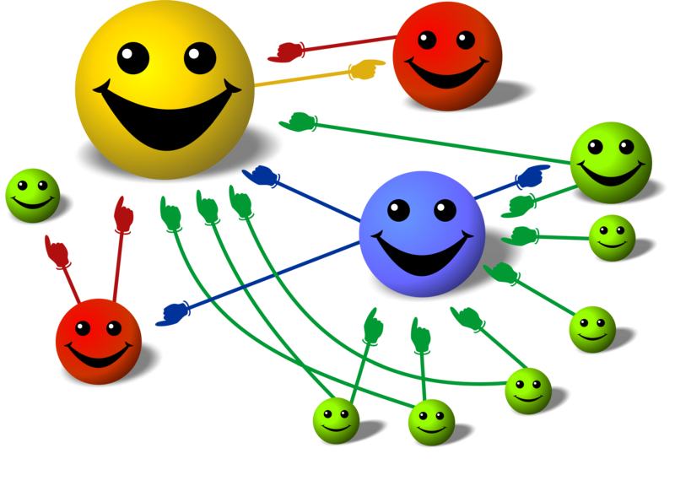
Links as votes
PageRank
the google juice
Problem: link gaming
Notes:
- Google ‘s founder insight: links are votes of confidence, in fact they are a purely social artifact that is useful when ranking online content
There is one inherent problem with looking at links though, it is an easy metric to game.
We could both agree to create a billion links between our pages, and voila, we’re at the top!
- Google needed something reliable.

Slide 34

P = 0.85
Follow link from page he/she is currently on.
Teleport to a random location on the web.
Random Surfer
powerful abstraction
P = 0.15
Notes:
Larry Page and Sergei Brin proposed a random surfer model as an approximation for our behavior online:
- Once a user is on the page, they can either follow one of the links
- They can teleport to a random location
They set the probabilities to be 0.85 and 0.15, respectively. These numbers were chosen pseudo-arbitrarily, but they have a big impact.. We’ll see how and why.

Slide 35
Follow link from page he/she is currently on.
Page K
Teleport to a random location on the web.
Surfin’
rinse & repeat, ad naseum
Page N
Page M
Notes:
In more concrete terms. Page N –> Page (M|K)
Repeat many many times over

Slide 36
On Page P, clicks on link to K
P = 0.85
On Page K clicks on link to M
P = 0.85
On Page M teleports to X
Surfin’
rinse & repeat, ad naseum
P = 0.15
…
Notes:
If we take a particular user, we can get the following scenario..
Not far from reality, when you think about how we browse the web (at least for myself)

Slide 37
P = 0.05
P = 0.20
X
N
P = 0.15
K
M
P = 0.6
Analyzing the Web Graph
extracting PageRank
Notes:
If you repeat the experiment for long enough, the probabilities for each page will stabilize and we might get a graph that looks something like the following.
(Caution: made up numbers)

Slide 38
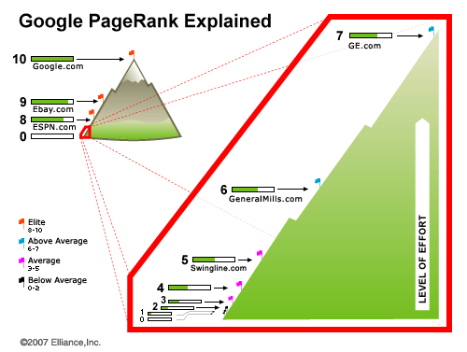
What is PageRank?
It’s a scalar!
Notes:
Which brings us to the next question.. What is PageRank? It’s a scalar value of 1 to 10.. Right?
Not really.

Slide 39
P = 0.05
P = 0.05
P = 0.05
P = 0.20
P = 0.20
P = 0.20
X
N
P = 0.15
P = 0.15
P = 0.15
K
M
P = 0.6
P = 0.6
P = 0.6
What is PageRank?
it’s a probability!
Notes:
If you repeat the experiment for long enough, the probabilities for each page will stabilize and we might get a graph that looks something like the following.
(Caution: made up numbers)

Slide 40
P = 0.05
P = 0.05
P = 0.20
P = 0.20
X
N
P = 0.15
P = 0.15
K
M
P = 0.6
P = 0.6
What is PageRank?
it’s a probability!
Higher Pr, Higher Importance?
Notes:
- Implicit assumption: higher postrank, means higher importance of the page.
- If many users are likely to land on this page, then it must be the case that this page is important, interesting, controversial… whichever.
- Google makes no claim to factual consistency, or quality of content, it simply points out the pages with most link love on the web.

Slide 41
Teleportation? sci-fi fans, … ?
Notes:
Why do we need teleportation? It does model our behavior, but there are more concrete reasons for it.

Slide 42
1. No in-links!
3. Isolated Web
X
N
K
2. No out-links!
M
M
Reasons for teleportation
enumerating edge cases
Notes:
Can’t reach pages with no in-links
Can’t escape from pages with no out-links
Certain parts of the web can be entry-only (no exit), or complete separated.
Don’t want to get our spiders stuck!

Slide 43
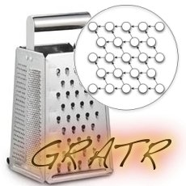
Breadth First Search
Depth First Search
A* Search
Lexicographic Search
Dijkstra’s Algorithm
Floyd-Warshall
Triangulation and Comparability detection
require 'gratr/import' dg = Digraph[1,2, 2,3, 2,4, 4,5, 6,4, 1,6] dg.directed? # true dg.vertex?(4) # true dg.edge?(2,4) # true dg.vertices # [5, 6, 1, 2, 3, 4] Graph[1,2,1,3,1,4,2,5].bfs # [1, 2, 3, 4, 5] Graph[1,2,1,3,1,4,2,5].dfs # [1, 2, 5, 3, 4]
Exploring Graphs
gratr.rubyforge.com
Notes:
What is the probability of teleportation?
Larry and Sergei proposed making it uniform.
The probability of teleporting to any given page is 0.15 / Number of pages

Slide 44
P(T) = 0.03
P(T) = 0.03
P(T) = 0.15 / # of pages
P(T) = 0.03
X
N
K
P(T) = 0.03
M
P(T) = 0.03
M
P(T) = 0.03
Teleportation
probabilities
Notes:
What is the probability of teleportation?
Larry and Sergei proposed making it uniform.
The probability of teleporting to any given page is 0.15 / Number of pages

Slide 45
Assume the web is N pages big Assume that probability of teleportation (t) is 0.15, and following link (s) is 0.85 Assume that teleportation probability (E) is uniform Assume that you start on any random page (uniform distribution L), then
Then after one step, the probability your on page X is:
PageRank: Simplified Mathematical Def’n
cause that’s how we roll

Slide 46
Link Graph
No link from 1 to N
 | 1 | 2 | … | … | N
1 | 1 | 0 | … | … | 0
2 | 0 | 1 | … | … | 1
… | … | … | … | … | …
… | … | … | … | … | …
N | 0 | 1 | … | … | 1
G = The Link Graph
ginormous and sparse
Huge!
Notes:
The link graph is absolutely ginormous: NxN
Stores data about the link structure of the web
Observation: largely sparse

Slide 47
Links to…
{ "1" => [25, 26], "2" => [1], "5" => [123,2], "6" => [67, 1] }
Page
G as a dictionary
more compact…
Notes:
Dictionary is a far more compact way of storing a sparse hash.
Having said that, capturing the entire link graph of the web is still very, very expensive.

Slide 48
Follow link from page he/she is currently on.
Page K
Teleport to a random location on the web.
Computing PageRank
the tedious way

Slide 49
Don’t trust me! Verify it yourself!
Identity matrix
Computing PageRank
in one swoop
Notes:
Through some manipulation the PostRank paper reduces the entire calculation to the following equation

Slide 50
Enough hand-waving, dammit! show me the code
Notes:
Not so fast. Doing math in Ruby is a bit of pain.
Anyone worked with large matrices in Ruby before? There are a number of problems here..
There is the enormous memory overhead (as we saw)
The interpreter was not created for this task.
Little dynamism in matrix manipulation.. Need raw CPU power.

Slide 51
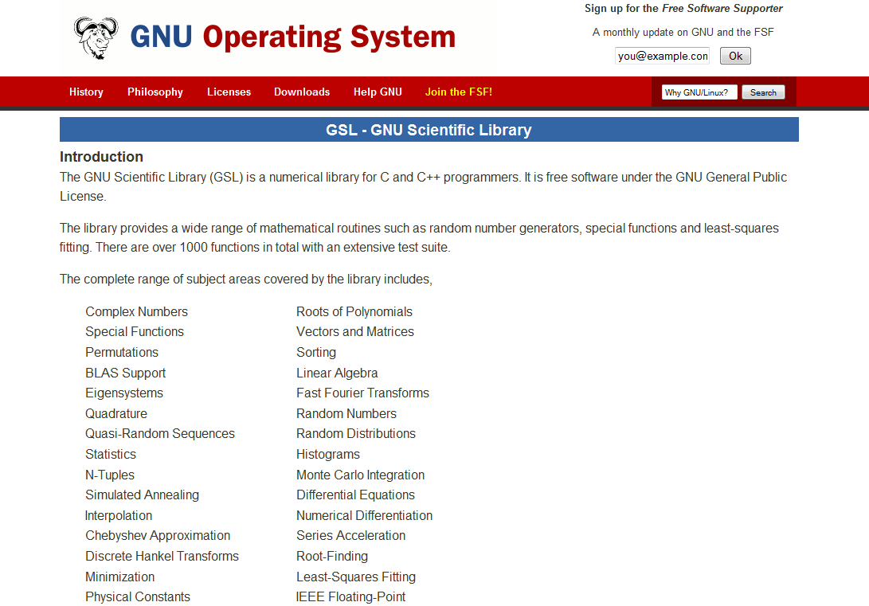
Hot, Fast, Awesome
Birth of EM-Proxy
flash of the obvious
Notes:
Thankfully, this is pretty much a solved problem for us…

Slide 52
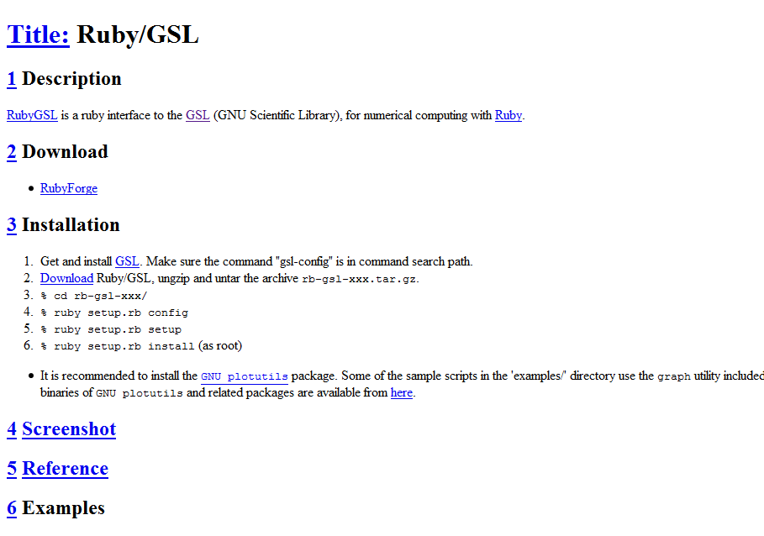
http://rb-gsl.rubyforge.org/
Hot, Fast, Awesome
Click there! … Give yourself a weekend.

Slide 53
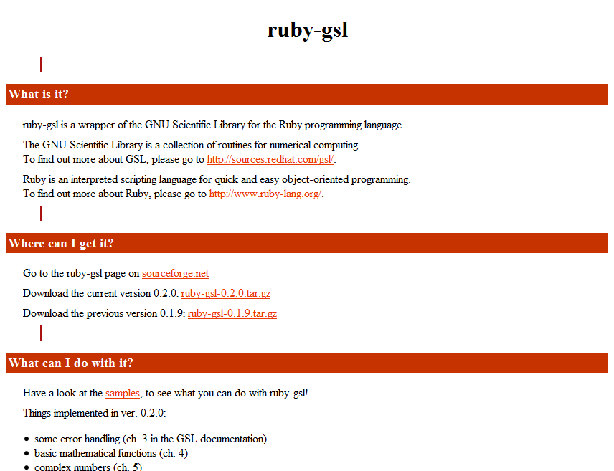
Click there! … Give yourself a weekend.
http://ruby-gsl.sourceforge.net/
Notes:
Appears to be just as good, and a bit newer. Pick your own flavor.
Neither is 1.9 compatible at this point, as far as I know.. Which is something I hope we fix very soon.

Slide 54
require "gsl" include GSL # INPUT: link structure matrix (NxN) # OUTPUT: pagerank scores def pagerank(g) raise if g.size1 != g.size2 i = Matrix.I(g.size1) # identity matrix p = (1.0/g.size1) * Matrix.ones(g.size1,1) # teleportation vector s = 0.85 # probability of following a link t = 1-s # probability of teleportation t*((i-s*g).invert)*p end
Verify NxN
PageRank in Ruby
6 lines, or less

Slide 55
require "gsl" include GSL # INPUT: link structure matrix (NxN) # OUTPUT: pagerank scores def pagerank(g) raise if g.size1 != g.size2 i = Matrix.I(g.size1) # identity matrix p = (1.0/g.size1) * Matrix.ones(g.size1,1) # teleportation vector s = 0.85 # probability of following a link t = 1-s # probability of teleportation t*((i-s*g).invert)*p end
Constants…
PageRank in Ruby
6 lines, or less

Slide 56
require "gsl" include GSL # INPUT: link structure matrix (NxN) # OUTPUT: pagerank scores def pagerank(g) raise if g.size1 != g.size2 i = Matrix.I(g.size1) # identity matrix p = (1.0/g.size1) * Matrix.ones(g.size1,1) # teleportation vector s = 0.85 # probability of following a link t = 1-s # probability of teleportation t*((i-s*g).invert)*p end
PageRank in Ruby
6 lines, or less
PageRank!

Slide 57
P = 0.33
X
P = 0.33
N
K
P = 0.33
pagerank(Matrix[[0,0,1], [0,0,1], [1,0,0]]) > [0.33, 0.33, 0.33]
Ex: Circular Web
testing intuition…
Notes:
Q: Let’s test our intuition, what would you expect as pagerank for these pages?

Slide 58
P = 0.05
X
P = 0.07
N
K
P = 0.87
pagerank(Matrix[[0,0,0], [0.5,0,0], [0.5,1,1]]) > [0.05, 0.07, 0.87]
Ex: All roads lead to K
testing intuition…
Notes:
Change one link and the pagerank scores are completely different.

Slide 59
PageRank + Ferret awesome search, ftw!
Notes:
Now that we have pagerank, how do we make use of it?

Slide 60
P = 0.05
2
P = 0.07
1
P = 0.87
require 'ferret' include Ferret index = Index::Index.new() index << {:title => "1", :content => "it is what it is", :pr => 0.05 } index << {:title => "2", :content => "what is it", :pr => 0.07 } index << {:title => "3", :content => "it is a banana", :pr => 0.87 }
3
Store PageRank
Notes:
We’re going to store the pagerank score alongside with the document in our Ferret index

Slide 61
index.search_each('content:"world"') do |id, score| puts "Score: #{score}, #{index[id][:title]} (PR: #{index[id][:pr]})" end puts "*" * 50 sf_pr = Search::SortField.new(:pr, :type => :float, :reverse => true) index.search_each('content:"world"', :sort => sf_pr) do |id, score| puts "Score: #{score}, #{index[id][:title]}, (PR: #{index[id][:pr]})" end
# Score: 0.267119228839874, 3 (PR: 0.87) # Score: 0.17807948589325, 1 (PR: 0.05) # Score: 0.17807948589325, 2 (PR: 0.07) # *********************************** # Score: 0.267119228839874, 3, (PR: 0.87) # Score: 0.17807948589325, 2, (PR: 0.07) # Score: 0.17807948589325, 1, (PR: 0.05)
TF-IDF Search

Slide 62
index.search_each('content:"world"') do |id, score| puts "Score: #{score}, #{index[id][:title]} (PR: #{index[id][:pr]})" end puts "*" * 50 sf_pr = Search::SortField.new(:pr, :type => :float, :reverse => true) index.search_each('content:"world"', :sort => sf_pr) do |id, score| puts "Score: #{score}, #{index[id][:title]}, (PR: #{index[id][:pr]})" end
# Score: 0.267119228839874, 3 (PR: 0.87) # Score: 0.17807948589325, 1 (PR: 0.05) # Score: 0.17807948589325, 2 (PR: 0.07) # *********************************** # Score: 0.267119228839874, 3, (PR: 0.87) # Score: 0.17807948589325, 2, (PR: 0.07) # Score: 0.17807948589325, 1, (PR: 0.05)
PageRank FTW!
Notes:
Add a new sort field and retrieve our results that way

Slide 63
index.search_each('content:"world"') do |id, score| puts "Score: #{score}, #{index[id][:title]} (PR: #{index[id][:pr]})" end puts "*" * 50 sf_pr = Search::SortField.new(:pr, :type => :float, :reverse => true) index.search_each('content:"world"', :sort => sf_pr) do |id, score| puts "Score: #{score}, #{index[id][:title]}, (PR: #{index[id][:pr]})" end
# Score: 0.267119228839874, 3 (PR: 0.87) # Score: 0.17807948589325, 1 (PR: 0.05) # Score: 0.17807948589325, 2 (PR: 0.07) # *********************************** # Score: 0.267119228839874, 3, (PR: 0.87) # Score: 0.17807948589325, 2, (PR: 0.07) # Score: 0.17807948589325, 1, (PR: 0.05)
Others
Google
Notes:
The order of results is different!

Slide 64
Search*: Graphs are ubiquitous!
PageRank is a general purpose hammer
Notes:
So why is all of this interesting?
How does it apply to you?
Well, nobody said that links have to be href attributes.
In fact, you can treat many different relationships as links, meaning you can turn any graph into a PageRank problem.

Slide 65

Username GitCred
==============================
37signals 10.00
imbriaco 9.76
why 8.74
rails 8.56
defunkt 8.17
technoweenie 7.83
jeresig 7.60
mojombo 7.51
yui 7.34
drnic 7.34
pjhyett 6.91
wycats 6.85
dhh 6.84
PageRank + Social Graph
GitHub
http://bit.ly/3YQPU
Notes:
Mark McGranaghan ran pagerank on the social graph on GitHub (built in clojure), and called it GitCred.

Slide 66
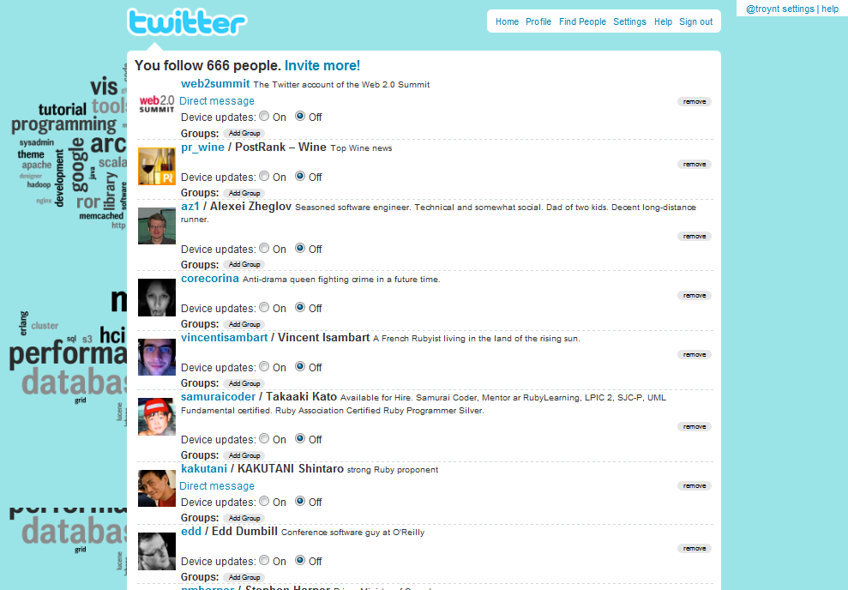
Hmm…
Analyze the social graph:
Filter messages by ‘TwitterRank’
Suggest users by ‘TwitterRank’
…
PageRank + Social Graph
Twitter
Notes:
You can also imagine applying same thing on top of twitter…
You can establish a twitterrank for all the people using the service
You can then recommend people based on their pagerank
You can filter twitter messages!
You can do all kinds of things

Slide 67

PageRank + Product Graph
E-commerce
Link items purchased in same cart… Run PR on it.
Notes:
Going beyond the social graph.. You can connect items that were purchased in the same cart, or once again connect the people in your network and build a recommendations system.

Slide 68

PageRank = Powerful Hammer use it!
Notes:
In other words, PageRank is a powerful hammer. Use it.

Slide 69
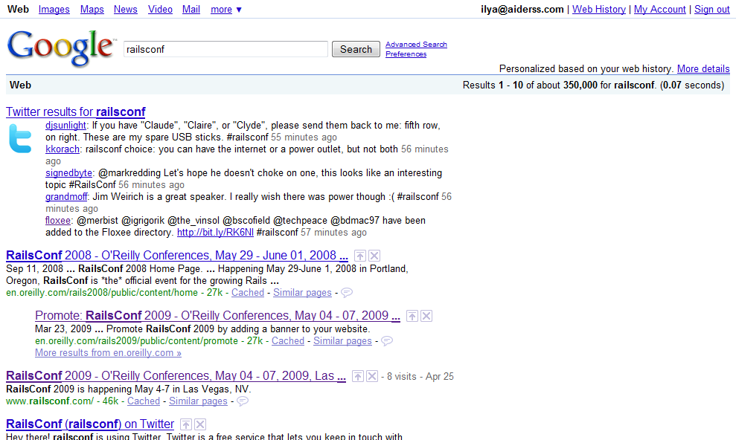
Personalization
how would you do it?
Notes:
Have you guys ever wondered how google does personalization?
Well, they don’t talk about it, but there is actually a very natural way to do it with PageRank.

Slide 70
Teleportation distribution doesn’t have to be uniform!
yahoo.com is my homepage!
PageRank + Personalization
customize the teleportation vector
Notes:
Nobody said that the teleportation vector has to be uniform.
In fact, we intuitively know that it’s not. You start on your homepage, which means your profile is biased towards that page.

Slide 71
Make pages with links!
Gaming PageRank
for fun and profit (I don’t endorse it)
http://bit.ly/pagerank-spam
Notes:
One way to game PageRank is just to create more pages with links, of course!
And if you’re really prolific (aka, if you double the web)… You’ll have a massive PR score!
Back in 2002 … a spammer nearly doubled the size of Google’s index. In the process, he got a massive PR score.
This is constant warfare within Google. Spammers create pages, billions of them, Google tries to find these fake clusters and eliminate them from the index.
Google doesn’t publicly talk about this, but they must have a sizable SPAM team working continously on keeping the index legit.

Slide 72

Slides: http://bit.ly/railsconf-pagerank
Ferret: http://bit.ly/ferret RB-GSL: http://bit.ly/rb-gsl
PageRank on Wikipedia: http://bit.ly/wp-pagerank
Gaming PageRank: http://bit.ly/pagerank-spam
Michael Nielsen’s lectures on PageRank: http://michaelnielsen.org/blog
Questions?
The slides…
Twitter
My blog

