Slide 1

Ruby Proxies for Scale, Performance and Monitoring
Ilya Grigorik
@igrigorik

Slide 2

postrank.com/topic/ruby
The slides…
Twitter
My blog

Slide 3
Code + Examples
EventMachine
Misc
Proxies

Slide 4





Proxy Love
Notes:
Proxy servers have become a popular solution as a tool for horizontal scalability. Just add more servers, and we’re good!

Slide 5
“Rails, Django, Seaside, Grails…” cant scale.
Myth: Slow Frameworks

Slide 6
The Proxy Solution
Notes:
Proxy servers have become a popular solution as a tool for horizontal scalability. Just add more servers, and we’re good!

Slide 7
The “More” Proxy Solution
Notes:
More proxy, more better.
Like it or not, this is more or less, the current tool of the trade. We love proxy servers!

Slide 8
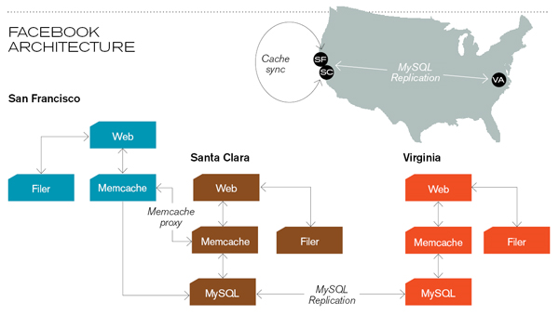
Transparent Scalability
Notes:
More proxy, more better.
Like it or not, this is more or less, the current tool of the trade. We love proxy servers!

Slide 9



Load Balancer
Reverse Proxy
App Server
MySQL Proxy
Proxy as Middleware
middleware ftw!

Slide 10
90% use case
%w[Transparent Intercepting Caching …] There are many different types!
Notes:
Content-filtering, anonymizing, hostile, intercepting, caching…

Slide 11
Transparent
Transparent, Cut-Through Proxy
Notes:
Performance (cut through)
Transparency
The client is not aware of the proxy, unless the proxy injects custom headers. Most proxies that operate in this way are also cut-through proxies, which means that they don’t have to buffer the request, but can stream it to the application server as the data arrives, which helps with performance.

Slide 12

Transparent Proxy = Scalability Power Tool
Notes:
Passenger is awesome, but the proxy, while it does add some complexity is architect’s powertool, as it allows to abstract entire service layers, partition your workload, and make your life easier all around.

Slide 13
Problem: Staging Environment
Production
Notes:
We discovered this wonderful world of proxies through a problem many of you can probably relate… Staging environment setup and maintenance!
Staging environments are a necessary evil. Can’t live without them, but boy are they annoying to maintain.

Slide 14
Simulating traffic?
Duplication
“Representative Load / Staging”
Notes:
First, you have duplication of your infrastructure, which means added cost. But the biggest pet peeve is: simulating traffic. You’re at the mercy of your users.
- Profile of your ‘typical’ queries / load changes on a daily basis.
- What you had yesterday, is no longer true today.
- Timing the queries, recording query profiling, etc.

Slide 15
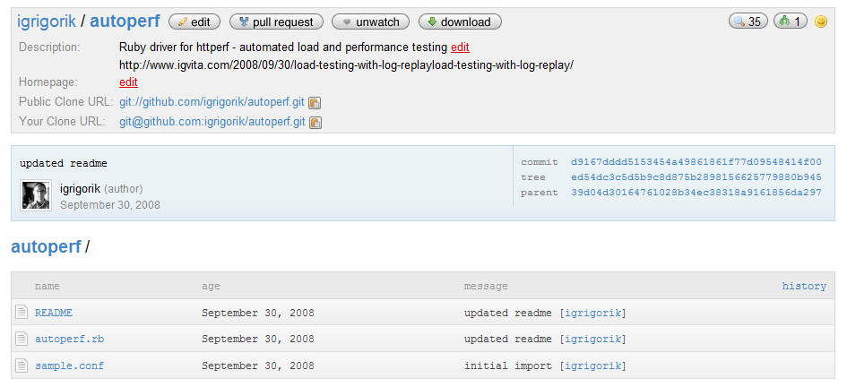
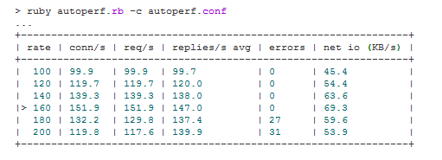
github.com/igrigorik/autoperf
Replay log data, rinse, repeat
Notes:
Record traffic, replay traffic. Rinse – repeat.
To be fair, httperf is a solid tool

Slide 16
Profile of queries has changed Fail
Load on production has changed Fail
Parallel environment Fail
Slower release cycle Fail
Staging fail.

Slide 17

Duplex Ruby Proxy, FTW!
Real (production) traffic
Benchmarking Proxy
flash of the obvious

Slide 18
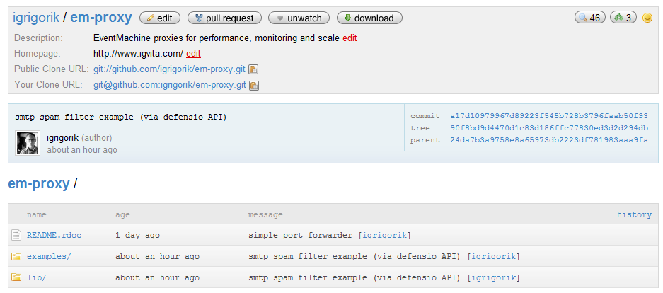
github.com/igrigorik/em-proxy
Proxy DSL FTW!

Slide 19
EventMachine: Speed + Convenience
building high performance network apps in Ruby

Slide 20
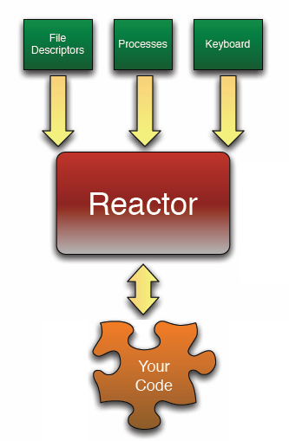
while true do
timers network_io other_io
end
p "Starting" EM.run do p "Running in EM reactor" end puts "Almost done"
EventMachine Reactor
concurrency without threads
Notes:
The reactor design pattern is a concurrent programming pattern for handling service requests delivered concurrently to a service handler by one or more inputs. The service handler then demultiplexes the incoming requests and dispatches them synchronously to the associated request handlers.

Slide 21
while true do
timers network_io other_io
end
p "Starting" EM.run do p "Running in EM reactor" end puts "Almost done"
EventMachine Reactor
concurrency without threads
Notes:
The reactor design pattern is a concurrent programming pattern for handling service requests delivered concurrently to a service handler by one or more inputs. The service handler then demultiplexes the incoming requests and dispatches them synchronously to the associated request handlers.

Slide 22
C++ core
Easy concurrency without threading
EventMachine Reactor
concurrency without threads

Slide 23
http = EM::HttpRequest.new('http://site.com/').get
http.callback {
p http.response
}
# ... do other work, until callback fires.
Event = IO event + block or lambda call
EventMachine Reactor
concurrency without threads

Slide 24
http = EM::HttpRequest.new('http://site.com/').get
http.callback {
p http.response
}
# ... do other work, until callback fires.
Event = IO event + block or lambda call
EventMachine Reactor
concurrency without threads

Slide 25
EM.run do EM.add_timer(1) { p "1 second later" } EM.add_periodic_timer(5) { p "every 5 seconds"} EM.defer { long_running_task() } end
class Server < EM::Connection def receive_data(data) send_data("Pong; #{data}") end def unbind p [:connection_completed] end end
EM.run do EM.start_server "0.0.0.0", 3000, Server end

Slide 26
EM.run do EM.add_timer(1) { p "1 second later" } EM.add_periodic_timer(5) { p "every 5 seconds"} EM.defer { long_running_task() } end
class Server < EM::Connection def receive_data(data) send_data("Pong; #{data}") end def unbind p [:connection_completed] end end
EM.run do EM.start_server "0.0.0.0", 3000, Server end
Connection Handler
Start Reactor

Slide 27


http://bit.ly/aiderss-eventmachine
by Dan Sinclair (Twitter: @dj2sincl)

Slide 28

Proxies for Monitoring, Performance and Scale welcome to the wonderful world of…

Slide 29
Proxy.start(:host => "0.0.0.0", :port => 80) do |conn| conn.server :name, :host => "127.0.0.1", :port => 81 conn.on_data do |data| # ... end conn.on_response do |server, resp| # ... end conn.on_finish do # ... end end
Relay Server
EM-Proxy
www.github.com/igrigorik/em-proxy

Slide 30
Proxy.start(:host => "0.0.0.0", :port => 80) do |conn| conn.server :name, :host => "127.0.0.1", :port => 81 conn.on_data do |data| # ... end conn.on_response do |server, resp| # ... end conn.on_finish do # ... end end
Process incoming data
EM-Proxy
www.github.com/igrigorik/em-proxy

Slide 31
Proxy.start(:host => "0.0.0.0", :port => 80) do |conn| conn.server :name, :host => "127.0.0.1", :port => 81 conn.on_data do |data| # ... end conn.on_response do |server, resp| # ... end conn.on_finish do # ... end end
Process response data
EM-Proxy
www.github.com/igrigorik/em-proxy

Slide 32
Proxy.start(:host => "0.0.0.0", :port => 80) do |conn| conn.server :name, :host => "127.0.0.1", :port => 81 conn.on_data do |data| # ... end conn.on_response do |server, resp| # ... end conn.on_finish do # ... end end
Post-processing step
EM-Proxy
www.github.com/igrigorik/em-proxy

Slide 33

%w[ <Transparent> Intercepting Caching … ] solution for every problem

Slide 34
Proxy.start(:host => "0.0.0.0", :port => 80) do |conn| conn.server :srv, :host => "127.0.0.1", :port => 81 # modify / process request stream conn.on_data do |data| p [:on_data, data] data end # modify / process response stream conn.on_response do |server, resp| p [:on_response, server, resp] resp end end
No data modifications
Port-Forwarding
transparent proxy

Slide 35
Proxy.start(:host => "0.0.0.0", :port => 80) do |conn| conn.server :srv, :host => "127.0.0.1", :port => 81 conn.on_data do |data| data end conn.on_response do |backend, resp| resp.gsub(/hello/, 'good bye') end end
Alter response
Port-Forwarding + Alter
transparent proxy

Slide 36
%w[ Transparent <Intercepting> Caching … ] solution for every problem

Slide 37
Proxy.start(:host => "0.0.0.0", :port => 80) do |conn| @start = Time.now @data = Hash.new("") conn.server :prod, :host => "127.0.0.1", :port => 81
conn.server :test, :host => "127.0.0.1", :port => 82
conn.on_data do |data| data.gsub(/User-Agent: .*?\r\n/, 'User-Agent: em-proxy\r\n') end conn.on_response do |server, resp| @data[server] += resp resp if server == :prod end conn.on_finish do p [:on_finish, Time.now - @start] p @data end end
Prod + Test
Duplex HTTP: Benchmarking
Intercepting proxy

Slide 38
Proxy.start(:host => "0.0.0.0", :port => 80) do |conn| @start = Time.now @data = Hash.new("") conn.server :prod, :host => "127.0.0.1", :port => 81
conn.server :test, :host => "127.0.0.1", :port => 82
conn.on_data do |data| data.gsub(/User-Agent: .*?\r\n/, 'User-Agent: em-proxy\r\n') end conn.on_response do |server, resp| @data[server] += resp resp if server == :prod end conn.on_finish do p [:on_finish, Time.now - @start] p @data end end
Respond from production
Duplex HTTP: Benchmarking
Intercepting proxy

Slide 39
Proxy.start(:host => "0.0.0.0", :port => 80) do |conn| @start = Time.now @data = Hash.new("") conn.server :prod, :host => "127.0.0.1", :port => 81
conn.server :test, :host => "127.0.0.1", :port => 82
conn.on_data do |data| data.gsub(/User-Agent: .*?\r\n/, 'User-Agent: em-proxy\r\n') end conn.on_response do |server, resp| @data[server] += resp resp if server == :prod end conn.on_finish do p [:on_finish, Time.now - @start] p @data end end
Run post-processing
Duplex HTTP: Benchmarking
Intercepting proxy

Slide 40
[ilya@igvita] > ruby examples/appserver.rb 81
[ilya@igvita] > ruby examples/appserver.rb 82
[ilya@igvita] > ruby examples/line_interceptor.rb
[ilya@igvita] > curl localhost
>> [:on_finish, 1.008561] >> {:prod=>"HTTP/1.1 200 OK\r\nConnection: close\r\nDate: Fri, 01 May 2009 04:20:00 GMT\r\nContent-Type: text/plain\r\n\r\nhello world: 0", :test=>"HTTP/1.1 200 OK\r\nConnection: close\r\nDate: Fri, 01 May 2009 04:20:00 GMT\r\nContent-Type: text/plain\r\n\r\nhello world: 1"}
Duplex HTTP: Benchmarking
Intercepting proxy

Slide 41
[ilya@igvita] > ruby examples/appserver.rb 81
[ilya@igvita] > ruby examples/appserver.rb 82
[ilya@igvita] > ruby examples/line_interceptor.rb
[ilya@igvita] > curl localhost
STDOUT
[:on_finish, 1.008561] {:prod=>"HTTP/1.1 200 OK\r\nConnection: close\r\nDate: Fri, 01 May 2009 04:20:00 GMT\r\nContent-Type: text/plain\r\n\r\nhello world: 0", :test=>"HTTP/1.1 200 OK\r\nConnection: close\r\nDate: Fri, 01 May 2009 04:20:00 GMT\r\nContent-Type: text/plain\r\n\r\nhello world: 1"}
Duplex HTTP: Benchmarking
Intercepting proxy

Slide 42
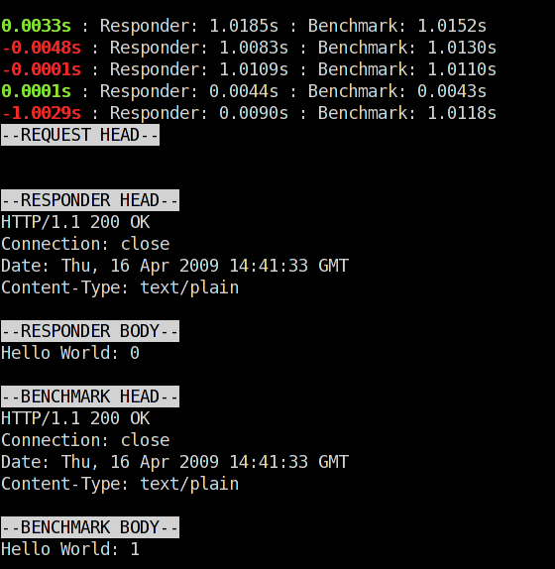
Same response, different turnaround time
Different response body!

Slide 43
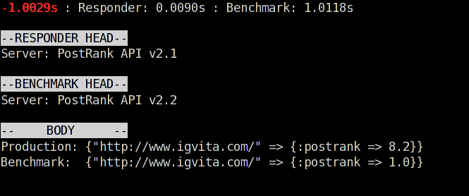
Woops!
Validating Proxy
easy, real-time diagnostics

Slide 44
Hacking SMTP
for fun and profit

Slide 45
Proxy.start(:host => "0.0.0.0", :port => 2524) do |conn| conn.server :srv, :host => "127.0.0.1", :port => 2525 # RCPT TO:<name@address.com>\r\n RCPT_CMD = /RCPT TO:<(.*)?>\r\n/ conn.on_data do |data| if rcpt = data.match(RCPT_CMD) if rcpt[1] != "ilya@igvita.com" conn.send_data "550 No such user here\n" data = nil end end data end conn.on_response do |backend, resp| resp end end
Intercept Addressee
Defeating SMTP Wildcards
Intercepting proxy

Slide 46
Proxy.start(:host => "0.0.0.0", :port => 2524) do |conn| conn.server :srv, :host => "127.0.0.1", :port => 2525 # RCPT TO:<name@address.com>\r\n RCPT_CMD = /RCPT TO:<(.*)?>\r\n/ conn.on_data do |data| if rcpt = data.match(RCPT_CMD) if rcpt[1] != "ilya@igvita.com" conn.send_data "550 No such user here\n" data = nil end end data end conn.on_response do |backend, resp| resp end end
Allow: ilya@igvita.com
550 Error otherwise
Defeating SMTP Wildcards
Intercepting proxy

Slide 47
[ilya@igvita] > mailtrap run –p 2525 –f /tmp/mailtrap.log
[ilya@igvita] > ruby examples/smtp_whitelist.rb
> require 'net/smtp‘ > smtp = Net::SMTP.start("localhost", 2524) > smtp.send_message "Hello World!", "ilya@aiderss.com", "ilya@igvita.com" => #<Net::SMTP::Response:0xb7dcff5c @status="250", @string="250 OK\n"> > smtp.finish => #<Net::SMTP::Response:0xb7dcc8d4 @status="221", @string="221 Seeya\n"> > smtp.send_message "Hello World!", "ilya@aiderss.com", “missing_user@igvita.com"
=> Net::SMTPFatalError: 550 No such user here
Duplex HTTP: Benchmarking
Intercepting proxy

Slide 48
[ilya@igvita] > mailtrap run –p 2525 –f /tmp/mailtrap.log
[ilya@igvita] > ruby examples/smtp_whitelist.rb
To: ilya@igvita.com
> require 'net/smtp‘ > smtp = Net::SMTP.start("localhost", 2524) > smtp.send_message "Hello World!", "ilya@aiderss.com", "ilya@igvita.com" => #<Net::SMTP::Response:0xb7dcff5c @status="250", @string="250 OK\n"> > smtp.finish => #<Net::SMTP::Response:0xb7dcc8d4 @status="221", @string="221 Seeya\n"> > smtp.send_message "Hello World!", "ilya@aiderss.com", “missing_user@igvita.com"
=> Net::SMTPFatalError: 550 No such user here
Denied!
Duplex HTTP: Benchmarking
Intercepting proxy

Slide 49

“Hacking SMTP”.gsub(/Hacking/, ’Kung-fu’)
DIY spam filtering with Defensio

Slide 50
Proxy.start(:host => "0.0.0.0", :port => 2524) do |conn| conn.server :srv, :host => "127.0.0.1", :port => 2525 RCPT_CMD = /RCPT TO:<(.*)?>\r\n/ FROM_CMD = /MAIL FROM:<(.*)?>\r\n/ MSG_CMD = /354 Start your message/
MSGEND_CMD = /^.\r\n/ conn.on_data do |data| # … end conn.on_response do |server, resp| p [:resp, resp] if resp.match(MSG_CMD) @buffer = true @msg = "" end resp end end
Intercept commands
SMTP + SPAM Filtering
building a state-machine

Slide 51
Proxy.start(:host => "0.0.0.0", :port => 2524) do |conn| conn.server :srv, :host => "127.0.0.1", :port => 2525 RCPT_CMD = /RCPT TO:<(.*)?>\r\n/ FROM_CMD = /MAIL FROM:<(.*)?>\r\n/ MSG_CMD = /354 Start your message/
MSGEND_CMD = /^.\r\n/ conn.on_data do |data| # … end conn.on_response do |server, resp| p [:resp, resp] if resp.match(MSG_CMD) @buffer = true @msg = "" end resp end end
Flag & Buffer message
SMTP + SPAM Filtering
building a state-machine

Slide 52
Save data
conn.on_data do |data| @from = data.match(FROM_CMD)[1] if data.match(FROM_CMD) @rcpt = data.match(RCPT_CMD)[1] if data.match(RCPT_CMD) @done = true if data.match(MSGEND_CMD) if @buffer @msg += data data = nil end if @done # … end data end
Buffer
SMTP + SPAM Filtering
building a state-machine

Slide 53
conn.on_data do |data| @from = data.match(FROM_CMD)[1] if data.match(FROM_CMD) @rcpt = data.match(RCPT_CMD)[1] if data.match(RCPT_CMD) @done = true if data.match(MSGEND_CMD) if @buffer @msg += data data = nil end if @done # … end data end
Flag end of message
Process message
SMTP + SPAM Filtering
building a state-machine

Slide 54


Slide 55
@buffer = false
uri = URI.parse('http://api.defensio.com/app/1.2/audit/key.yaml') res = Net::HTTP.post_form(uri, { "owner-url" => "http://www.github.com/igrigorik/em-proxy", "user-ip" => "216.16.254.254", "article-date" => "2009/05/01", "comment-author" => @from, "comment-type" => "comment", "comment-content" => @msg}) defensio = YAML.load(res.body)['defensio-result'] p [:defensio, "SPAM: #{defensio['spam']}"] if defensio['spam'] conn.send_data "550 No such user here\n" else data = @msg end
Defensio API
SMTP + SPAM Filtering
building a state-machine

Slide 56
@buffer = false
uri = URI.parse('http://api.defensio.com/app/1.2/audit/key.yaml') res = Net::HTTP.post_form(uri, { "owner-url" => "http://www.github.com/igrigorik/em-proxy", "user-ip" => "216.16.254.254", "article-date" => "2009/05/01", "comment-author" => @from, "comment-type" => "comment", "comment-content" => @msg}) defensio = YAML.load(res.body)['defensio-result'] p [:defensio, "SPAM: #{defensio['spam']}"] if defensio['spam'] conn.send_data "550 No such user here\n" else data = @msg end
Pass / Deny Message
SMTP + SPAM Filtering
building a state-machine

Slide 57
Protocol Trace
[:relay_from_backend, :srv, "354 Start your message"] [:resp, "354 Start your message"] [:srv, "\n"] [:relay_from_backend, :srv, "\n"] [:resp, "\n"] [:connection, "Hello World\r\n"] [:connection, ".\r\n"] [:defensio, "SPAM: false, Spaminess: 0.4"] [:srv, "250 OK\n"] [:relay_from_backend, :srv, "250 OK\n"] [:resp, "250 OK\n"]
SMTP + SPAM Filtering
building a state-machine

Slide 58
@PostRank: Beanstalkd + Ruby Proxy
because RAM is still expensive

Slide 59
~ 93 Bytes of overhead per job
~300 Bytes of data / job
x 80,000,000 jobs in memory
~ 30 GB of RAM = 2 X-Large EC2 instances
Oi, expensive!
Beanstalkd Math

Slide 60
Observations:
1. Each job is rescheduled several times
2. > 95% are scheduled for > 3 hours into the future
3. Beanstalkd does not have overflow page-to-disk
Memory is wasted…
Extending Beanstalkd
We’ll add it ourselves!

Slide 61
Intercepting Proxy
1 “Medium” EC2 Instance
@PostRank: “Chronos Scheduler”

Slide 62
Proxy.start(:host => "0.0.0.0", :port => 11300) do |conn| conn.server :srv, :host => "127.0.0.1", :port => 11301 PUT_CMD = /put (\d+) (\d+) (\d+) (\d+)\r\n/ conn.on_data do |data| if put = data.match(PUT_CMD) if put[2].to_i > 600 p [:put, :archive] # INSERT INTO .... conn.send_data "INSERTED 9999\r\n" data = nil end end data end conn.on_response do |backend, resp| resp end end
Intercept PUT command

Slide 63
Proxy.start(:host => "0.0.0.0", :port => 11300) do |conn| conn.server :srv, :host => "127.0.0.1", :port => 11301 PUT_CMD = /put (\d+) (\d+) (\d+) (\d+)\r\n/ conn.on_data do |data| if put = data.match(PUT_CMD) if put[2].to_i > 600 p [:put, :archive] # INSERT INTO .... conn.send_data "INSERTED 9999\r\n" data = nil end end data end conn.on_response do |backend, resp| resp end end
If over 10 minutes…
Archive & Reply

Slide 64
Overload the protocol
PUT
put job, 900
RESERVE, PUT, …
@PostRank: “Chronos Scheduler”

Slide 65
400% cheaper + extensible!
~79,000,000 jobs, 4GB RAM
PUT
Upcoming jobs: ~ 1M
RESERVE, PUT, …
@PostRank: “Chronos Scheduler”

Slide 66
%w[ Transparent <Intercepting> Caching … ] solution for every problem

Slide 67
Slides: http://bit.ly/ruby-proxy
Code: http://github.com/igrigorik/em-proxy
Twitter: @igrigorik
Thanks. Questions?
The slides…
Twitter
My blog

