Slide 1

Ruby C10K: High Performance Networking a case study with EM-Proxy
Ilya Grigorik
@igrigorik

Slide 2

postrank.com/topic/ruby
Twitter
My blog

Slide 3
EM-Proxy
+
Examples
C10K
EventMachine
Benchmarks + Misc

Slide 4





Proxy Love
Notes:
Proxy servers have become a popular solution as a tool for horizontal scalability. Just add more servers, and we’re good!

Slide 5
“Rails, Django, Seaside, Grails…” cant scale.
Myth: Slow Frameworks

Slide 6
The Proxy Solution
Notes:
Proxy servers have become a popular solution as a tool for horizontal scalability. Just add more servers, and we’re good!

Slide 7
The “More” Proxy Solution
Notes:
More proxy, more better.
Like it or not, this is more or less, the current tool of the trade. We love proxy servers!

Slide 8
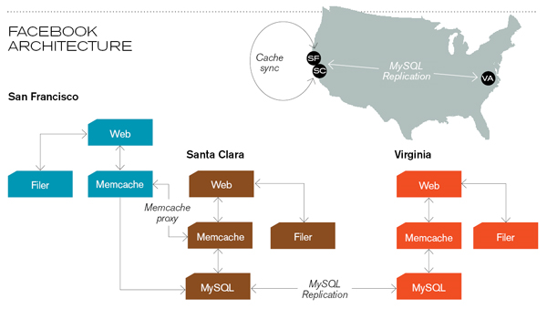
Transparent Scalability
Notes:
More proxy, more better.
Like it or not, this is more or less, the current tool of the trade. We love proxy servers!

Slide 9





Load Balancer
Reverse Proxy
App Server
MySQL Proxy
Architecture
middleware ftw!
Shard 1
Shard 2

Slide 10

C10K Problem + Ruby
why do we care?

Slide 11



Bottleneck: ~100 req / s
Complexity, Time, and Money
circa 1995-2000
Notes:
Reading the papers and mailing lists, it is clear that much of the bottlenecks were actually in the operating system. Web servers would reach capacity at several hundred requests/s at most. In fact, it was not unusual for servers to max out at double digit numbers for tasks as simple as serving static files. Of course, the computers were slower as well, but there were a number of performance bottlenecks which needed to be addressed.

Slide 12
Receive
Verify
Dispatch
Aggregate
Handle errors
Render
Send
I/O + Kernel
Bottlenecks
Application
Bottlenecks
Kernel + I/O Bottlenecks
Notes:
In order to even think about this problem, first we have to look at the server. It turns out, if you’re really aiming for high concurrency, than your options are limited.

Slide 13
Server Specification | Resources / connection
2.6Ghz CPU | 0.26 Mhz / conn
1.7 GB Ram | ~170kb / conn
250 MB/s | 3.2 kb/s / conn
C10K Challenge: 10,000 Concurrent Connections

Slide 14
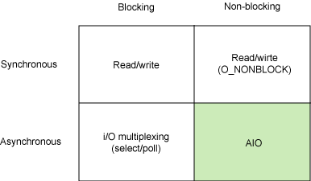
Notes:
In order to even think about this problem, first we have to look at the server. It turns out, if you’re really aiming for high concurrency, than your options are limited.

Slide 15
No concurrency
Blocking
Ok resource utilization
require 'rubygems' require 'socket' server = TCPServer.new(80) loop do session = server.accept session.print "HTTP/1.1 200 OK\r\n\r\ndone" session.close end
Fork!
Synchronous + Blocking IO

Slide 16
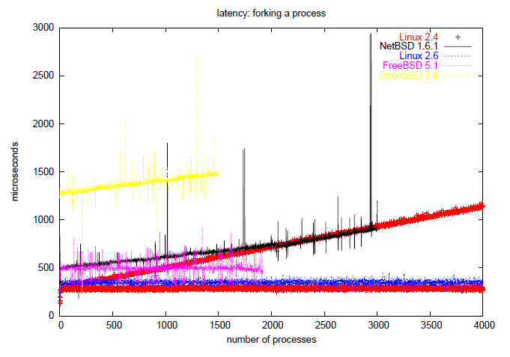
Fork Latency
Linux 2.6: ~200 microseconds
Notes:
Apache uses the pre-fork model to ‘minimize’ the cost of forking.

Slide 17
Socket.accept_nonblock
Busy-wait CPU cycles
Poll for each socket
select( […], nil, nil )
1024 FD limit by default
Non linear performance
Non-Blocking IO + Poll
concurrency without threads

Slide 18
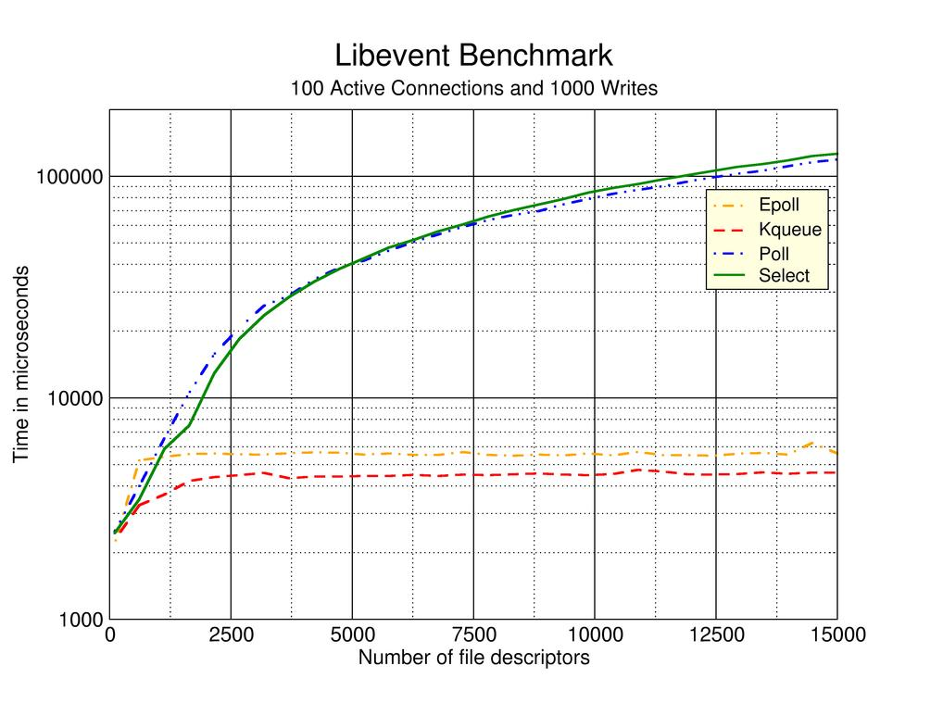
Epoll + Kqueue Benchmarks
Notes:
Kqueue and it’s younger cousin Epoll have been invented to address the problems with select’s non-linear performance. Instead of scanning each socket, Epoll and Kqueue deliver only the notifications for sockets that can be acted upon. This is done via both kernel and hardware hooks.

Slide 19
while (1) {
int nfds = epoll_wait(fd, arr, 3, timeout);
if (nfds < 0) die("Error in epoll_wait!");
for(int i = 0; i < nfds; i++) {
int fd = events[i].data.fd;
handle_io_on_socket(fd);
}
}
and in Ruby…
require 'eventmachine' EM.epoll
EM.run { # ... }
EPoll & KQueue
concurrency without threads

Slide 20
while (1) {
int nfds = epoll_wait(fd, arr, 3, timeout);
if (nfds < 0) die("Error in epoll_wait!");
for(int i = 0; i < nfds; i++) {
int fd = events[i].data.fd;
handle_io_on_socket(fd);
}
}
and in Ruby…
require 'eventmachine' EM.epoll
EM.run { # ... }
EPoll & KQueue
concurrency without threads
Notes:
Using Epoll from Ruby is way easier than from C. Thankfully, eventmachine maintainers have already done all the work for us.

Slide 21
EventMachine: Speed + Convenience
building high performance network apps in Ruby

Slide 22
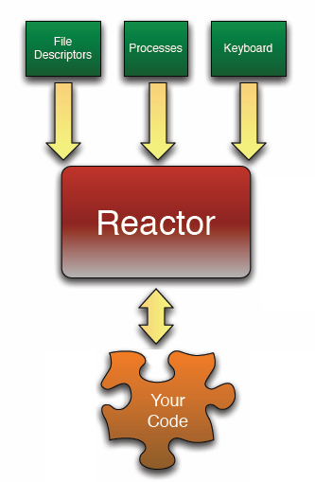
while true do
timers network_io other_io
end
p "Starting" EM.run do p "Running in EM reactor" end puts "Almost done"
EventMachine Reactor
concurrency without threads
Notes:
The reactor design pattern is a concurrent programming pattern for handling service requests delivered concurrently to a service handler by one or more inputs. The service handler then demultiplexes the incoming requests and dispatches them synchronously to the associated request handlers.

Slide 23
while true do
timers network_io other_io
end
p "Starting" EM.run do p "Running in EM reactor" end puts "Almost done"
EventMachine Reactor
concurrency without threads
Notes:
The reactor design pattern is a concurrent programming pattern for handling service requests delivered concurrently to a service handler by one or more inputs. The service handler then demultiplexes the incoming requests and dispatches them synchronously to the associated request handlers.

Slide 24
C++ core
Easy concurrency without threading
EventMachine Reactor
concurrency without threads

Slide 25
http = EM::HttpRequest.new('http://site.com/').get
http.callback {
p http.response
}
# ... do other work, until callback fires.
Event = IO event + block or lambda call
EventMachine Reactor
concurrency without threads

Slide 26
http = EM::HttpRequest.new('http://site.com/').get
http.callback {
p http.response
}
# ... do other work, until callback fires.
Screencast: http://bit.ly/hPr3j
Event = IO event + block or lambda call
EventMachine Reactor
concurrency without threads

Slide 27
EM.run do EM.add_timer(1) { p "1 second later" } EM.add_periodic_timer(5) { p "every 5 seconds"} EM.defer { long_running_task() } end
class Server < EM::Connection def receive_data(data) send_data("Pong; #{data}") end def unbind p [:connection_completed] end end
EM.run do EM.start_server "0.0.0.0", 3000, Server end

Slide 28
EM.run do EM.add_timer(1) { p "1 second later" } EM.add_periodic_timer(5) { p "every 5 seconds"} EM.defer { long_running_task() } end
class Server < EM::Connection def receive_data(data) send_data("Pong; #{data}") end def unbind p [:connection_completed] end end
EM.run do EM.start_server "0.0.0.0", 3000, Server end
Start Reactor

Slide 29
EM.run do EM.add_timer(1) { p "1 second later" } EM.add_periodic_timer(5) { p "every 5 seconds"} EM.defer { long_running_task() } end
class Server < EM::Connection def receive_data(data) send_data("Pong; #{data}") end def unbind p [:connection_completed] end end
EM.run do EM.start_server "0.0.0.0", 3000, Server end
Connection Handler
Start Reactor

Slide 30


http://bit.ly/aiderss-eventmachine
by Dan Sinclair (Twitter: @dj2sincl)

Slide 31
Profile of queries changes Fail
Load on production changes Fail
Parallel environment Fail
Slower release cycle Fail
Problem: Staging Environment Fail

Slide 32

Proxies for Monitoring, Performance and Scale welcome to the wonderful world of… (C10K proof)…

Slide 33

Duplex Ruby Proxy, FTW!
Real (production) traffic
Benchmarking Proxy
flash of the obvious

Slide 34
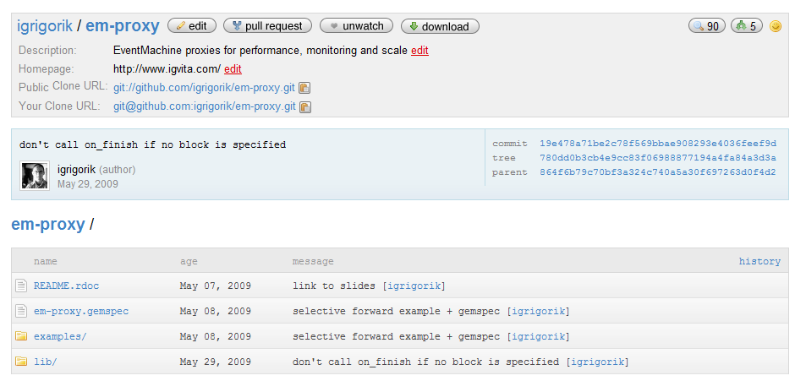
github.com/igrigorik/em-proxy
Proxy DSL: EM + EPoll

Slide 35
Proxy.start(:host => "0.0.0.0", :port => 80) do |conn| conn.server :name, :host => "127.0.0.1", :port => 81 conn.on_data do |data| # ... end conn.on_response do |server, resp| # ... end conn.on_finish do # ... end end
Relay Server
EM-Proxy
www.github.com/igrigorik/em-proxy

Slide 36
Proxy.start(:host => "0.0.0.0", :port => 80) do |conn| conn.server :name, :host => "127.0.0.1", :port => 81 conn.on_data do |data| # ... end conn.on_response do |server, resp| # ... end conn.on_finish do # ... end end
Process incoming data
EM-Proxy
www.github.com/igrigorik/em-proxy

Slide 37
Proxy.start(:host => "0.0.0.0", :port => 80) do |conn| conn.server :name, :host => "127.0.0.1", :port => 81 conn.on_data do |data| # ... end conn.on_response do |server, resp| # ... end conn.on_finish do # ... end end
Process response data
EM-Proxy
www.github.com/igrigorik/em-proxy

Slide 38
Proxy.start(:host => "0.0.0.0", :port => 80) do |conn| conn.server :name, :host => "127.0.0.1", :port => 81 conn.on_data do |data| # ... end conn.on_response do |server, resp| # ... end conn.on_finish do # ... end end
Post-processing step
EM-Proxy
www.github.com/igrigorik/em-proxy

Slide 39
Proxy.start(:host => "0.0.0.0", :port => 80) do |conn| conn.server :srv, :host => "127.0.0.1", :port => 81 # modify / process request stream conn.on_data do |data| p [:on_data, data] data end # modify / process response stream conn.on_response do |server, resp| p [:on_response, server, resp] resp end end
Example: Port-Forwarding
transparent proxy

Slide 40
Proxy.start(:host => "0.0.0.0", :port => 80) do |conn| conn.server :srv, :host => "127.0.0.1", :port => 81 # modify / process request stream conn.on_data do |data| p [:on_data, data] data end # modify / process response stream conn.on_response do |server, resp| p [:on_response, server, resp] resp end end
Example: Port-Forwarding
transparent proxy

Slide 41
Proxy.start(:host => "0.0.0.0", :port => 80) do |conn| conn.server :srv, :host => "127.0.0.1", :port => 81 # modify / process request stream conn.on_data do |data| p [:on_data, data] data end # modify / process response stream conn.on_response do |server, resp| p [:on_response, server, resp] resp end end
No data modifications
Example: Port-Forwarding
transparent proxy

Slide 42
Proxy.start(:host => "0.0.0.0", :port => 80) do |conn| conn.server :srv, :host => "127.0.0.1", :port => 81 conn.on_data do |data| data end conn.on_response do |backend, resp| resp.gsub(/hello/, 'good bye') end end
Example: Port-Forwarding + Alter
transparent proxy

Slide 43
Proxy.start(:host => "0.0.0.0", :port => 80) do |conn| conn.server :srv, :host => "127.0.0.1", :port => 81 conn.on_data do |data| data end conn.on_response do |backend, resp| resp.gsub(/hello/, 'good bye') end end
Alter response
Example: Port-Forwarding + Alter
transparent proxy

Slide 44

Duplicating HTTP Traffic
for benchmarking & monitoring

Slide 45
Proxy.start(:host => "0.0.0.0", :port => 80) do |conn| @start = Time.now @data = Hash.new("") conn.server :prod, :host => "127.0.0.1", :port => 81
conn.server :test, :host => "127.0.0.1", :port => 82
conn.on_data do |data| data.gsub(/User-Agent: .*?\r\n/, 'User-Agent: em-proxy\r\n') end conn.on_response do |server, resp| @data[server] += resp resp if server == :prod end conn.on_finish do p [:on_finish, Time.now - @start] p @data end end
Prod + Test
Duplex HTTP: Benchmarking
Intercepting proxy

Slide 46
Proxy.start(:host => "0.0.0.0", :port => 80) do |conn| @start = Time.now @data = Hash.new("") conn.server :prod, :host => "127.0.0.1", :port => 81
conn.server :test, :host => "127.0.0.1", :port => 82
conn.on_data do |data| data.gsub(/User-Agent: .*?\r\n/, 'User-Agent: em-proxy\r\n') end conn.on_response do |server, resp| @data[server] += resp resp if server == :prod end conn.on_finish do p [:on_finish, Time.now - @start] p @data end end
Respond from production
Duplex HTTP: Benchmarking
Intercepting proxy

Slide 47
Proxy.start(:host => "0.0.0.0", :port => 80) do |conn| @start = Time.now @data = Hash.new("") conn.server :prod, :host => "127.0.0.1", :port => 81
conn.server :test, :host => "127.0.0.1", :port => 82
conn.on_data do |data| data.gsub(/User-Agent: .*?\r\n/, 'User-Agent: em-proxy\r\n') end conn.on_response do |server, resp| @data[server] += resp resp if server == :prod end conn.on_finish do p [:on_finish, Time.now - @start] p @data end end
Run post-processing
Duplex HTTP: Benchmarking
Intercepting proxy

Slide 48
[ilya@igvita] > ruby examples/appserver.rb 81
[ilya@igvita] > ruby examples/appserver.rb 82
[ilya@igvita] > ruby examples/line_interceptor.rb
[ilya@igvita] > curl localhost
>> [:on_finish, 1.008561] >> {:prod=>"HTTP/1.1 200 OK\r\nConnection: close\r\nDate: Fri, 01 May 2009 04:20:00 GMT\r\nContent-Type: text/plain\r\n\r\nhello world: 0", :test=>"HTTP/1.1 200 OK\r\nConnection: close\r\nDate: Fri, 01 May 2009 04:20:00 GMT\r\nContent-Type: text/plain\r\n\r\nhello world: 1"}
Duplex HTTP: Benchmarking
Intercepting proxy

Slide 49
[ilya@igvita] > ruby examples/appserver.rb 81
[ilya@igvita] > ruby examples/appserver.rb 82
[ilya@igvita] > ruby examples/line_interceptor.rb
[ilya@igvita] > curl localhost
STDOUT
[:on_finish, 1.008561] {:prod=>"HTTP/1.1 200 OK\r\nConnection: close\r\nDate: Fri, 01 May 2009 04:20:00 GMT\r\nContent-Type: text/plain\r\n\r\nhello world: 0", :test=>"HTTP/1.1 200 OK\r\nConnection: close\r\nDate: Fri, 01 May 2009 04:20:00 GMT\r\nContent-Type: text/plain\r\n\r\nhello world: 1"}
Duplex HTTP: Benchmarking
Intercepting proxy

Slide 50
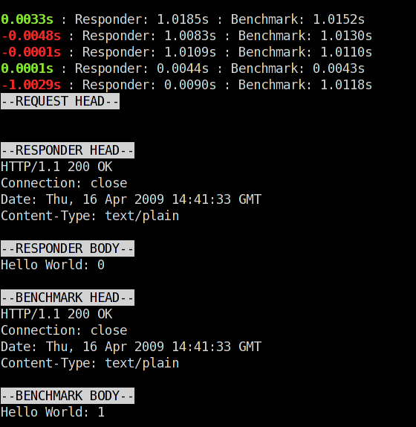
Same response, different turnaround time
Different response body!

Slide 51
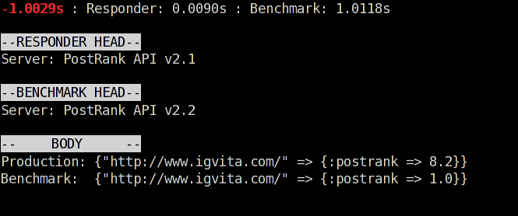
Woops!
Validating Proxy
easy, real-time diagnostics

Slide 52
Hacking SMTP: Whitelisting
for fun and profit

Slide 53
Proxy.start(:host => "0.0.0.0", :port => 2524) do |conn| conn.server :srv, :host => "127.0.0.1", :port => 2525 # RCPT TO:<name@address.com>\r\n RCPT_CMD = /RCPT TO:<(.*)?>\r\n/ conn.on_data do |data| if rcpt = data.match(RCPT_CMD) if rcpt[1] != "ilya@igvita.com" conn.send_data "550 No such user here\n" data = nil end end data end conn.on_response do |backend, resp| resp end end
Intercept Addressee
Defeating SMTP Wildcards
Intercepting proxy

Slide 54
Proxy.start(:host => "0.0.0.0", :port => 2524) do |conn| conn.server :srv, :host => "127.0.0.1", :port => 2525 # RCPT TO:<name@address.com>\r\n RCPT_CMD = /RCPT TO:<(.*)?>\r\n/ conn.on_data do |data| if rcpt = data.match(RCPT_CMD) if rcpt[1] != "ilya@igvita.com" conn.send_data "550 No such user here\n" data = nil end end data end conn.on_response do |backend, resp| resp end end
Allow: ilya@igvita.com
550 Error otherwise
Defeating SMTP Wildcards
Intercepting proxy

Slide 55
[ilya@igvita] > mailtrap run –p 2525 –f /tmp/mailtrap.log
[ilya@igvita] > ruby examples/smtp_whitelist.rb
> require 'net/smtp‘ > smtp = Net::SMTP.start("localhost", 2524) > smtp.send_message "Hello World!", "ilya@aiderss.com", "ilya@igvita.com" => #<Net::SMTP::Response:0xb7dcff5c @status="250", @string="250 OK\n"> > smtp.finish => #<Net::SMTP::Response:0xb7dcc8d4 @status="221", @string="221 Seeya\n"> > smtp.send_message "Hello World!", "ilya@aiderss.com", “missing_user@igvita.com"
=> Net::SMTPFatalError: 550 No such user here
Duplex HTTP: Benchmarking
Intercepting proxy

Slide 56
[ilya@igvita] > mailtrap run –p 2525 –f /tmp/mailtrap.log
[ilya@igvita] > ruby examples/smtp_whitelist.rb
To: ilya@igvita.com
> require 'net/smtp‘ > smtp = Net::SMTP.start("localhost", 2524) > smtp.send_message "Hello World!", "ilya@aiderss.com", "ilya@igvita.com" => #<Net::SMTP::Response:0xb7dcff5c @status="250", @string="250 OK\n"> > smtp.finish => #<Net::SMTP::Response:0xb7dcc8d4 @status="221", @string="221 Seeya\n"> > smtp.send_message "Hello World!", "ilya@aiderss.com", “missing_user@igvita.com"
=> Net::SMTPFatalError: 550 No such user here
Denied!
Duplex HTTP: Benchmarking
Intercepting proxy

Slide 57

: Beanstalkd + EM-Proxy
because RAM is still expensive

Slide 58
~ 93 Bytes of overhead per job
~300 Bytes of data / job
x 80,000,000 jobs in memory
~ 30 GB of RAM = 2 X-Large EC2 instances
Oi, expensive!
Beanstalkd Math

Slide 59
Observations:
1. Each job is rescheduled several times
2. > 95% are scheduled for > 3 hours into the future
3. Beanstalkd does not have overflow page-to-disk
Memory is wasted…
Extending Beanstalkd
We’ll add it ourselves!

Slide 60
Intercepting Proxy
1 “Medium” EC2 Instance
@PostRank: “Chronos Scheduler”

Slide 61
Proxy.start(:host => "0.0.0.0", :port => 11300) do |conn| conn.server :srv, :host => "127.0.0.1", :port => 11301 PUT_CMD = /put (\d+) (\d+) (\d+) (\d+)\r\n/ conn.on_data do |data| if put = data.match(PUT_CMD) if put[2].to_i > 600 p [:put, :archive] # INSERT INTO .... conn.send_data "INSERTED 9999\r\n" data = nil end end data end conn.on_response do |backend, resp| resp end end
Intercept PUT command

Slide 62
Proxy.start(:host => "0.0.0.0", :port => 11300) do |conn| conn.server :srv, :host => "127.0.0.1", :port => 11301 PUT_CMD = /put (\d+) (\d+) (\d+) (\d+)\r\n/ conn.on_data do |data| if put = data.match(PUT_CMD) if put[2].to_i > 600 p [:put, :archive] # INSERT INTO .... conn.send_data "INSERTED 9999\r\n" data = nil end end data end conn.on_response do |backend, resp| resp end end
If over 10 minutes…
Archive & Reply

Slide 63
Overload the protocol
PUT
put job, 900
RESERVE, PUT, …
@PostRank: “Chronos Scheduler”

Slide 64
400% cheaper + extensible!
~79,000,000 jobs, 4GB RAM
PUT
Upcoming jobs: ~ 1M
RESERVE, PUT, …
@PostRank: “Chronos Scheduler”

Slide 65

… x 2,500
1 process / 1 core
~ 5,000 open sockets
~ 1200 req/s
EM-Proxy
Beanstalkd
MySQL
2x EM-Proxy (dual core)
C10K Success!
Performance: Beanstalk + EM-Proxy
is it “C10K proof”?

Slide 66
C10K: http://www.kegel.com/c10k.html
Code: http://github.com/igrigorik/em-proxy
Twitter: @igrigorik
Thanks. Questions?
Twitter
My blog

