Slide 1

Beyond 'gem install MySQL’ in Ruby
alternative drivers & architecture
Ilya Grigorik
@igrigorik

Slide 2








and dozens of others…
The slides…
Twitter
My blog

Slide 3
Ruby MySQL Drivers
Internals of Ruby VM
Async
Rails
Looking into the future…

Slide 4




vs.
vs.

Slide 5
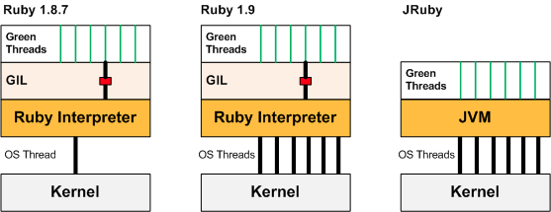

Global Interpreter Lock is a mutual exclusion lock held by a programming language interpreter thread to avoid sharing code that is not thread-safe with other threads.
There is always one GIL for one interpreter process.
Concurrency is a myth in Ruby
(with a few caveats, of course)
http://bit.ly/ruby-gil
Notes:
To understand what's going on, we need to take a closer look at the Ruby runtime. Whenever you launch a Ruby application, an instance of a Ruby interpreter is launched to parse your code, build an AST tree, and then execute the application you've requested - thankfully, all of this is transparent to the user. However, as part of this runtime, the interpreter also instantiates an instance of a Global Interpreter Lock (or more affectionately known as GIL), which is the culprit of our lack of concurrency:

Slide 6
N-M thread pool in Ruby 1.9…
Better but still the same problem!
Concurrency is a myth in Ruby
still no concurrency in Ruby 1.9
http://bit.ly/ruby-gil

Slide 7
RTM, your mileage will vary.
Concurrency is a myth in Ruby
still no concurrency in Ruby 1.9
http://bit.ly/ruby-gil

Slide 8
Blocks entire
Ruby VM
Not as bad, but
avoid it still..
1. Avoid locking interpreter threads at all costs
still no concurrency in Ruby 1.9
Notes:
Thread non-blocking region in Ruby 1.9
With right driver architecture can block OS thread but VM will continue

Slide 9
require 'rubygems’
require 'sequel' DB = Sequel.connect('mysql://root@localhost/test') while true DB['select sleep(1)'].select.first end
Blocking 1s call!
ltrace –ttTg -x mysql_real_query -p [pid of script above]
mysql.gem under the hood
22:10:00.218438 mysql_real_query(0x02740000, "select sleep(1)", 15) = 0 <1.001100> 22:10:01.241679 mysql_real_query(0x02740000, "select sleep(1)", 15) = 0 <1.000812>
http://bit.ly/c3Pt3f

Slide 10
Blocking calls to mysql_real_query
mysql_real_query requires an OS thread
Blocking on mysql_real_query blocks the Ruby VM
Aka, “select sleep(1)” blocks the entire Ruby runtime for 1s
(ouch)
gem install mysql what you didn’t know…

Slide 11
gem install mysqlplus
An enhanced mysql driver with an ‘async’ interface and threaded access support

Slide 12
select ([] …)
class Mysql
def ruby_async_query(sql, timeout = nil)
send_query(sql)
select [(@sockets ||= {})[socket] ||= IO.new(socket)],nil,nil,nil
get_result
end
begin
alias_method :async_query, :c_async_query
rescue NameError => e
raise LoadError.new("error loading mysqlplus")
end
end
mysqlplus.gem under the hood
gem install mysqlplus

Slide 13
spinning in select
OS thread remains available
Currently executing thread is put into WAIT_SELECT
Allows multiple threads to execute queries
Yay?
mysqlplus.gem + ruby_async_query
Notes:
rb_thread_select() on the mysql connection's file descriptor, effectively putting that thread in a WAIT_SELECT and letting other threads run until the query's results are available.

Slide 14
static VALUE async_query(int argc, VALUE* argv, VALUE obj) {
...
send_query( obj, sql );
...
schedule_query( obj, timeout);
...
return get_result(obj);
}
static void schedule_query(VALUE obj, VALUE timeout) {
...
struct timeval tv = { tv_sec: timeout, tv_usec: 0 };
for(;;){
FD_ZERO(&read);
FD_SET(m->net.fd, &read);
ret = rb_thread_select(m->net.fd + 1, &read, NULL, NULL, &tv);
...
if (m->status == MYSQL_STATUS_READY)
break;
}
}
send query and block
Ruby: select() = C: rb_thread_select()
mysqlplus.gem + C API
Notes:
https://gist.github.com/raw/61762/4d0ba698aa868a7dbd04678c0fa37a7a60201dbf/gistfile1.txt

Slide 15
Ruby: ruby select()
alias :query, :async_query
Native: rb_thread_select
ruby_async_query vs. c_async_query
use it, if you can.
Notes:
rb_thread_select() on the mysql connection's file descriptor, effectively putting that thread in a WAIT_SELECT and letting other threads run until the query's results are available.

Slide 16
Non VM-blocking database calls (win)
But there is no pipelining! You can’t re-use same connection.
You will need a pool of DB connections
You will need to manage the database pool
You need to watch out for other blocking calls / gems!
Requires threaded execution / framework for parallelism
mysqlplus gotchas what you need to know…

Slide 17
max concurrency = 5
require 'rubygems'
require 'mysqlplus'
require 'db_pool'
pool = DatabasePool.new(:size => 5) do
puts "Connecting to database…"
db = Mysql.init
db.options(Mysql::SET_CHARSET_NAME, "UTF8")
db.real_connect(hostname, username, password,
database, nil, sock)
db.reconnect = true
db
end
pool.query("select sleep 1")
5 shared connections
Managing your own DB Pool
is easy enough…

Slide 18
JVM
(RTM)
MVM
(innovation bait)
Multi-Process
Threading
Multiple cores!
Avoid blocking extensions
Green threads…
Multi-proc + Threads?
Avoid blocking extensions
Green threads…
Threaded servers (Mongrel)
Coordination + Locks
Single core, no matter what
Concurrency in Ruby
50,000-foot view

Slide 19
Rails 2.2 RC1: i18n, thread safety…
Chief inclusions are an internationalization framework, thread safety (including a connection pool for Active Record)…
http://bit.ly/br8Nkh (Oct 24, 2008)

Slide 20
require "active_record”
ActiveRecord::Base.establish_connection(
:adapter => "mysql",
:username => "root",
:database => "database",
:pool => 5
)
threads = []
10.times do |n|
threads << Thread.new {
ActiveRecord::Base.connection_pool.with_connection do |conn|
res = conn.execute("select sleep(1)")
end
}
end
threads.each { |t| t.join }
5 shared connections
# time ruby activerecord-pool.rb
#
# real 0m10.663s
# user 0m0.405s
# sys 0m0.201s
Scaling ActiveRecord with mysqlplus
http://bit.ly/bDtFiy

Slide 21
require "active_record"
require "mysqlplus"
class Mysql; alias :query :async_query; end
ActiveRecord::Base.establish_connection(
:adapter => "mysql",
:username => "root",
:database => "database",
:pool => 5
)
threads = []
10.times do |n|
threads << Thread.new {
ActiveRecord::Base.connection_pool.with_connection do |conn|
res = conn.execute("select sleep(1)")
end
}
end
threads.each { |t| t.join }
Parallel execution!
# time ruby activerecord-pool.rb
#
# real 0m2.463s
# user 0m0.405s
# sys 0m0.201s
Scaling ActiveRecord with mysqlplus
http://bit.ly/bDtFiy

Slide 22
config.threadsafe!
require 'mysqlplus’
class Mysql; alias :query :async_query; end
In your environtments/production.rb
Concurrency in Rails? Not so fast… :-(
Scaling ActiveRecord with mysqlplus
http://bit.ly/bDtFiy

Slide 23
Global dispatcher lock
Random locks in your web-server (like Mongrel)
Gratuitous locking in libraries, plugins, etc.
In reality, you still need process parallelism in Rails.
But, we’re moving in the right direction.
JRuby?
Rails + MySQL = Concurrency? almost, but not quite

Slide 24
gem install activerecord-jdbcmysql-adapter
development:
adapter: jdbcmysql
encoding: utf8
database: myapp_development
username: root
password: my_password
Subject to all the same Rails restrictions (locks, etc)
JRuby: RTM, your mileage will vary
all depends on the container

Slide 25

GlasshFish will reuse your database connections via its internal database connection pooling mechanism.
http://wiki.glassfish.java.net/Wiki.jsp?page=JRuby
JRuby: RTM, your mileage will vary
all depends on the container
Notes:
While jruby is able to take advantage of Java's native threading, if you are running Rails ver < 2.2 which is not thread-safe, and thus cannot benefit from it. Glassfish provides a jruby runtime pool to allow servicing of multiple concurrent requests. Each runtime runs a single instance of Rails, and requests are handed off to whichever one happens to be available at the time of the request.
The dynamic pool will maintain itself with the minimum number of runtimes possible to allow consistent, fast runtime access for the requesting application between its min and max. It also may take an initial number of runtimes, but that value is not used after pool creation in any way.

Slide 26
Non-blocking IO in Ruby: EventMachine
for real heavy-lifting, you have to go async…

Slide 27
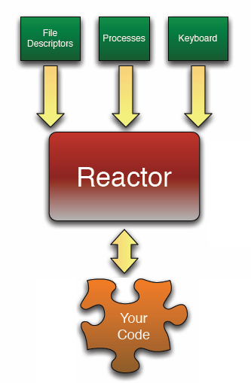
p "Starting" EM.run do p "Running in EM reactor" end p ”won’t get here"
while true do
timers network_io other_io
end
EventMachine Reactor
concurrency without threads
Notes:
The reactor design pattern is a concurrent programming pattern for handling service requests delivered concurrently to a service handler by one or more inputs. The service handler then demultiplexes the incoming requests and dispatches them synchronously to the associated request handlers.

Slide 28
p "Starting" EM.run do p "Running in EM reactor" end p ”won’t get here"
while true do
timers network_io other_io
end
EventMachine Reactor
concurrency without threads

Slide 29
C++ core
Easy concurrency without threading
EventMachine Reactor
concurrency without threads

Slide 30
Non-blocking IO requires non-blocking drivers:
AMQP http://github.com/tmm1/amqp
MySQLPlus http://github.com/igrigorik/em-mysqlplus
Memcached http://github.com/astro/remcached
DNS http://github.com/astro/em-dns
Redis http://github.com/madsimian/em-redis
MongoDB http://github.com/tmm1/rmongo
HTTPRequest http://github.com/igrigorik/em-http-request
WebSocket http://github.com/igrigorik/em-websocket
Amazon S3 http://github.com/peritor/happening
And many others:
http://wiki.github.com/eventmachine/eventmachine/protocol-implementations

Slide 31
gem install em-mysqlplus
EventMachine.run do
conn = EventMachine::MySQL.new(:host => 'localhost')
query = conn.query("select sleep(1)")
query.callback { |res| p res.all_hashes }
query.errback { |res| p res.all_hashes }
puts ”executing…”
end
# > ruby em-mysql-test.rb
#
# executing…
# [{"sleep(1)"=>"0"}]
callback fired 1s after “executing”
em-mysqlplus: example
async MySQL driver

Slide 32
non-blocking driver
require 'mysqlplus'
def connect(opts)
conn = connect_socket(opts)
EM.watch(conn.socket, EventMachine::MySQLConnection, conn, opts, self)
end
def connect_socket(opts)
conn = Mysql.init
conn.real_connect(host, user, pass, db, port, socket, ...)
conn.reconnect = false
conn
end
EM.watch: reactor will poll & notify
em-mysqlplus: under the hood
mysqlplus + reactor loop

Slide 33
Features:
Maintains C-based mysql gem API
Deferrables for every query with callback & errback
Connection query queue - pile 'em up!
Auto-reconnect on disconnects
Auto-retry on deadlocks
http://github.com/igrigorik/em-mysqlplus
em-mysqlplus
mysqlplus + reactor loop

Slide 34
EventMachine.run do
conn = EventMachine::MySQL.new(:host => 'localhost')
results = []
conn.query("select sleep(1)") {|res| results.push 1 }
conn.query("select sleep(1)") {|res| results.push 2 }
conn.query("select sleep(1)") {|res| results.push 3 }
EventMachine.add_timer(1.5) {
p results # => [1]
}
end
Still need DB pooling, etc. No magic pipelining!
em-mysqlplus: under the hood
mysqlplus + reactor loop

Slide 35
Stargazing with Ruby 1.9 & Fibers
the future is here! Well, almost…

Slide 36

Ruby 1.9 Fibers are a means of creating code blocks which can be paused and resumed by our application (think lightweight threads, minus the thread scheduler and less overhead).
f = Fiber.new {
while true do
Fiber.yield "Hi”
end
}
p f.resume # => Hi
p f.resume # => Hi
p f.resume # => Hi
Manual / cooperative scheduling!
Ruby 1.9 Fibers
and cooperative scheduling
http://bit.ly/d2hYw0
Notes:
coroutines

Slide 37
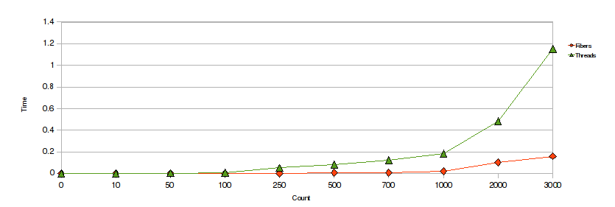
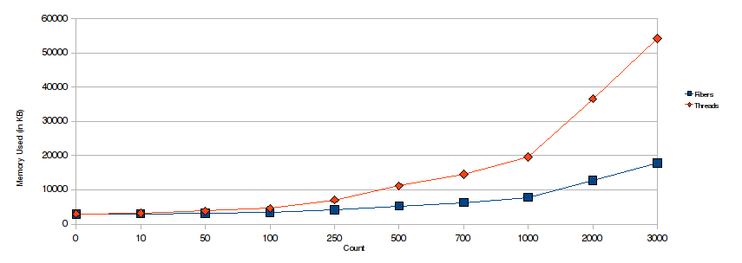
Fibers vs Threads: creation time much lower
Fibers vs Threads: memory usage is much lower
Ruby 1.9 Fibers
and cooperative scheduling
http://bit.ly/aesXy5
Notes:
coroutines

Slide 38
def query(sql)
f = Fiber.current
conn = EventMachine::MySQL.new(:host => 'localhost')
q = conn.query(sql)
# resume fiber once query call is done
c.callback { f.resume(conn) }
c.errback { f.resume(conn) }
return Fiber.yield
end
EventMachine.run do
Fiber.new {
res = query('select sleep(1)')
puts "Results: #{res.fetch_row.first}"
}.resume
end
async query, sync execution!
Untangling Evented Code with Fibers
http://bit.ly/d2hYw0
Notes:
coroutines

Slide 39
Good news, you don’t even have to muck around with Fibers!
gem install em-synchrony
http://github.com/igrigorik/em-synchrony
Fiber aware connection pool with sync/async query support
Multi request interface which accepts any callback enabled client
Fibered iterator to allow concurrency control & mixing of sync / async
em-http-request: .get, etc are synchronous, while .aget, etc are async
em-mysqlplus: .query is synchronous, while .aquery is async
remcached: .get, etc, and .multi_* methods are synchronous
em-synchrony: simple evented programming
best of both worlds…
Notes:
coroutines

Slide 40
EventMachine.synchrony do
db = EventMachine::Synchrony::ConnectionPool.new(size: 2) do
EventMachine::MySQL.new(host: "localhost")
end
multi = EventMachine::Synchrony::Multi.new
multi.add :a, db.aquery("select sleep(1)")
multi.add :b, db.aquery("select sleep(1)")
res = multi.perform
p "Look ma, no callbacks, and parallel MySQL requests!”
p res
EventMachine.stop
end
Fiber-aware connection pool
Parallel queries, synchronous API, no threads!
em-synchrony: MySQL example
async queries with sync execution
Notes:
coroutines

Slide 41
Fibers & Cooperative Scheduling in Ruby:
http://www.igvita.com/2009/05/13/fibers-cooperative-scheduling-in-ruby/
Untangling Evented Code with Ruby Fibers:
http://www.igvita.com/2010/03/22/untangling-evented-code-with-ruby-fibers/
EM-Synchrony:
http://github.com/igrigorik/em-synchrony
em-synchrony: more info
check it out, it’s the future!
Notes:
coroutines

Slide 42
Non-blocking Rails???
Mike Perham did it with EM PG driver + Ruby 1.9 & Fibers: http://bit.ly/9qGC00
We can do it with MySQL too…

Slide 43
git clone git://github.com/igrigorik/em-mysqlplus.git
git checkout activerecord
rake install
database.yml
development:
adapter: em_mysqlplus
database: widgets
pool: 5
timeout: 5000
environment.rb
require 'em-activerecord’
require 'rack/fiber_pool'
# Run each request in a Fiber
config.middleware.use Rack::FiberPool
config.threadsafe!
Async Rails
with EventMachine & MySQL

Slide 44
class WidgetsController < ApplicationController
def index
Widget.find_by_sql("select sleep(1)")
render :text => "Oh hai”
end
end
ab –c 5 –n 10 http://127.0.0.1:3000/widgets
Server Software: thin
Server Hostname: 127.0.0.1
Server Port: 3000
Document Path: /widgets/
Document Length: 6 bytes
Concurrency Level: 5
Time taken for tests: 2.210 seconds
Complete requests: 10
Failed requests: 0
Requests per second: 4.53 [#/sec] (mean)
woot! Fiber DB pool at work.
Async Rails
with EventMachine & MySQL

Slide 45
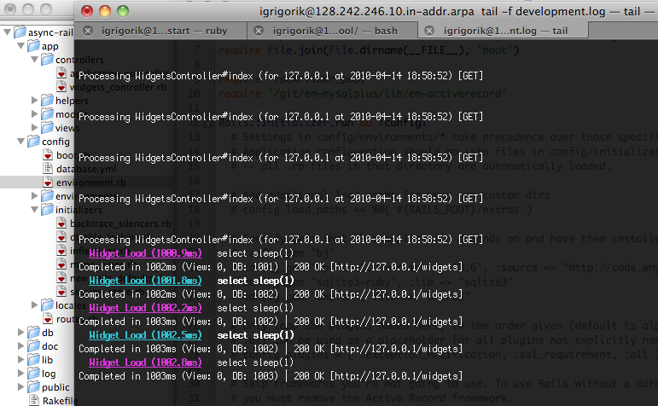
git clone git://…./igrigorik/mysqlplus
git checkout activerecord
rake install
One app server, 5 parallel DB requests!

Slide 46

Blog post & slides: http://bit.ly/gem-mysql
Code: http://github.com/igrigorik/presentations
Twitter: @igrigorik
Questions?

