Slide 1

Notes:
Animation time: 4 seconds

Slide 2

Notes:
Animation time: 11 seconds

Slide 3
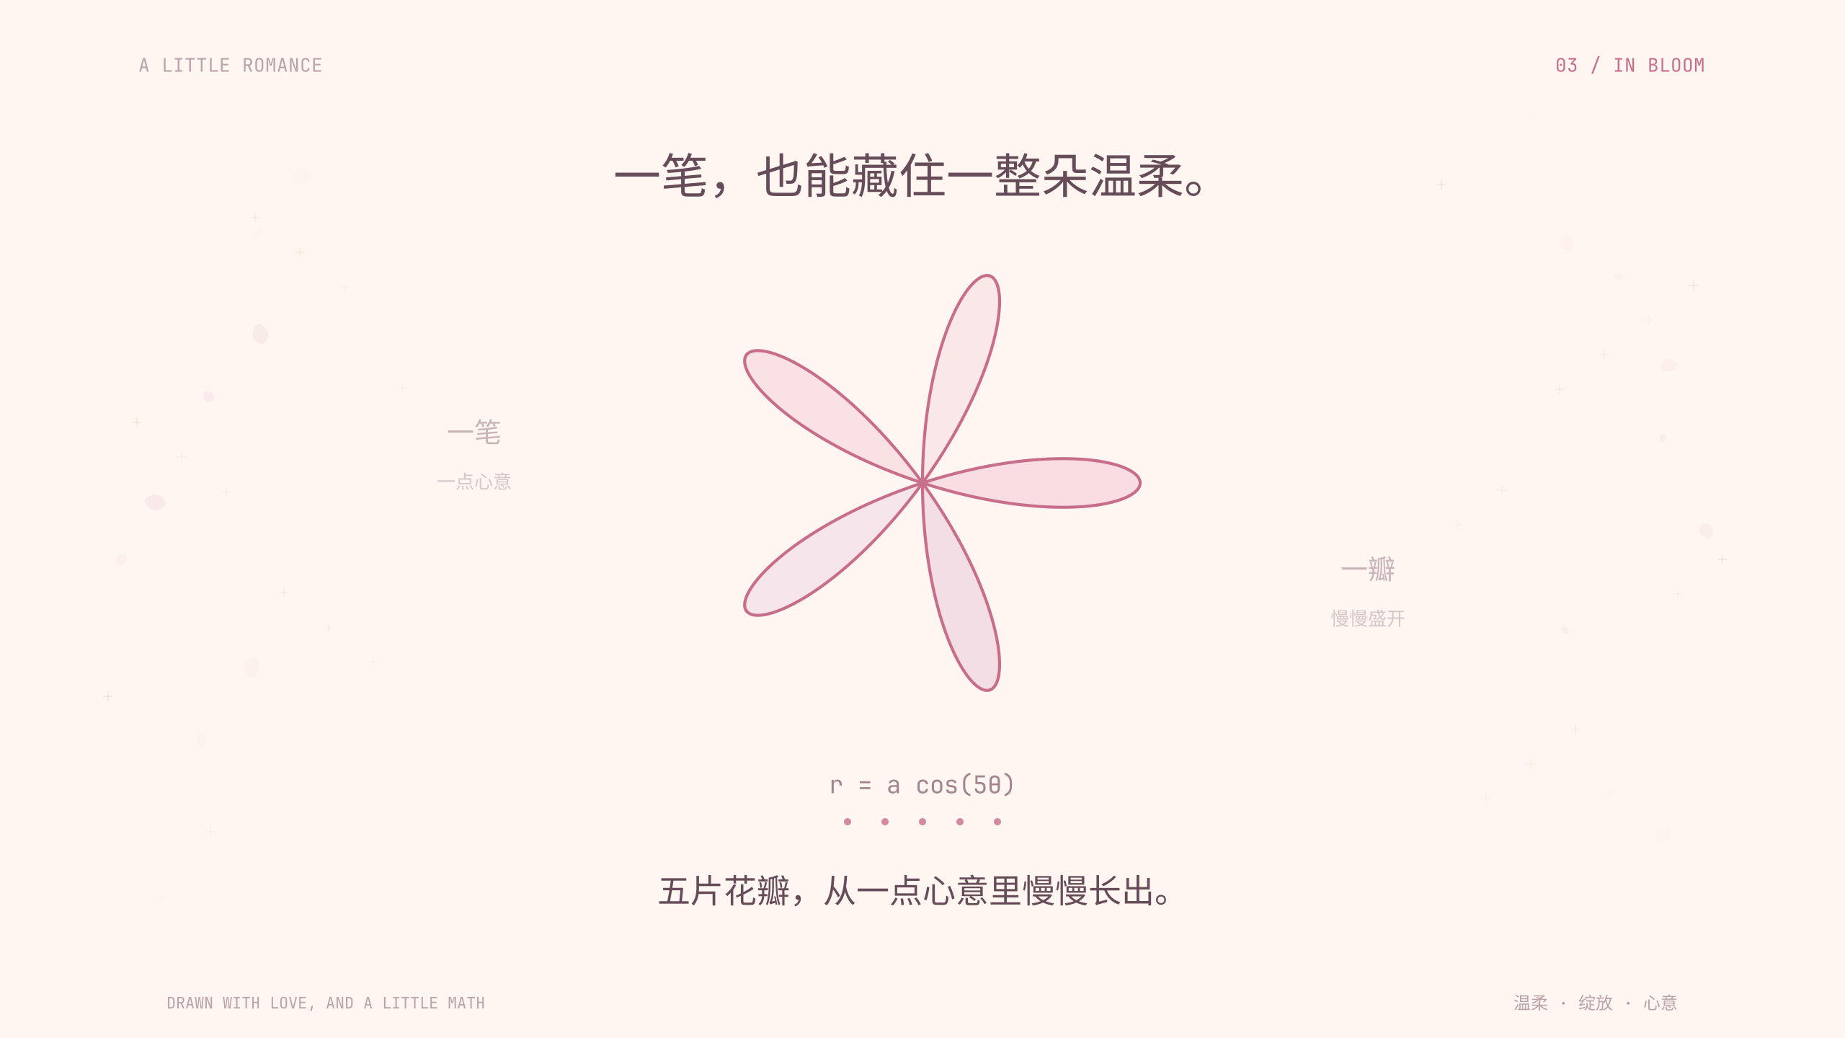
Notes:
Animation time: 26 seconds

Slide 4
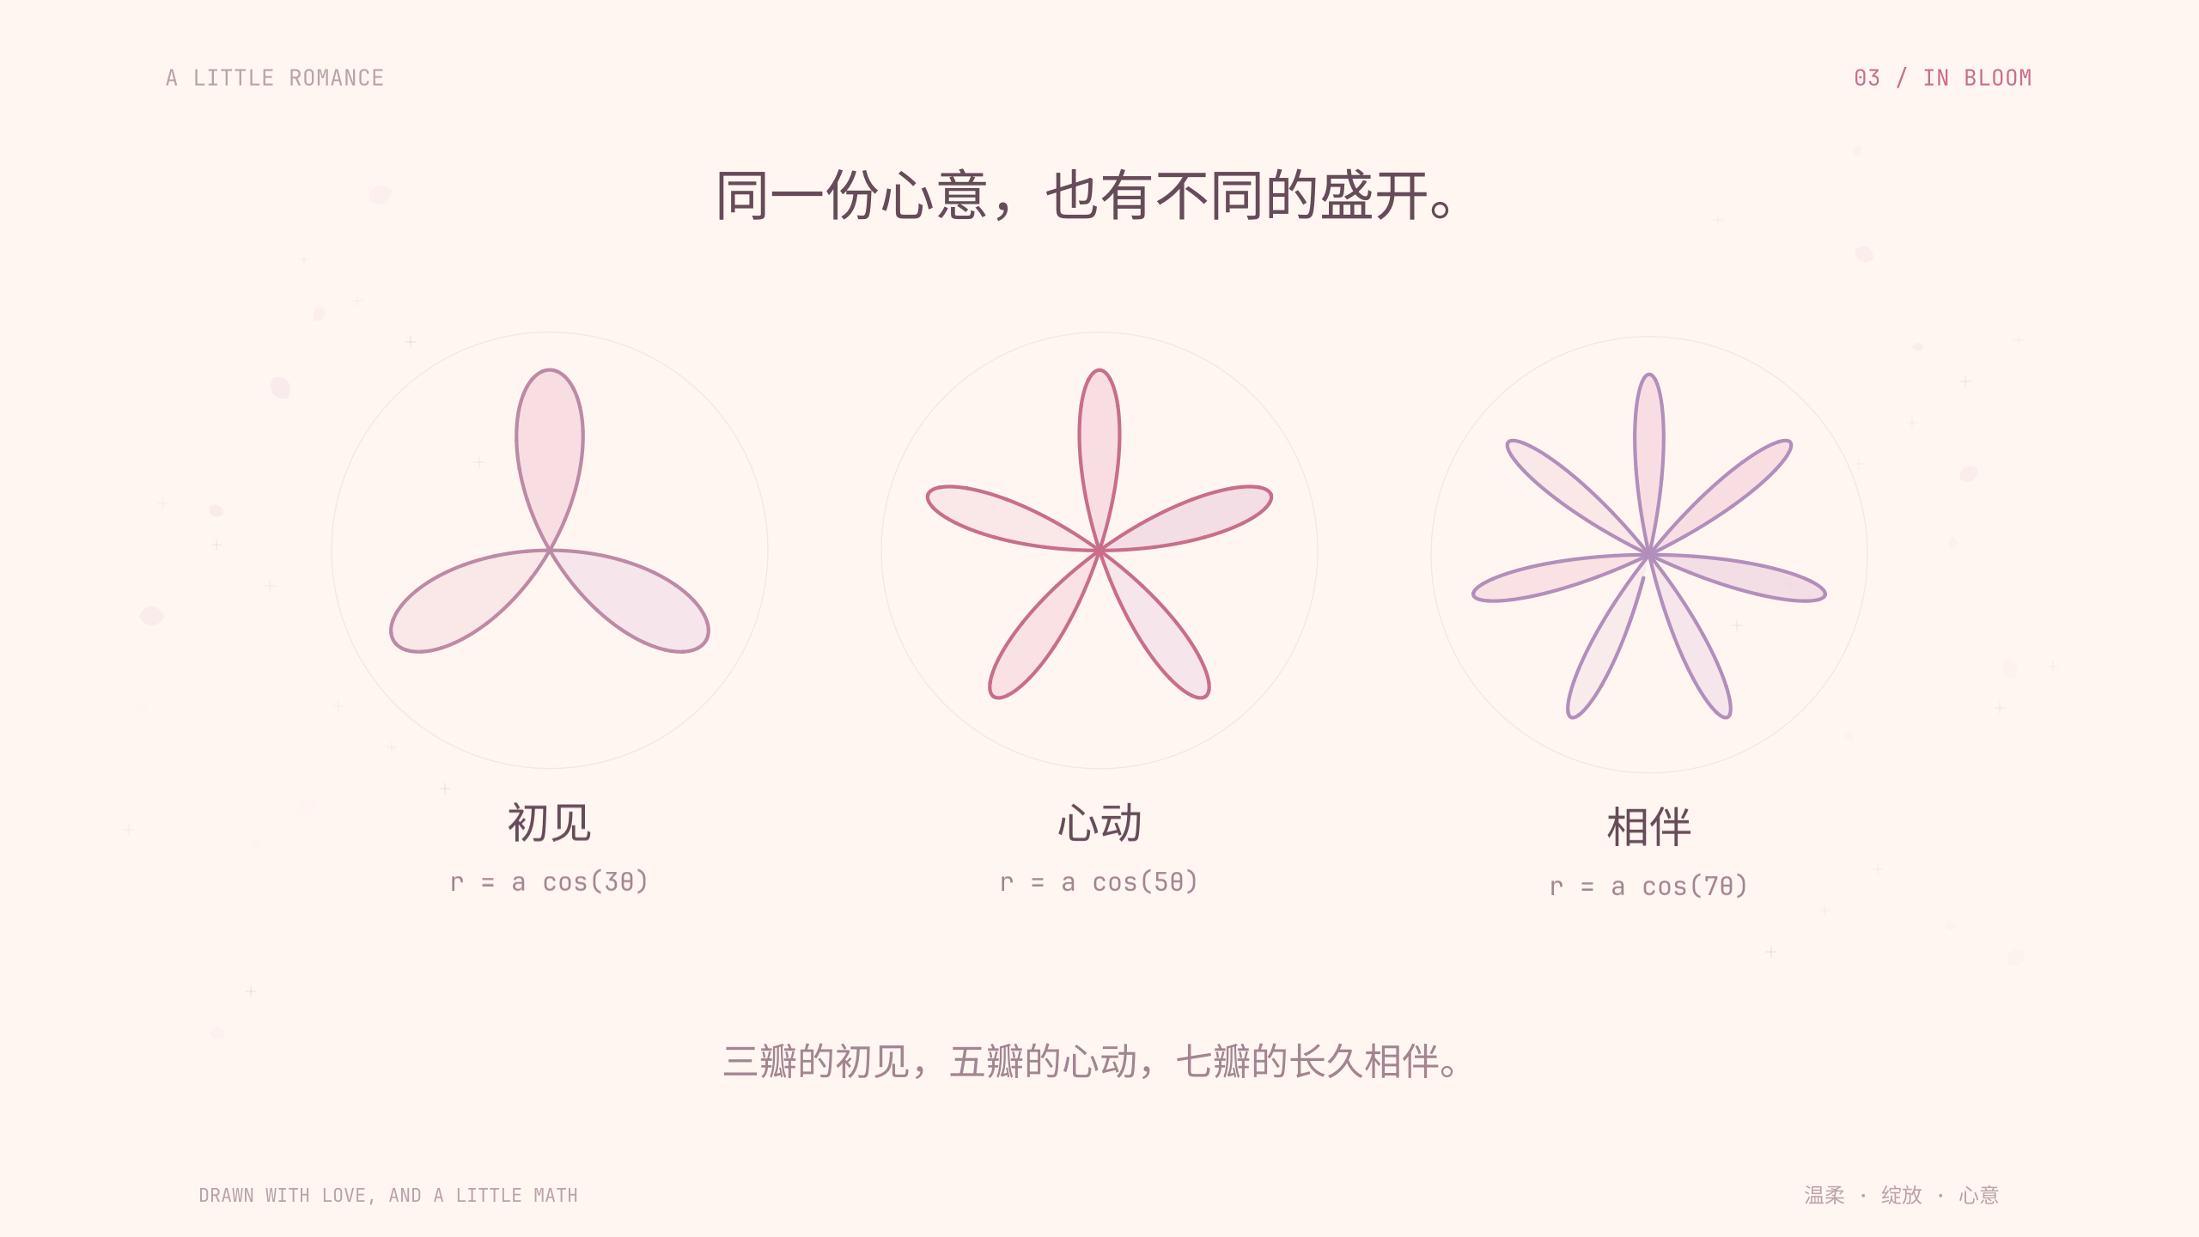
Notes:
Animation time: 33 seconds

Slide 5

Notes:
Animation time: 42 seconds

Slide 6

Notes:
Animation time: 50 seconds

Slide 7

Notes:
Animation time: 60 seconds

