Slide 1
Gesture-Based HCI
Exploring Gesture Interaction with OpenCV and MediaPipe

Slide 2
Introduction
This presentation delves into the concepts of gesture-based human-computer interaction, highlighting essential technologies like OpenCV and MediaPipe, and their applications. We will explore how these tools can create an intuitive user experience through gesture recognition.

Slide 3
01
System Overview

Slide 4
Introduction to Gesture-Based Interaction
Gesture-based interaction enables users to control devices through natural hand and body movements. This technology revolutionizes user experience by allowing more intuitive and efficient interaction without traditional input devices. Key advantages include increased accessibility and the potential for hands-free operation, making it ideal for various applications from gaming to virtual reality and smart home controls.

Slide 5
Key Components and Technologies
The primary components of gesture-based interaction systems include cameras for motion capture, algorithms for gesture recognition, and frameworks for implementation. OpenCV serves as a powerful library for image processing, while MediaPipe offers robust solutions for real-time tracking of limbs and faces. Together, these technologies create a comprehensive platform for gesture recognition that can be integrated into various applications, enhancing user engagement and interaction.

Slide 6
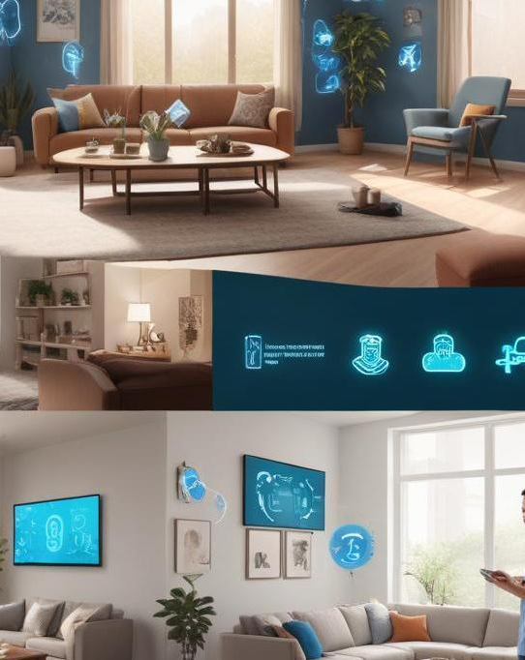
Applications and Use Cases
Gesture-based interaction has a wide range of applications across various fields. In healthcare, it facilitates touchless interactions, enhancing hygiene and safety in medical environments. In gaming and entertainment, it creates immersive experiences where players control characters using gestures. Moreover, in smart home technology, gestures enable seamless control of devices, increasing convenience for users. Additionally, educational tools often incorporate gesture recognition to engage learners in interactive and dynamic ways, making learning more enjoyable and effective.

Slide 7
02
Technical Implementation

Slide 8
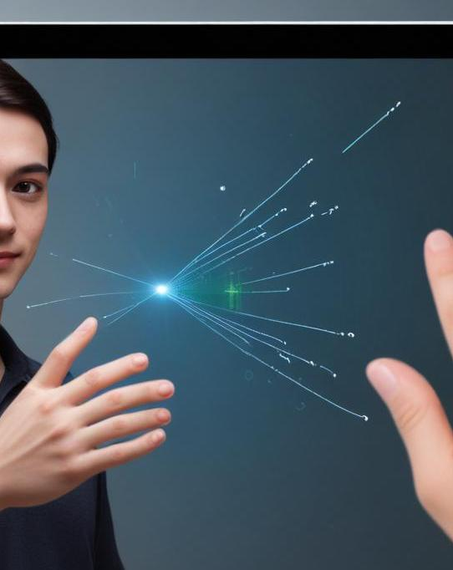
Using OpenCV for Gesture Recognition
OpenCV is a versatile library that plays a crucial role in gesture recognition by providing various tools for image processing and analysis. It allows developers to perform real-time processing of video frames obtained from cameras. By leveraging features such as contour detection, color tracking, and optical flow algorithms, OpenCV helps identify specific gestures with high accuracy. It also supports machine learning models that can be trained to recognize custom gestures, broadening the range of interaction possibilities.

Slide 9
Integrating MediaPipe for Tracking
MediaPipe is an efficient framework developed by Google for building cross-platform multimodal applied machine learning pipelines. In gesture recognition, MediaPipe simplifies the process of tracking hand and body movements through its pre-trained models. It provides robust solutions such as hand landmark detection, enabling real-time tracking of a user's hands, crucial for interpreting gestures accurately. By integrating MediaPipe with OpenCV, developers can enhance gesture recognition capabilities and achieve smoother interactions in applications.

Slide 10
Leveraging Palm's text-bison-001
Palm's text-bison-001 is an advanced model that aids in natural language processing, allowing for enhanced interaction through gesture recognition systems. It can interpret user intents based on gestures and provide contextual responses, enhancing human-computer communication. By integrating this model, developers can create more intuitive applications where gestural input and natural language understanding work together, leading to a seamless and engaging user experience. This integration is particularly valuable in scenarios where voice-based inputs may not be feasible.

Slide 11
Conclusions
In conclusion, gesture-based human-computer interaction systems powered by OpenCV, MediaPipe, and Palm's text-bison-001 present a significant advancement in user interface design. By harnessing the strengths of these technologies, we can create seamless, intuitive, and engaging experiences across various applications. As these tools continue to evolve, the potential for innovative uses in our daily lives expands, paving the way for a more interactive and user-friendly digital future.

Slide 12
THANK YOU
By team:Deciders
Team member 1:Gurram Pranavi sri
Team member 2:Ippe Akshaya
Team member 3:Jammula Varsha

