Slide 1


STUDYMATE: AN AI-POWERED PDF BASED QUESTION & ANSWER SYSTEM FOR STUDENTS
BY:B.MAHESHWARI
A.HARINI& D.CHANDRIKA

Slide 2
INTRODUCTION:
The challenge of creating an intelligent system that enables students to upload PDF documents—like lecture notes, textbooks, or assignments—and then ask natural-language questions about their content. A Meta AI-powered PDF-based Question and Answer (Q&A) system is an intelligent study assistant designed to help students interact with their study materials more effectively. By integrating artificial intelligence with PDF documents, the system allows learners to upload their notes, textbooks, or research papers and instantly ask questions related to the content. The AI processes the text, understands the context, and provides accurate, easy-to-understand answers. This not only saves time spent on searching for information but also enhances comprehension, personalized learning, and exam preparation.

Slide 3
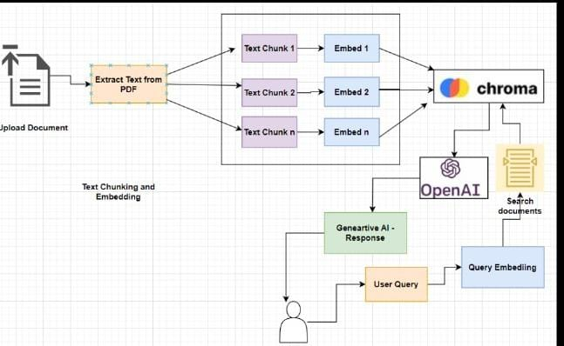
ARCHITECTURE:
Architecture The system has four main parts:
1. PDF Upload – Students upload their study materials (like notes or textbooks in PDF).
2. Text Extraction – The system reads the PDF and pulls out the text.
3. AI Processing – Meta AI understands the text, finds the meaning, and prepares accurate answers.
4. Q&A Interface – Students type their questions, and the system gives clear answers based only on the uploaded PDF. This flow makes it easy for students to interact with their study material, just like chatting with their textbook.

Slide 4
FUTURE SCOPE:
Future Scope In the future, this Meta AI-powered PDF Q&A system can become even smarter and more useful for students. It could support voice-based questions, give summaries of long chapters, create practice tests from PDFs, and even suggest personalized study plans. It may also work with multiple file types (like Word or PowerPoint) and support different languages so that more students can benefit from it. With these improvements, the system can turn into a complete smart study assistant. Future Scope Adding voice-based question answering for hands-free learning. Generating chapter summaries from long PDF s. Creating practice tests and quizzes from study material. Suggesting personalized study plans based on the student’s needs. Supporting multiple file formats like Word, PPT, or images .Offering multi-language support for global use. Integrating with online learning platforms for a smoother study experience.

Slide 5
SOLUTION:
The solution is to create a smart study tool where students can upload their PDF notes or textbooks and directly ask questions about them. The system will first read the PDF and extract the text, then use Meta AI to understand the content. When a student asks a question, the AI will search within the document and provide a clear and accurate answer.This saves students from manually going through large PDFs and helps them learn faster, prepare better for exams, and understand concepts easily. The system can be used on mobile phones, laptops, or online platforms, making it accessible anytime and anywhere.

Slide 6
CONCLUSION:
The Meta AI-powered PDF Question and Answer system is a smart study helper that makes learning easier for students. Instead of spending hours searching through textbooks or notes, students can quickly upload their PDFs, ask questions, and get clear answers. This saves time, improves understanding, and makes studying more interactive. In the future, with more features, it can become a complete digital study companion for students everywhere.
THANK YOU

