Slide 1
IDEA International data encryption algorithm 23pc19 – harish hj

Slide 2
agenda
Introduction
Encryption
Key Scheduling
Decryption
Security

Slide 3
INTroduction
It is a symmetric key block cipher designed for secure encryption of data.
It was developed by Xuejia Lai and James Massey in 1991 as an improvement over the Data Encryption Standard (DES)
IDEA is widely known for its strong security and resistance to cryptanalysis.

Slide 4
Encryption
Block Size: 64-bit
Operates on 64-bit plaintext blocks, producing 64-bit ciphertext blocks.
Key Size: 128-bit
Uses a 128-bit key for encryption and decryption.
Number of Rounds: 8.5
Consists of 8 full rounds + 1 half-round (output transformation).
Operations Used:
Bitwise XOR (⊕)
Addition mod 2^16 (AND 0xFFFF trick)
Multiplication mod (2^16)+1 (Special case: 65536 → 0)

Slide 5
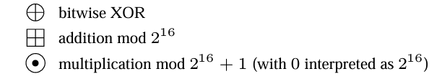
Round uses six 16-bit subkeys K(r)i , 1 ≤i≤6,to transform 64-bit input X into an output of four16-bit blocks, which are in put to the next round.(Where r is the round number)
The round 8 output enters the output transformation, employing four additional subkeys K(9)i , 1 ≤ i ≤ 4 to produce the final ciphertext Y =(Y1,Y2,Y3,Y4).
The corresponding group operations on sub-blocks a and b of bitlength n =16:

Slide 6
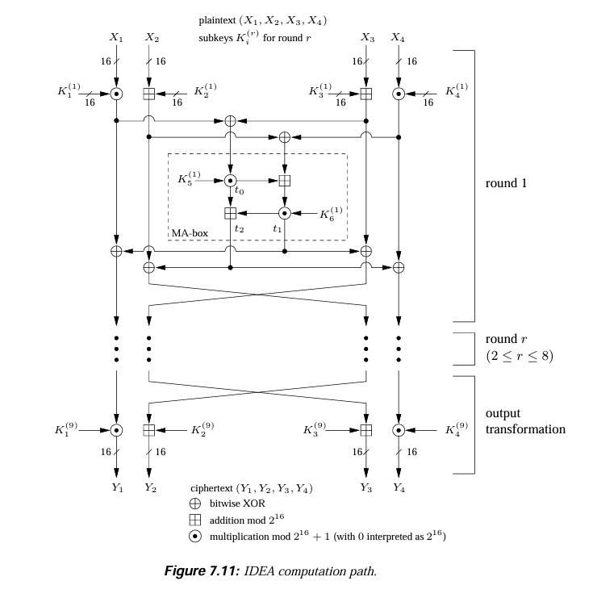

Slide 7
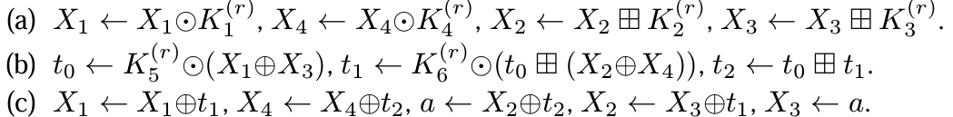
INPUT: 64-bit plaintext M = m1...m64; 128-bit key K = k1...k128.
OUTPUT: 64-bit ciphertext block Y =(Y1,Y2,Y3,Y4).
Compute 16-bit subkeys K(r)1 ,... ,K(r)6 for rounds 1 ≤ r ≤ 8, and K(9)1 ,... ,K(9)4 for the output transformation
(X1,X2,X3,X4) ← (m1...m16, m17...m32, m33...m48, m49...m64), where Xi is a 16-bit data store.
For round r from 1 to 8 do:
(output transformation)
Y1 ← X1.K(9)1
Y4 ← X4.K(9)4
Y2 ← X3⊞K(9)2
Y3 ← X2 ⊞K(9)3

Slide 8
key schedule
INPUT: 128-bit key K = k1...k128.
OUTPUT: 52 16-bit key sub-blocks K(r)i for 8 rounds r and the output transformation.
Order the subkeys K(1)1 ...K(1)6 ,K(2)1 ...K(2)6 ,... ,K(8)1 ...K(8)6 ,K(9)1 ...K(9)4 .
Partition K into eight 16-bit blocks, assign these directly to the first 8 subkeys.
Do the following until all 52 subkeys are assigned, cyclic shift K left 25 bits; partition the result into 8 blocks, assign these blocks to the next 8 subkeys.

Slide 9
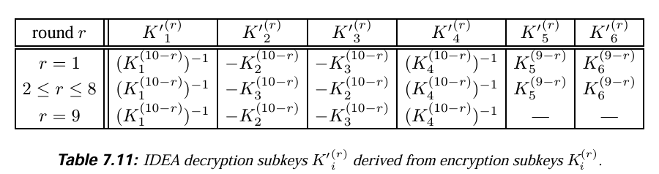
decryption
Decryption is achieved using Encryption Algorithm with the cipher text Y provided as input M, and the same encryption key K, but the following change to the key schedule.
First use K to derive all encryption subkeys K(r)i ; from these compute the decryption subkeys K`(r)i.
−Ki denotes the additive inverse (mod 2^16)of Ki
Ki^−1 denotes the multiplicative inverse (mod 2^16 +1)of Ki

Slide 10
Security
For the full 8-round IDEA, other than attacks on weak keys, no published attack is better than exhaustive search on the 128-bit key space.
The security of IDEA currently appears to be bounded only by the weaknesses arising from its relatively small 64-bit block size, despite its 128-bit key length, making it vulnerable to birthday attacks and Sweet32 when encrypting large amounts of data.
Performance Issues (Slow Compared to AES) IDEA relies heavily on modular multiplication, which is computationally expensive on most processors.

Slide 11
Thank you

