Slide 1


















BUAN 6356.001
Predictive Modeling for Loan Repayment Forecasting
Enhancing Financial Risk Management
By: Tucker Strow
Likith Rajashekar
Adithya Ramakrishnan
& Andres Gonzales
10:00AM

Slide 2




Agenda • Agenda • Agenda • Agenda • Agenda • Agenda • Agenda • Agenda • Agenda • Agenda • Agenda • Agenda • Agenda • Agenda
Table of contents
Introduction
DATA CLEANING
Agenda
MODELS & RESULTS
INTERPRET & CONCLUDE

Slide 3

Introduction
Predicting loan repayments is vital for effective financial risk management in lending institutions.
Dataset Overview: We utilized an anonymized loan default dataset sourced from Kaggle. It includes various features such as loan amount, term, interest rate, installment, employment length, home ownership, annual income, loan status, purpose, and a binary indicator for repayment failure.
Objectives of the Study:
Our objective is to develop robust predictive models to forecast the likelihood of loan repayment based on available data.
By leveraging this dataset, we aim to enhance the accuracy and reliability of loan repayment forecasting for banks and lenders worldwide.
Back to Agenda Page

Slide 4















Data Preprocessing • Data Preprocessing • Data Preprocessing • Data Preprocessing • Data Preprocessing • Data Preprocessing • Data
Data Preprocessing
Loading and Cleaning Data
Correlation Analysis
One-Hot Encoding
Data Splitting: Training and Testing Sets
Back to Agenda Page
Data Preprocessing • Data Preprocessing • Data Preprocessing • Data Preprocessing • Data Preprocessing • Data Preprocessing • Data

Slide 5

Loading and Cleaning Data:
Conducted correlation analysis to identify relationships between variables and assess multicollinearity.
Omitted highly correlated variables to avoid redundancy in the modeling process.
We began by loading the dataset into R and performed initial data exploration.
Cleaning steps included handling missing values, converting data types, and ensuring consistency in coding conventions.
Correlation Analysis:
Back to Agenda Page

Slide 6





One-Hot Encoding:
Data Splitting: Training and Testing Sets:
Back to Agenda Page
Categorical variables were one-hot encoded to convert them into a numerical format suitable for modeling.
This process expanded categorical variables into binary columns, capturing each category as a separate feature.
We split the dataset into training and testing sets to facilitate model development and evaluation.
The training set (60% of the data) was used to train the models, while the testing set (40%) was reserved for assessing model performance.

Slide 7
Data Preprocessing • Data Preprocessing • Data Preprocessing • Data Preprocessing • Data Preprocessing • Data Preprocessing • Data
Modeling Approaches
Baseline Model: ZeroR
Principal Component Analysis (PCA)
Logistic Regression
Decision Tree
Bagging (Random Forest)
Back to Agenda Page
Data Preprocessing • Data Preprocessing • Data Preprocessing • Data Preprocessing • Data Preprocessing • Data Preprocessing • Data

Slide 8
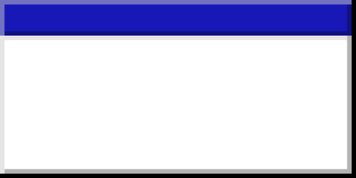

ZeroR Baseline Model • ZeroR Baseline Model • ZeroR Baseline Model • ZeroR Baseline Model ZeroR Baseline Model • ZeroR Baseline Model • ZeroR Baseline
ZeroR Baseline Model
Implications:
Model Evaluation
ZeroR Model Overview:
Baseline Model: ZeroR (Zero Rule) serves as a simple baseline model for comparison.
Prediction Strategy: The ZeroR model predicts the majority class for all instances in the testing set.
While simplistic, the ZeroR model provides a benchmark for evaluating the performance of more complex models.
Any predictive model developed should outperform the success rate achieved by the ZeroR model to be considered effective.
ZeroR Baseline Model • ZeroR Baseline Model • ZeroR Baseline Model • ZeroR Baseline Model ZeroR Baseline Model • ZeroR Baseline Model • ZeroR Baseline

Slide 9
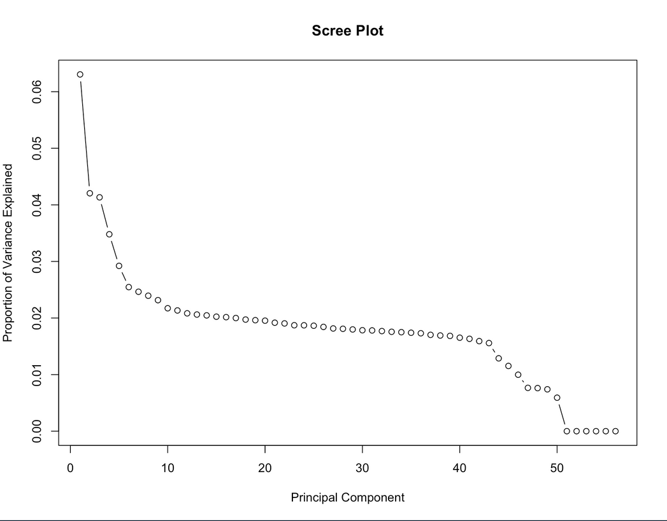
Principal Component Analysis (PCA)
PCA Results: Explored the variance explained by each principal component.
Scree Plot: Visualized the proportion of variance explained by each principal component.
Dimension Reduction: Selected a subset of principal components to achieve significant variance capture while reducing dimensions.
Dimensionality Reduction: Utilized PCA to reduce the dimensionality of the dataset and identify principal components capturing variance.
Objective: Streamline the modeling process by retaining essential information while reducing computational complexity.
Limitations:
While PCA aids in dimensionality reduction, it may not always lead to substantial gains in predictive performance.
Careful consideration is required to balance dimension reduction with preserving predictive power.
Back to Agenda Page

Slide 10


Logistic Regression Model
Logistic Regression Overview:
Model Type: Implemented Logistic Regression, a classic statistical technique for binary classification tasks.
Predictor Variables: Utilized principal components obtained from PCA as predictor variables.
Model Development and Evaluation:
Training Phase: Trained the logistic regression model using the training dataset.
Testing Phase: Evaluated model performance on the testing dataset.
Performance Metrics: Analyzed model summary statistics and calculated classification accuracy.
Model Interpretation:
Interpretability: Logistic regression allows for easy interpretation of coefficients and their impact on the outcome variable.
Insights: Examined coefficients to understand the influence of predictor variables on the likelihood of loan repayment.
Back to Agenda Page

Slide 11
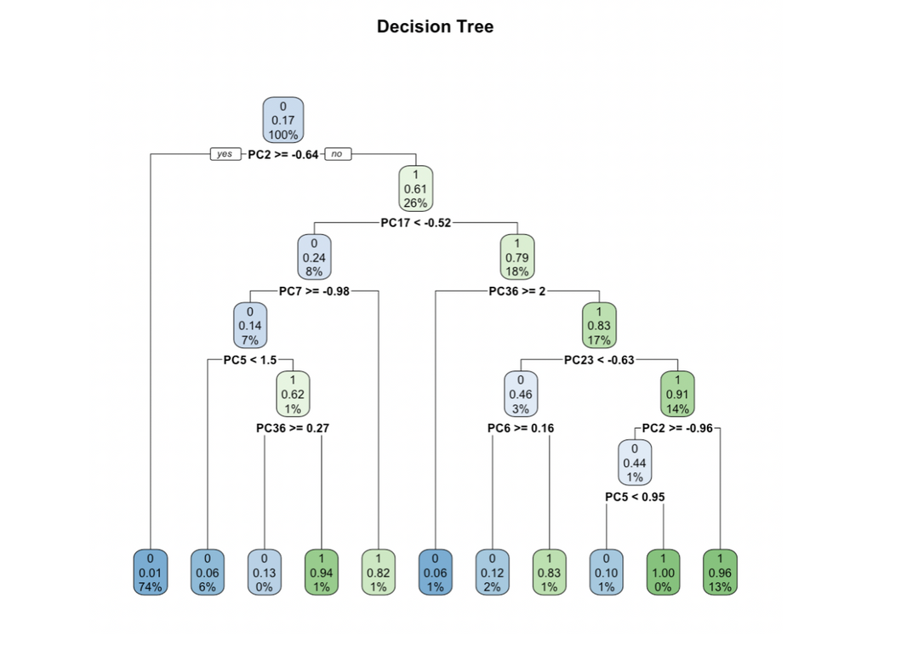


Decision Tree
A decision tree model is constructed using the transformed dataset to capture complex decision boundaries and interactions among features.
The model's performance is visualized and evaluated through a confusion matrix and accuracy calculation.
Back to Agenda Page

Slide 12



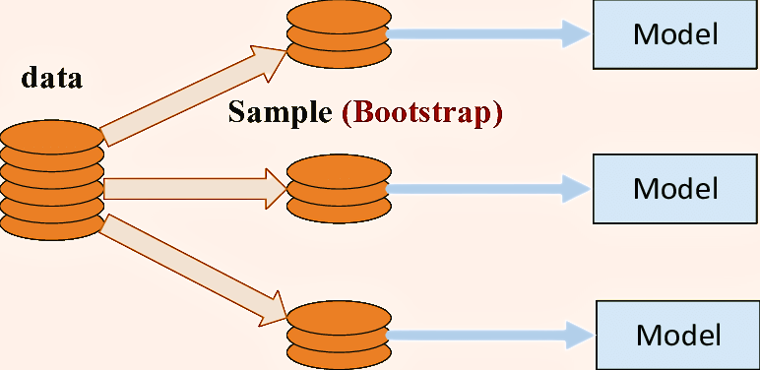
Bagging (Bootstrap Aggregation)
Bagging, using the Random Forest algorithm, reduces variance and improves stability in predictive models. It creates multiple subsets of the dataset, trains a model on each, and averages predictions or uses majority voting. Random Forest adds randomness to this process, enhancing robustness and predictive power.
Performance is evaluated using a confusion matrix, deriving metrics like accuracy, precision, recall, and F1 score. Feature importance is also assessed to understand main influencers on loan repayment behavior. Hence, Bagging with Random Forest is a powerful predictive tool providing robust predictions and critical insights.
Back to Agenda Page

Slide 13


MODEL RESULTS
 | ZeroR | Logistic Regression | Decision Tree | Bagging
Accuracy | 0.8292 | 0.9991 | 0.9736 | 0.9991
Specificity | 1 | 0.9998 | 0.9876 | 1
Sensitivity | 0 | 0.9958 | 0.9055 | 0.9948
Precision | 0 (Undefined) | 0.999 | 0.9376 | 1
Back to Agenda Page

Slide 14
Data Preprocessing • Data Preprocessing • Data Preprocessing • Data Preprocessing • Data Preprocessing • Data Preprocessing • Data
Interpretation and conclusion
Leveraging Predictive Analytics for Loan Assessment
Transforming Lending Practices with Predictive Modeling
Back to Agenda Page
Data Preprocessing • Data Preprocessing • Data Preprocessing • Data Preprocessing • Data Preprocessing • Data Preprocessing • Data

Slide 15
Leveraging Predictive Analytics for Loan Assessment
Introduction
Our experiment aimed to optimize loan assessment processes using predictive analytics.
Key Findings
Accurate loan assessment is crucial, with a focus on minimizing false negatives.
Sensitivity analysis revealed Logistic Regression as the top-performing model.
Recommendation
We recommend using Logistic Regression for loan evaluation due to its superior sensitivity.
Sensitivity Analysis
Logistic Regression exhibited the highest sensitivity compared to other models.
Key Takeaways
Adopting Logistic Regression can enhance loan approval processes and risk management strategies for lenders.
Back to Agenda Page

Slide 16
Summary of Experiment
Explored predictive modeling techniques including ZeroR, Logistic Regression, Decision Trees, and Bagging.
Performance Evaluation
Logistic Regression demonstrated exceptional performance, particularly in sensitivity.
Data Preparation
Extensive data cleaning and preparation improved dataset quality, aided by techniques like PCA.
Implications for Lenders
Integrating predictive models can improve risk management and decision-making in lending practices.
Benefits include a more stable financial ecosystem for both lenders and borrowers.
Call to Action
Encourage lenders to adopt Logistic Regression and other predictive analytics tools for enhanced loan assessment.
Implement recommendations effectively to maximize benefits.
Transforming Lending Practices with Predictive Modeling
Back to Agenda Page

Slide 17
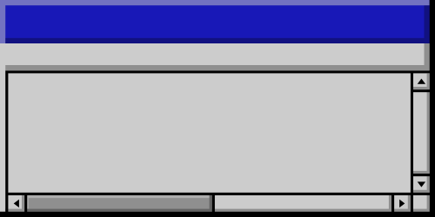


Thank you!

