Slide 1
AgriPro

Slide 2
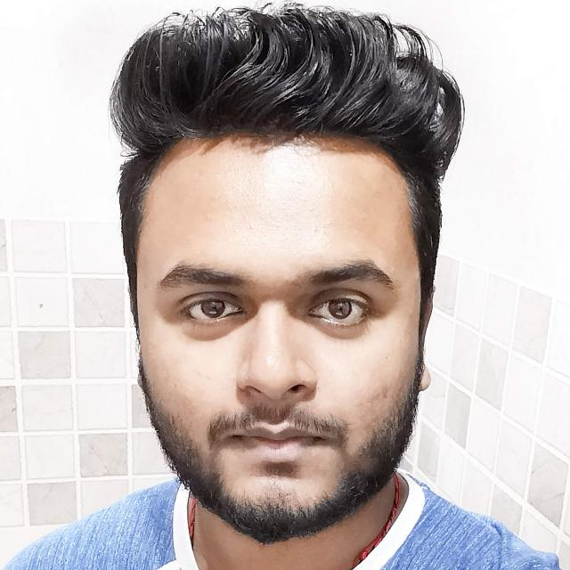
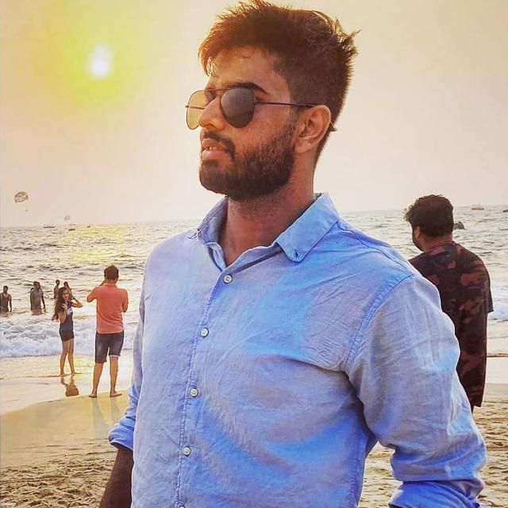
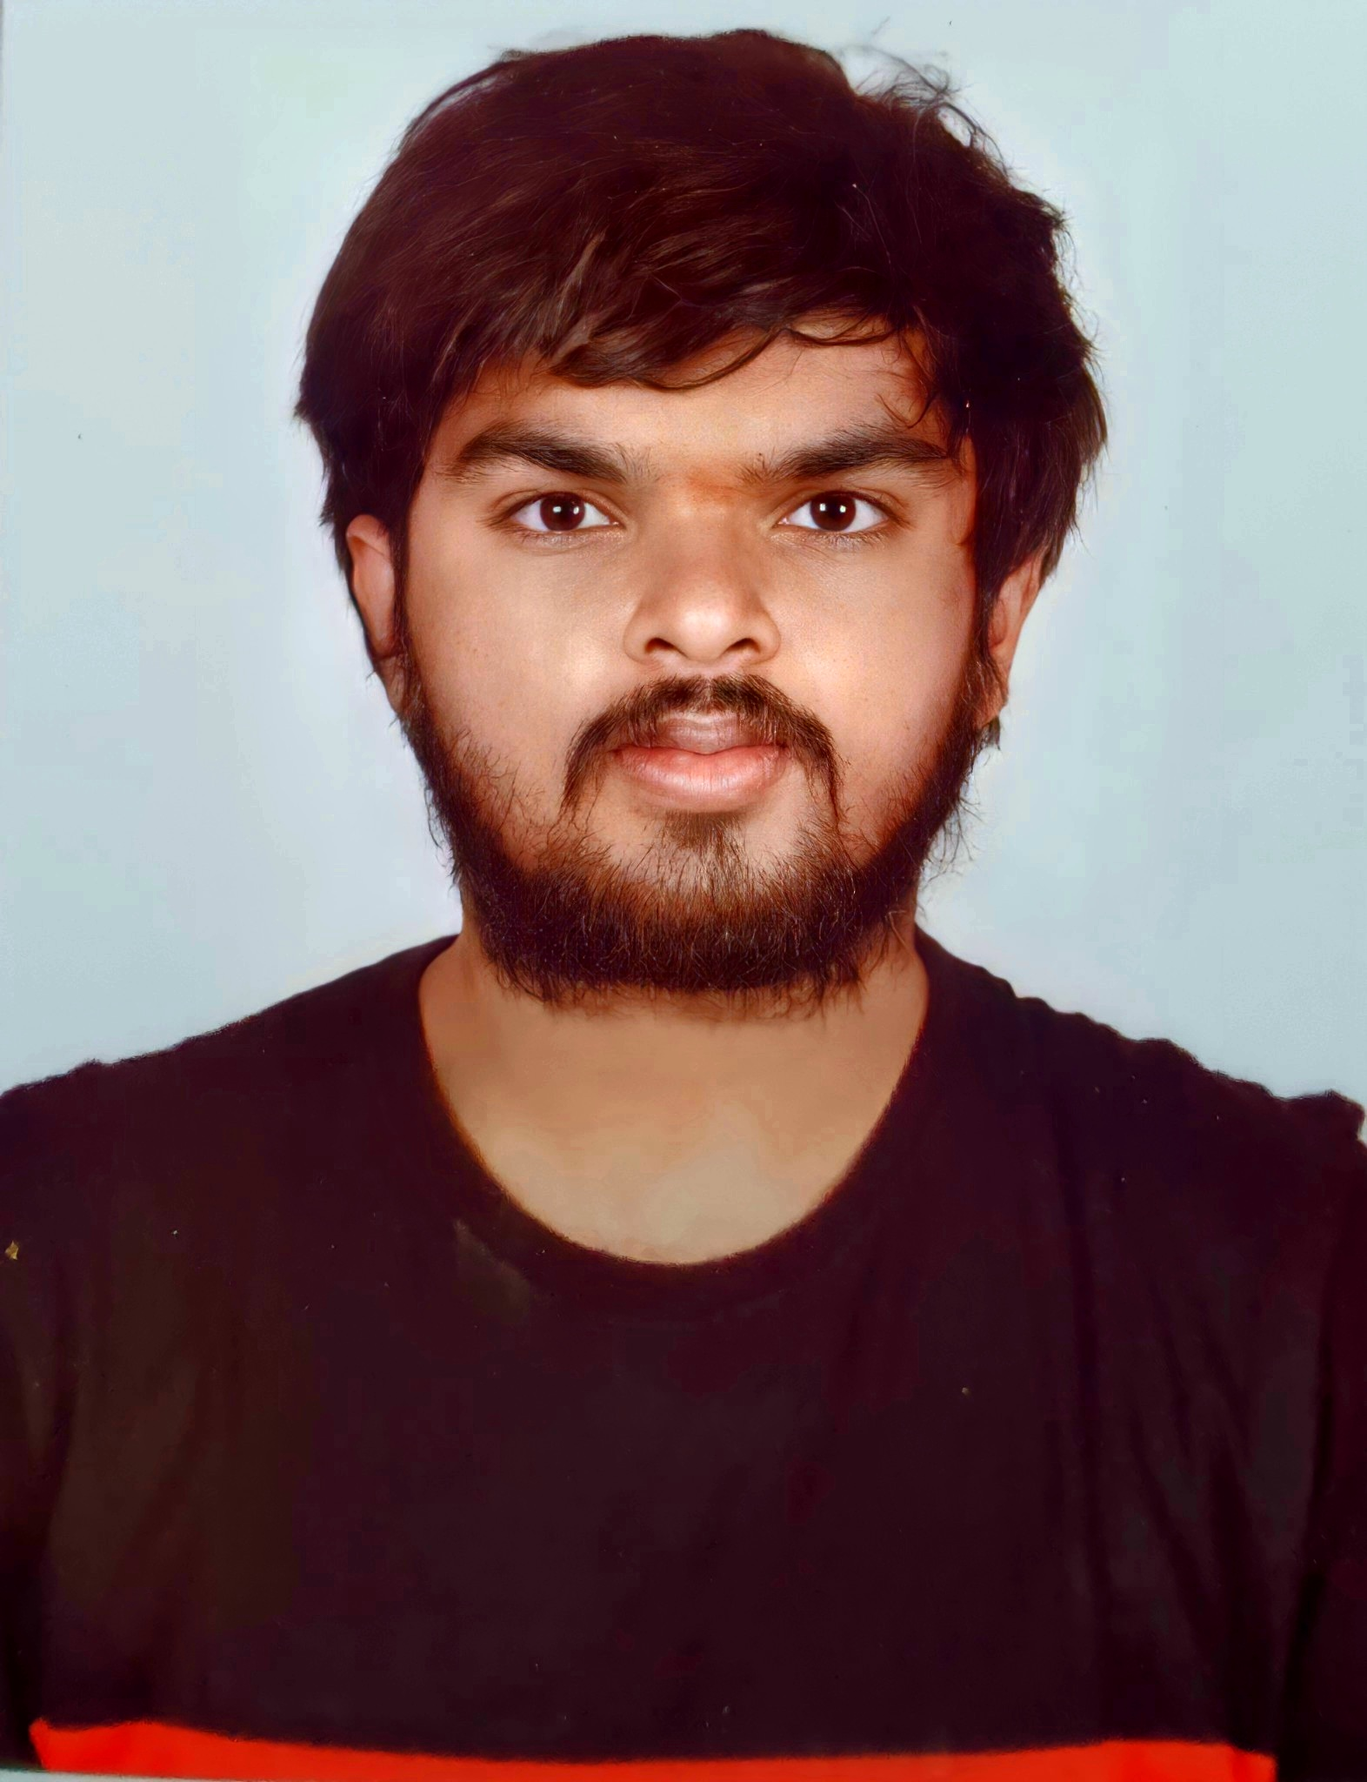
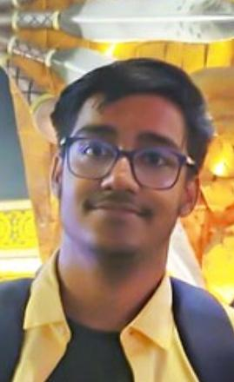
Our Team
Shree
Ratn Student
Data science enthusiast
and web developer
Rushikesh
Chaskar Student
Web developer and deep learning enthusiast
Tarush J
Reddy Student
Web and Android developer
Subbhashit Mukherjee Student
Data science and deep learning enthusiast

Slide 3
Theme
Agriculture - Post Harvest Management

Slide 4
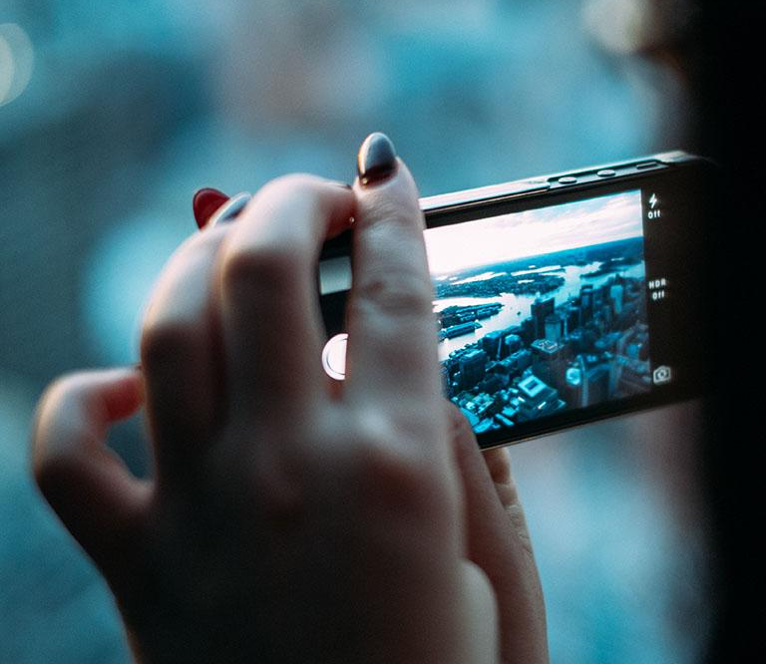
Content
Problem Statement
Proposed System
Frameworks And Tools
Functions
Our App vs Other Applications
Collaboration with key users

Slide 5
Problem Statement
1

Slide 6
Agricultural supply chain in India is impacted by middlemen, mismanaged mandis and inconsistent pricingThe percentage losses in the post-harvest sector adversely affect the Indian economy and are estimated to be from 10-25% in durables, semi-perishables and products like milk, meat, fish and eggs, and 30-40% in fruits and vegetables. We are trying to help Farmers by providing solutions for crop protection and yield.

Slide 7
Proposed System
2

Slide 8
To provide Fertilizer and Pesticides amount calculator for different crops based on size on the land.
To identify pest damage and disease through image detection and suggest proper diagnosis for the same.
To provide Fertilizer and Irrigation Recommender for crops.

Slide 9
To provide a soil predictor to check if the land is fertile or not.
To provide cultivation tips with weather report.
To provide yield prediction for crops.

Slide 10
Frameworks And Tools
3

Slide 11
We are implementing our system as a web based project built using Django , HTML , CSS and Javascript.
We have used HTML , CSS and Javascript to make the user interface for our website.
We have used python for performing all the machine learning and deep learning related tasks.

Slide 12
Functions
4

Slide 13
Provides system for detecting pest damage and disease by clicking pictures of plants.
Provides system for calulationg fertilizers and pesticides with suitable user interface
Provides system for predicting soil and yeild prediction along with fertilizer and irrigation recommender.
Provides cultivation tips along with weather report .

Slide 14
Our App vs Other Applications
5

Slide 15
Apps | Fertilizer and Irrigation Recommender | Cultivation Tips with Weather Report | Soil and Yeild Prediction | Fertilizer and Pesticides Cost Calculator | Pest damage and disease detection | Crop cost and pricing
Our App | ✓ | ✓ | ✓ | ✓ | ✓
Plantrix |  | ✓ |  |  | ✓
Kisan Suvidha |  | ✓ |  |  |  | ✓
Farm Bee |  | ✓ |  |  |  | ✓

Slide 16
Collaboration with Key Users
6

Slide 17
Helps farmers with faster and precise pest and disease detection to protect crops.
Helps farmers to predict soil and yield prediction along with fertilizers and irrigation recommender for better crop growth.

Slide 18
Helps farmers to calculate the cost of fertilizers and pesticides required for crop cultivation thereby saves a lot of money.
Provide cultivation tips along with weathor report for better yield of crops.

Slide 19
Thank you!

