Slide 1

Gift Genie: From Idea to Intelligent Assistant
Unveiling a sophisticated, multilingual AI agent powered by RAG, Streamlit, and LangChain to revolutionize the art of gift-giving.

Slide 2



Phase 1: The Basic Gift Genie
Concept
Technology
Goal
A simple Streamlit application that accepts a user prompt (e.g., "gift for a coffee lover who loves hiking") and generates preliminary gift suggestions.
Utilizing LangChain to seamlessly orchestrate the interaction with a powerful large language model (LLM) to quickly brainstorm creative gift ideas.
To establish a foundational, functional, and user-friendly tool capable of providing initial, relevant gift suggestions based purely on contextual cues.

Slide 3
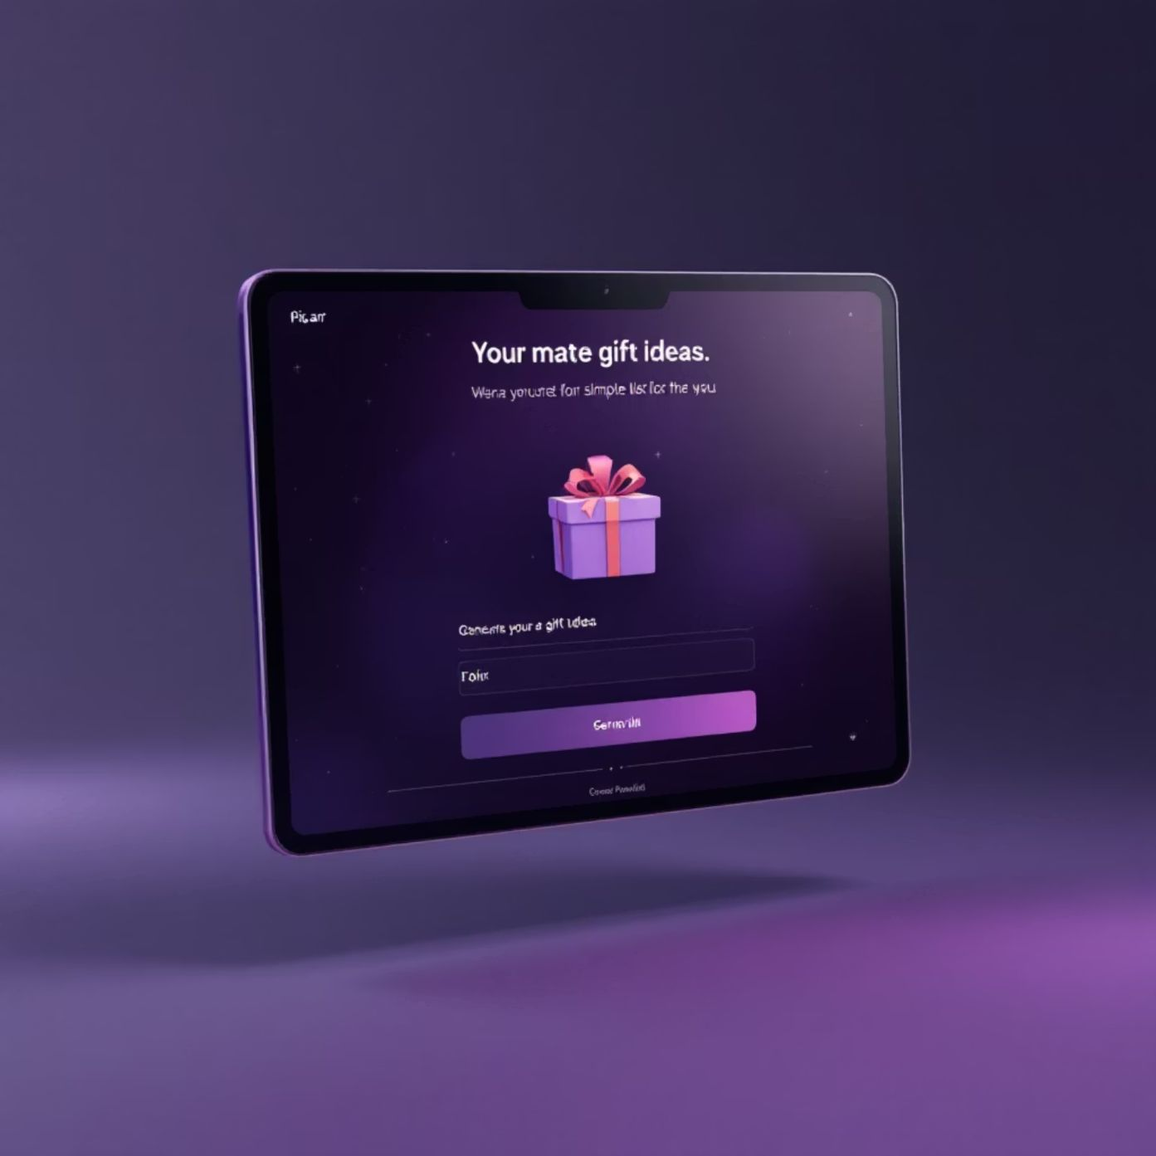
Visualizing the Initial Interface
User Experience Focus
The initial design emphasizes clean aesthetics and intuitive interaction. Users input their request into a text box, and the system delivers personalized ideas with the click of a button.
Minimalist UI built with Streamlit.
Text input field for detailed prompts.
Clear "Generate Gifts" action button.
Rapid feedback loop for quick suggestions.

Slide 4
Phase 2: Enhancing with RAG and Product Data
Moving beyond abstract ideas, Phase 2 integrates real-world product information for actionable recommendations.
Challenge: Product Specificity
Solution: Retrieval-Augmented Generation (RAG)
Process: Dataset Integration
The initial model offers general concepts, but lacks details on availability, pricing, or specific product links.
The Flipkart dataset, sourced from platforms like Kaggle, is ingested and vectorized, allowing LangChain to query actual product listings for highly relevant matches.
We implement RAG to ground the LLM's suggestions in a comprehensive product knowledge base.

Slide 5
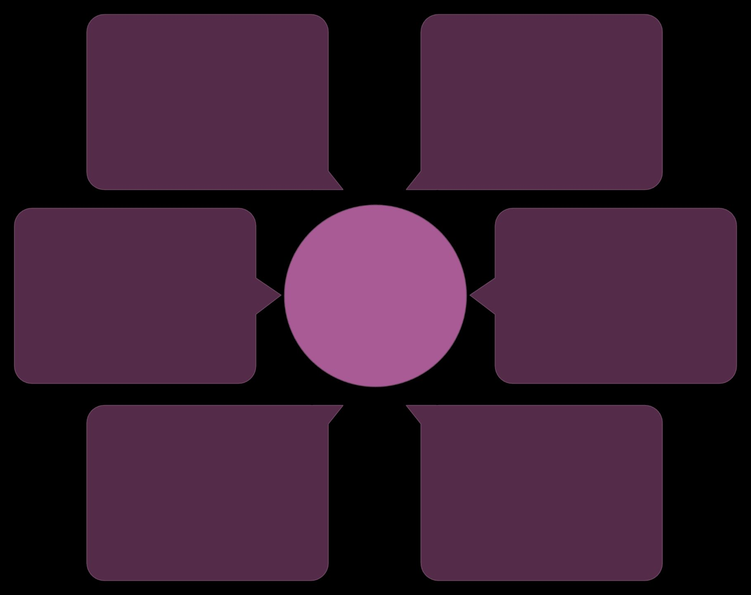
The RAG Workflow: Data-Driven Gifting
Enriched Gift Suggestions
User prompt
Gift preferences and context
Informed, catalog-aware ideas
LangChain orchestrator
Combined context
RAG Gift Suggestion Flow
Factual + creative input
Routes queries and merges results
Language Model (LLM)
Flipkart Dataset (Vector DB)
Generative reasoning and prose
Product facts and embeddings
By connecting the creative intelligence of the LLM with the factual knowledge of the product catalog, RAG transforms the Genie from an idea generator into a smart shopping assistant.

Slide 6
Phase 3: The Multilingual Gift Genie
Achieving true global utility requires breaking down language barriers.
1
2
3
Global Reach
Multilingual Agent Integration
Accuracy Assurance
The core objective is to expand the Gift Genie's capabilities to natively support users interacting in multiple languages.
This agent ensures that the RAG-enhanced suggestions remain contextually relevant and accurate, regardless of the input language, maximizing user satisfaction worldwide.
We leverage advanced LangChain features to integrate a specialized agent capable of understanding, processing, and responding accurately across different languages.

Slide 7

A World of Gifting, Unlocked
The Multilingual Agent enables the Gift Genie to assist users across continents and cultures, making personalized gifting universally accessible.

Slide 8





The Core Tech Stack Behind the Magic
Streamlit
LangChain
Provides the clean, interactive, and responsive front-end interface, making the AI accessible to all users without complex setup.
Serves as the vital orchestration layer, managing data flow, RAG queries, and the complex conversational logic of the agents.
Gemini Pro
Flipkart Dataset
The powerhouse LLM responsible for generating highly creative and contextually appropriate gift suggestions in all supported languages.
The comprehensive product knowledge base that grounds the AI's recommendations in real, purchasable items, crucial for the RAG process.
This modular approach ensures flexibility and scalability for future enhancements and data sources.

Slide 9



The Power of AI in Gifting: Core Benefits
Hyper-Personalization
Efficiency & Speed
Universal Accessibility
AI analyzes subtle cues in the user's prompt to tailor gift suggestions with unmatched accuracy, moving beyond generic category searches.
The Genie drastically cuts down the time spent finding the perfect present by instantly filtering millions of products based on specific criteria.
The multilingual agent ensures anyone, anywhere can benefit from personalized gift ideas, regardless of their native language.

Slide 10

Conclusion: The Future of Gift Genie
Ultimate Vision
Our journey is dedicated to creating the most intelligent, comprehensive, and globally accessible AI-powered gifting assistant on the market.
Market Impact
We aim to fundamentally change the way people approach finding and giving gifts, making the process joyful and stress-free.
Call to Action
Explore the possibilities of integrating advanced AI with real-world data and experience the sophisticated future of thoughtful gifting today.

