Slide 1

Agentic AI for Local Food Security & Wastage Reduction
Module 2: The Matching & Allocation Agent (Processing & Logic Team)
Building the intelligence layer to connect surplus food with maximum community impact.

Slide 2
The Control Center
Agentic AI System
Module 1 (Input)
A multi-agent system driving autonomous decision-making in food distribution.
Data acquisition and urgency scoring (e.g., freshest produce, soonest expiry).
Module 2 (Logic)
Module 3 (Output)
The Matching & Allocation Agent: Determining the optimal recipient for every food item.
Logistics, fulfillment, and real-time feedback loops.
Module 2 acts as the "Brain," translating needs and availability into an executable distribution strategy.

Slide 3




The Brain of the System: Matching & Allocation Agent
Core Algorithm
Strategic Balance
Generates the **optimal food distribution plan** by solving a complex logistical puzzle.
Balances **charity needs, food urgency, and donor capacity constraints** simultaneously.
Autonomous Decisions
Enables **autonomous, data-driven decisions** to reduce food waste and improve food security.

Slide 4

Module 2: Key Functions
1
2
3
Constraint Intake
Optimal Allocation
Execution Command
Structured data modeling of recipient requirements and limitations.
Execution of the core mathematical optimization algorithm (The MAS Logic).
Generating the final, unchangeable distribution plan for transport.

Slide 5


Charity Constraint Intake: Defining Needs Profiles
The first step is establishing the rules of engagement for each distribution partner.
Charity Needs Profile
Data Modeling
Maintain a dynamic database of all recipient limitations and preferences.
Representing constraints as structured, machine-readable data for algorithmic matching.
Example Profiles: Charity A accepts up to 200 kg of produce; Charity B only accepts prepared meals; Charity C requires items that fit in its refrigerated unit.

Slide 6

Technical Focus: Data Modeling for Constraints
Defining parameters for each charity (e.g., maximum volume, required temperature, acceptable food types).
Using standardized nomenclature to ensure seamless integration with food item categorization (Module 1).
Ensuring data is dynamic and updatable in real-time, reflecting changing storage and staffing availability.
This foundation ensures the allocation algorithm performs **precise, constraint-aware allocation**.

Slide 7

Optimal Allocation Algorithm: The Core Logic
Input: Urgency Score
Prioritize items by urgency
Processing: Constraint Matching
Match items to eligible charities
Output: Maximized Distribution
Allocate to maximize impact
Urgency Prioritization
Prioritize food items based on the highest Urgency Score (from Module 1) to prevent waste.
Constraint Satisfaction
Match prioritized items exclusively to charities that satisfy all acceptance criteria.
Quantity Maximization
Maximize total distributed quantity while strictly adhering to charity capacity limits.

Slide 8
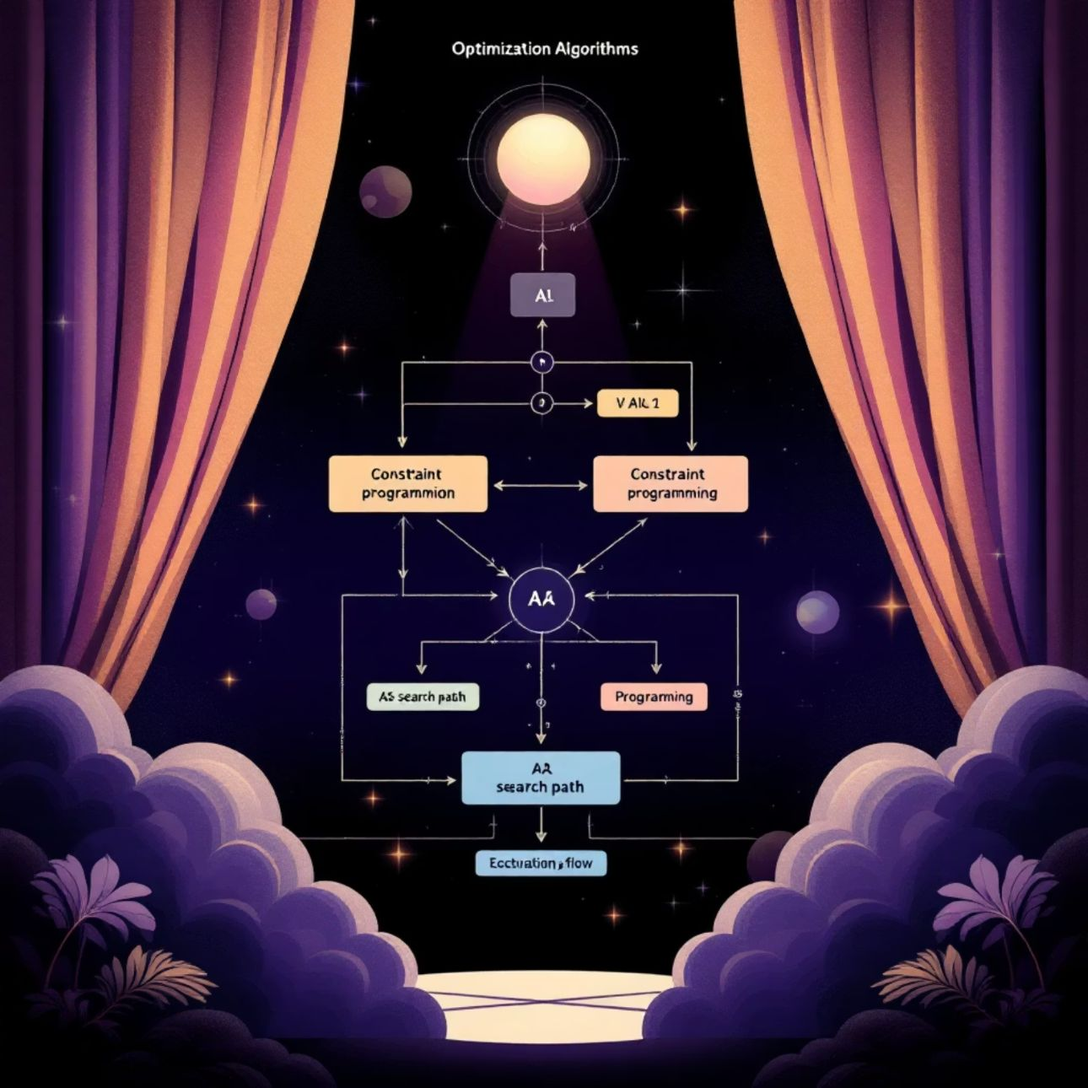
Algorithm Selection: Achieving Efficiency and Fairness
The team must select the right computational approach to solve the complex resource allocation problem.
Technique Overview
Greedy Algorithms: Simple, fast approximations for rapid distribution planning.
Constraint Programming (CP): Precise solution to guarantee all rules are met simultaneously.
Simple Optimization Loops: Iterative processes that converge on a near-optimal outcome.
The final outcome is an efficient, fair, and waste-minimizing distribution plan ready for execution.

Slide 9


Execution Command: Finalizing the Distribution Plan
Once the optimal allocation is calculated, the system generates the definitive instruction set.
Immutable Plan Generation
Programming & Deployment
A final, unchangeable "Distribution Plan" is generated (e.g., Item X (15kg of apples) → Charity A).
The logic is implemented via robust core Python logic, ensuring stability and scalability.
Seamless Handoff
Learning Loop
This command acts as a trigger, enabling seamless handoff to logistics and delivery teams (Module 3).
Data from the executed plan supports real-time adjustments and refinement for future allocation cycles.

Slide 10



Summary: The Role of the Allocation Agent
Module 2 transforms raw data on surplus food and charity requirements into actionable, optimized logistics commands.
Objective: Maximizing food utilization and minimizing food waste across the local ecosystem.

