Slide 1
FakeGuard AI — Fake Review Detection System
An Intelligent System for Detecting Fake Reviews using Machine Learning, Deep Learning, and Explainable AI

Slide 2
Contents
Introduction
Problem Statement
Objectives
Dataset Description
Methodology
Feature Engineering
Model Development
Evaluation
System Architecture
Results & Insights
Conclusion
References

Slide 3
Introduction
Online platforms rely heavily on user reviews to influence customer decisions. However, the increasing presence of fake reviews has created serious challenges in maintaining trust and credibility. These deceptive reviews are often generated to manipulate product ratings and mislead users.
This project focuses on developing an intelligent system to detect fake reviews using a combination of Natural Language Processing (NLP), Machine Learning, and Deep Learning techniques. The system analyzes both the textual content and behavioral patterns of reviewers to identify suspicious activities.
By integrating multiple approaches, the proposed system aims to provide accurate, reliable, and explainable predictions for review authenticity.

Slide 4
Problem Statement
Online platforms such as e-commerce websites and review portals rely heavily on user-generated reviews to guide customer decisions. However, the presence of fake or deceptive reviews has become a major issue, leading to misleading information and reduced user trust.
Fake reviews are often generated to artificially boost or harm product ratings. These reviews may appear genuine, making them difficult to detect using simple techniques.
Therefore, there is a need for an intelligent and automated system that can accurately identify fake reviews by analyzing both textual content and user behavior.

Slide 5
Objective
To develop a system for detecting fake and genuine reviews
To apply Natural Language Processing (NLP) techniques for text analysis
To extract meaningful features such as TF-IDF, sentiment, and behavioral patterns
To implement Machine Learning models like Logistic Regression, SVM, and Random Forest
To use Deep Learning (LSTM) for capturing contextual information in text
To integrate Explainable AI (SHAP) for interpreting model predictions
To evaluate model performance using standard metrics such as accuracy, precision, recall, and F1-score

Slide 6
Dataset Overview
The dataset used in this project is a synthetic yet realistic collection of online reviews designed specifically for fake review detection. It contains both genuine and fake reviews along with relevant metadata such as ratings, reviewer information, and timestamps.
The dataset includes both structured data (ratings, reviewer ID, timestamps) and unstructured data (review text), enabling comprehensive analysis using both statistical and NLP techniques.
This controlled dataset allows better feature engineering, balanced class distribution, and improved model performance.

Slide 7
Dataset Attributes
Review Text – Main textual content of the review
Label – Indicates whether review is Fake (1) or Genuine (0)
Rating – Numerical value (1 to 5 stars)
Reviewer ID – Unique identifier for each user
Timestamp – Time when the review was posted
These attributes help in analyzing both content-based and behavior-based patterns in reviews.

Slide 8
Data Preprocessing
Removal of noise such as punctuation, special characters, and stopwords
Conversion of text to lowercase for uniformity
Tokenization to split text into individual words
Lemmatization to reduce words to their base form
Handling missing values to ensure data consistency
Encoding categorical data into numerical format
Preprocessing improves data quality and prepares it for feature extraction and model training.

Slide 9
Feature Extraction
TF-IDF (Term Frequency–Inverse Document Frequency) for converting text into numerical vectors
N-grams (unigrams + bigrams) to capture word sequences and writing patterns
Review Length as a statistical feature
Sentiment Scores using VADER (positive, negative, neutral, compound)
Behavioral Features such as review frequency, duplication, and rating patterns
A hybrid combination of features improves model performance and detection accuracy.

Slide 10
Textual Features
Word Count – Measures length of the review
N-grams – Captures sequences of words and writing patterns
TF-IDF – Converts text into numerical form based on word importance
These features help in identifying patterns such as repetitive phrases, exaggerated language, and unnatural writing styles commonly found in fake reviews.

Slide 11
Sentiment Features
Polarity Score – Determines whether sentiment is positive, negative, or neutral
Subjectivity Score – Measures whether the text is opinion-based or factual
Fake reviews often exhibit extreme sentiment, such as overly positive or overly negative opinions.
Sentiment analysis is performed using the VADER model, which provides fine-grained sentiment scores.

Slide 12
Behavioral Features
Review Frequency – Detects users posting many reviews in a short time
Rating Pattern – Identifies users giving mostly extreme ratings
Duplicate Reviews – Detects repeated or similar content
Readability Score – Identifies unnatural or bot-like text
Behavioral features provide strong indicators of suspicious activity and significantly improve detection accuracy.

Slide 13
Machine Learning Models
Logistic Regression – Simple and effective baseline model
Support Vector Machine (SVM) – Handles high-dimensional text data efficiently
Random Forest – Ensemble model that improves accuracy and reduces overfitting
These models are trained on extracted features and used to classify reviews as fake or genuine.

Slide 14
Deep Learning Model– LSTM
Uses sequential processing of text data
Pipeline: Tokenization → Padding → Embedding → LSTM layers
Captures contextual relationships and long-term dependencies
Performs better on complex and long reviews
LSTM complements machine learning models by improving detection of subtle patterns.

Slide 15
Explainable AI
SHAP (SHapley Additive Explanations) is used for model interpretation
Identifies important words/features influencing predictions
Provides transparency and improves trust in the system
Helps users understand why a review is classified as fake or genuine
Explainability is essential for real-world AI applications.

Slide 16
Dataset Challenges
Class Imbalance – Genuine reviews are usually more than fake ones
Noisy Text Data – Includes stopwords, punctuation, and irrelevant words
Missing Values – Some fields may be incomplete
Variability – Different writing styles across users
These challenges require proper preprocessing and feature engineering to ensure model accuracy.

Slide 17
Model Evaluation
Dataset is split into training and testing sets (80:20)
Models are evaluated using:
Accuracy – overall correctness
Precision – correctness of positive predictions
Recall – ability to detect fake reviews
F1-Score – balance between precision and recall
Confusion Matrix used to analyze classification errors
Cross-validation ensures model stability and avoids overfitting

Slide 18
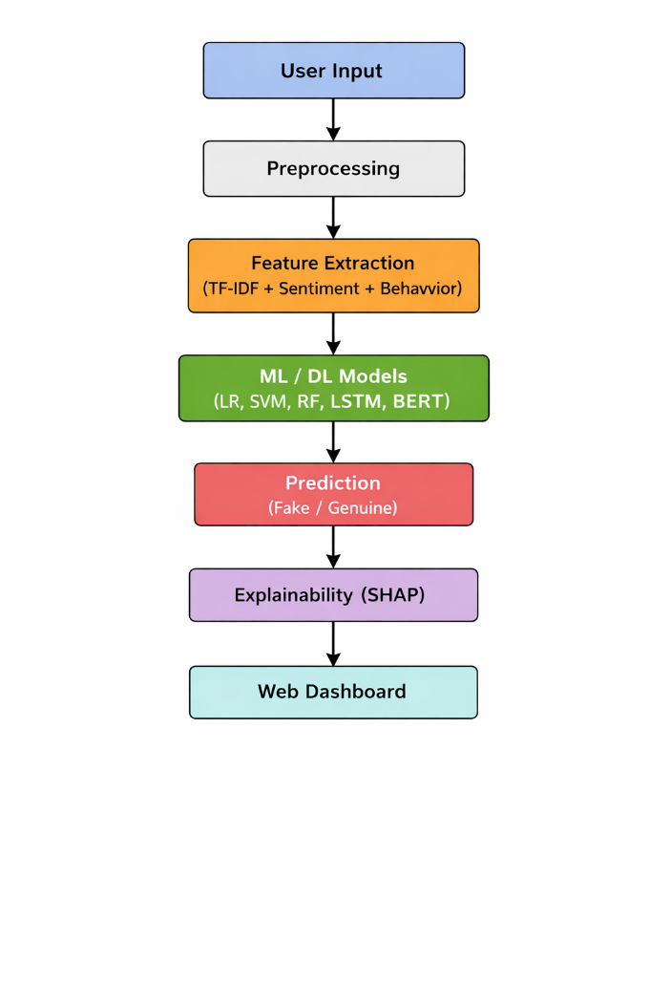
System Architecture
The system follows a pipeline architecture where each module contributes to the final prediction.

Slide 19
Results & Insights
Accurate classification of fake and genuine reviews
Detection of patterns such as:
Repetitive and exaggerated language
Extreme sentiment behavior
Identification of suspicious users through behavioral analysis
Confidence score (Trust Gauge) based on model predictions
SHAP explanations highlight important features influencing results

Slide 20
Conclusion
The proposed Fake Review Detection System effectively identifies fake and genuine reviews using a combination of NLP, Machine Learning, Deep Learning, and Explainable AI. By integrating textual, sentiment, and behavioral features, the system improves accuracy and reliability. The use of SHAP enhances transparency by explaining model predictions. Overall, the system provides a robust and practical solution for detecting deceptive reviews in real-world applications.

Slide 21
Future Scope
Integration with real-time review systems
Use of advanced transformer models like BERT for better accuracy
Detection of multilingual fake reviews
Deployment as a web or mobile application
Continuous learning with live data

Slide 22
References
[1] N. Jindal and B. Liu, “Review spam detection,” Proc. 16th Int. World Wide Web Conf. (WWW), pp. 1189–1190, 2007.
[2] M. Ott, Y. Choi, C. Cardie, and J. Hancock, “Finding deceptive opinion spam by any stretch of the imagination,” Proc. 49th Annual Meeting of the ACL, pp. 309–319, 2011.
[3] A. Mukherjee, V. Venkataraman, B. Liu, and N. Glance, “What Yelp fake review filter might be doing,” Proc. Int. AAAI Conf. on Web and Social Media (ICWSM), pp. 409–418, 2013.
[4] Y. Ren and D. Ji, “Neural networks for deceptive opinion spam detection,” Information Sciences, vol. 385–386, pp. 213–224, 2017.
[5] J. Devlin, M. Chang, K. Lee, and K. Toutanova, “BERT: Pre-training of deep bidirectional transformers for language understanding,” Proc. NAACL-HLT, pp. 4171–4186, 2019.
[6] S. Lundberg and S. Lee, “A unified approach to interpreting model predictions,” Advances in Neural Information Processing Systems (NeurIPS), pp. 4765–4774, 2017.
[7] F. Pedregosa et al., “Scikit-learn: Machine learning in Python,” Journal of Machine Learning Research, vol. 12, pp. 2825–2830, 2011.

